Slide 1
Throne dimensions specifications (m)
Depth | Width (front) | Height | Lining length | Throne | Color
1 | 1.25 | 2 | 2 | Bison | White
1 | 1.25 | 2 | 2 | Eagle | Yellow
1 | 1.25 | 2 | 2 | Wolf | Blue
1 | 1.25 | 2 | 2 | Bear | Red

Slide 2
LED Specifications: Link
LED Strip is SK6812, assume 30 LED per m (assumed)
LED Strip thickness is 10 mm (for 144 LED per m version)
LED Strip Length is 1 meter (assumed)
1 meter
LED Strip =

Slide 3
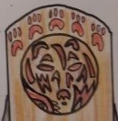
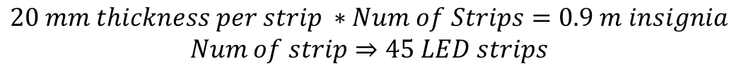
Lazy Packing Topology: Top Insignia
Block Level diagram LED layout (LED strips used is 0.5 meter)
~1 meter
…
~0.5 meter
20 mm is 10 mm for LED strip plus space between strips
$$20 mm thickness per strip ∗Num of Strips=0.9 m insignia$$
$$Num of strip⇒45 LED strips$$

Slide 4
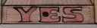
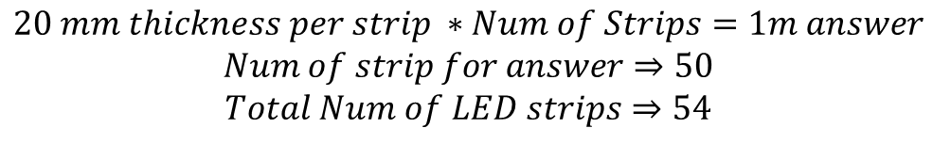
Lazy Packing Topology: Bottom Answer
~1.25 meter
~0.5 meter
…
20 mm is 10 mm for LED strip plus space between strips
$$20 mm thickness per strip ∗Num of Strips=1m answer$$
$$Num of strip for answer⇒50$$
$$Total Num of LED strips⇒54$$

