Slide 1
Explains your scripts: what each one does, and how to run them
Script name | How to run* | API doc. | Description
alternativeFuel.py | python alternativeFuel.py | https://developer.nrel.gov/docs/transportation/alt-fuel-stations-v1/ | These scripts extract, process, and transform data according to their respective information source (API). Scripts should be tested by running them individually. They will save versions of the processed & transformed datasets to the following directories: “datasets/alternative” and “datasets/complaints” & upload to the database after
complaints.py | python complaints.py | https://www.nhtsa.gov/nhtsa-datasets-and-apis#faq-56806
fuelEconomyData.py (1) | n/a | https://www.fueleconomy.gov/feg/ws/index.shtml
connector.py | n/a | n/a | The “connector.py” connects to a ‘dummy’ Azure database. It is just responsible for (CRUD) database operations. This script is not supposed to run.
<python> command might be different depending on the environmental variable (and version) that was set when Python was installed
(1) Unable to complete this script in time

Slide 2
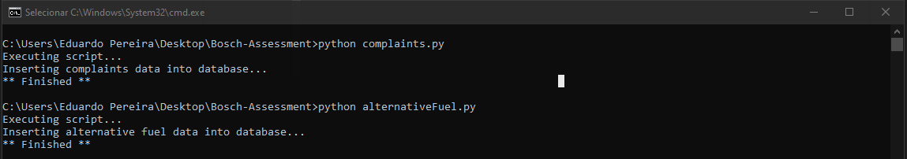
Explains your scripts: what each one does, and how to run them

Slide 3
Document any decisions you made during the data processing and transformation steps.
“complaints.py”
Data processing:
Casting fields to their data type (dateComplaintFiled, dateOfIncident)
‘Exploding’ ‘products’ column (taking the dictionaries out of the list)
Dropping repeated columns (‘manufacturer’)
Dropping unnecessary columns (‘size’)
Normalizing columns (‘products’). Each key is a new column. Each value a new row.
Concatenating datasets (df_complains & normalized_df)
Adding new date column (‘dateExtraction’)
Dropping null values if they existed (‘componentes’)
Splitting column values to be able to ‘explode’ them after
Filter dataset by model and make (I noticed other values were being returned even if filtered directly on the API)

Slide 4
Document any decisions you made during the data processing and transformation steps.
“alternativeFuel.py”
Data processing:
Remove deprecated columns (as specified in the documentation)
Casting fields type (according to the documentation). Also casting dates to ISO8601 format
Dropping columns with more than 50% of their values as null
Removing duplicated rows
Filling null values (access_days_time)
Adding new date column (‘monthYearHistory’)
Making sure Canada states are not in the US (using Loc and IsIn)
Removing rows with other countries info (Bangalore is in India)
Filling empty values (‘state’) with values from other rows (using merge)
Fill empty dates with ‘1900-01-01’ (ISO8601 format) (date_last_confirmed, open_date, updated_at)
Fill null values with zero (ev_level2_evse_num)
Replacing null values with boolean value ‘False’ (ev_workplace_charging)
Normalizing column ‘’ev_network_web” by just using the format ‘www.domain.com’
Regex to extract the first 10 numbers of the station_phone column
Removing outliers bigger than the 75% quantile (ev_level2_evse_num)
Exploding "ev_connector_types“ column. For each connector type, a new row
Remove rows where the ‘city’ column has a number (if ‘city’ column has a number then it’s probably a street)

Slide 5
Document any decisions you made during the data processing and transformation steps.
Data transformation:
After processing both datasets, I’ve decided to group the information. My goal was to save to the database a snapshot of the data. This way we could do history analysis or some predictive modeling.
“complaints.py”:
Example:
Chrysler (FCA US, LLC), JEEP, WRANGLER, 2021, AIR, 2, 2023-11-02
Chrysler (FCA US, LLC), JEEP, WRANGLER, 2021, AIR, 20, 2024-11-02
“alternativeFuel.py”:
Example:
2023-11-02, ELEC, US, AK, Anchorage, CHADEMO, 1
2023-12-02, ELEC, US, AK, Anchorage, CHADEMO, 7

Slide 6
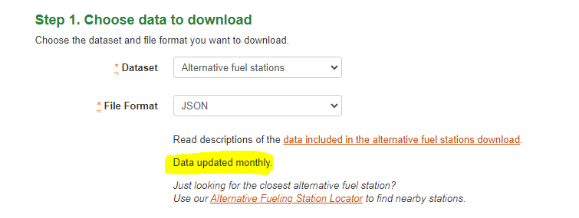
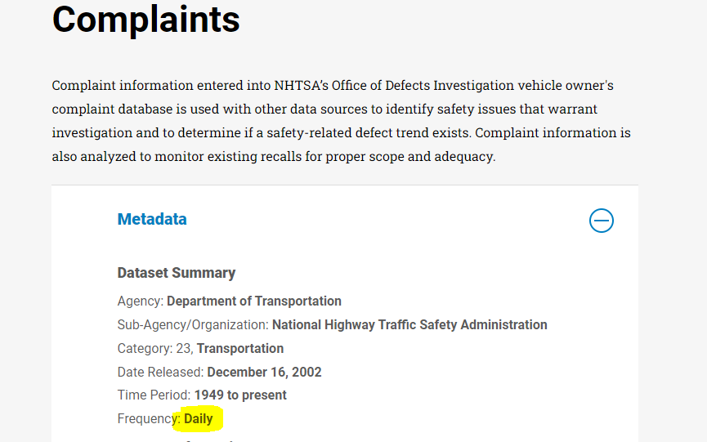
Explain your data loading process and your strategy for automation
“Alternative fuel stations” & “Complaints”
1. “Alternative fuel stations” dataset is updated monthly
2. “Complaints” dataset is updated daily

Slide 7
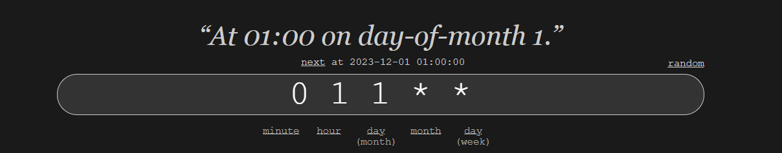
Explain your data loading process and your strategy for automation
“Alternative fuel stations” & “Complaints”
2. The goal is to use Cron jobs to schedule both (“alternativeFuel.py” & “Complaints”) script execution. This way these scripts will run at 01:00 AM* on the first of every month.
Please note this time is just a suggestion, it would be better if the scripts ran at two different times.
Ex:
“alternativeFuel.py”: (0 1 1 * *)
“complaints.py”: (0 4 1 * *)
3. Every new month the script will upload a snapshot of the current month information to the database

Slide 8
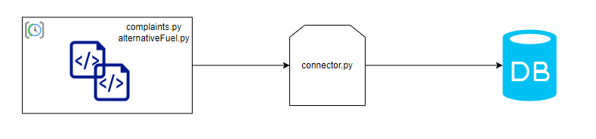
Explain your data loading process and your strategy for automation
Cron job executes both scripts (AlternativeFuel & Complaints) at the specified schedule
The scripts call their data sources and gather all the required information
The scripts process and transform the data into a suitable format
The scripts call the connector and they pass through the transformed dataframes
The connector uploads the information (snapshot) to the database. This module is just responsible for CRUD operations.

Slide 9
Discuss any challenges you faced and how you addressed them
APIs: At first I thought it would require a key to connect to the “Alternative Fuels Data Center” API. I even signed up for an API, but later I found out that I could’ve just used the “Demo_key”. Generally speaking, connecting and extracting the required information from all the sources was an easy task.
Processing & Transform data: The ‘Alternative Fuels’ dataset had plenty of columns and the majority of them had a lot of ‘issues’. I’ve tried multiple regex combinations but the column ‘access_days_time’ (for example) was really difficult to parse – and I wasn’t successful parsing it.
Time: This was by far the biggest challenge and it is why I was unable to deliver all the requested info. The challenge itself wasn’t that technically difficult to overcome. However, it was difficult to have the required spare time (after working hours) to complete all the tasks. Cleaning the datasets is where I spent the most time.

