Slide 1

• Eduardo Rafael • Data Analysis Project • Ironhack Bootcamp Full time

Slide 2

Soccer : Context
• Moneyball Movie
• Players salaries
• Less Oportunities
• Schooling situation of the players
• Athletes with high perfomance
• Examples of players in Brazil and around the world

Slide 3

FIFA Soccer : Project
• Data Analysis for bidding players
• Player skills
• Comparing players
• Recommending players

Slide 4

Tools and Labraries
• Python, Tableau and Streamlit
• Web Scrapping, Data Vizualization and System Recommendation
• Pandas, BeautifulSoup and Scipy

Slide 5

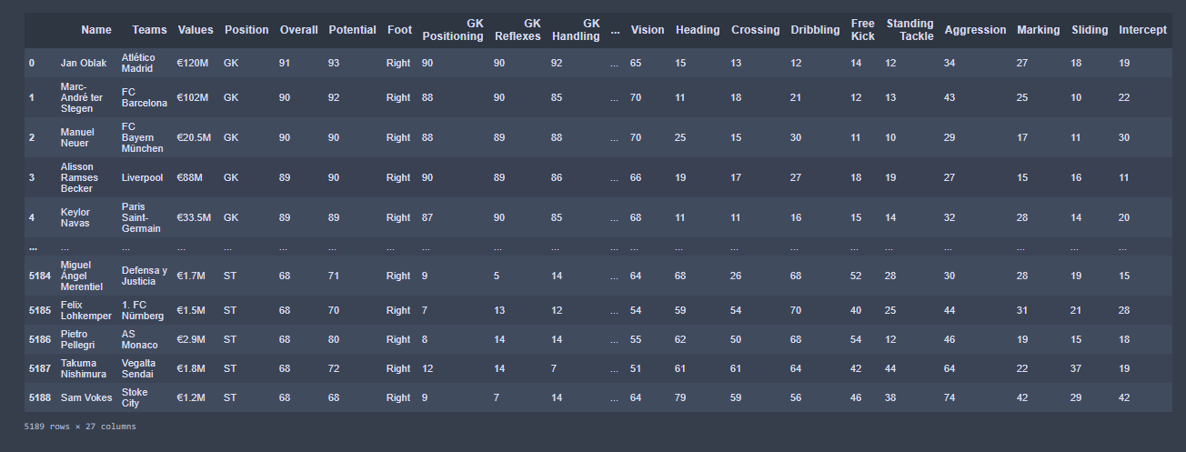
Table for analysis

