Slide 1
E-Cafe
UC 42532 – Bases de Dados (p2g1)
Diogo Moreira - 93127
Eduardo Santos - 93107

Slide 2
Overview
E-Cafe is a cafe subdivided in three subcafes:
Cafe_Bar
Cafe_Pastelaria
Cafe_Restaurante
User access to adding products to a Recibo depends on which subcafe he currently is:
Cafe_Bar gives access to “Bebidas”
Cafe_Pastelaria gives access to “Pasteis”
Cafe_Restaurante gives access to “Almocos”
And every subcafe has access to “Bebidas Geral” (like cafe,compal,ucal,...)
Area exclusive to the Admins where:
Add/Remove Funcionarios and Clientes in the Cafe
Add/Edit/Remove Produtos and choose their respective area

Slide 3
Main features/functionalities
Adding/Removing Recibo
Select and view previously added Recibo and its linked Produtos
Admin Login
Adding/Removing Empregado
Adding/Removing Cliente
Adding/Editing/Removing Produtos

Slide 4

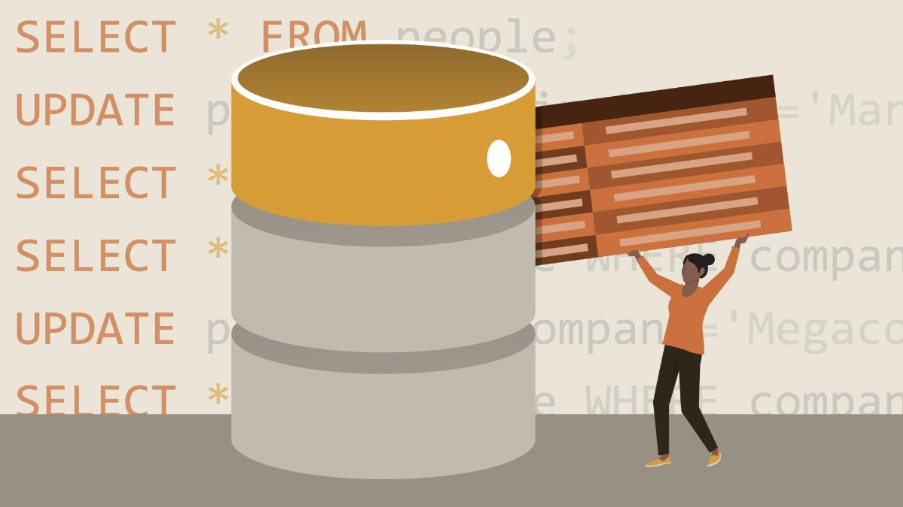
SQL PROGRAMMING

Slide 5
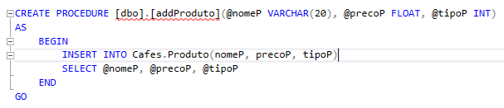
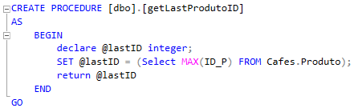
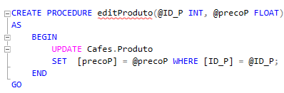
Stored Procedures
Addding/Removing
Recibos,Empregados,Clientes,...
Login
Get Information
IDs, Quantities,...
Edit
For editing Produtos

Slide 6
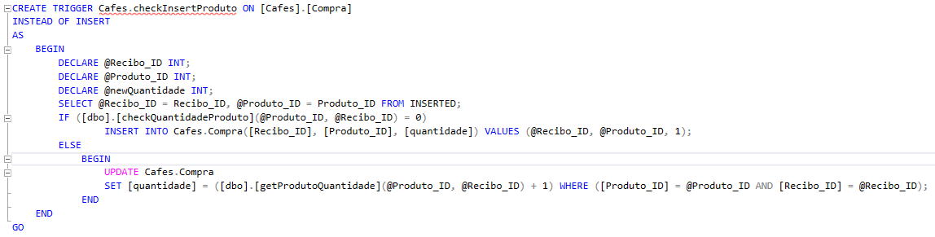
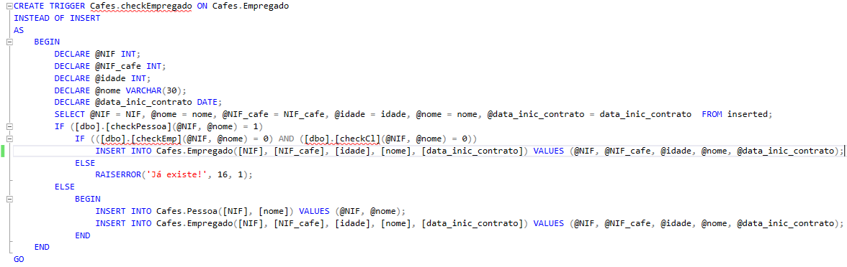
Triggers
checkInsertProduto
checkRemoveRecibo
checkCliente
checkNIFs
checkEmpregado

Slide 7
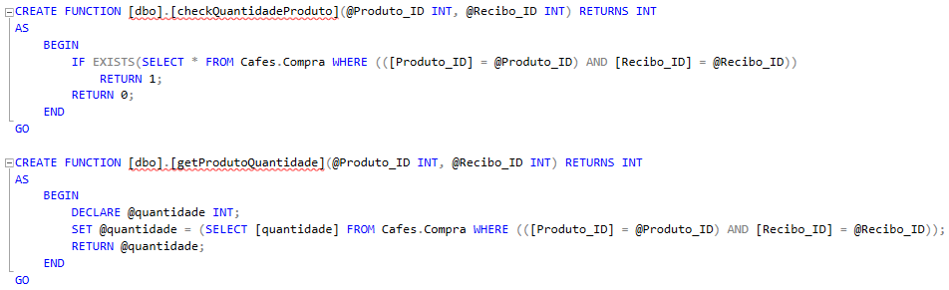
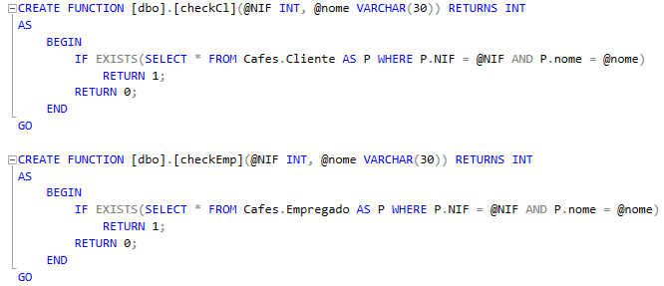
User-Defined Functions
Check if Information was inserted correctly
Retrieve Information from tables
Check if Cliente NIF and Empregado NIF exist
And check for more information in other tables

Slide 8
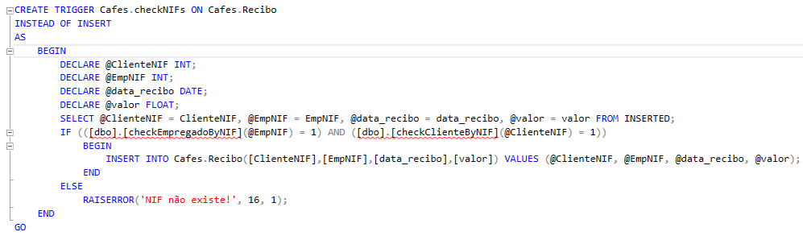
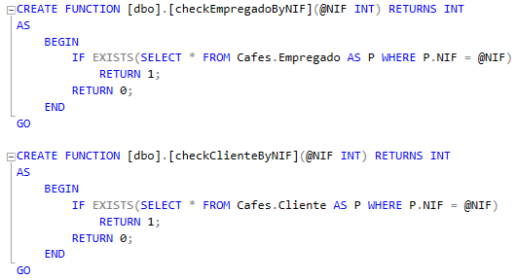
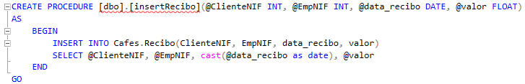
Transactions
insertRecibo

Slide 9
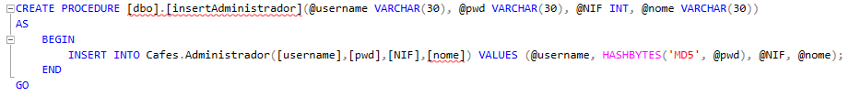
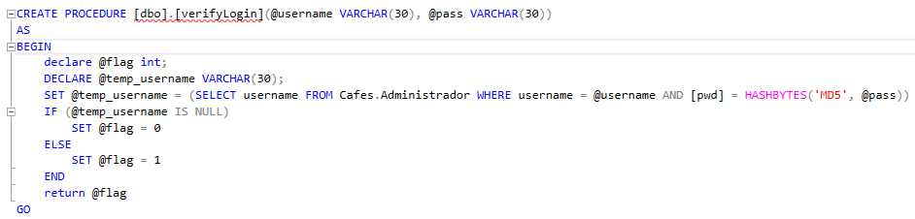
Login verification & hashing password

Slide 10
DEMO

Slide 11
The end

