Slide 1

Creation Of A Music App
Design and prototyping of an application using a human-centered approach
Project Title: Muse-IC
Group: Pedro, Wei, Eduardo
Lab Class: P7

Slide 2

Introduction
App where users can listen to or upload their own songs/podcasts
Most Music Apps Don’t Allow for both functionalities
2 Main Users:
  Listener: App usage includes listening to music, podcasts, creating playlists and reading lyrics
  Artist: App usage includes content sharing and stats overview

Slide 3


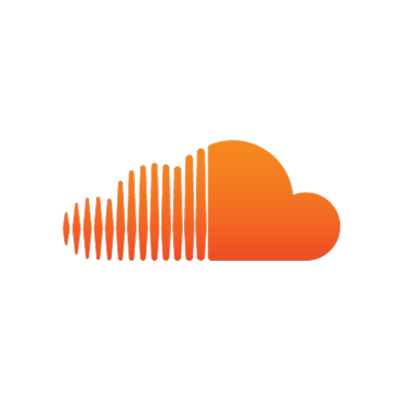
Project Objectives
Create an overall better app that includes many features from top music streaming and music sharing apps like Spotify, Apple Music/iTunes and Soundcloud
Create A Social Network For User’s Do Develop Their Capabilities And Improve Their Performance

Slide 4

Personas
Name: Fransico Almeida
Sex: M
Age: 20
Profession: University Student
Backgound: Lives in Lista. During semesters lives alone in a department near the University. Francisco usually listens to music during the night, it’s something he loves to do while he studies, because otherwise he thinks the room is too quiet. After some searching he finds Muse-IC.

Slide 5

Personas
Name: Ana Beatriz
Sex: F
Age: 22
Profession: University Student
Backgound: She likes to sing since she was little, everyone says she sings well. After entering college, she started making her music. She wants to share it with everybody, her friend Franscisco suggested that she should try Muse-ic, saying that it was a good way to improve her personal work on the music industry.

Slide 6
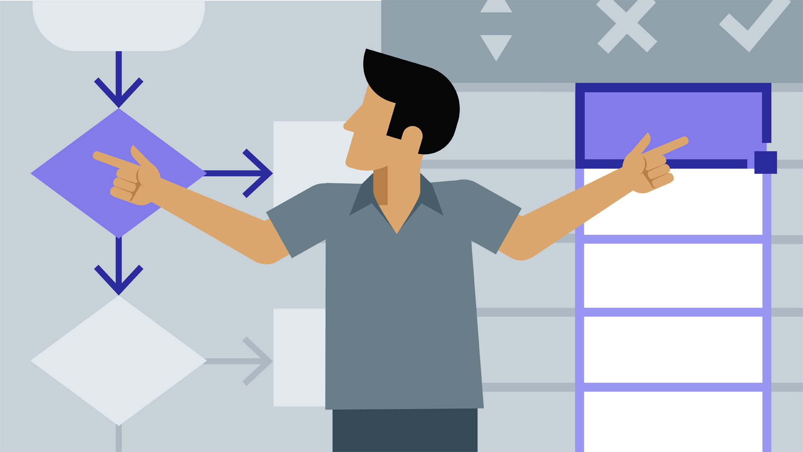
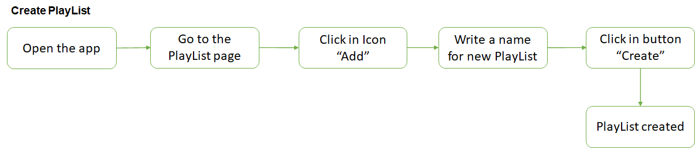
Scenario for Francisco
Francisco searches the desktop app to listen to music on the Web, and sees Muse-ic, considers it an interesting app that has desired features. He installs the app, creates an account, and starts using it. First of all, he wants to create a new playlist with the name "Estudo", which will contain soft musics to help him concentrate more on the study. He goes to the playlists page, clicks in Add button, writes "Estudo" in the text box and clicks in Create button, so the new playlist is created.

Slide 7
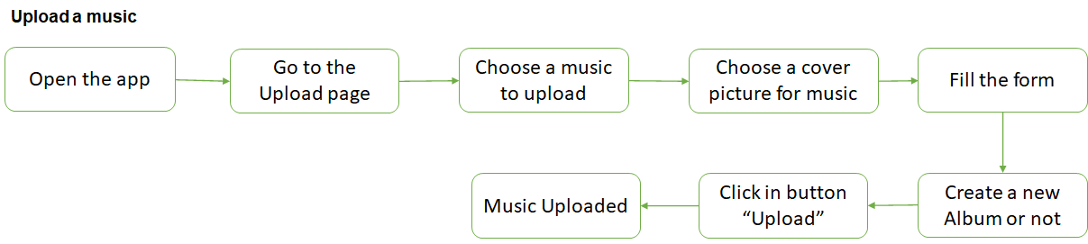
Scenario for Ana
Her friend Francisco said that he had started listening to music on Muse-IC, and suggested that he could also use it to share her musics on the net. She accepted the suggestion. She installs the app, creates an account, clicks the Upload button, chooses the previously recorded song that she thinks is the best of all and an image for cover, fills in the necessary information for the music, and at the end, clicks the Upload button to finish. The music appears in the Uploaded list.

Slide 8
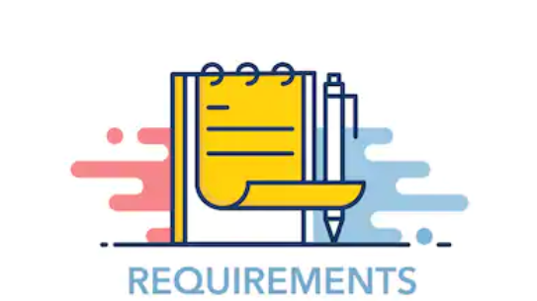
Requirements
Non-functional requirements:
Menu ‘help and documentation’
Using global symbols, for example '+' to add
Easy to use
Desktop app for windows
Functional Requirements/ App Features:
Play music
Follow artist
Like/Review
Playlists
Favourites
etc.

Slide 9

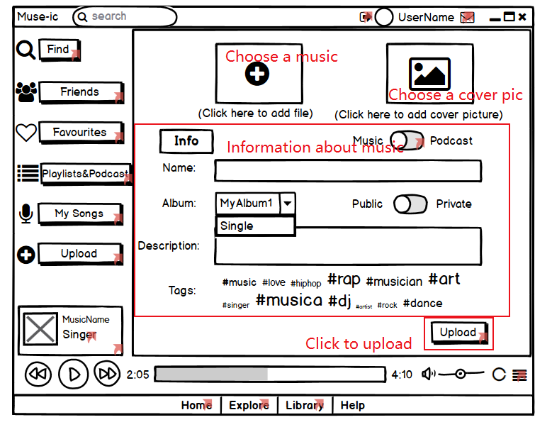
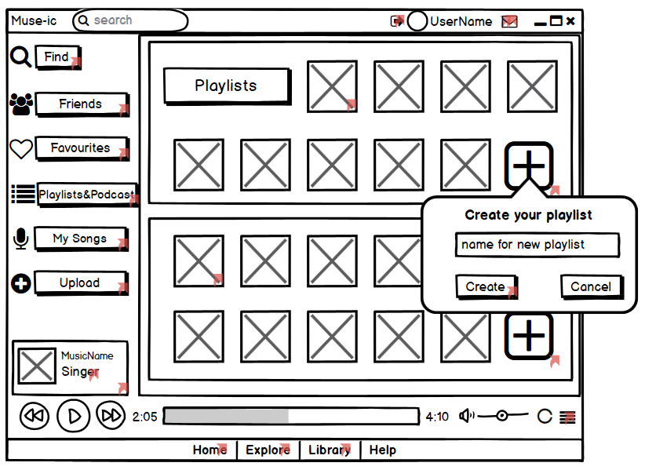
Low Fidelity Prototype
For our prototype we used an app called Balsamiq, which we considered to be a good choice according to what we pretended to develop
Upload a music
Create new PlayList

Slide 10

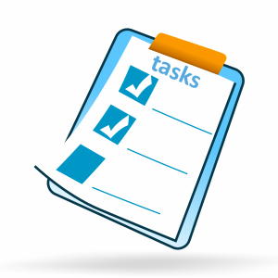
LFP User Evaluation
In this step we want to know:
we designed the prototype in the correct way?
we designed what users want?
we designed a good user interface?
can user do tasks correctly and easily?
Personas and scenarios were addressed:
Francisco Almeida
  Create new PlayList
Ana Beatriz
  Upload a music

Slide 11
LFP User Evaluation
Tasks used:
Upload a music
Find a music and add to a playlist
Comment on a playlist
Play one of the uploaded musics
See musics uploaded by a friend
We did tests with 4 users who pointed out some aspects that we should improve
No alert when an upload is completed
Can’t jump to Friend page with click in his photo
“MySongs” rather than “MyUploaded”

Slide 12
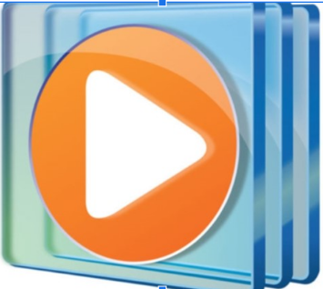


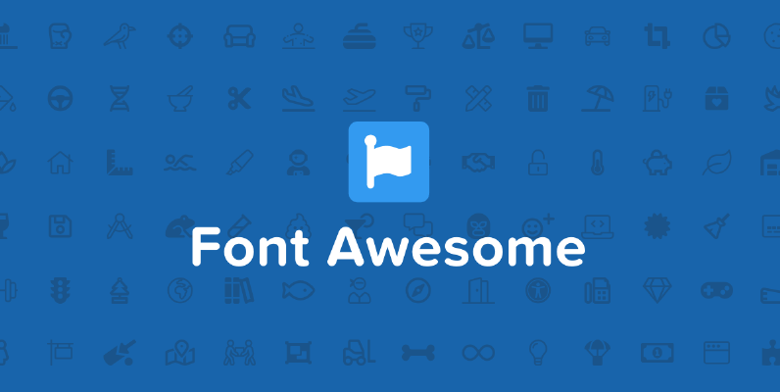
Platform Used for the Functional Prototype
Programming language: C#
IDE: Visual Studio
Libraries:
  Windows Media Player
  FontAwesome.Sharp

Slide 13
User Evaluation of the Functional Prototype
Demo/Tasks And Usability Tests

Slide 14
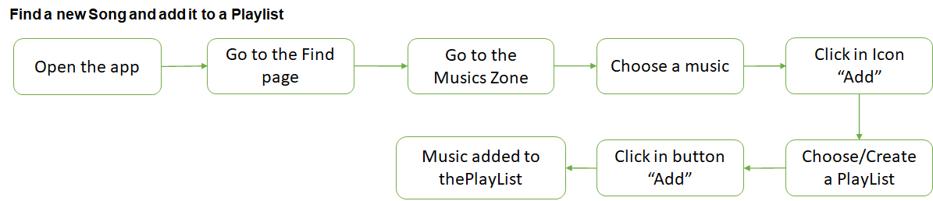
User Evaluation of the Functional Prototype

Slide 15
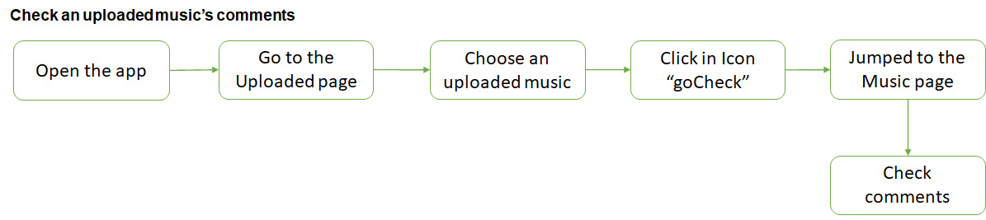
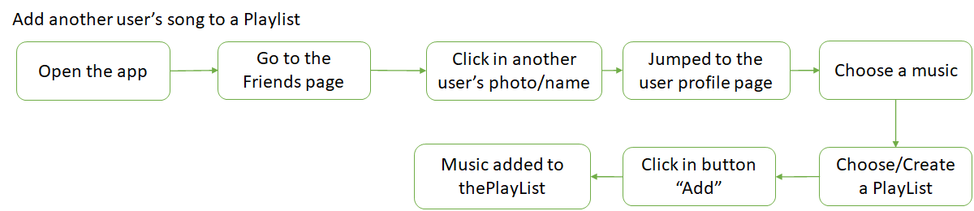
User Evaluation of the Functional Prototype

Slide 16
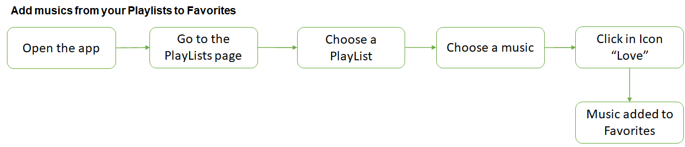
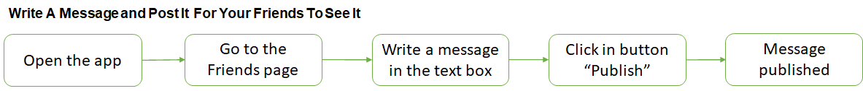
User Evaluation of the Functional Prototype

Slide 17
Demo Da Aplicação

Slide 18
User Evaluation of the Functional Prototype
5 Participants
All users were Listeners
All tasks Completed
Only 1 User Needed Help in Task:’ Post A New Activity Message’
Notes From Observers:
Upload - 4xVery Easy, 1xEasy
Find New Music and Add To Playlist - 3x Very Easy, 2xEasy
Check Comments From Uploaded Song - 4x Very Easy, 1x Easy
Add Another User’s Song To Playlist - 3x-Very Easy, 2xEasy
Add Musics From Playlists To Favorites - 5xVery Easy
Write and Post New Activity Message - 3xVery Easy, 1xEasy, 1xNormal

Slide 19
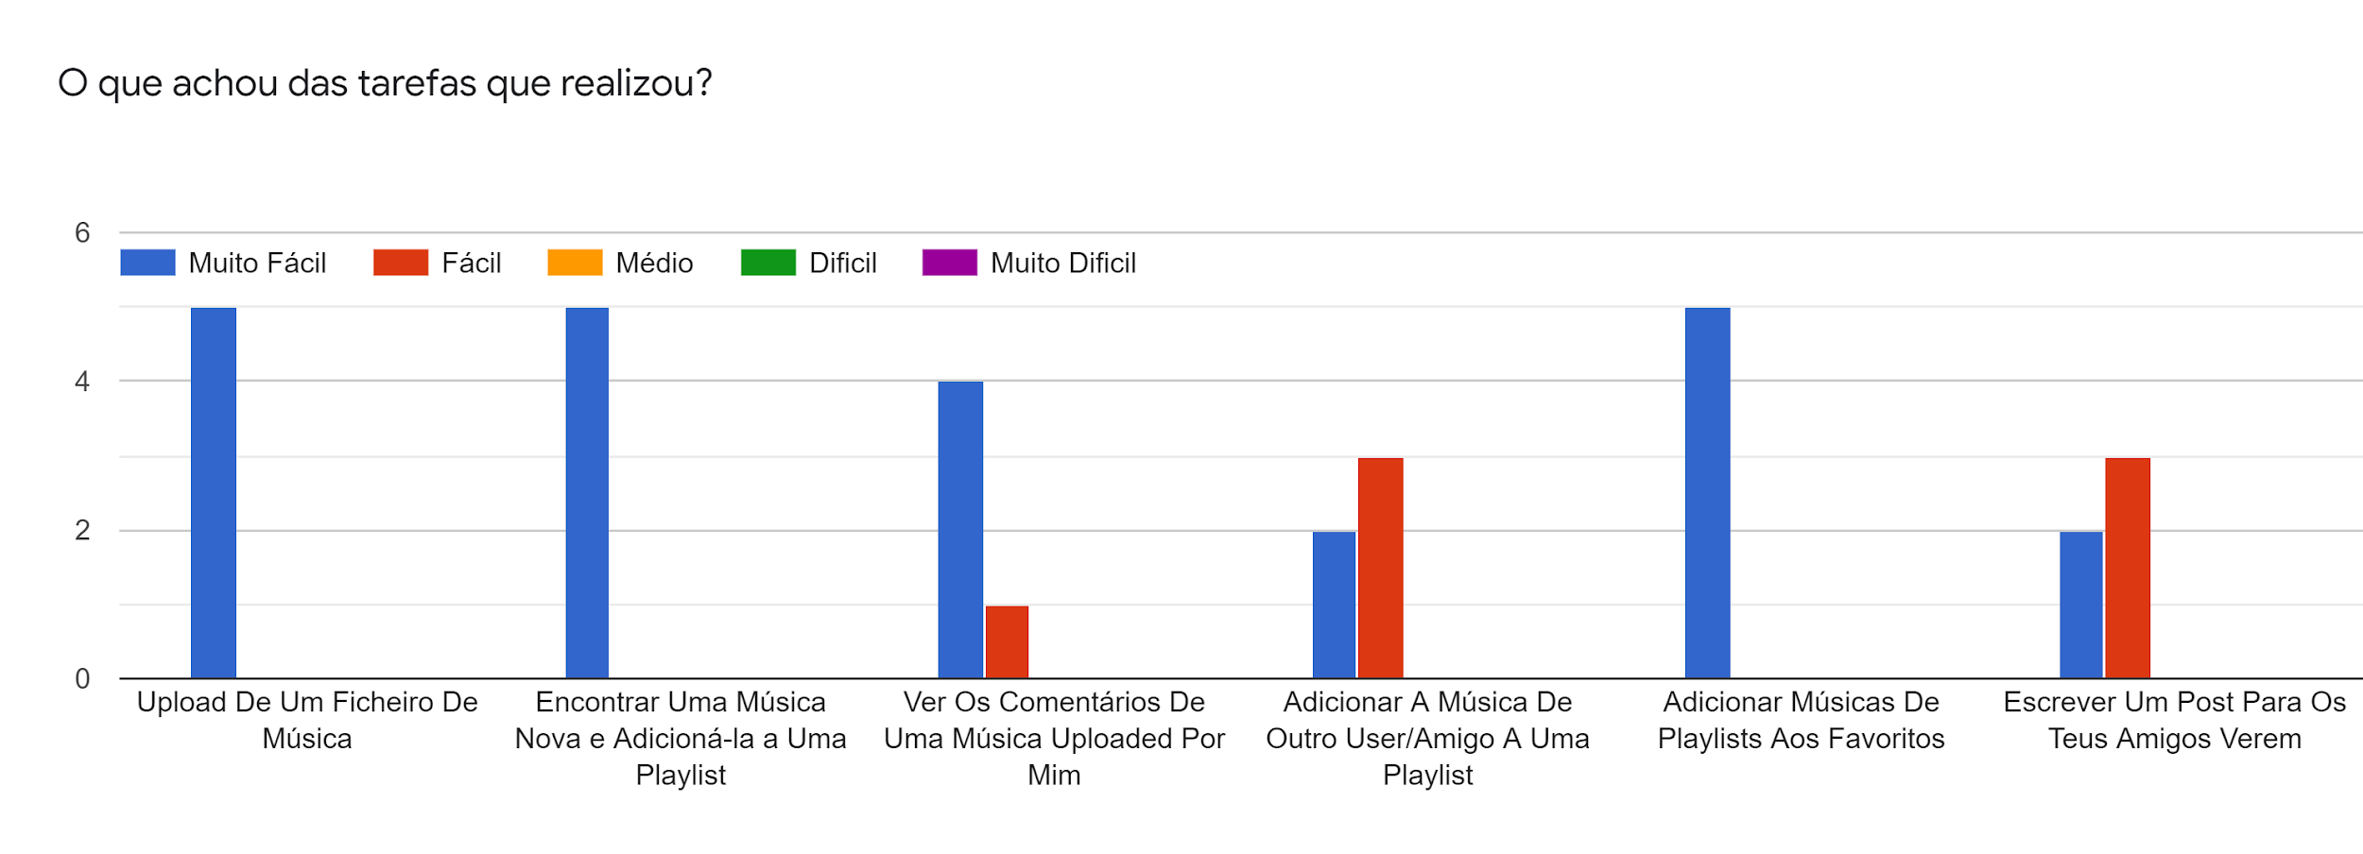
User Evaluation of the Functional Prototype
Blue = Really Easy; Red = Easy; Orange = Medium Difficulty; Green = Hard; Purple = Really Hard
Upload
Find a New Song and Add It to a Playlist
Check An Uploaded Music's Comments
Add another User’s/Friend Song To A New Playlist
Add Musics From Your Playlists To Favorites
Write A Message and Post It For Your Friends To See It
Task 1 Task 2 Task 3 Task 4 Task 5 Task 6

Slide 20

Final user Thoughts
Change The Colors For Better Visibility
Add a ‘Go Back’ Button x2
UserName Accesses It’s Profile
Add A Help Window

Slide 21
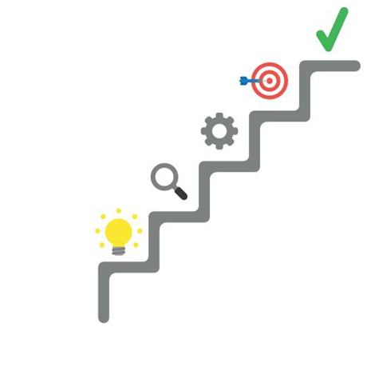
Future Work
Add Find Album, Singer and Implement Podcast Version Of App
Get Shazam and Genius Integration
Add a Go Back Button
Beautify user interface
Develop A Database
Effort:
Pedro Marques 92926 - 40%;
Wei Ye 93442 - 35%;
Eduardo Santos 93107 - 25%

