Slide 1
SOFTWARE Agents for Stock Market Trading M.Sc. Thesis
Djohan Wahyudi
Supervised by:
Prof. Dr. Pericles A. Mitkas
Vivia Nikolaidou

Slide 2


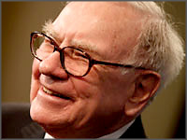
Background
Richest Men in the world
Carlos Slim Helu
Net Worth: $53.5 billion
Source: Telecom
Bill Gates
Net Worth: $53 billion
Source: Microsoft
Warren Buffett
Net Worth: $47 billion
Source: Investments
Software Agents combine the field of these richest men in the world

Slide 3
Goal and Purpose
Goal : To create a software agent that will make profit and avoid loss
Minimal Achievement : Succeed in building the parser and the simulator
Maximal Achievement : Succeed in finding the agent that wins a lot of money

Slide 4
Software Agents
A Software Agent is a computer program which works toward goals in a dynamic environment on behalf of another entity, possibly over an extended period of time, without continuous direct supervision or control, and exhibits a significant degree of flexibility and even creativity in how it seeks to transform goals into action tasks. (http://agtivity.com/agdef.htm)
A Software Agent is a piece of software that acts for a user or other program in a relationship of agency (wikipedia)
Intelligent Agent (IA) is an autonomous entity which observes and acts upon an environment (wikipedia)

Slide 5




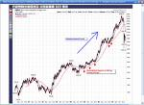
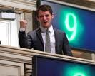
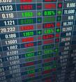
Stock Market
Double Auction Market
Seller : Ask Order
Buyer : Bid Order
Stock Market Transaction
Guarantees the Seller will get the money he asks for.
Guarantees the Buyer will get the stock by paying not more than the price he wants to buy
Analysis
Fundamental Analysis
Technical Analysis

Slide 6
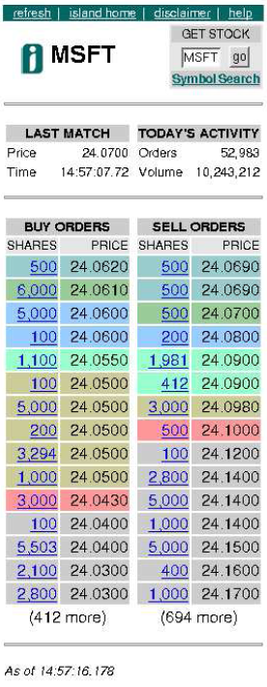
Penn Lehman Competition
Competition for Stock Market Agents (2002-2005)
Built a simulator that is called Penn Exchange Simulator (PXS)
Using Real Stock Market data from the island website
The agent will have unlimited amount of money and can perform short, but the agent needs to put the money balance into 0 in the end of the day

Slide 7
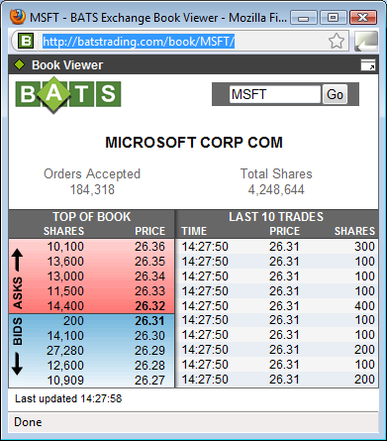
Data from BATS website

Slide 8
Architecture
BATS Website
Simulator
Parser
Extractor
Executor
Agent
Agent
Analyzer
Historical Data
Simulation Data
Result Analysis

Slide 9
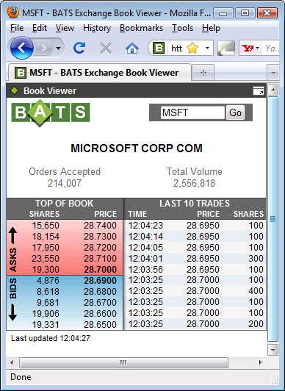
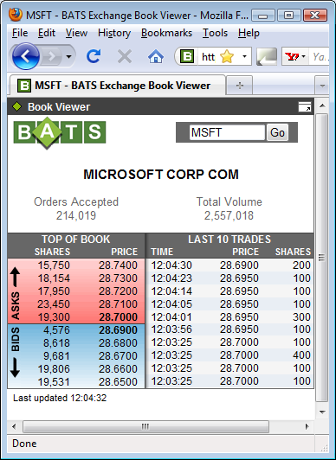
Extractor Calculation
200 Shares in Transaction List - Create the Order
Same Number of Shares = Don’t do anything
Input all the order in database
200 Shares in Total Volume
5 Seconds

Slide 10
Several Changes in Developing Executor
The Parser responsible for putting the order based on the history
The Executor will get the orders and choose the ones that haven’t executed by looking at Transaction
Extractor
Executor
After finding the match order it will execute it and put it in Transaction
Order History
Order
Transaction
Order History Executed by the time range and the Order executed by looking from Transaction
No Need to Query anymore from Transaction table because if the order is executed it will be deleted
The Agent puts the order based on its algorithm
Agent

Slide 11
Agent
Should produce Ask and Bid Orders
Take the decision based on the algorithm being used
Can use several algorithms for the decision making, using majority result
Algorithm
Will have access to all the necessary data. (Time, Price, Order)
Need to give result to agents and produce the decisions (Buy, Sell or Do nothing)

Slide 12
Algorithms
Up Buy Down Sell
Reverse Strategy
Trend Following
Average Order
Static Order Book Imbalance (SOBI)
Volume Average Weighed Price (VWAP)
Market Making
Jump and Dump
Moving Average
Momentum
Reverse Momentum
Channel Breakout
Reverse Channel Breakout
Buy Low Sell High

Slide 13
Basic Condition
To avoid loss the agent should not sell the stock at a lower price than it bought
Selling condition applied to agents
price >= min(history price)
Average Order better without the condition

Slide 14
Reverse Strategy
Condition
Price Going Down : Buy
Price Going Up : Sell
Proven in (Feng and Stone, 2004) to be a good strategy. It was also confirmed in the first simulation.
Even though it looks like against the logic, it is a good strategy because of the fluctuation behavior of stock market.

Slide 15
Average Order
It calculates the average of the order, which is considered the actual price
Condition
If the average order > price then
Buy the stock
If the average order < price then
Sell the stock
This algorithm is considered capable of predicting whether the stock market price will go up or down (from investigating with the basic condition)

Slide 16
Channel Breakout
Condition
Buy : If the price is higher than maximum price
Sell : If the price is lower than minimum price
It was not that good in comparison with other agents in the first simulation (7th in rank)
It was the second highest in minimum daily which means that the algorithm can help the agent to avoid risk.

Slide 17
Market Making
It is a popular algorithm in Penn Lehman Competition
How it works :
Create 2 orders every time it makes the transaction
The middle value : current price
The range : desired profit
Create
Ask Order : current price + 0.5 * desired profit
Bid Order : current price - 0.5 * desired profit
If both orders executed, it will have the desired profit

Slide 18
Jump & Dump
It was the winner of Penn Lehman Competition in May 2005
Original algorithm
Buy lots of shares
Buy all the shares in ask book. Calculate Jump Price. Place a pair of buy/sell orders for just one share each close to the jump price.
Continue to buy any shares in the ask book that are priced lower than the jump price, and keep placing small buy/sell orders close to the jump price. Continue this behavior for 40 minutes.
Sell off all shares until cash level = gross Profit.

Slide 19
Jump & Dump
Simplified algorithm :
Buy Stock
Calculate the jump price with desired profit
Sell the stock
It was considered the best algorithm in the first step simulation and second step simulation.
It reached $259,094 from $100,000 in 2 months when it ran alone.

Slide 20
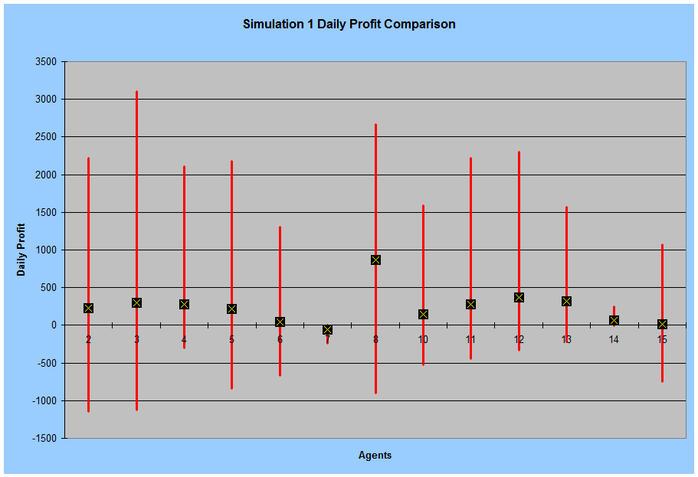

Slide 21
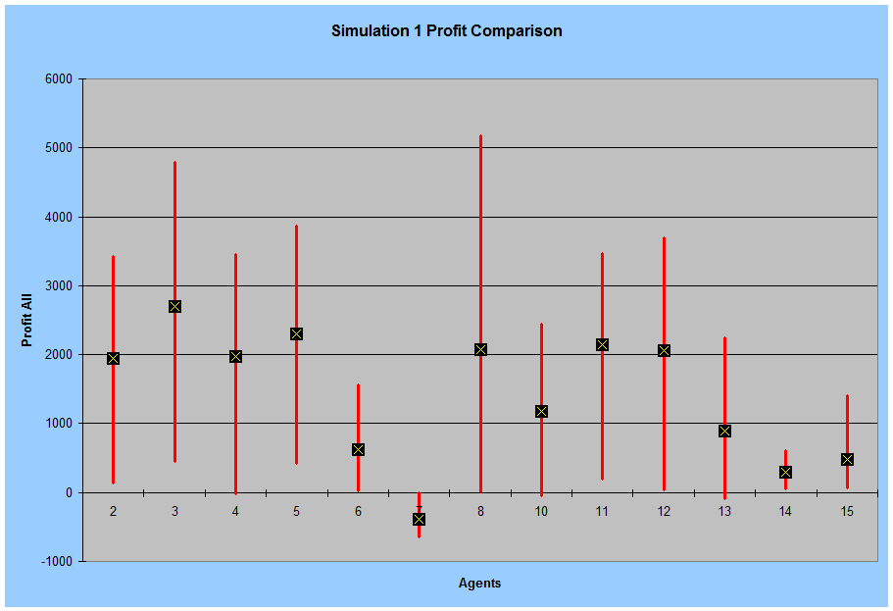

Slide 22
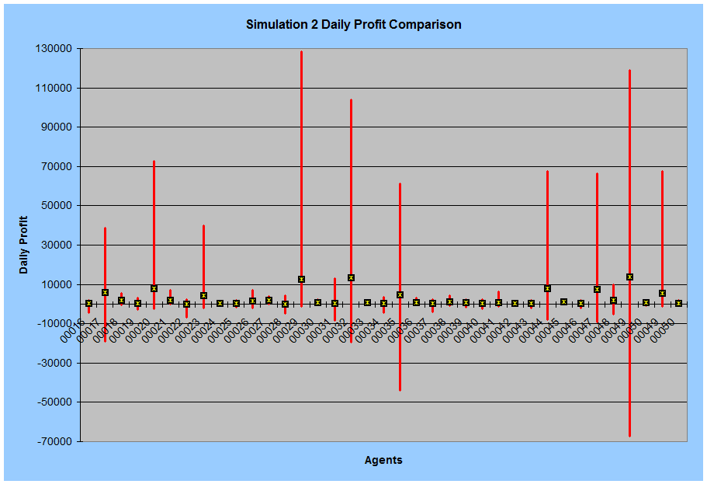

Slide 23
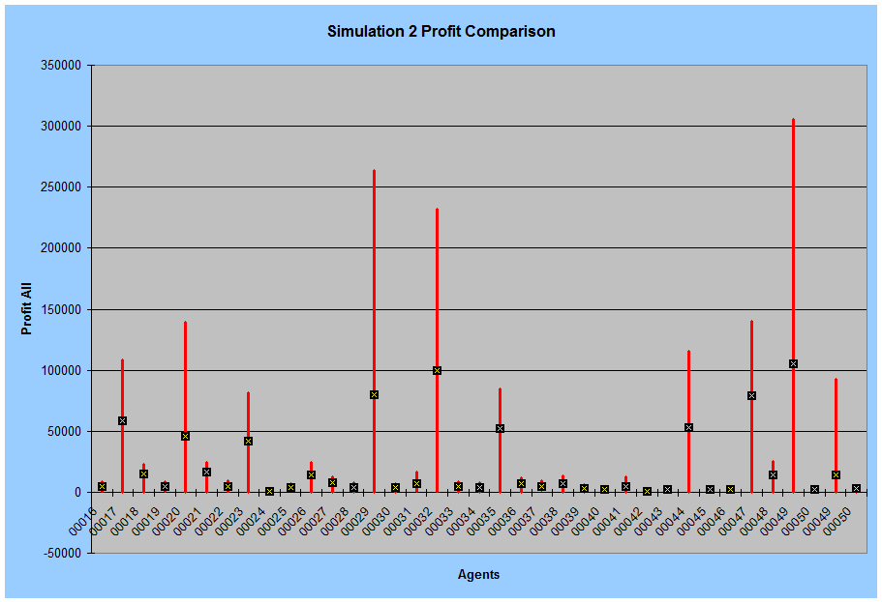

Slide 24
5 Best Combinations in 1 Simulation
Rank | Agent | Overall Result | Profit
1 | 49-9,5 | 10,139 | 139
2 | 47-9,5,4,13 | 10,112 | 112
4 | 20-9,3,12,5 | 10,070 | 70
3 | 32-9,3,5,13 | 10,065 | 65
5 | 29-9,3,12,13 | 10,048 | 48
Rank | Agent | Overall Result | Profit
1 | 32-9,3,5,13 | 277,196 | 177,196
2 | 49-9,5 | 219,805 | 119,805
3 | 47-9,5,4,13 | 210,130 | 110,130
4 | 20-9,3,12,5 | 123,059 | 23,059
5 | 29-9,3,12,13 | 108,665 | 8,665

Slide 25
10 Best Combinations in 1 Simulation
Rank | Agent | Overall Result | Profit
1 | 23 | 11,467 | 1,467
2 | 49 | 11,202 | 1,202
3 | 32 | 11,112 | 1,112
4 | 20 | 10,896 | 896
5 | 17 | 10,683 | 683
6 | 29 | 10,160 | 160
7 | 47 | 10,115 | 116
8 | 35 | 10,085 | 85
9 | 44 | 10,035 | 36
Rank | Agent | Overall Result | Profit
1 | 32 | 224,430 | 124,430
2 | 47 | 199,588 | 99,588
3 | 17 | 183,100 | 83,100
4 | 49 | 180,602 | 80,602
5 | 20 | 148,011 | 48,011
6 | 44 | 109,407 | 9,407
7 | 23 | 101,590 | 1,590
8 | 29 | 101,186 | 1,186
9 | 35 | 101,090 | 1,090

Slide 26
When Stock Is Going Down
Agent | Start Money | Date | Overall | Stock | Loss | %
49 | 10,000 | 1/22/2010 | 9,992.91 | 19 | -7.09 | -0.0709
 |  | 1/29/2010 | 9,990.73 | 18 | -9.27 | -0.0927
 | 100,000 | 1/22/2010 | 99,831.16 | 881 | -168.84 | -0.16884
 |  | 1/29/2010 | 98,851.44 | 3414 | -1148.56 | -1.14856
32 | 10,000 | 1/22/2010 | 9,991.09 | 10 | -8.91 | -0.0891
 |  | 1/29/2010 | 9,991.01 | 17 | -8.99 | -0.0899
 | 100,000 | 1/22/2010 | 99,909.38 | 166 | -90.62 | -0.09062
 |  | 1/29/2010 | 99,915.64 | 116 | -84.36 | -0.08436

Slide 27
Conclusions
The project has built the simulator that can represent a real stock market environment using real stock market data.
The combination of simple algorithms that works well in stock market has been found (Agent 32)
Jump & Dump : Take advantage when the price is going up
Average Order : Know whether the price will go up or down
Reverse Strategy : Take advantage of fluctuation behavior of stock market
Channel Breakout : Keep the risk low
The agent can
gain a lot of money (230 % from $100,000 in 2 months, 11% from $10,000 in 2 months)
avoid loss (less than 0.1 % per day)

Slide 28
Future Work
Try to do the research with more data and time.
Consider to use
Data Mining
Fuzzy Logic
Neural Networks
Consider to include
Option
The only way to gain money when the price is going down
News
Can avoid risk if there are major issues
Fundamental Analysis
Should know which company is good to invest on
Try to connect the agent to real stock market

Slide 29
Thank You for your Attention
Any Questions … ???

