Slide 1

Painel do Price Each Análise
- Criado por Eduardo Dietrich Zimmermann (Eduardo Zimmermann)
Powered By

Slide 2
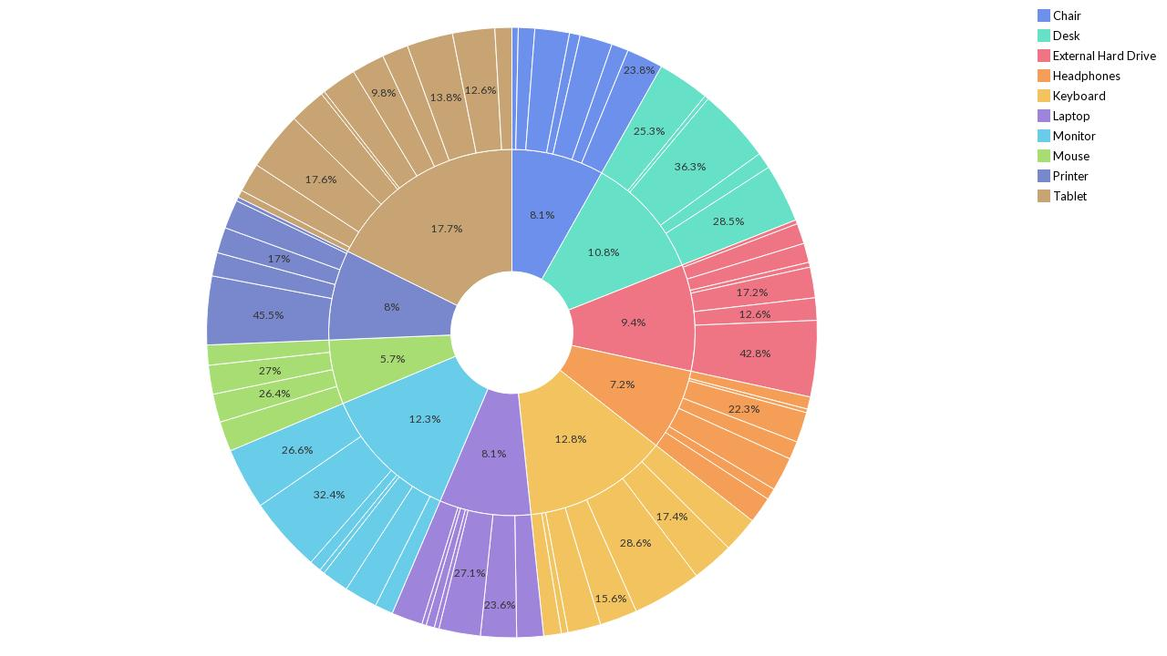
Order Date referente a Price Each por Product(1)
Powered By

Slide 3
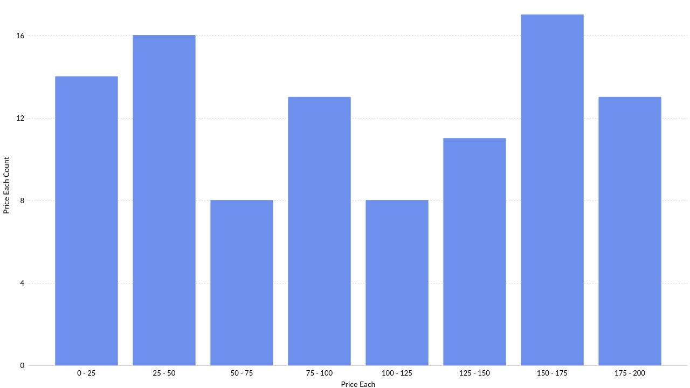
Distribuição de Price Each em intervalos diferentes
Powered By

Slide 4
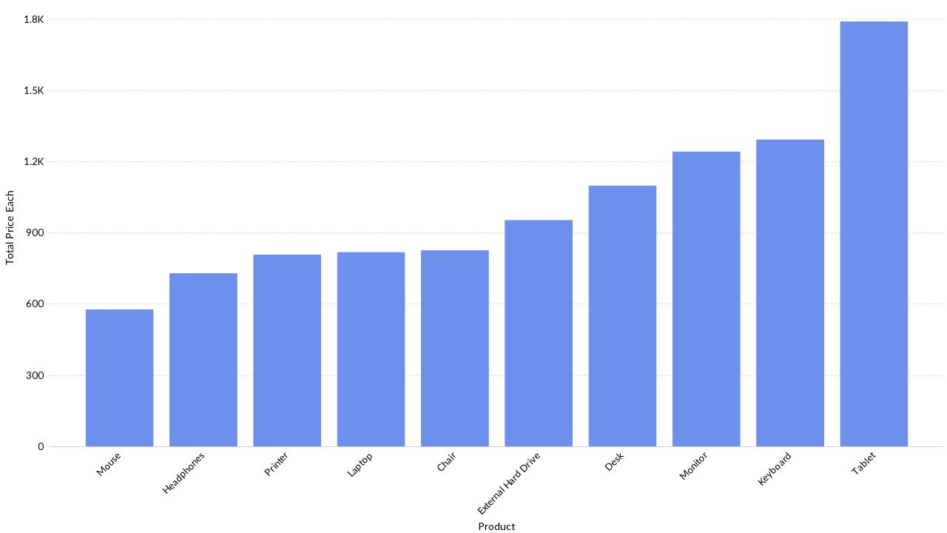
Product-referente Price Each
Powered By

Slide 5
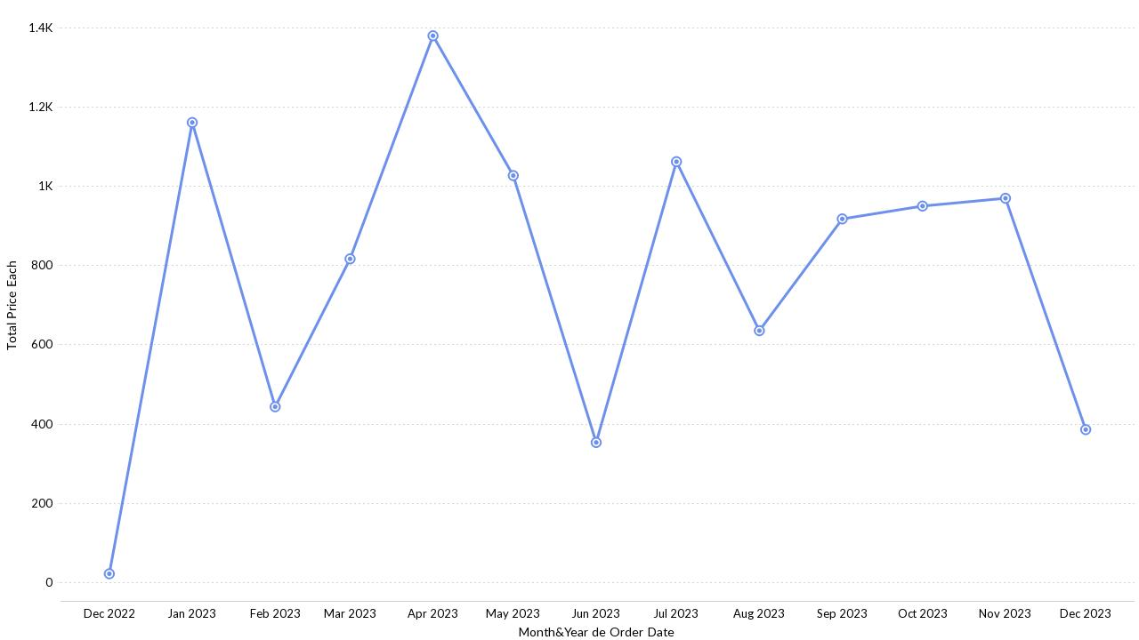
Price Each Através de Meses
Powered By

Slide 6
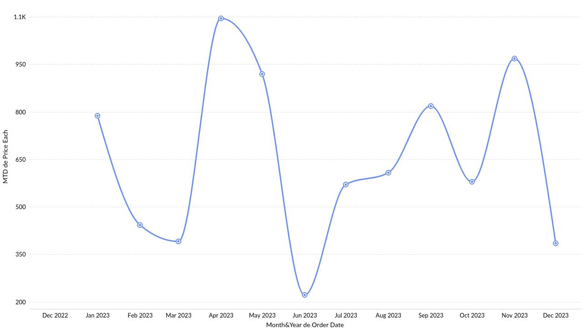
Acumulado do mês (MTD) Price Each por cada Mês
Powered By

Slide 7
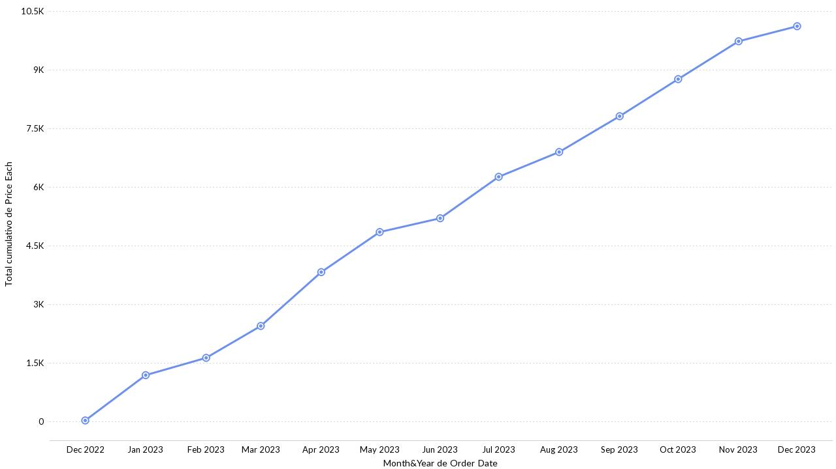
Em execução Price Each entre Meses
Powered By

Slide 8
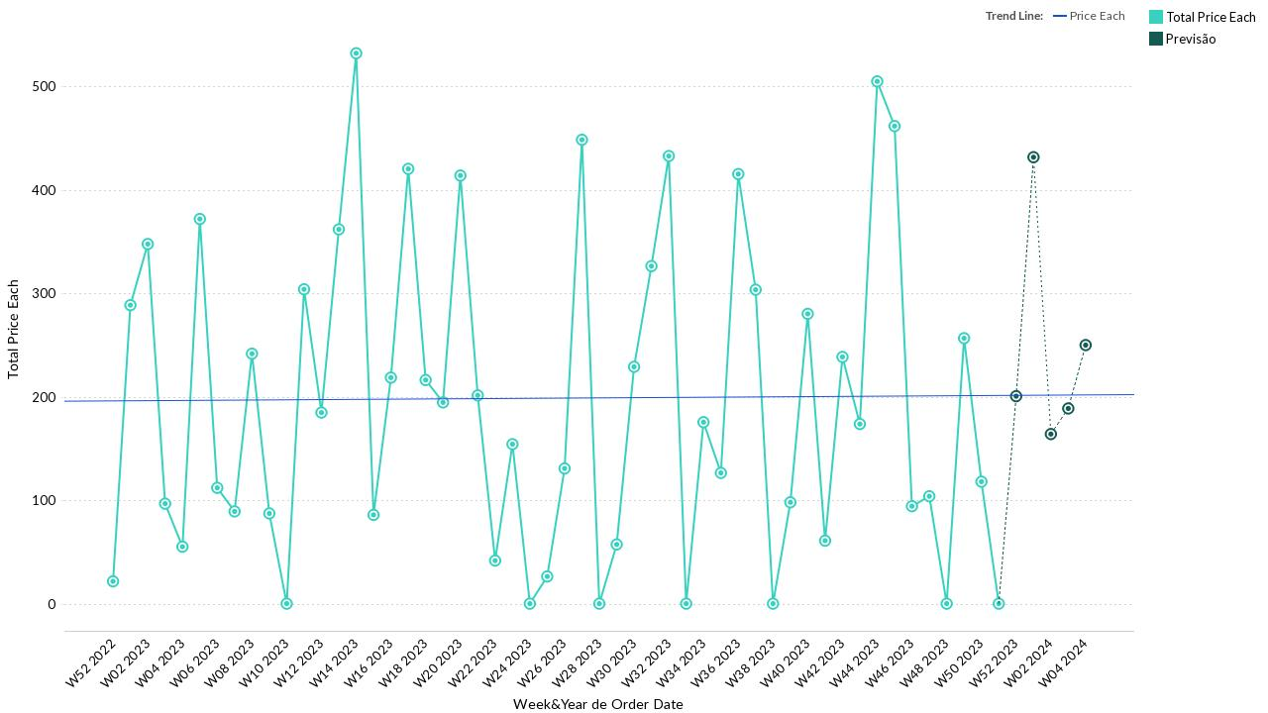
Price Each entre Semanas com previsão e tendência
Powered By

Slide 9
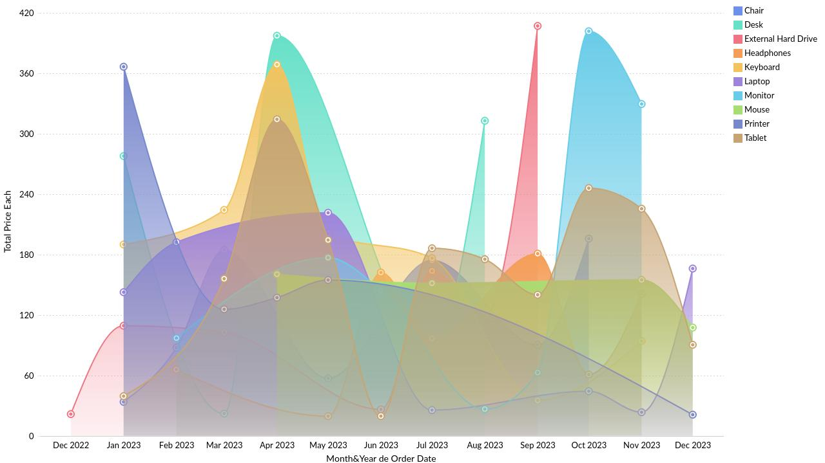
Price Each Através de Meses por Product
Powered By

Slide 10
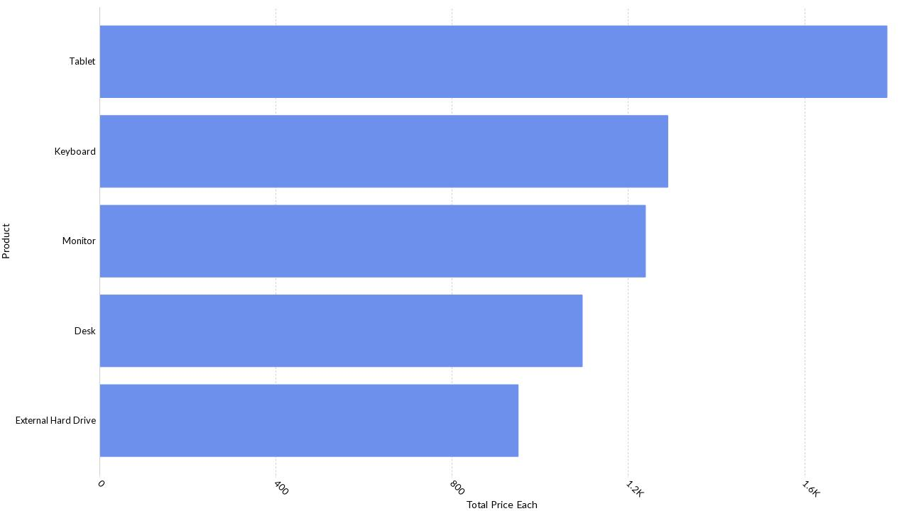
Top 5 Product por Price Each
Powered By

Slide 11
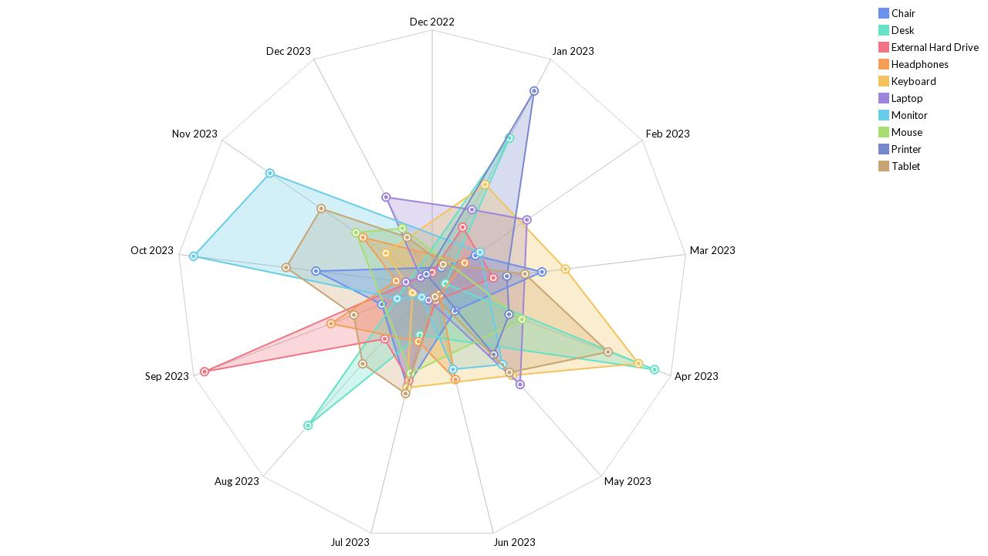
Order Date referente a Price Each por Product
Powered By

Slide 12
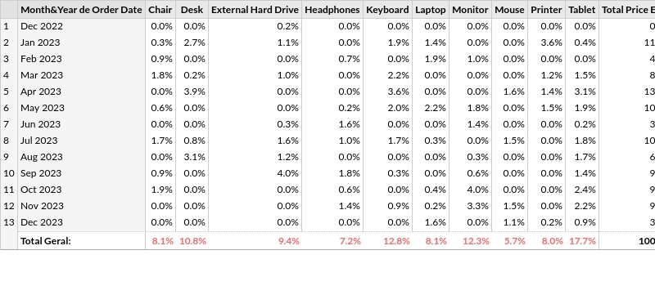
Distribuição de Price Each entre Meses por Product
Powered By

Slide 13
Thank you
Powered By

