Slide 1
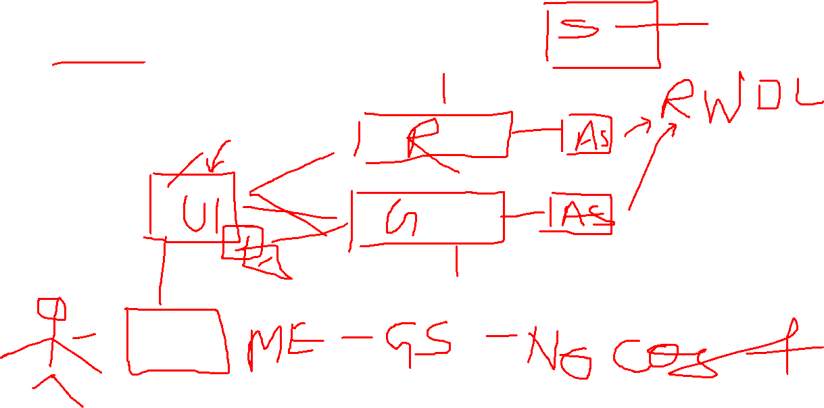
Azure Policy to Azure Administrators

Slide 2
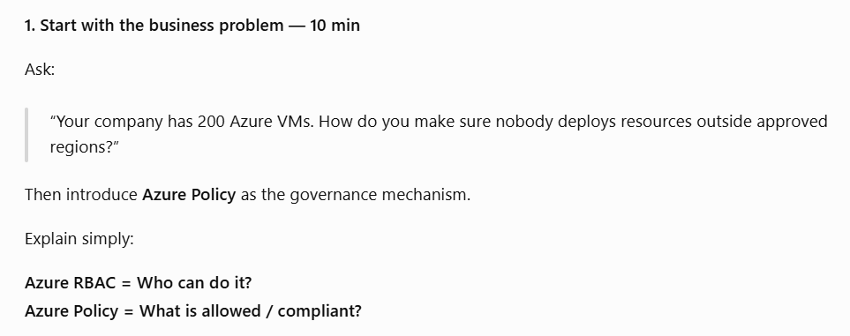

Slide 3
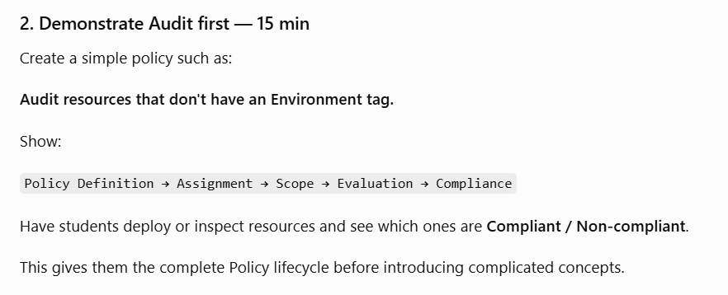

Slide 4
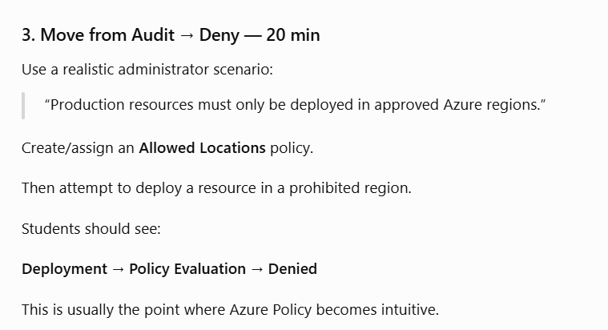

Slide 5
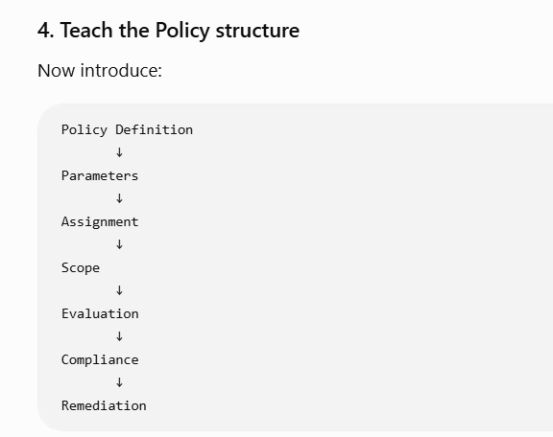

Slide 6
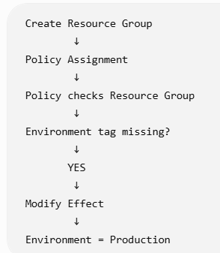

Slide 7
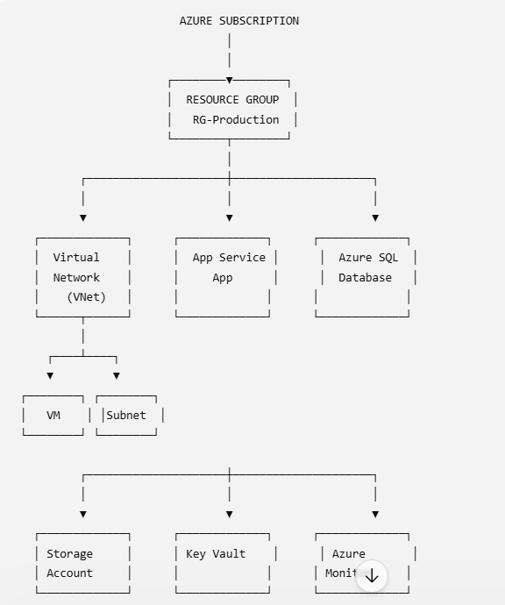

Slide 8
Azure Storage

Slide 9
Storage Accounts
Azure Storage account is the main container for Azure storage services.
Supports Blob, File, Queue, and Table Storage.
Choose the appropriate performance and redundancy based on workload.

Slide 10
Blob Storage
Used for storing unstructured data such as documents, images, videos, backups and logs.
Main components: Storage Account → Container → Blob.
Blob access tiers: Hot, Cool, Cold, Archive.

Slide 11
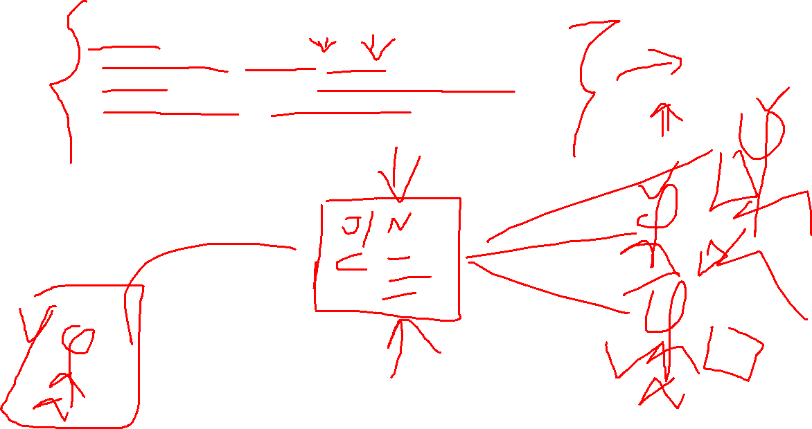
Azure Files
Managed cloud file shares using SMB/NFS.
Useful when applications need a traditional shared file system.
Can be mounted from Windows or Linux.

Slide 12
Redundancy Azure provides different replication options:
LRS – copies data within one datacenter.
ZRS – copies data across availability zones.
GRS – replicates data to a secondary region.
GZRS – combines zone and geo-replication.

Slide 13
Access Keys
Storage accounts have two access keys.
Keys provide broad access and should be protected carefully.
Two keys allow key rotation without downtime.
Prefer Microsoft Entra ID + RBAC where possible.

Slide 14
SAS (Shared Access Signature)
Provides limited, delegated access to storage resources.
Can restrict permissions, resource, IP address and expiry time.
Useful when users/applications need temporary access without exposing account keys.

Slide 15
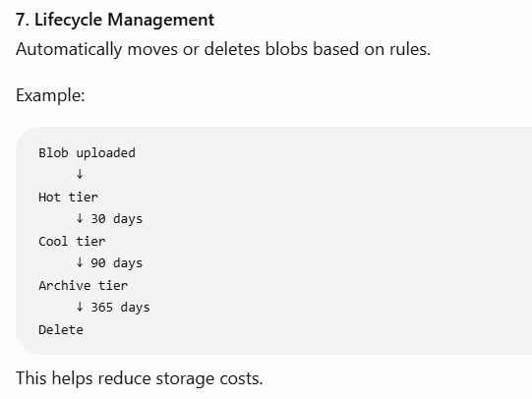

Slide 16
Storage Security Important controls include:
Microsoft Entra ID and RBAC
Private Endpoints
Storage firewall/network restrictions
HTTPS-only access
Encryption at rest
Secure transfer
Microsoft Defender for Storage
Avoid exposing storage containers publicly unless required

Slide 17
