Slide 1
PREDICTING NFL GAME MARGINS USING LINEAR REGRESSION
Elliot Wilens
Github.com/edubu2/metis-project2

Slide 2


PREDICTING NFL GAME MARGINS USING LINEAR REGRESSION
Agenda
Data gathering
Feature engineering
Feature selection
Results
Next Steps
But first, a question…
Why do people like sports?
Notes:
Why do people like sports? I’ll try to answer for everyone…
Gives us something to root for & get excited about
RESULTS ARE INHERENTLY UNPREDICTABLE

Slide 3



Data Sources and Tools
Tech Stack
Python3
pandas
NumPy
BeautifulSoup
scikit-learn
NumPy
StatsModels
matplotlib
Seaborn
All stats gathered from pro-football-reference.com via web scraping with BeautifulSoup
11,948 data points (filtered down from 20500)

Slide 4
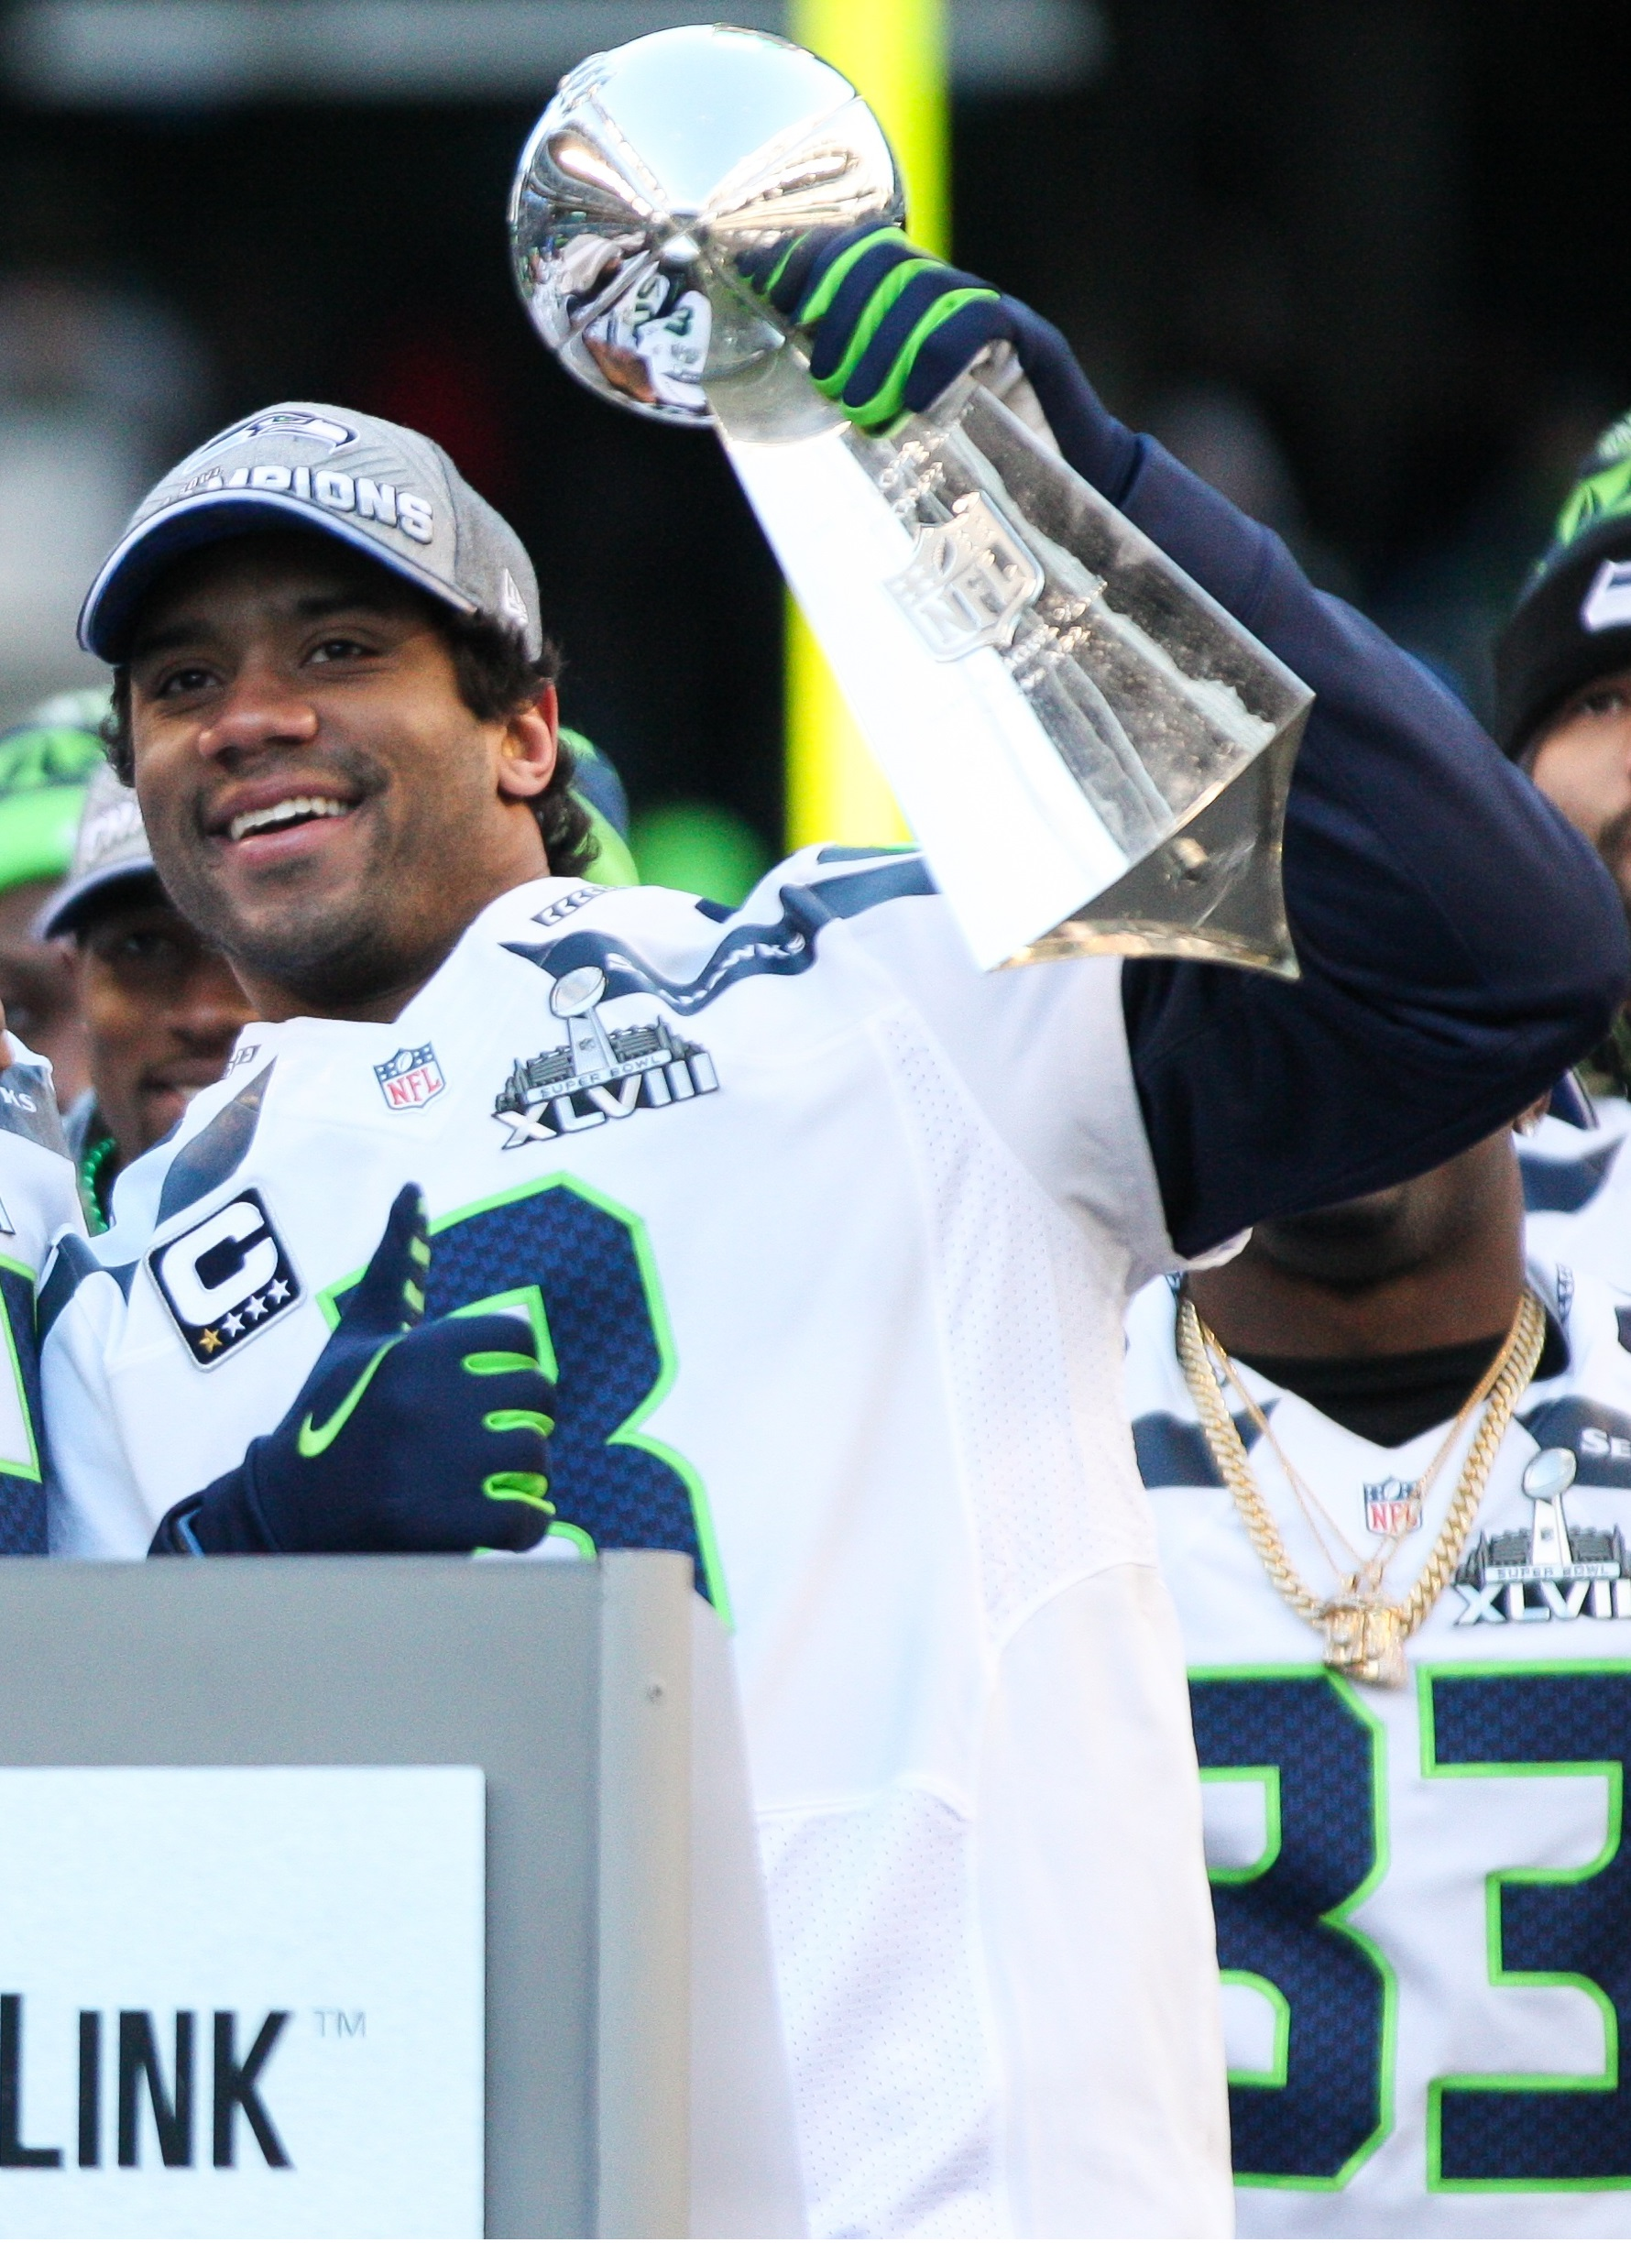
Feature Engineering
Objective: Implement features that will help answer the question:
How is this team playing right now?
EWMA vs Standard Rolling Averages
Exponentially Weighted Moving Average
Weights most recent week stronger than past weeks
4-week EWMA vs. 19-week EWMA
Subtracting these helps answer above question

Slide 5
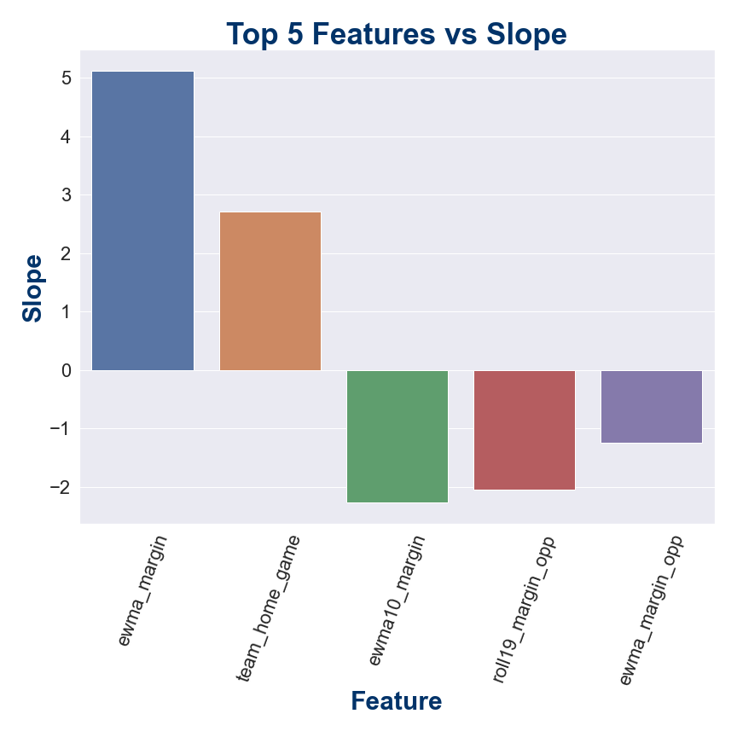
Feature Selection
200 available features → 20
Used Lasso regularization to simplify model in terms of num. features (with K-Fold CV)
Top Ten features in terms of Lasso Coefficients (abs. value)
1. EWMA Margin
2. Home Game
3. EWMA (10-week) Margin
4. Season Total Margin (opponent)
5. EWMA Margin (opponent)
6. Season Total Wins
7. Third Down Conversion Percent (opponent)
8. Third Down Conversion Percent
9. EWMA Total Yards Allowed
10. EWMA (10-week) Wins (opponent)
Notes:
Hundreds of experiments before touching test sets!

Slide 6
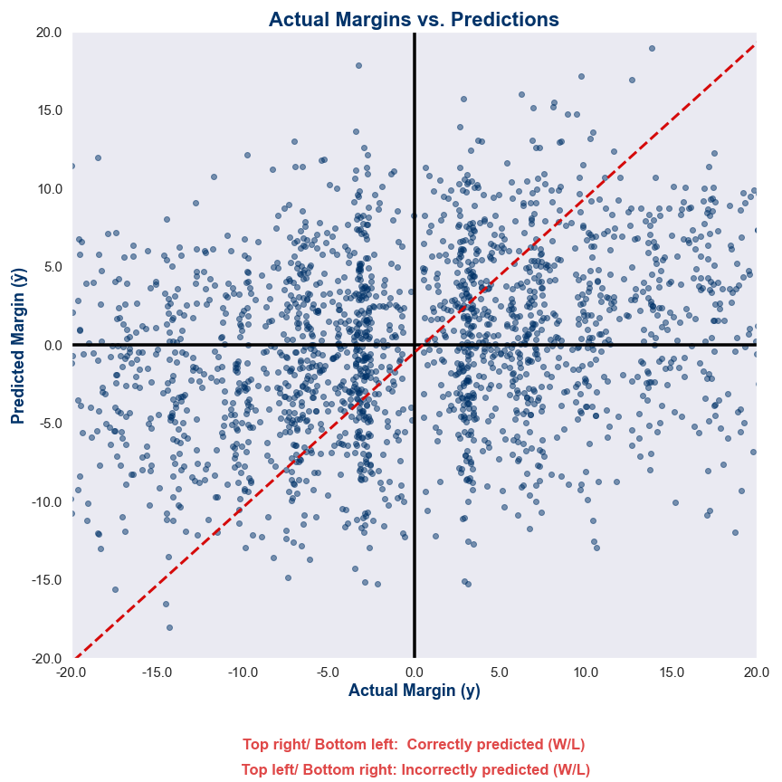
Model Selection & Results
Standard Linear Regression Model with Standardized Features
Limitation: cannot predict games in weeks 1-3
Test R² : 0.151
Predicted W/L outcome successfully 64% of the time in test set
Standard Deviation of Residuals: 13.58 pts
can expect margin to be within 13.58 pts approximately 68% of the time, since the distribution of points margin is relatively normal
(since each game adds another +x, -x to the distribution)
Simplified Linear Model R² : 0.118
Using: Home Game, Season Total Margin & Wins

Slide 7
Next Steps
Further explore model results by team & by year
Model did not seem to recognize change in gameplay over time
Explore time-series modeling
Calculate ELO Ratings for each team (fivethirtyeight.com)
Incorporate team rankings in certain stat categories into algorithm
Include features that indicate whether the team is at/near ”full strength” (i.e. injured QB, WR, star DE)
Capture weather data during web-scraping process

Slide 8
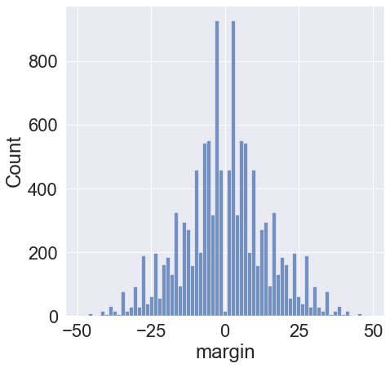
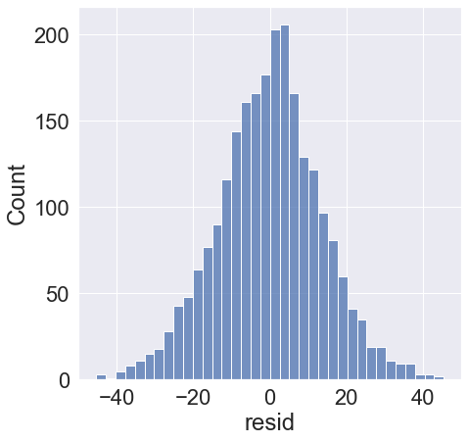
Appendix
Dataset
Data Gathering
Feature Engineering
Home Game * EWMA Margin

