Slide 1
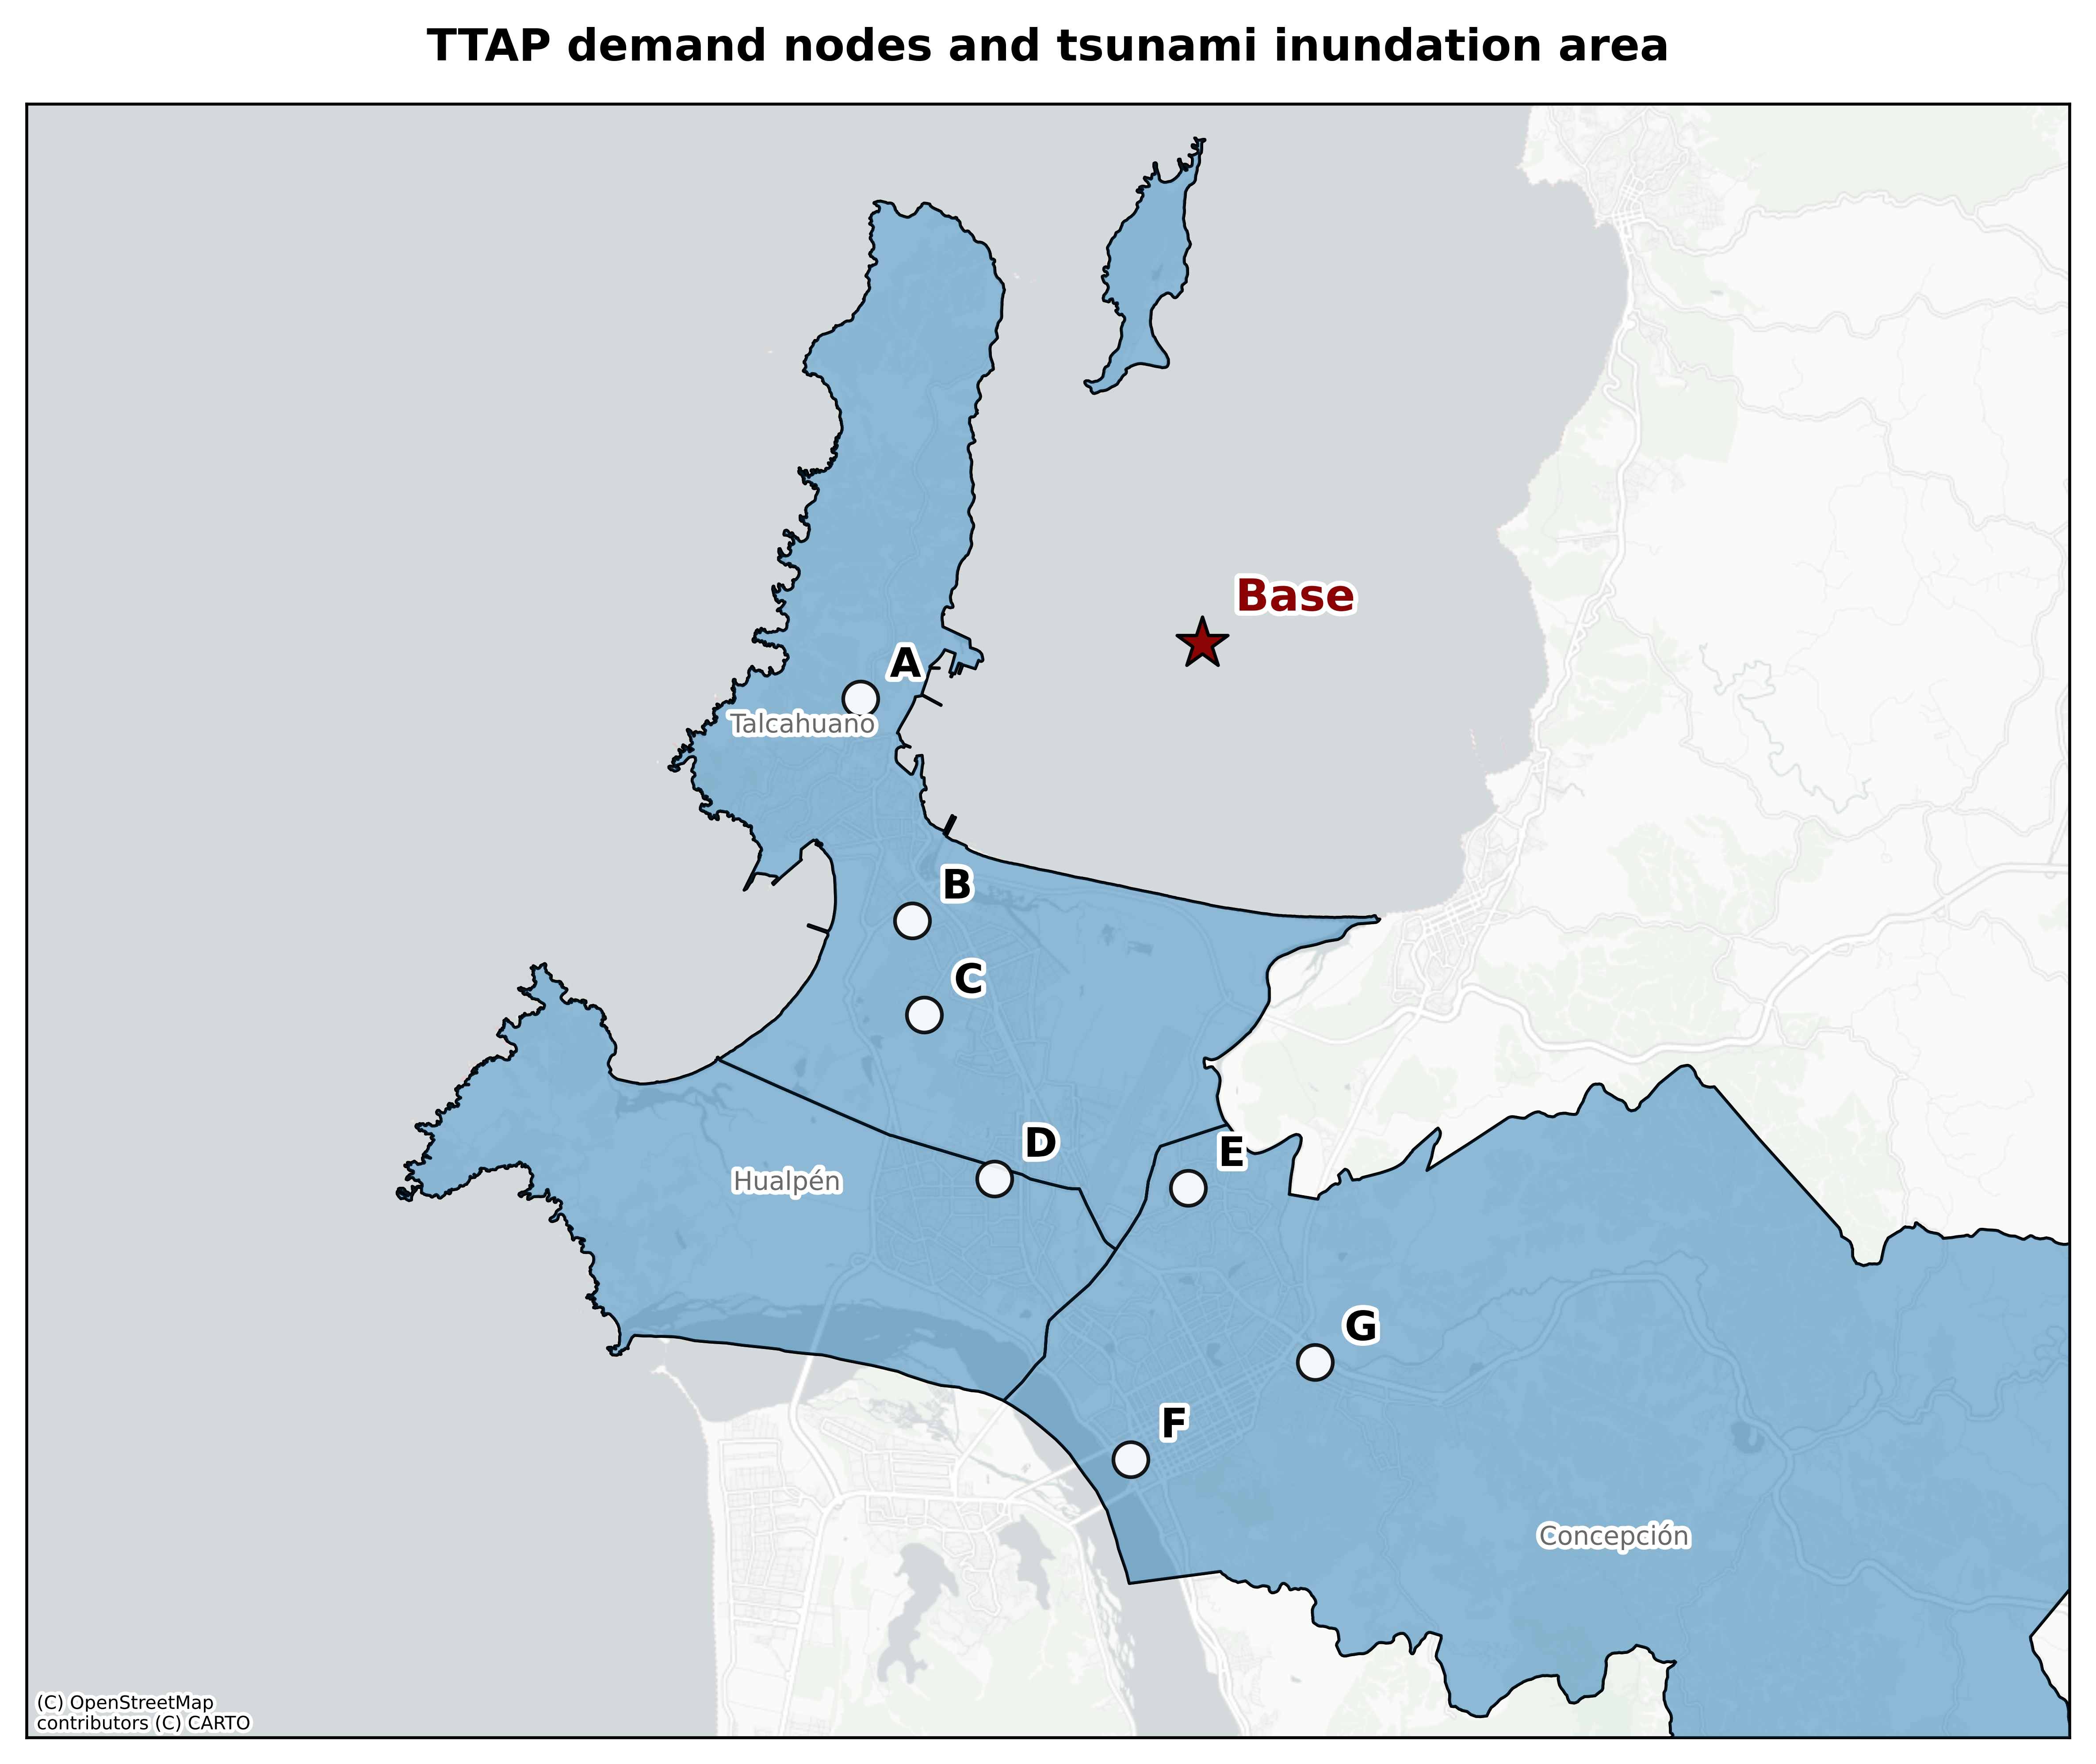
Tasks: 4
Tasks: 7
Tasks: 4
Tasks: 4
Tasks: 5
Tasks: 3
Tasks: 3

Slide 2
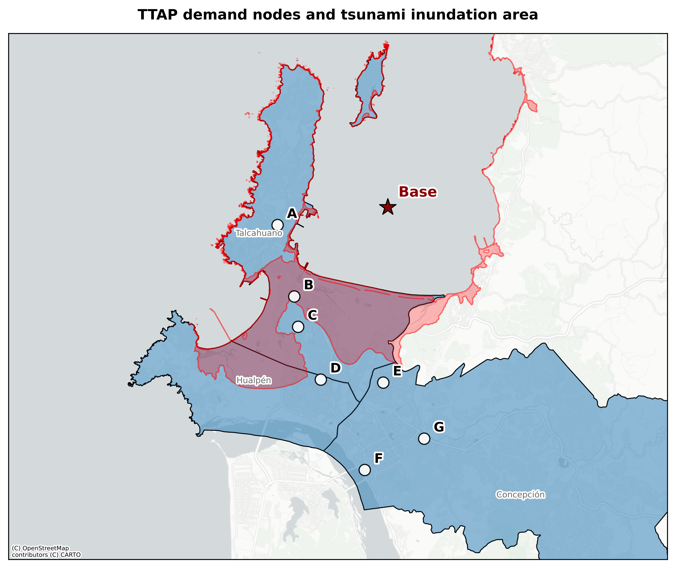
Red shaded area indicates the tsunami inundation zone reported by SHOA (2013).
Tasks: 4
Tasks: 7
Tasks: 4
Tasks: 4
Tasks: 5
Tasks: 3
Tasks: 3

Slide 3
Green points indicate tsunami evacuation meeting points identified in evacuation maps by SENAPRED (2025).
Tasks: 4
Tasks: 7
Red shaded area indicates the tsunami inundation zone reported by SHOA (2013).
Tasks: 4
Tasks: 4
Tasks: 5
Tasks: 3
Tasks: 3

Slide 4
Green points indicate tsunami evacuation meeting points identified in evacuation maps by SENAPRED (2025).
Tasks: 1,2,9,10
Red shaded area indicates the tsunami inundation zone reported by SHOA (2013).
Tasks: 3,7,8,11,12,13,14
Tasks: 5,6,15,16
Tasks: 21,24,27,30
Tasks: 4,17,18,19,20
Tasks: 23,26,29
Tasks: 22,25,28

