Slide 1


Contexts & Dependency Injection
http://www.cdi-spec.org/learn/

Slide 2

My code is spaghetti

Slide 3
Common antipatterns
Control Freak
Bastard Injection
Constrained Construction
Service Locator *
Factory

Slide 4
Service Locator advantages
We have support for late binding by changing the registration.
We can develop code in parallel because we program against interfaces and can replace modules at will.
We can achieve good separation of concerns, so nothing stops us from writing maintainable code. But doing so becomes much more difficult.
We can replace DEPENDENCIES with Test Doubles for TESTABILITY

Slide 5
Service Locator drawbacks
The module drags along a redundant DEPENDENCY – locator itself.
We don’t see which modules depend on which, need to open constructor implementation for it
“Surprises” with some dependency not being resolved are likely
Breaks encapsulation

Slide 6

Dependency Injection

Slide 7
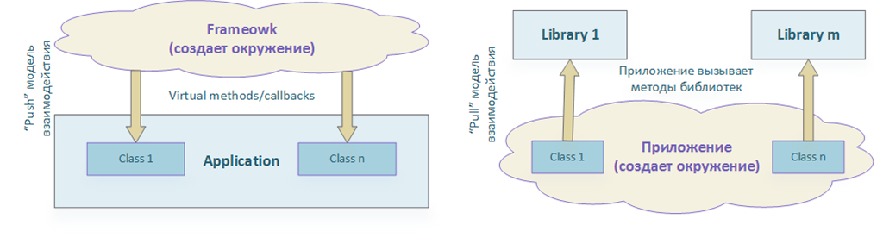
Inversion of Control
Library vs Framework
Don't call us, we'll call you

Slide 8
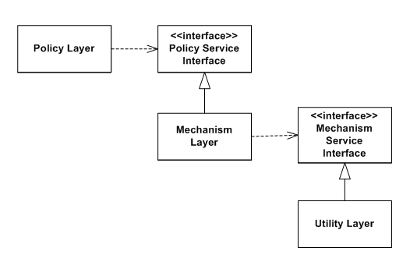
Dependency Inversion Principle
High-level modules should not depend on low-level modules. Both should depend on abstractions.
Abstractions should not depend upon details. Details should depend upon abstractions.

Slide 9
Dependency Injection
Implements last, but not the least principle of SOLID – Dependency Inversion (Inversion of Control)
Is a process of managing dependencies of software components
Enforces loose coupling
Enables parallel development
Handles cross-cutting concerns
As a result - ehanced testability
As a result - ehanced maintainability

Slide 10
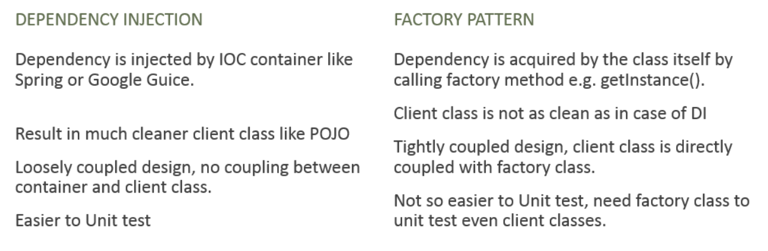
DI vs Factory

Slide 11

Bean
Requirments:
No-args constructor
Constructor with @Inject

Slide 12
Annotations save the world
@Inject
@Produces
@Qualifier
@New
@Any
@All
@Named
@Alternative

Slide 13
