Slide 1
A Forest Full of Trees
Using Trees and Forests for Classification Tasks
Evan Simpson
p.evansimpson@gmail.com

Slide 2
Warmer: Put the Steps in Order
Install and Load the Libraries Inspect the Prediction Prepare the Data Build and Evaluate the Model Conduct Exploratory Data Analysis (EDA) Collect/Load the Data Frame the problem
Notes:
Warmer

Slide 3
Warmer: Put the Steps in Order
Frame the problem
Collect/Load the Data
Install and Load the Libraries
Conduct Exploratory Data Analysis (EDA) Prepare the Data Build and Evaluate the Model
Inspect the Prediction
Notes:
Warmer

Slide 4

Types of Machine Learning
Unsupervised?
Supervised?
Reinforcement?
Why?
‹#›
Notes:
What type of machine learning are the three examples above
Sorting hat: it could be supervised but we hope it is reinforcement learning
Speech Recognition: Same as above
Self-driving car: Definitely reinforcement learning
‹#›

Slide 5

But…..
100% Accurate?
‹#›
Notes:
False Positive
‹#›

Slide 6


Machine Learning Algorithms
‹#›

Slide 7
Decision Trees
Job Offers
‹#›
Notes:
1. start with all observations in one group
2. identify a binary question, i.e., ("*yes/no*", "*over/under*") which will lead to mostly homogeneous groups
3. repeat step two until every subgroup homogeneous or some other metric has been achieved

Slide 8
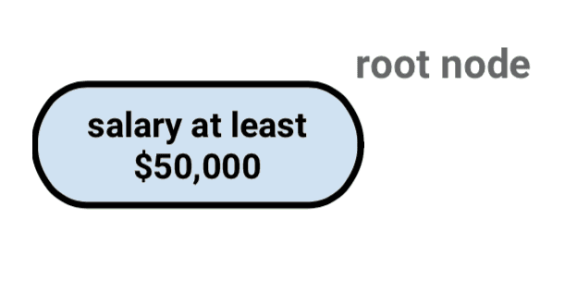
‹#›
Notes:
The root node contains all observations

Slide 9
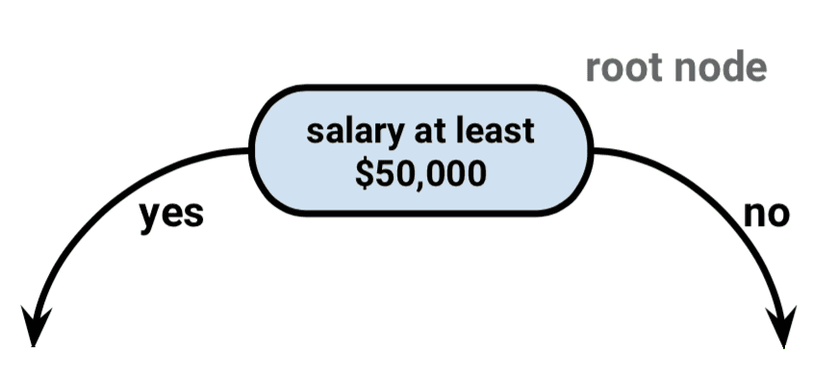
‹#›
Notes:
The first split is done to create as homogenous groups as possible.

Slide 10
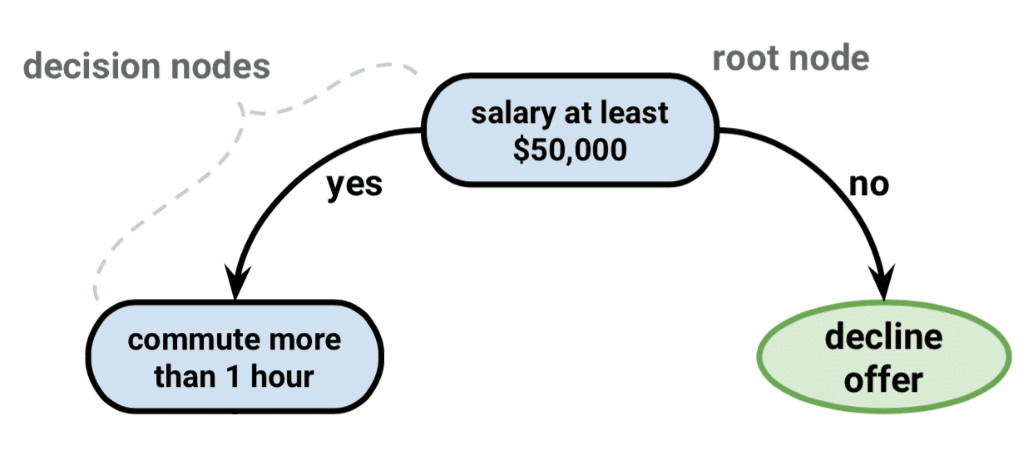
‹#›

Slide 11
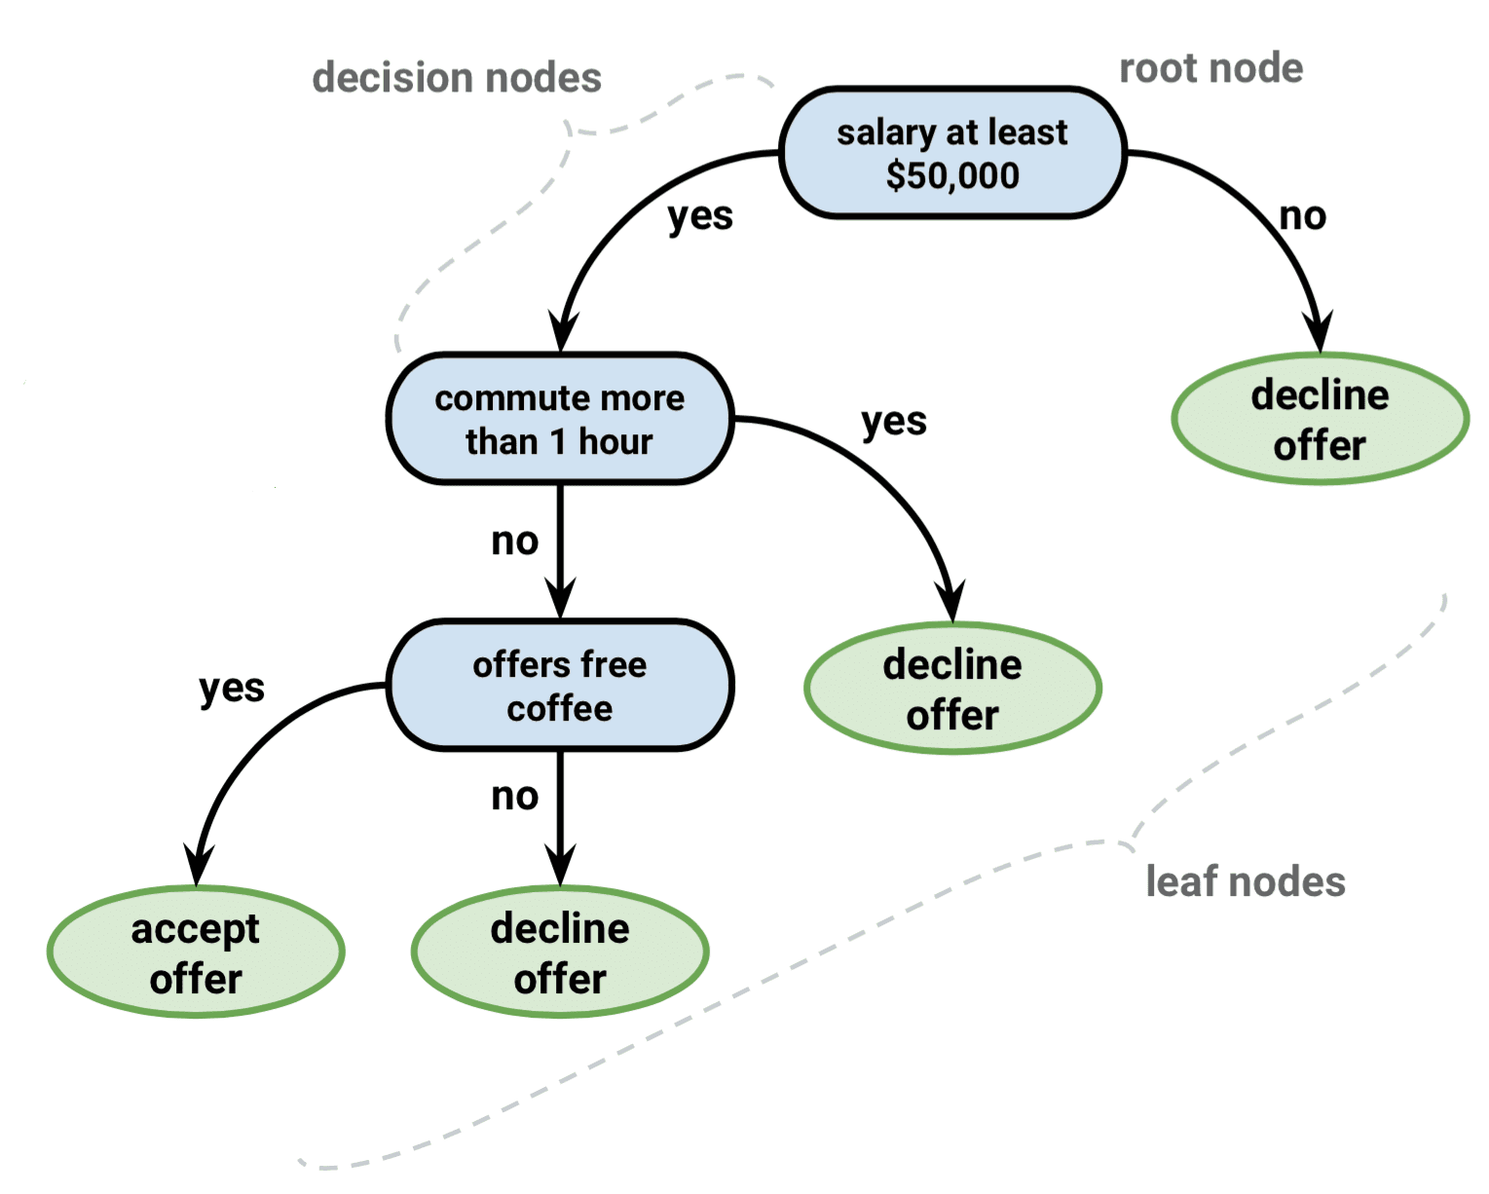
‹#›

Slide 12
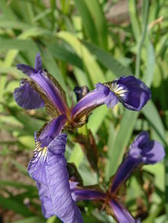
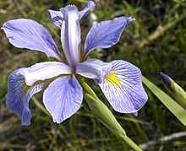
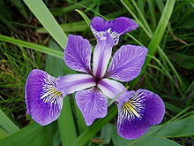
Task
Iris Virginica
Iris Setosa
Iris Versicolor

Slide 13
Decision Trees
Advantage
Easy to interpret and use
Transparent
Disadvantage
- Non-linear Data
- Easy to overfit
‹#›

Slide 14

Ensemble Methods
‹#›

Slide 15
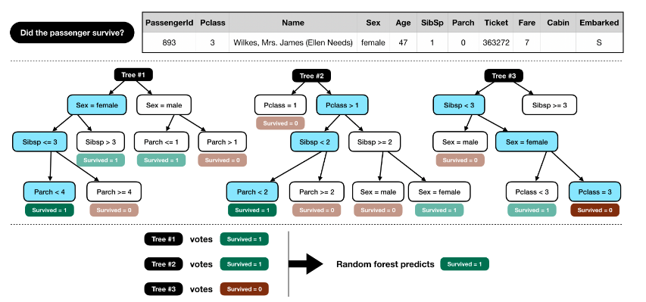
Random Forest
‹#›
Notes:
each tree sees different rows
at each split, it sees different columns

Slide 16
Task
Iris Virginica
Iris Setosa
Iris Versicolor

Slide 17
Random Forest
Advantage
Incredibly Powerful
Disadvantage
Black Box

Slide 18
Summary
Decision Trees
Interpretability/Over-fitting
Random Forest
Flexibility/Black Box

Slide 19
Resources
Kaggle Tutorial using Random Forest
Visualizing Decision Trees
DataCamp Decision Tree Tutorial
Hands On Machine Learning Chapters 6 and 7

