Slide 1

IntelliCare ER: Enhancing Emergency Room Operations with MIMIC-IV Dataset Presented by Group 10

Slide 2

Group Members
Jerusha Sheba Maben - 0825449.
Pearlin Ronald Pereira - 0815060.
Manushree Venkatesh - 0828892.
Eduardo Chavez Barrientos - 0828349
Noushin Asadsamani - 0829532.

Slide 3

Introduction
The introduction of an innovative Emergency Room (ER) management system based on the MIMIC-IV dataset is poised to revolutionize hospital operations.
The ER system is projected to increase healthcare delivery efficiency while also contributing to data-driven decision-making by combining real-time patient tracking, medication reconciliation, diagnosis analysis, and other essential features. The incorporation of the MIMIC-IV dataset provides an unparalleled potential to tailor ER operations to patients' particular needs, ultimately leading to improved outcomes and resource efficiency.

Slide 4

Background and Motivation
Background:
Healthcare Challenges: Traditional ER operations face hurdles in optimizing patient care and overall efficiency.
MIMIC-IV Dataset Opportunity: Leveraging data from a Boston-area academic medical center to understand patient scenarios and hospital processes.
Motivation:
Impactful Healthcare Delivery: Aspire to introduce an advanced ER management system for streamlined processes and elevated patient care.
Dataset Promise: Real-time patient tracking, optimized medication reconciliation, and improved diagnoses management to redefine the ER environment.
Specific Pain Points: Addressing medication management with Pyxis system integration and patient prioritization through an acuity-based triage system.
In essence, our initiative is prompted by the imperative to surmount ER challenges, utilizing the transformative potential of the MIMIC-IV dataset for enhanced patient outcomes and improved resource efficiency.

Slide 5

Problem Statement
The goal of this project is to use the dataset's richness of information to improve patient care, optimize medication administration, and streamline critical processes in the ER environment.
Medical Information Mart for Intensive Care IV (MIMIC-IV) is a relational database containing real hospital stays for patients admitted to a tertiary academic medical center in Boston, MA, USA.
MIMIC-IV contains comprehensive information for each patient while they were in the hospital: laboratory measurements, medications administered, vital signs documented, and so on.

Slide 6

Work Breakdown Structure
Project Management : Commence, plan, execute, monitor, and close the project.
Data Integration : Extract MIMIC-IV data, load into Python, merge tables, perform EDA, clean, and transform.
Data Analysis : Plot graphs, create associations, integrate tables, analyze different aspects independently.
Results Integration and Reporting : Combine analyzed results, prepare comprehensive reports, and create visualizations/dashboards.
Implementation of Non-Functional Requirements : Data security, system scalability, improved usability, reliability, and quality control.

Slide 7
Project Timeline
Week | Tasks
1-2 | Commence the Project; Extract MIMIC-IV Data
3-4 | Plan the Project; Load Data into Python
5-6 | Execute the Project; Merge Tables and EDA
7-8 | Monitor and Control Project; Data Cleaning and Transformation
9-10 | Close the Project; Real-Time Patient Tracking Analysis
11-12 | Medication Reconciliation Analysis
13-14 | Diagnoses Analysis
15-16 | Pyxis System Integration Analysis
17-18 | Triage System Analysis; Vital Signs Monitoring Analysis
19-20 | Analyze Tables Separately and Combine
21-22 | Find Relationships Between Tables; Results Integration
23-24 | Prepare Comprehensive Report
25-26 | Create Visualizations and Dashboards
27-28 | Implement Data Security Measures; Scalability Optimization
29-30 | Improved Usability; Reliability Measures; Quality Control Checks

Slide 8

Tools and Techniques
Project Management:
Tools: JIRA
Data Integration:
Tools: Python (Pandas)
Data Analysis:
Tools: Tableau, Python (Matplotlib, Seaborn)
Results Integration and Reporting:
Tools: Python (Pandas), Microsoft Word, Tableau

Slide 9

Visualizations

Slide 10
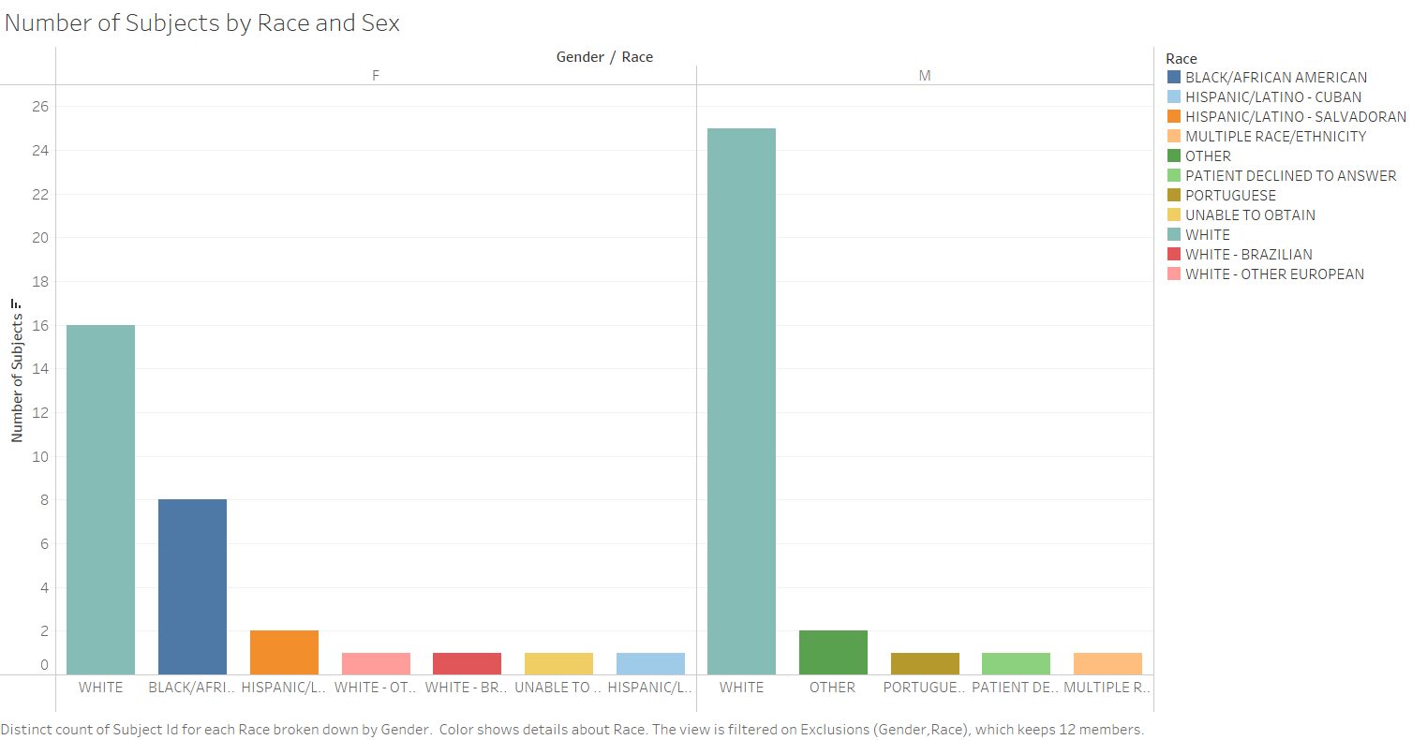
Number of Subjects by Race and Sex

Slide 11

Key Findings
The following graph shows that the number of casualties was higher for men than for women.
The predominant race of men admitted to the ER was white, followed by other races/ethnicities.
In the category of women, white women were ranked as the highest number of women admitted into the ER. This was then followed by Black/African women and Hispanic/Latino - Salvadorian Women.
Hispanic/Latino - Cuban women had the lowest frequency of ER visits.

Slide 12
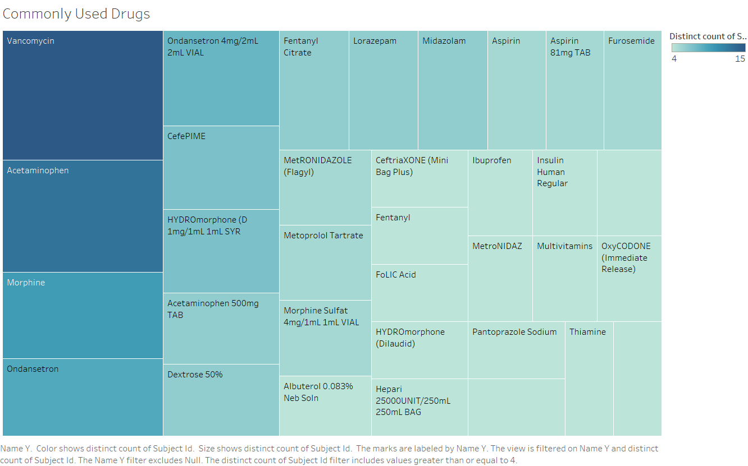
Drugs Commonly used by our Subjects

Slide 13
Key Findings
Vancomycin, which is generally used to treat bacterial infections, was the most commonly utilised medicine in the ER. Severe Skin and Soft Tissue Infections, Bacterial Pneumonia, Bone and Joint Infections, and Bloodstream Infections can all be treated with this medicine.
This was followed by paracetamol and morphine, which are routinely used to treat fever and pain, respectively. Whereas, Morphine is used for trauma, post-surgical pain, chest pain, and respiratory distress, while taking into account potential opioid-related hazards.
Some of the least used drugs were Fentanyl, Folic Acid, Hydromorphone and a few others.

Slide 14
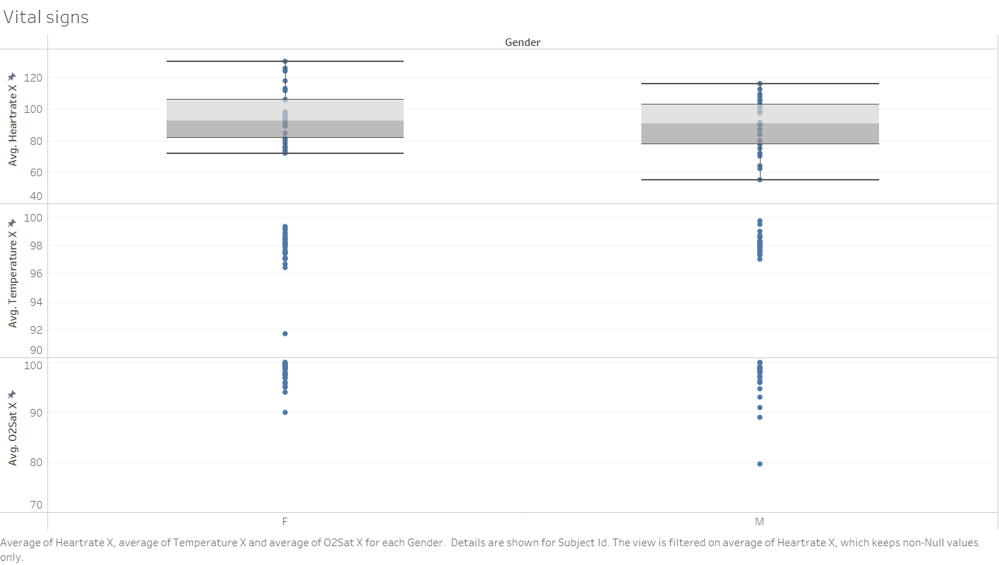
Gender wise Vital Signs of our Subjects
Notes:
We plot the vital signs for patients as they arrive at the emergency room using a boxplot. Here we split females from males since vital signs can be different for each group. For hearthrate we can identify some abnormalities especially in female with a significant increase in normal range. Some outliers in temperature again in female with some patients with hipotermia. And for O2sat some male under 80% lower that the lowest rate wich requires urgent care.

Slide 15
Key Findings
Upon the arrival of patients at the emergency room, we meticulously record and graph their vital signs using a boxplot. This data is segregated by gender, as the vital signs can vary between males and females.
In the case of heart rate, we have observed some anomalies, particularly in females, where there is a noticeable increase beyond the normal range. Similarly, temperature readings have revealed outliers among females, with some patients exhibiting symptoms of hypothermia.
For oxygen saturation (O2sat), we have identified some males with levels below 80%, which is lower than the minimum acceptable rate. This is a critical situation that necessitates immediate medical attention.

Slide 16
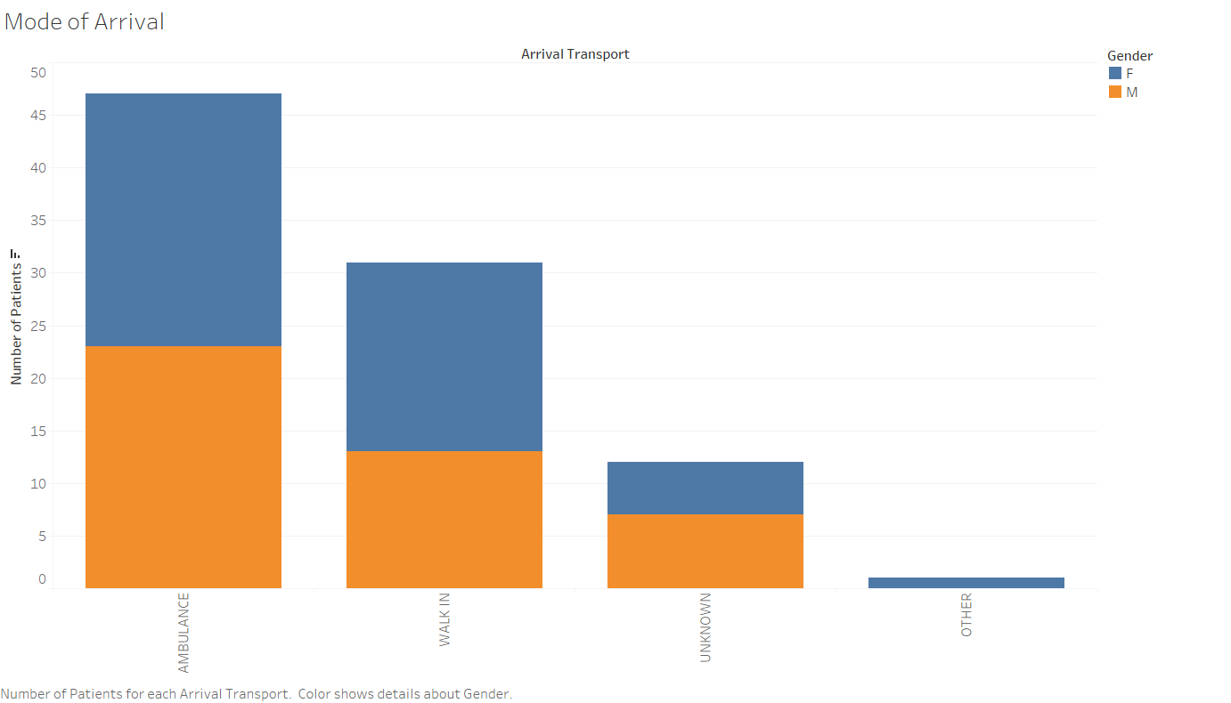
Gender distribution of our method of arrival transport

Slide 17

Key Findings
When we look at the mode of arrival, majority of the patients arrived via ambulance, followed by walk-ins and other unspecified modes of arrival.
Women were somewhat more likely than men to arrive by ambulance.
Women also made up a larger proportion of walk-ins than men.

Slide 18
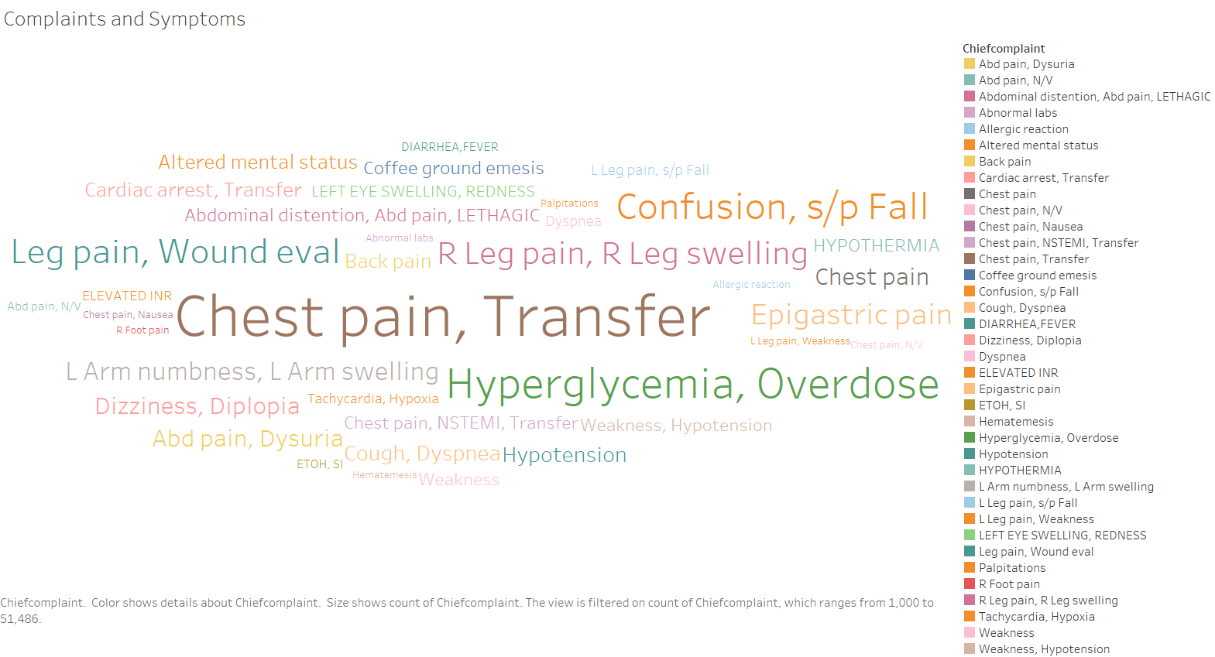
Subject Complaints and Symptoms

Slide 19
Key Findings
The word cloud indicates that most of the patients were either moved from another hospital or were admitted due to chest pain.
The second most common cause of ER admissions for patients was hyperglycemia and overdosage.
Abnormal test results and hematemesis were the least common reasons for ER admissions.

Slide 20
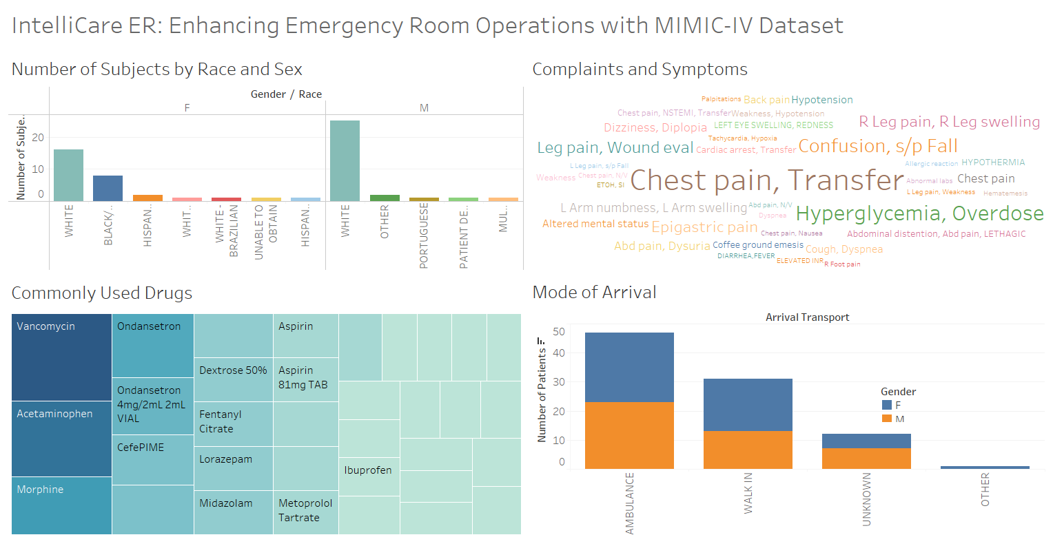
Dashboard

Slide 21
Recommendations
Implement real-time patient tracking for efficient ER management.
1
Enhance medication reconciliation with automated safety alerts.
2
Develop tools for detailed analysis of patient diagnoses post-discharge.
3
Strengthen integration with the Pyxis system for streamlined medication management.
4
Introduce an acuity-based system to prioritize patients in the triage process.
5

Slide 22

Any Questions?

