Slide 1
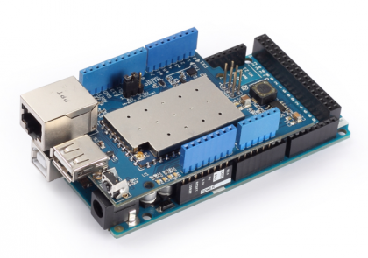
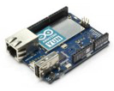
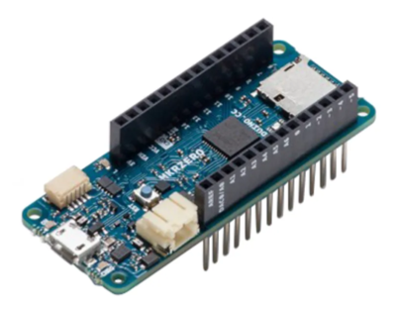
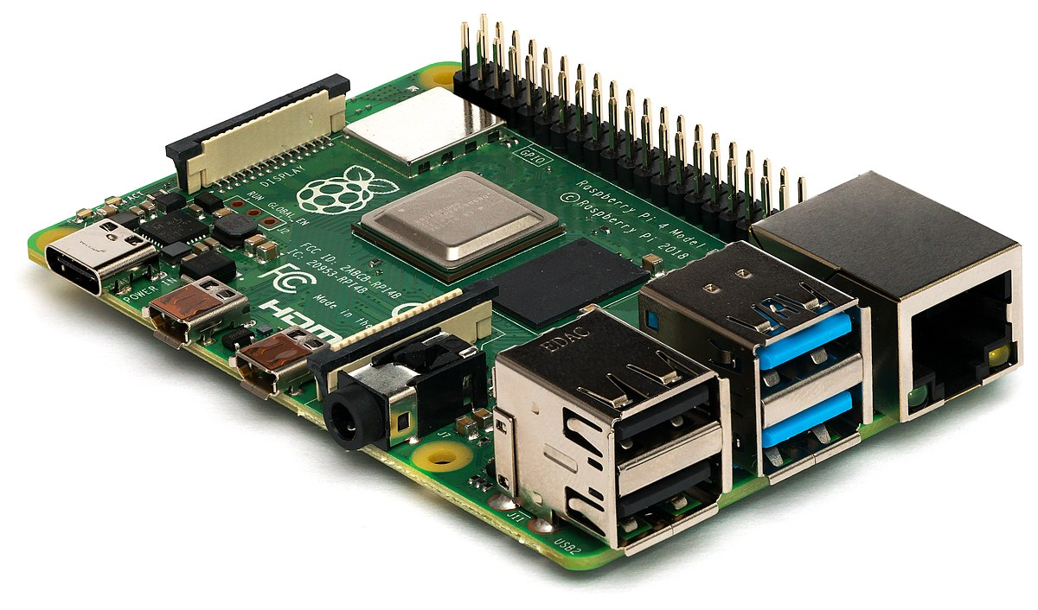
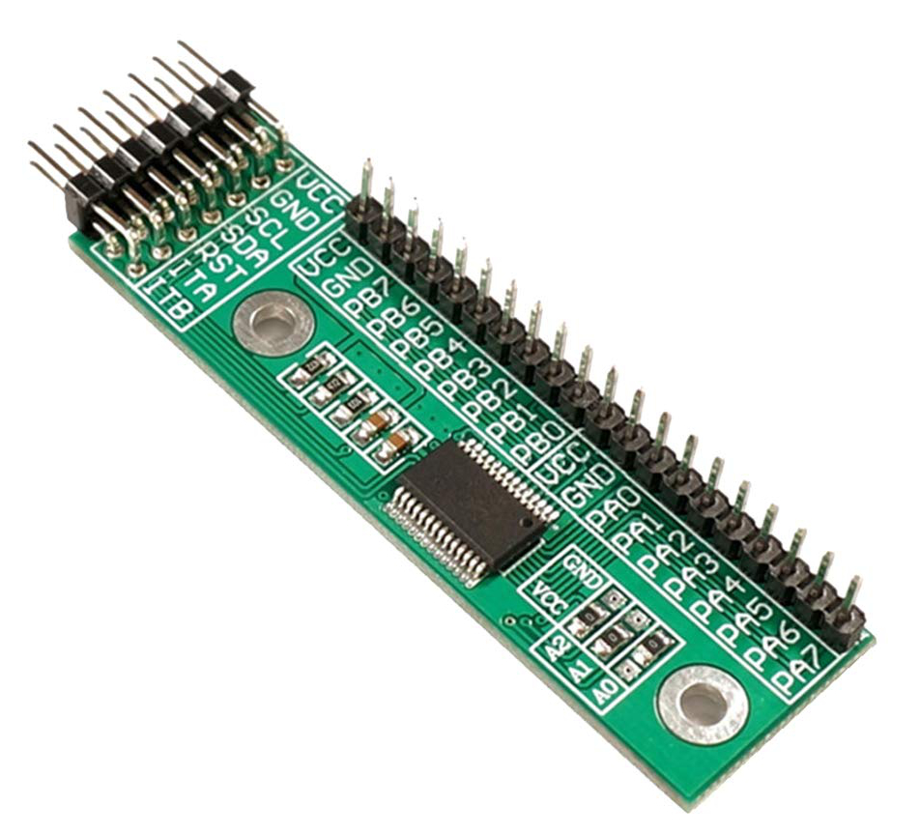
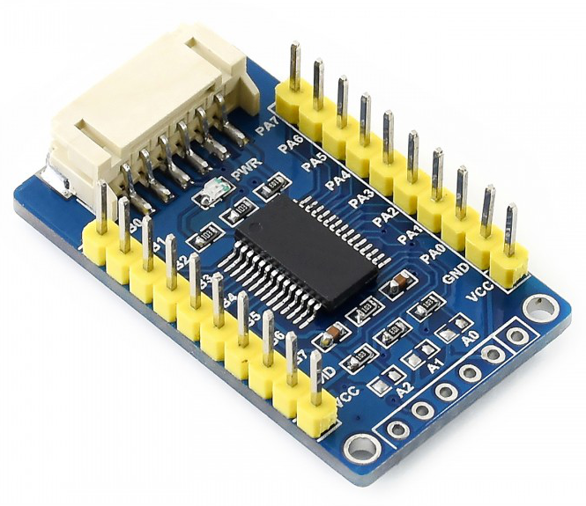
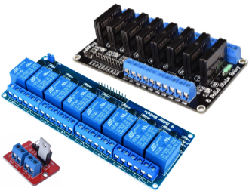
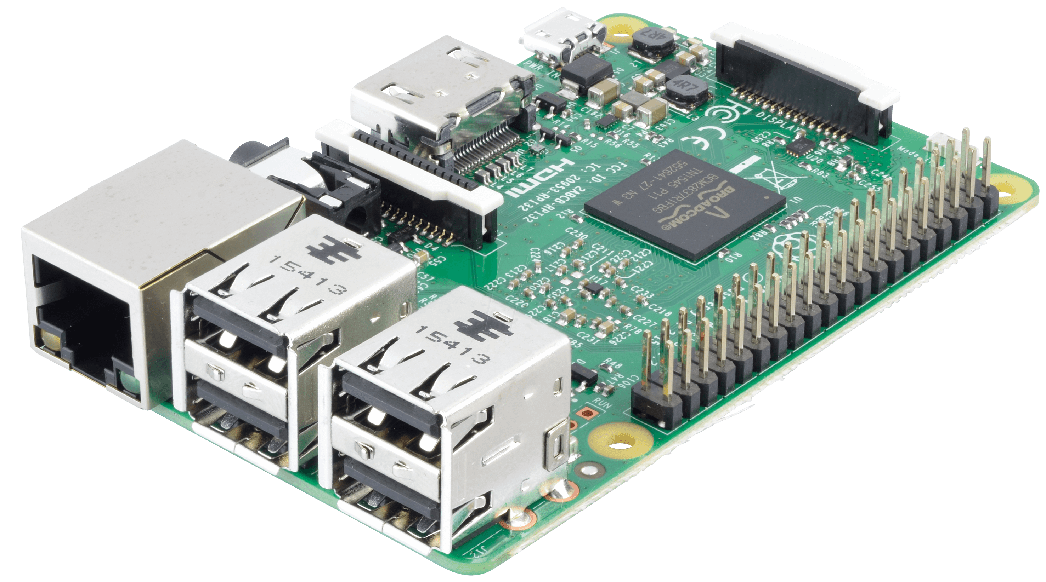
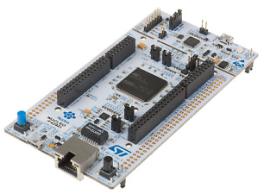


PiPyRelayProp
Raspberry Pi 3B/3B+/4
Optional: 16 I/O Pins Expander (MCP23017)
Arduino props
AdruinoProps library
Arduino Yún,
Arduino Mega 2560 Rev3 + Dragino Yún Shield
Arduino Ethernet
Arduino MKR WiFi 1010
Arduino NANO 33 IoT
Arduino + Ethernet Shield
MQTT
broker
Prop inbox
door:open
door:close
Raspberry Pi props
PyProps library
Raspberry Pi 3B/3B+/4
Prop outbox
DATA maglock=on challenge=0
DATA maglock=off challenge:1
Prop inbox
door:open
door:close
Prop outbox
DATA maglock=on challenge=0
DATA maglock=off challenge:1
SRD relays (smoke machines)
SSR relays (power supplies, lights)
MOSFET relays (maglocks)
STM32 props
STM32 Nucleo-144
Outbox Protocol
DATA -> send variables to control
MESG -> send text to display in control
DONE -> acknowledge that a command has been performed
OMIT -> acknowledge that a command has been ignored
OVER -> notify that a challenge is over
REQU -> request a command to another prop
PROG -> request a control program (audio/video)
Game master workstation

