Slide 1
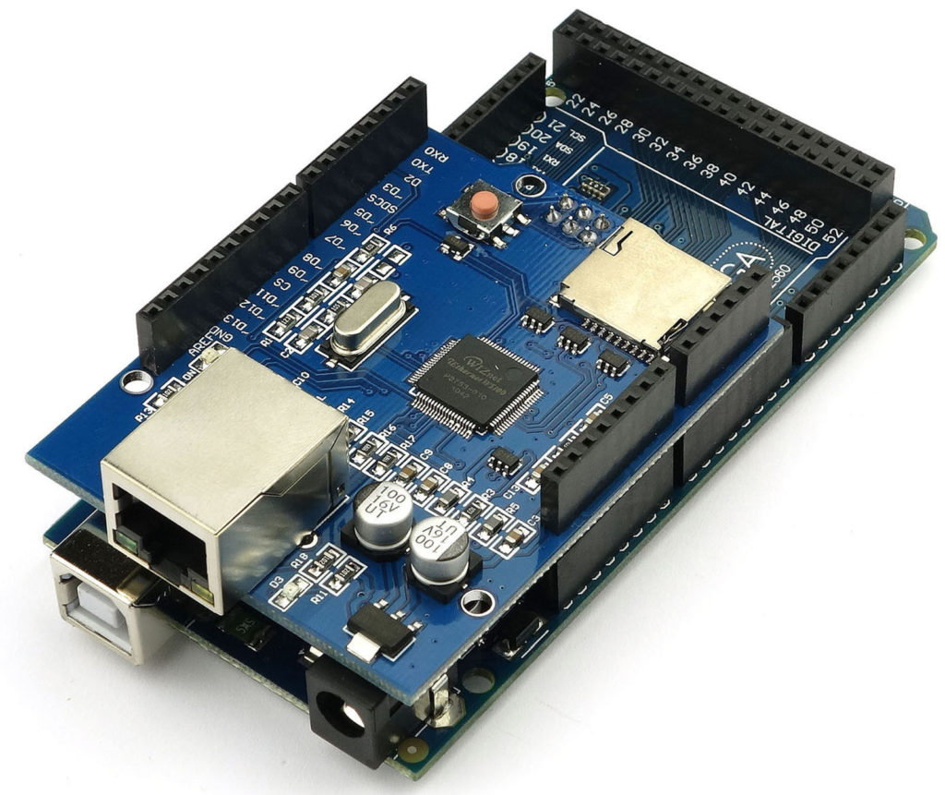
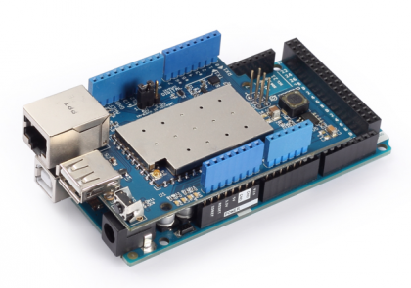
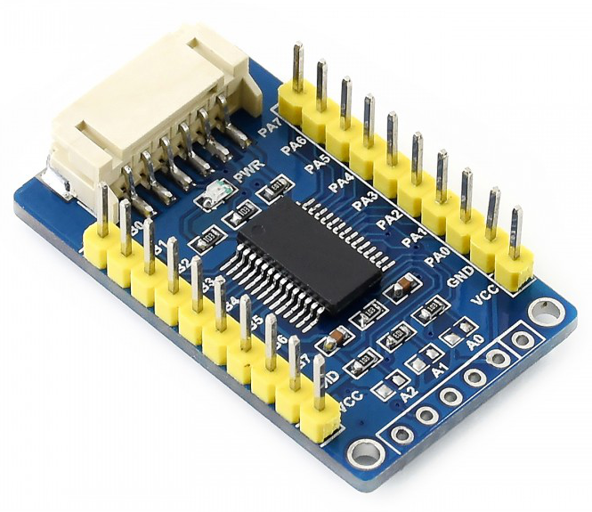
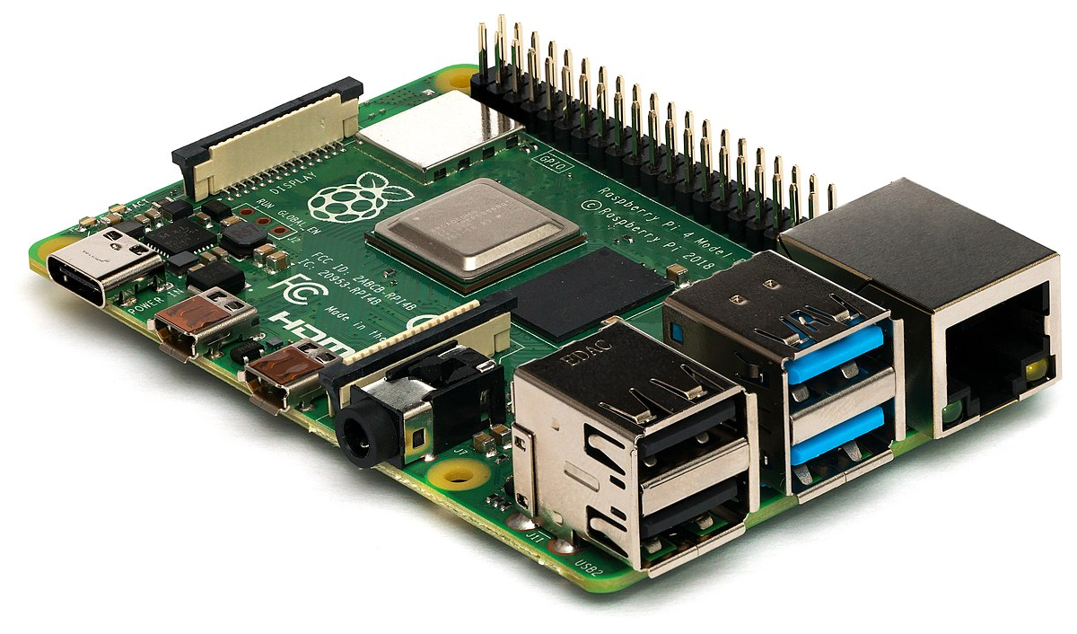
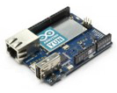
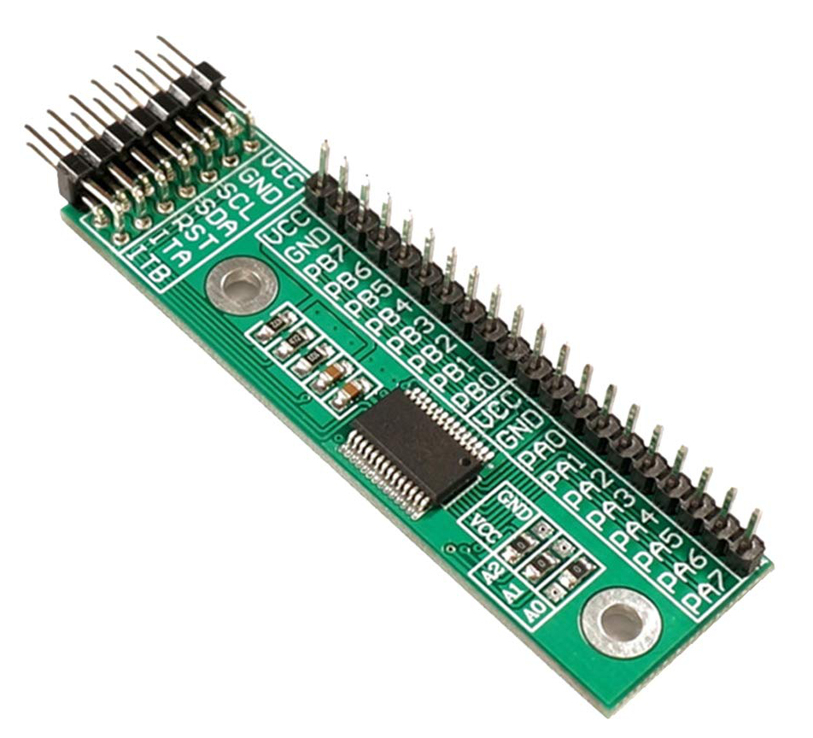
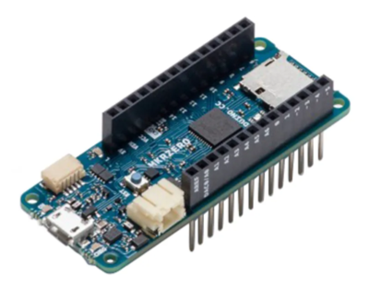

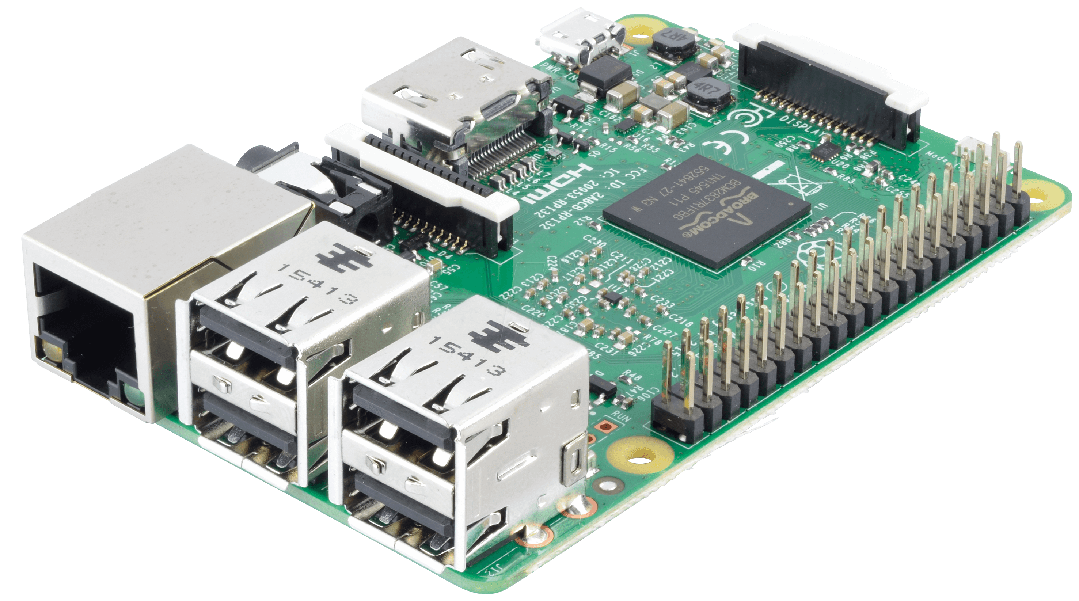

PiPyRelayProp | MegaRelayProp
Raspberry Pi 3B/3B+/4 (+ I/O Expander)
- or -
Arduino Mega 2560 Rev3 + Dragino Yún Shield
Arduino Mega 2560 Rev3 + Ethernet Shield
Arduino Mega 2560 Rev3 + WiFi Shield
16 I/O Pins Expander (MCP23017)
Arduino in-room props
AdruinoProps library
Arduino Yún,
Arduino Mega 2560 Rev3 + Dragino Yún Shield
Arduino Ethernet
Arduino MKR WiFi 1010
Arduino NANO 33 IoT
Arduino + Ethernet Shield
Prop inbox
door:open
door:close
Mosquitto MQTT broker
Prop outbox
DATA maglock=on challenge=0
DATA maglock=off challenge:1
Prop inbox
door:open
door:close
Prop outbox
DATA maglock=on challenge=0
DATA maglock=off challenge:1
Raspberry Pi in-room props
PyProps library
Raspberry Pi 3B/3B+/4
Outbox Protocol
DATA -> send variables to control
MESG -> send text to display in control
DONE -> acknowledge that a command has been performed
OMIT -> acknowledge that a command has been ignored
OVER -> notify that a challenge is over
REQU -> request a command to another prop
PROG -> request a control program (audio/video)
Game master workstation

