Slide 1
Health Literacy
Emilee Moeke
NSG 524 Health Promotion in Individual and Client Populations
11/7/2017

Slide 2
Definition…
As defined by the Affordable Care Act: “Health literacy is the capacity to obtain, communicate, process, and understand basic health information and services to make appropriate health decisions” (U.S. Department of Health and Human Services, 2016).
Health literacy allows people to: “Navigate the healthcare system, including filling out complex forms and locating providers and services, Share personal information, such as health history, with providers, Engage in self-care and chronic-disease management, Understand mathematical concepts such as probability and risk.” (Office of Disease Prevention and Health Promotion, n.d.).
Improved Health Literacy means improved patient outcomes

Slide 3
Importance of health literacy
Low Health Literacy has been defined as the “silent killer” of millions of Americans. (Zarcadoolas, 2010).
The National Action Plan to Improve Health Literacy states that multiple reports have shown that: “limited health literacy is negatively associated with the use of preventive services (e.g., mammograms or flu shots), management of chronic conditions (e.g., diabetes, high blood pressure, asthma, and HIV/AIDS), and self-reported health.”
The CDC states: Limited health literacy costs the healthcare system money and results in higher than necessary morbidity and mortality.
A retrospective study by Haun and associates looking at health care costs for Veterans noted that costs for veterans labeled as having marginal or inadequate health literacy were $143 million dollars more than those veterans having adequate health literacy (Haun et al, 2015).
These facts highlight the importance of Health Literacy for both individuals and the overall healthcare system.

Slide 4
Importance of Health Literacy continued…
There are astounding figures related to those not being deemed as having health literacy.
“Only 12 percent of adults have Proficient health literacy, according to the National Assessment of Adult Literacy. In other words, nearly 9 out of 10 adults may lack the skills needed to manage their health and prevent disease” (Office of Disease Prevention and Health Promotion, n.d.).

Slide 5
Populations at risk
Health Literacy depends on both systemic and individual factors, including: age, education level, socio-economic status, race, ethnicity, primary language, and whether or not you have a chronic disease.
According to the Office of Disease Prevention and Health Promotion the populations most likely to experience low health literacy are older adults, racial and ethnic minorities, people with less than a high school degree or GED certificate, people with low income levels, non-native speakers of English, and people with compromised health status.
Also, a person’s health literacy skills can be impacted by their access to educational resources

Slide 6
How to present information
The Office of Disease Prevention and Health Promotion provides recommendations on how to improve the usability of health information in order to increase health literacy:
Use Plain language – use words that are commonly used and simplify wording if possible.
Focus on actions and behaviors
Keep it simple – limit the message, “short and sweet”
Use an active voice
Use visuals to help covey message, but “Don’t just decorate”, only include images and words that help convey the message
Do not use images of what NOT to do (only positive images)
Make visuals culturally relevant
Use at least 12-point font or larger
Avoid using all CAPITAL letters, italics or fancy script – makes more difficult to read
Keep line lengths short (40-50 characters)
Use headings and bullets to help break up and organize information
Improve the usability of online resources!

Slide 7
At risk population: Older adults
The 2003 National Assessment of Adult Literacy results showed:
“… only 3% of adults age 65 and older were proficient in health literacy skills . Low health literacy among the elderly is associated with higher hospitalization rates, an inability to manage chronic diseases, and increased mortality.”
The elderly population of America is a major issue when it comes to health literacy, because they are the most seen population.
As individuals age, their need for health interventions increase, while health literacy stays the same

Slide 8


strategies to promote health literacy in Older adults
Information should be presented in a structured and easy to read way, as studies have shown that “Older adults struggle with mental multitasking (Speros, 2009).”
Package information in clear and concise ways, with each health topic being its own individual message. Clumping multiple points together makes it harder for older adults to process.
Find ways to bridge the technology gap
Instead of only employing the Internet for an overview of health information, use radio or local TV news to discuss health information.
Give that older adults respond better with face to face interactions (Speros, 2009), create programs that allow health providers to go out into the community and deliver the “simplified health messages” directly to these patients.
Spend more time on the development of materials and tools designed for older adults in regards to their health.
Technology is key in today’s world of health – establish classes and seminars for older adults to learn how to use portals to check lab results and look up information.
Improve quality of websites and add E-Health Tools to make it easier for older adults to quickly get the information they need

Slide 9
strategies to promote health literacy in Older adults
Simplify the message of the health information that is being given (Zarcadoolas, 2010).
Using plain language that is easy to understand for most reading levels and incorporate this in all education documents
Slow the flow of information down
“Older adults learn new information at a slower rate than younger adults due to a decline in fluid intelligence, defined as the reasoning and processing components of learning.” (Speros, 2009)
With the elderly population it is very important to address them with a level of respect and acknowledge that it may be difficult to hear information from a much younger provider.
According to Speros, it is also useful to have family members or friends present to help with educating the older adult. This creates another trustworthy resource for the patient to rely on for information.

Slide 10

Implementation of strategies In healthcare setting
All of this information should be conveyed to all staff members in the health system - not just those with direct patient contact. This could be done in a mandatory online training module or an in-service on how to address the elderly population.
It is important to have “super-users”, or staff that get additional training regarding health information and the elder adult to be a resource for other staff members.
Having a course on these important factors regarding the aging population will be beneficial to staff members as well as the patients, and help with overall patient outcomes.
(Brach et al, 2012)

Slide 11


Implementation in the community
Create community outreach programs that cater to the older adult.
Incorporate monthly classes targeted to the elderly on topics such as self care, chronic disease management, etc.
Within the community outreach programs, health providers can be involved as presenters and confirm that all appropriate strategies are being used to best educate the elderly
Hold technology classes for the elderly at community centers
These do not need to be solely health based, but by learning how to better navigate the internet and computers – the elderly will be better able to access there eMAR or “MyChart” type applications, and be better equipped to manage their health.
(CDC 2009)

Slide 12

Strategies to adapt interventions to culturally diverse groups
The Center for Disease Control and Prevention, in their article on Improving Health Literacy for Older Adults, states that:
“Older adults in minority communities who are not native English speakers present health care workers with unique challenges for service delivery. Health literacy issues are compounded by differences in language and the specialized vocabulary used both in written and spoken form to convey health information.”
These patients pose a new level of complications. The below are obvious, but necessary points to reiterate in regards to culturally diverse patients:
Always use an interpreter in the patient’s native language to convey important messages, even if they are partially bilingual.
Have the educational information in the given language of the patient
Make sure to use simple words that will not have different meanings in different languages, so it is easier to translate.

Slide 13
Culturally diverse interventions
In the article, “Understanding Cultural and Linguistic Barriers to Health Literacy” the authors present ways to help create better health literacy in this patient population.
The first important point made by Singleton and Kruase, is to make sure that health professionals are cognizant that culture affects one’s perception of health and health literacy
“Examples of cultural influences on patient health beliefs and behaviors can be found in patients' perceptions of locus of control, preferences, communication norms, and prioritization of needs, as well as in their understanding of physical and mental illness and of the roles of the individual, family, and community” (Singleton & Krause, 2009).

Slide 14
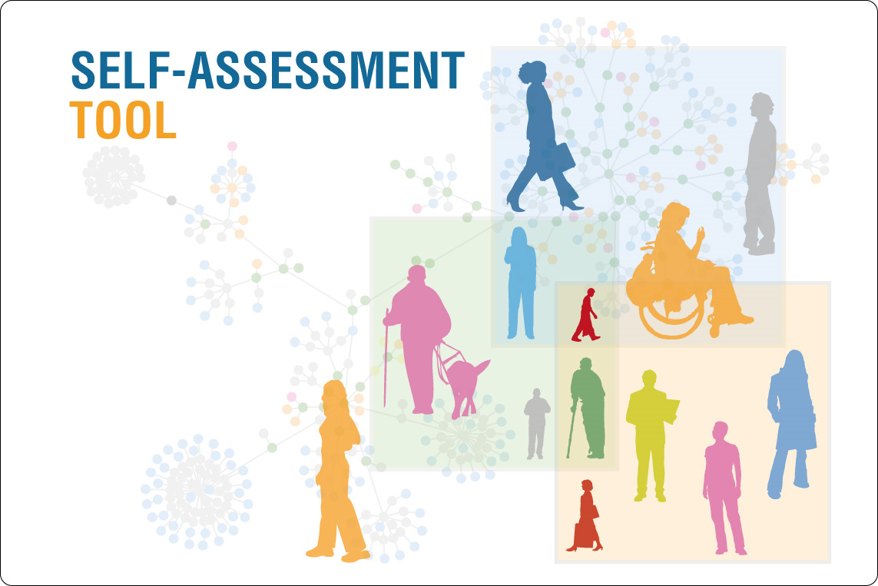
Culturally diverse interventions
When working with this patient population a very useful tool would be to do a patient self-assessment regarding health literacy.
With this tool health providers would be able to have a baseline for where the patient’s health literacy is at and be better able to build off it regarding information pertaining to their health.
According to Singleton and Krause, “63% of providers in community health center settings reported using “gut feelings as a clinician” to estimate patient health literacy.”
By using this tool it would be much easier to create better education materials for the patients, as well as tailor the content to the individual patient.

Slide 15
References
Brach, C., Keller, D., Hernandez, L., Baur, C., Parker, R., Dreyer, B., ... Schillinger, D. (2012). Ten attributes of health literate health care organizations. Retrieved from http://nam.edu/wp-content/uploads/2015/06/BPH_Ten_HLit_Attributes.pdf
Centers for Disease Control and Prevention [CDC]. (2017). Health Literacy. Retrieved from http://www.cdc.gov/healthliteracy/
Centers for Disease Control and Prevention. (2009). Improving Health Literacy for Older Adults: Expert Panel. Retrieved from: https://www.cdc.gov/healthliteracy/pdf/olderadults.pdf
Haun, J. N., Patel, N. R., French, D. D., Campbell, R. R., Bradham, D. D., & Lapcevic, W. A. (2015). Association between health literacy and medical care costs in an integrated healthcare system: a regional population based study. BMC Health Services Research, 15, 249. Retrieved from: http://doi.org/10.1186/s12913-015-0887-z
Kutner, M., Greenberg, E., Jin, Y., and Paulsen, C. (2006). The Health Literacy of America’s Adults: Results From the 2003 National Assessment of Adult Literacy (NCES 2006–483). U.S. Department of Education. Washington, DC: National Center for Education Statistics. Retrieved from: https://nces.ed.gov/pubs2006/2006483_1.pdf
Singleton, K., Krause, E., (Sept. 30, 2009) "Understanding Cultural and Linguistic Barriers to Health Literacy" OJIN: The Online Journal of Issues in Nursing.14(3) DOI: 10.3912/OJIN.Vol14No03Man04.
Speros, C.I., (Sept. 30, 2009) "More than Words: Promoting Health Literacy in Older Adults" OJIN: The Online Journal of Issues in Nursing 14(3) DOI: 10.3912/OJIN.Vol14No03Man05.
U.S. Department of Health and Human Services, Office of Disease Prevention and Health Promotion (2010). National Action Plan to Improve Health Literacy. Retrieved from: https://health.gov/communication/hlactionplan/pdf/Health_Literacy_Action_Plan.pdf
U.S. Department of Health and Human Services(2016). Healthy People 2020 Progress Review. Retrieved from: https://www.cdc.gov/nchs/data/hpdata2020/hp2020_-ecbp_and_hchit_-progress_-review_-presentation.pdf
U.S. Department of Health and Human Services: Office of Disease Prevention and Health Promotion [Office of Disease Prevention and Health Promotion](n.d). Quick Guide to Health Literacy. Retrieved from: https://health.gov/communication/literacy/quickguide/Quickguide.pdf
Zarcadoolas, C. (2010). The simplicity complex: Exploring simplified health messages in a complex world. Health Promotion International, 26(3), 338-350. doi:10.1093/heapro/daq075

