Slide 1
DroidLab – smart experiments
BME TMIT
Dr Rolland Vida, Balázs Lajtha

Slide 2
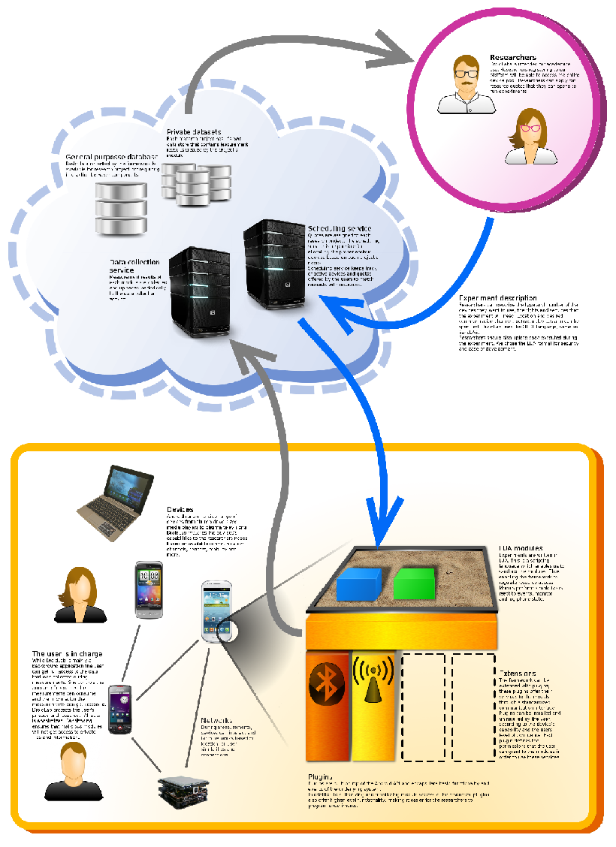
What is DroidLab?
DroidLab is an open framework that enables researchers to run distributed experiments on Android devices. It is composed of a back end server architecture and of an Android application that will be available in the Play Store.
Researchers will be able to upload scripts that will be distributed to available devices. The application on the Android phone will provide a safe sandbox that only grants user-supervised access to the phone's resources.
DroidLab Android application will be extendable with plugins that provide specific functionality (like WiFi, Bluetooth, Telephony...).

Slide 3
Current state
DroidLab is currently under development with no available releases. Android application is already operational but without resource quotas and user configuration options.

Slide 4
Roadmap
After server is ready and module pushing mechanism has been tested, first internal release is planned for 2013 mid august. This will incorporate some reference plugins. It will run modules that measure cellular network coverage and delay tolerant networking.
The private DroidLab network will be opened for researchers in 2013 Q4.
Public release of the application is expected for 2014 Q1.

