Slide 1
Disc 1: Control and Environments
TA: Kevin Wang

Slide 2
My Info
OH: Thurs 6:30 - 7:30 Cory 241
Email: kwang626@berkeley.edu
Lab: Tues 11:00 - 12:30 Soda 277
Disc: Thurs 5:00 - 6:30 Wheeler 224

Slide 3
Administrivia
Homework 1 due today (Thursday 1/31) by midnight
Lab 0 + Lab 1 due Tomorrow (Friday 2/1)
Hog is due 2/7 (Turn it in by 2/6 for a point of extra credit!)
Phase 1 due 2/5 (Work individually)
Phase 2 & 3 due 2/7 (Can work with a partner)

Slide 4
Booleans!!
False-y
False
None
0
[], “”, (), {}
Truth-y
Everything Else

Slide 5
Review: Short Circuiting

Slide 6
Review: Short Circuiting!
Remember: And keeps evaluating until the first false-y value and returns it. Or keeps evaluating until the first truth-y value and returns it.
Both return the value of the last item evaluated, not necessarily True/False
Ex: True and 0 and False → 0

Slide 7
Short Circuiting Cont.
>>> 1 and True and 1/0 and False
Error
>>> 1 and True and False and 1/0
False

Slide 8
Short Circuiting Cont.
>>> 1 and True and 1/0 and False
Error
>>> 1 and True and False and 1/0
False
Why did the second expression not result in an Error?

Slide 9
Short Circuiting Cont.
>>> 1 and True and 1/0 and False
Error
>>> 1 and True and False and 1/0
False
Why did the second expression not result in an Error?
Because And stopped evaluating as soon as it reached the first false-y value, so 1/0 was never evaluated

Slide 10
Control

Slide 11
A little bit about syntax...
if <conditional expression>:
<suite of statements>
elif <conditional expression>:
<suite of statements>
else:
<suite of statements>

Slide 12
A little bit about syntax...
if <conditional expression>:
<suite of statements>
elif <conditional expression>:
<suite of statements>
else:
<suite of statements>
Don’t forget the colon!
Else doesn’t require any conditional expressions.

Slide 13
Examples:
n = 0
if n < 10:
print(1)
elif n >= 0:
print(2)

Slide 14
Examples:
n = 0
if n < 10:
print(1)
elif n >= 0:
print(2)

Slide 15
Examples:
n = 0
if n < 10:
print(1)
if n >= 0:
print(2)

Slide 16
Examples:
n = 0
if n < 10:
print(1)
if n >= 0:
print(2)

Slide 17
Examples:
n = 0
if n < 10:
print(1)
print(2)

Slide 18
While Loops

Slide 19
Syntax
while <conditional expression>:
<body>
Keep looping through the body until the conditional expression is false.

Slide 20
Example 1:
n = 0
while n < 10:
print(n)
n += 1
print(n)

Slide 21
Example 1:
Output:
0
1
2
3
4
5
6
7
8
9
10
n = 0
while n < 10:
print(n)
n += 1
print(n)

Slide 22
Example 2:
n = 100
while n < 10:
print(n)
n += 1
print(n)

Slide 23
Example 1:
Output:
100
n = 100
while n < 10:
print(n)
n += 1
print(n)

Slide 24
Statements vs Expressions
Expressions evaluate to values
1 + 1 → 2
Statements don’t evaluate to values
e.g. def statements, assignment statements
So we wouldn’t do return x = 2
Can still change our environment and control flow

Slide 25
A little bit about feedback...

Slide 26
Attendance:
links.cs61a.org/kevin-disc

Slide 27
Environment Diagrams

Slide 28
What are Frames?
A frame is an object that lists bindings between variables and values.
Frames can also tell us how to look up a binding.
The global frame exists by default.

Slide 29

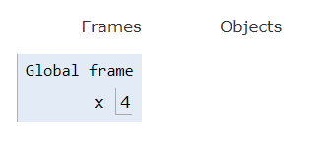
Assignment Statements
Creates a new binding in your current frame!
Remember, evaluate the right side, and then bind it to the left side.

Slide 30
Def Statements
Used to create function objects, and then bind them to a name
Don’t go into the body of the function yet
The name of the binding is the name of the function
The parent of the function is the frame in which it was defined
Things to keep track of: name, parameters, parent frame

Slide 31
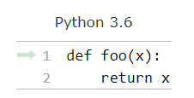
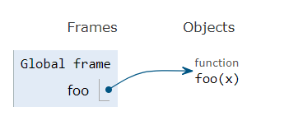
Def Statements Example
[P = G]

Slide 32
Call Expressions
Remember these three steps:
Evaluate the operator (the function)
“Does this function exist?”
Evaluate the operands (the arguments provided to the function)
Reduce the arguments down into their simplest form
Apply the operator to the operands
Call the function with the arguments.
Now we can go into the body of the function.
Call expressions create new frames

Slide 33
When you create new frames….
Label it with a unique index (f1, f2, f3…)
Include the name of the function object
Include the parent frame of the function object.
Remember that every frame has a RV (return value)

Slide 34
Looking up variables
If you can find the variable in the current frame, then great!
Otherwise, you can search for that variable in your parent frame, then that frame’s parent, and so on
If there are no more parent frames, then that variable doesn’t exist!

Slide 35
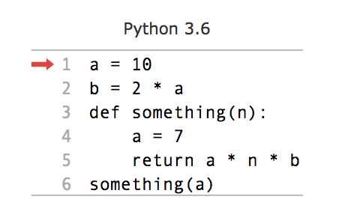
Let’s put it all together
PythonTutor

Slide 36
Exam Question Spring 2016 MT1 Q2

Slide 37
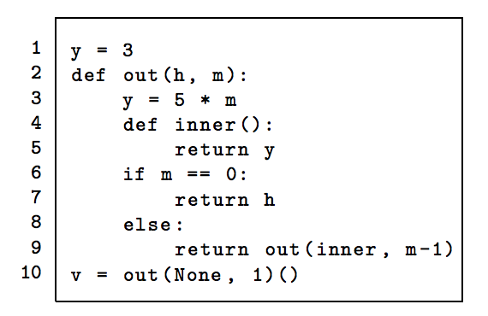
https://goo.gl/zyc44g

