Slide 1
Rust’s Recipes for
Code and Community
@qedunham
talks.edunham.net/djangoconau2019

Slide 2
Rust’s Recipes for
Code and Community
@qedunham
talks.edunham.net/djangoconau2019

Slide 3
Rust’s Recipes for
Code and Community
@qedunham
talks.edunham.net/djangoconau2019

Slide 4

Notes:
DevOps, Sysadmin, call it what you will --

Slide 5

Notes:
I'm an Oregonian

Slide 6

Notes:
who writes Python

Slide 7

Notes:
to make servers go.

Slide 8

Notes:
So why am I in Australia

Slide 9
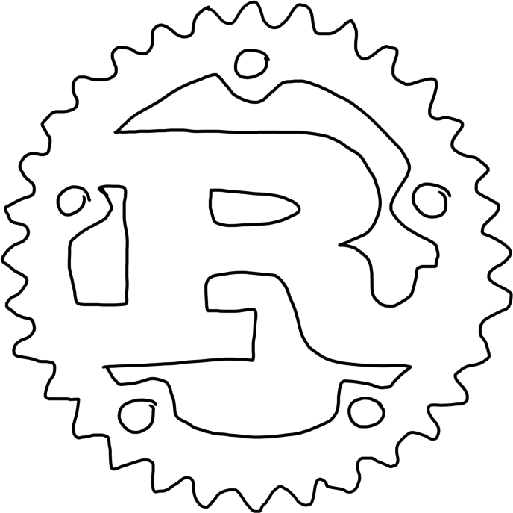
Notes:
talking to Django people

Slide 10
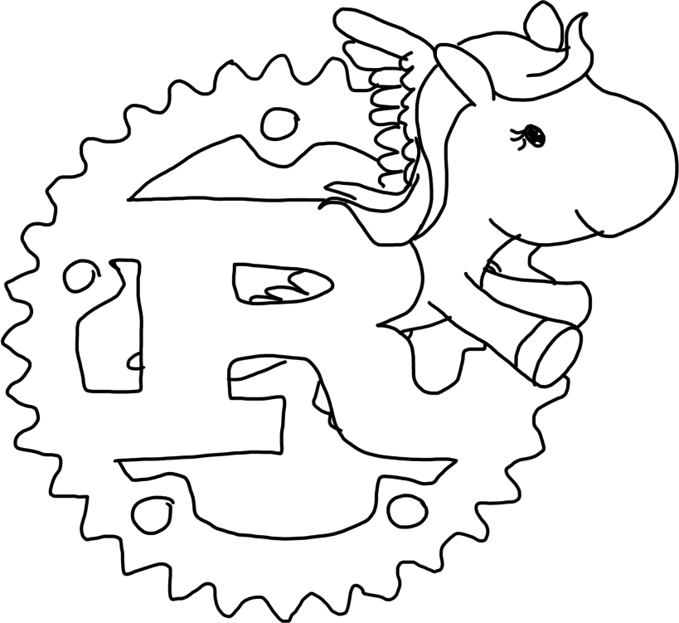
Notes:
about Rust?

Slide 11

Notes:
I last touched Django about a decade ago, at a point in the project's development where the user experience got more frustrating the further away you were from being a newspaper... and I was working on a management console for what would eventually become cloud servers, which was about as far from newspapers as it gets.. The Rust part comes in when, in 2015 I left university to take a job as the sole DevOps engineer for Mozilla Research.

Slide 12
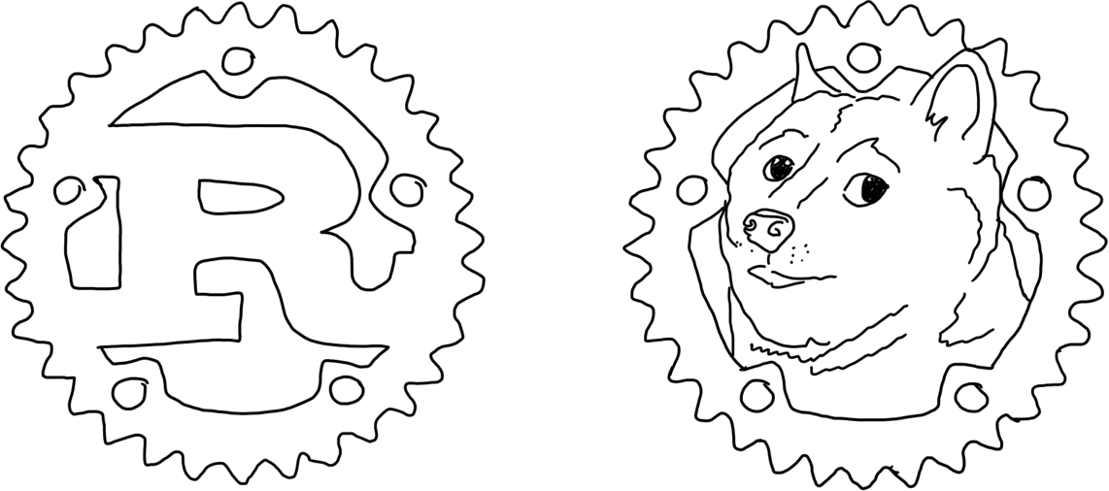
&
Notes:
I spent the followig 3 years embedded within the Rust and Servo teams there,

Slide 13

Notes:
lowering the organization's number of diplomas per capita,

Slide 14
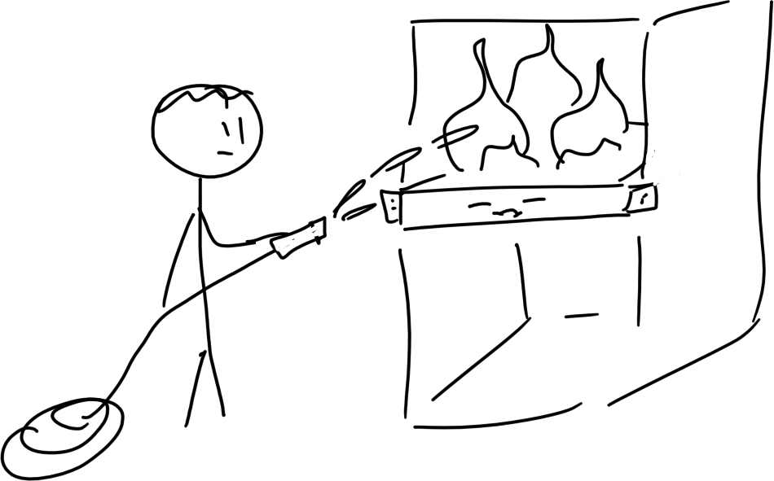
Notes:
keeping the servers running, picking up grad school terms like reify and elide from casual conversation,

Slide 15
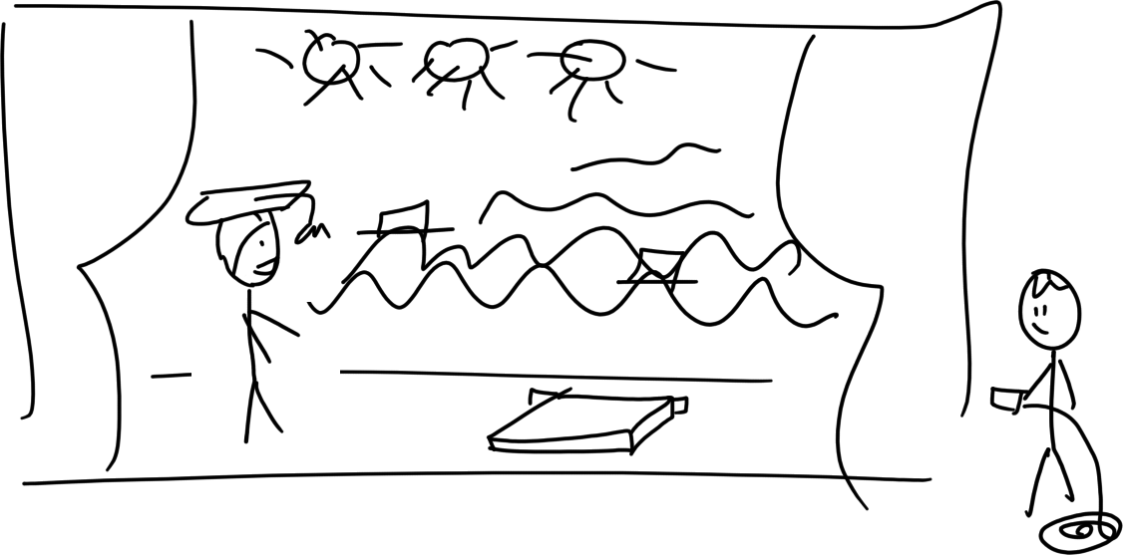
Notes:
and enjoying my backstage pass behind the scenes of of these amazing projects.

Slide 16
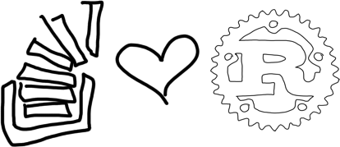
Notes:
Servo is an experimental browser engine, and Rust is the language that Stackoverflow's developer survey rated 3rd most loved in 2015 and 1st most loved every single year since then.

Slide 17
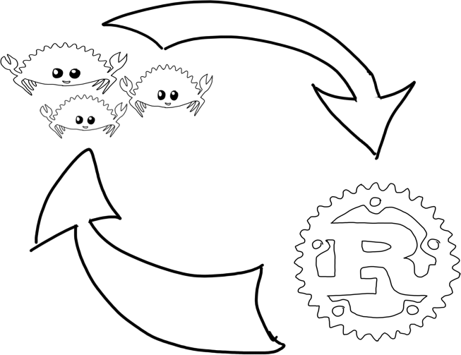
Notes:
Last year I moved out of Research to pursue my career goals elsewhere within Mozilla, but my time with Rust has permanently improved my vocabulary of solutions to common open source software challenges. I'm here to share some of my observations about how Rust's code has shaped its community, how the community has shaped the code, and the questions that Rust has answered which you should probably be asking too. I hope you can forgive me if I also manage to orient you to basic Rust programming concepts and workflows along the way.

Slide 18
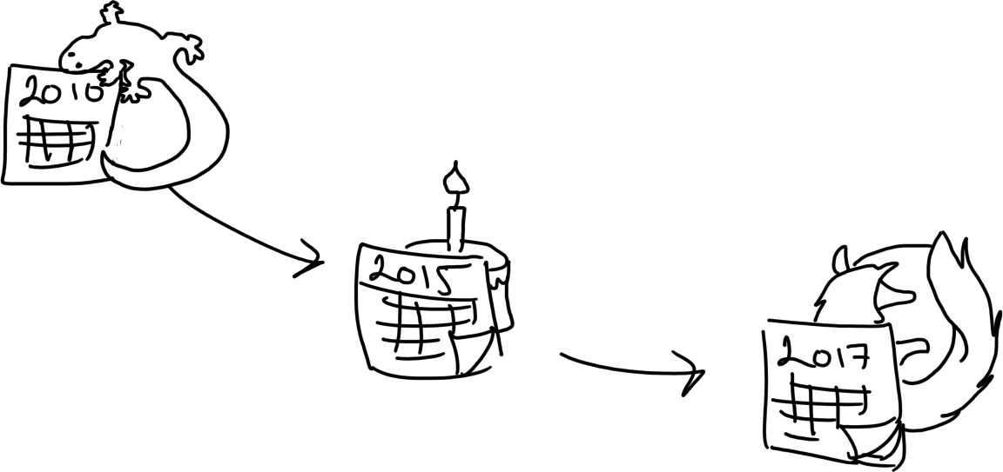
Notes:
Rust's original author Graydon began work on the language's foundations around 2010. His motivation was the difficulties that he and his colleagues faced when developing Mozilla's Gecko browser engine in C++. Countless feature additions and removals later, Rust 1.0 stable came out in May of 2015. Firefox started shipping with Rust components improving Gecko since 2017, so if you're viewing your Django site in Firefox, you're probably running some Rust without even realizing it! It's already passed its initial goals, but the language's mixture of features and community have given it no signs of slowing down since then.

Slide 19
Notes:
If you ask where Rust's name came from, you'll get a different answer every time, especially from the people who could be credited with originating it. The game Rust came later, as you can tell because the language has /r/rust on Reddit, though that's where many of the game's players discover the programming language.

Slide 20

Notes:
Rust's mascot is just Ferris, a Rustacean just like the language's human users call themselves. The habit of pun-ishingly awful names extends into libraries and even functions within the compiler.

Slide 21
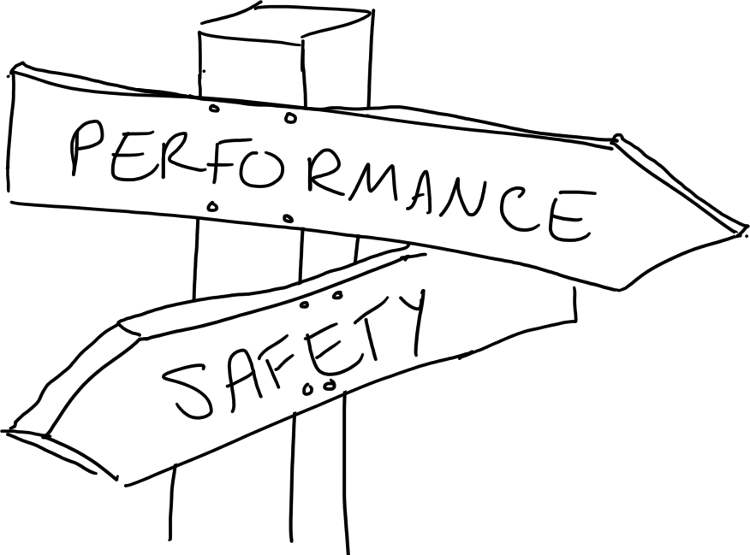
Notes:
Although the cute mascot definitely helps, Rust's technical appeal is its simultaneous emphasis on both performance and safety. Neither speed nor safety is novel on its own. Before Rust, the languages best for writing performant code would tell the user what rules to follow and then happily allow them to break those rules if they wanted to or even just made a mistake. Languages designed to help users write provably safe and correct code were infeasibly slow for production use, and sometimes refused to deal with real-world challenges like networking and file i/o at all. But safe Rust by default enforces rules of ownership, borrowing, and value lifetimes that prohibit users from ever compiling code that would yield undefined behavior. The compiler can't do everything, so unsafe rust, a way to write code that the compiler can't verify as safe, is available for micromanaging the computer's behavior when needed. Instead of asking people to remember all the rules for writing code free from undefined behavior, the computer enforces them for you: Computers are way better than humans at keeping track of hundreds of things at once.

Slide 22
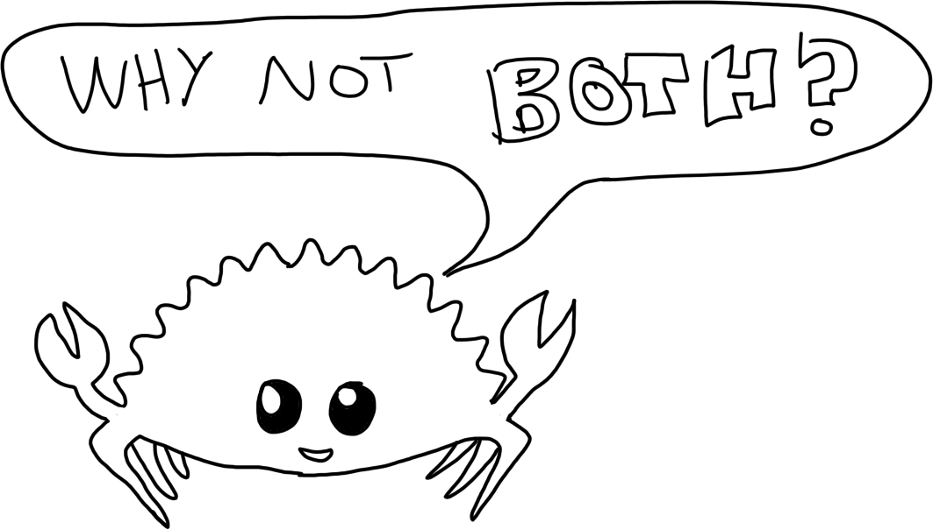
Notes:
The lesson from Rust's niche in the ecosystem that I try to apply to other projects is how useful it can be to find intersections between problems or projects that haven't been fully explored. When people who focused on safe languages and people who focused on fast languages teamed up, they managed to create something that did both.

Slide 23
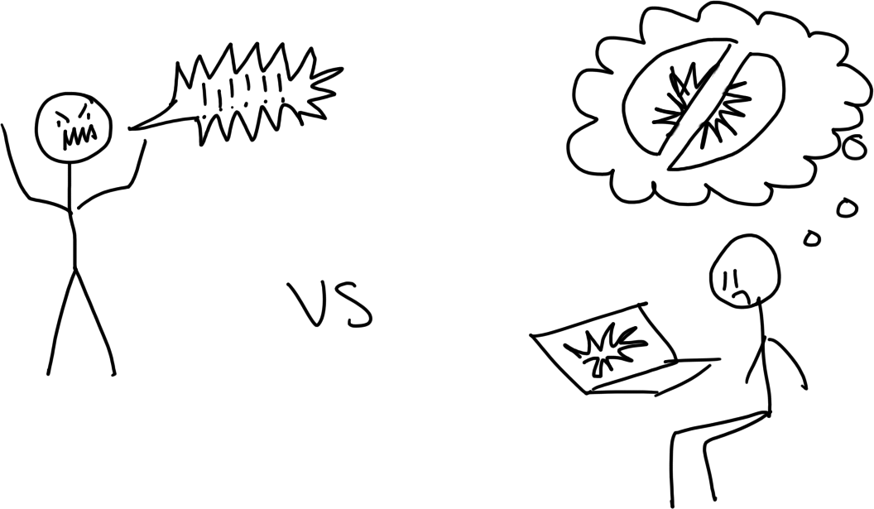
Notes:
And they weren't content to just address the apparent dichotomy between code safety and performance. Rust's originators set up the community in a way that addresses incompatibilities between humans as well.
I’m sure you’ve noticed in your own communities – there are some individuals who won’t be content unless they can communicate a certain way, and others who won’t be content unless they can avoid that kind of communication.

Slide 24
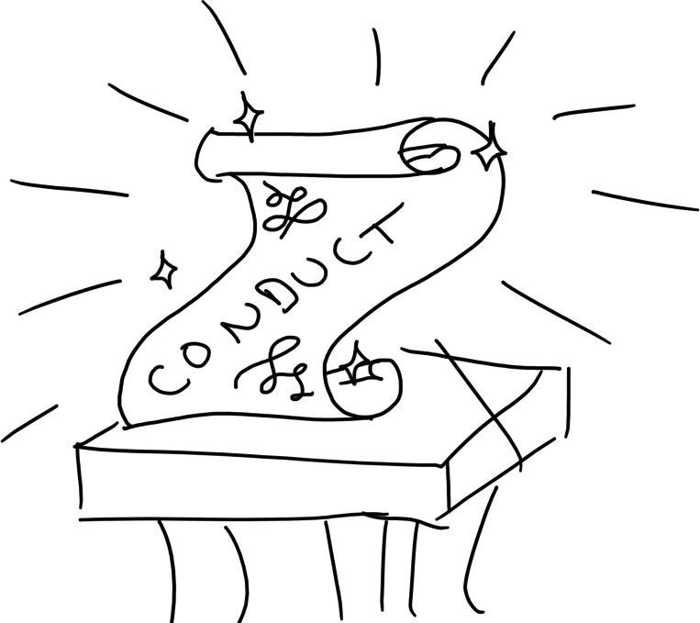
Notes:
They enstated Rust's code of conduct, defining what behaviors are desirable when working with and on the language, and which result in warnings to then removal of an account. This was originally a controversial decision -- people are accustomed to communities where the culture is set by whoever gets there first and scares off those who disagree with them . In this one, the leaders were explicitly choosing what's acceptable and what isn't, rather than just letting it happen!

Slide 25
https://www.rust-lang.org/policies/code-of-conduct
Notes:
People who disapproved of the code of conduct were certain that refusing to accept contributions from people who violated the conduct rules would doom the project. I can't even really blame them -- it's easy to assume that the amount of contribution each individual can bring to a project is somehow fixed, so taking one away will reduce the total amount of contribution that gets done -- kind of like how taking some bricks away will reduce the amount of a structure you can build with what you have . But Rust's big experiment has shown me that excluding the people who make a community hostile actually has the opposite effect -- the contributors who remain are able to collaborate better and get more done in a way that compensates and then some for the absence of those unwilling to follow the guidelines. It's more like a forest than a building -- when a big shady tree falls down, hundreds of little plants and new trees pop up in the sunlight that's now able to reach the forest floor. We've seen again and again, both when contributors left due to disagreements and when they simply stepped back into retirement from the project on good terms, how a healthy community is able to grow into the vacuums that they leave.

Slide 26
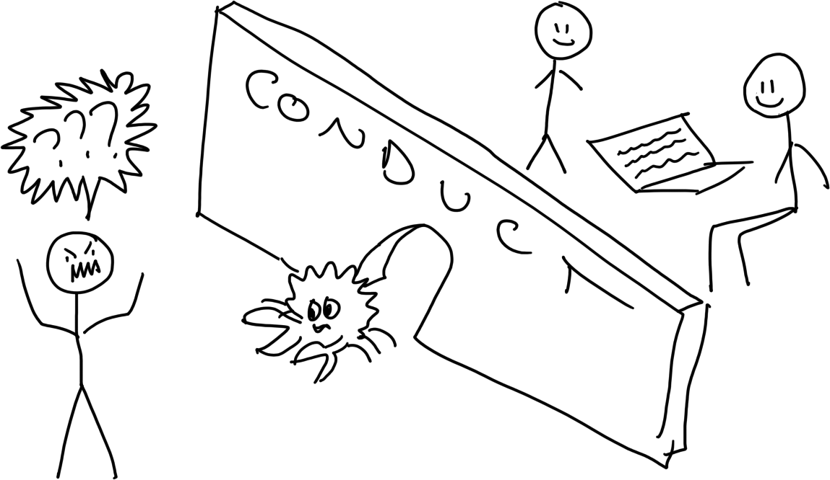
Notes:
And you know what? As Rust has gotten bigger, the yelling about the code of conduct has died down a bit. I think people might be accepting that they really do have to choose: Act how we ask and be welcomed, or be a jerk to others and we'll try to help you stop and then remove you if you don't. There are plenty of other language projects that people for whom the code of conduct is a deal-breaker can go play with, and they seem to be gradually figuring out that no amount of being offended will let them be jerks inside of Rust spaces.

Slide 27
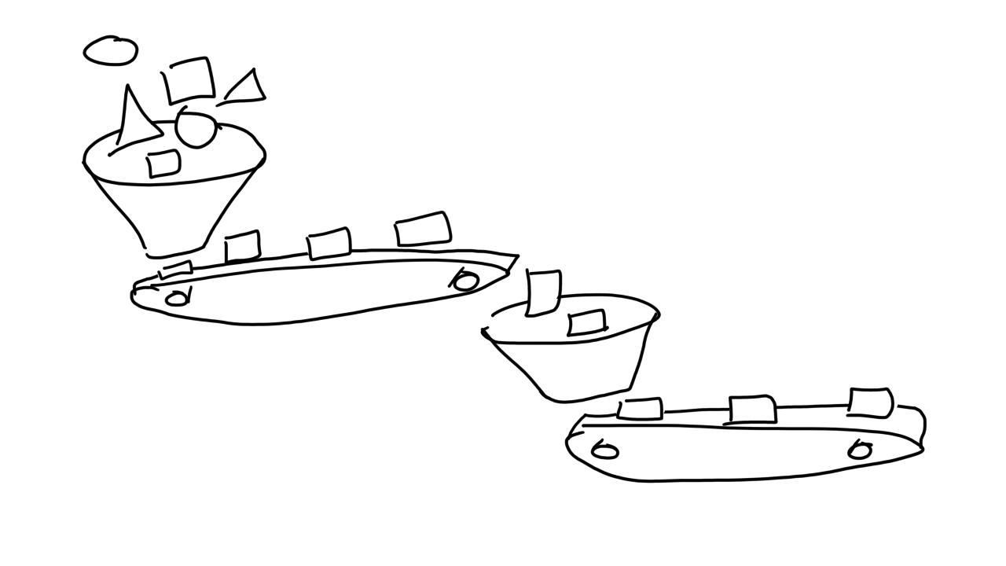
Notes:
Watching those first 3 years of stable Rust play out, from my immersion in both the compiler team and the Servo browser engine, gave me a new appreciation for the way in which the habits of a project's first developers permeate its whole future and those of every project downstream The first tutorials and example programs in a language are written by its author; the first users' ideas of the language are shaped by the idioms and preferences expressed in that early code. Users who find a tool's idioms utterly intolerable don't stick around to become experts in it, which reinforces any pattern that starts to get established. Fortunately in Rust, the first developers thought quite carefully about their values, and intentionally selected processes that furthered their technical and cultural goals. So a quick tour of how the compiler gets built will reveal the preferences and habits that have indirectly shaped the community of Rust users.

Slide 28
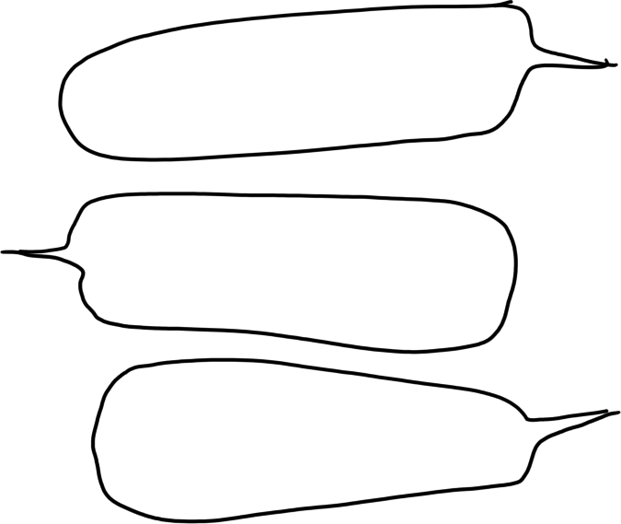
Notes:
How do they add a new feature to the compiler? First, they talk about it. For the kind of long-form, asynchronous discussions that most projects hold on mailing lists, Rust opted for Discourse forums and GitHub issues.

Slide 29
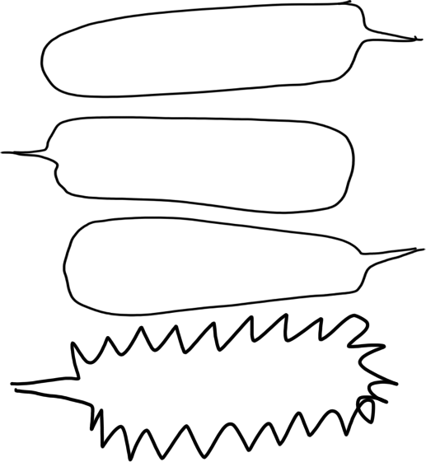
Notes:
These technologies beat email because of their mutable history: Rust's moderation team members are able to silently remove any unacceptable posts, while neither engaging with a troll nor making it look like the postings were silently tolerated.

Slide 30
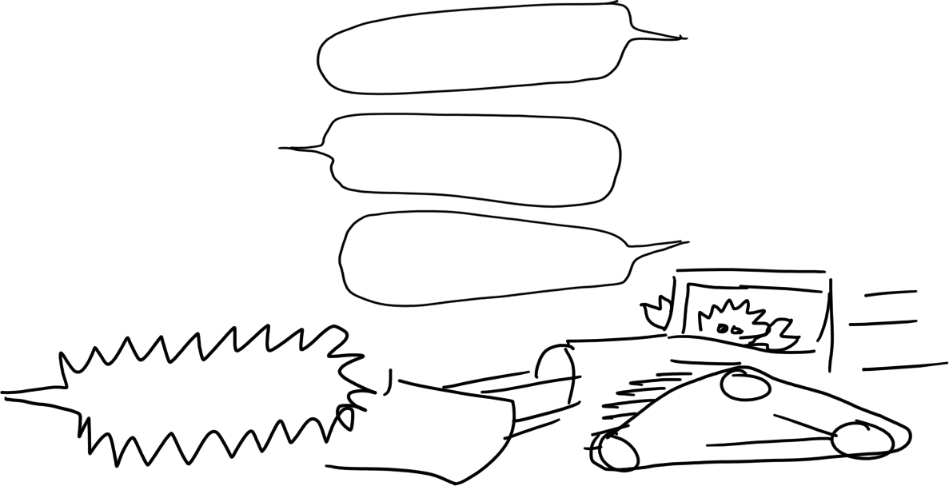
Notes:
Moderators with the power to alter history in this way have earned users' trust that they won't abuse that power, and users who really can't stand the idea of anyone having those powers have not stuck around for long.

Slide 31
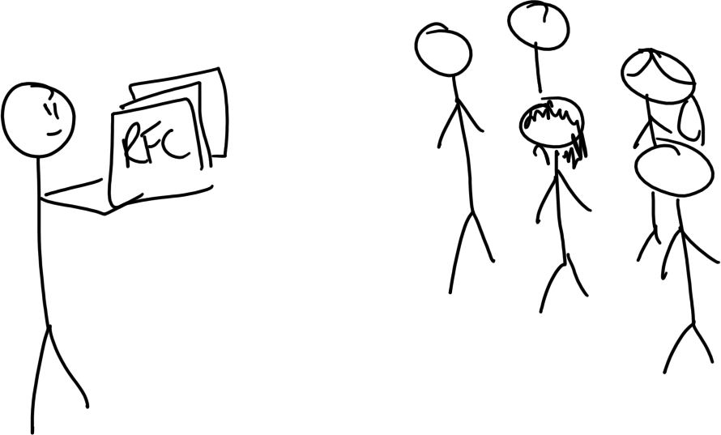
Notes:
Simple changes are made directly by pull request to the Rust repository, but more substantial changes require consensus from the Rust teams, and input from the users. Substantial changes go through the RFC, or request for comment, process. You fork the RFCs repo, then copy the template and fill it out with your language change idea. The appropriate Rust subteam is assigned to triage it, and your pull request is the site of public conversation and debate about the change. When the subteam thinks the discussion is wrapping up, they decide on a disposition and place the RFC into a 10-day Final Comment Period, during which anyone can log a final comment or objection that they think needs to be considered. The combination of public discussion, but expert teams ultimately condensing that discussion into their idea of what's best for the language, balances the need for openness and inclusion with the need to arrive at decisions rather than simply arguing forever.

Slide 32
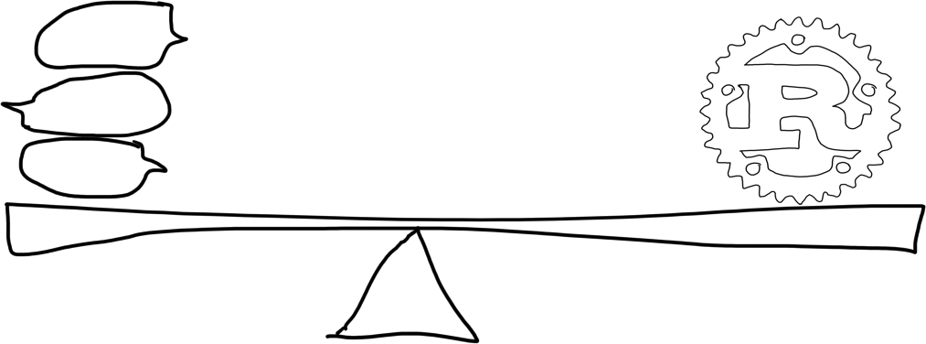

Slide 33
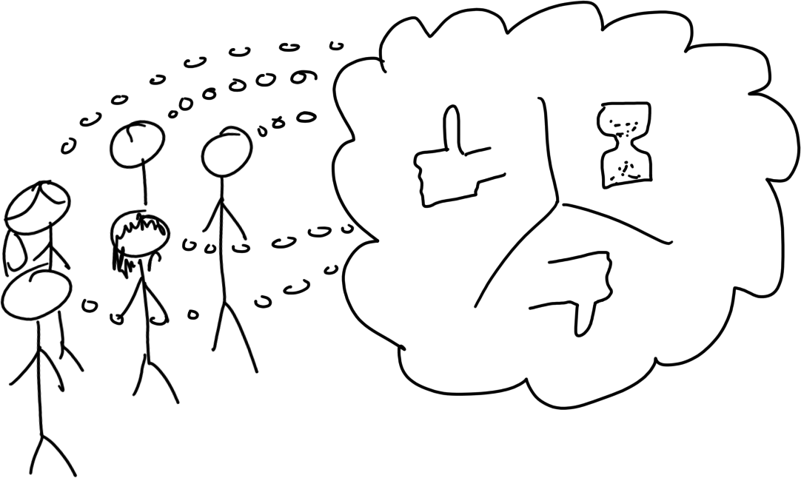
Notes:
It's teams, not individuals, that have the final say in whether or not to accept an RFC. Each Rust team has a leader, but the team structure allows members to take breaks or even retire without causing any major interruptions to the language's development. This structure helps team members mentor those who've newly joined, and allows others to fill in the gaps when someone leaves. Rustaceans struggle with burnout as much as any other contributors, but from my own experience serving on and ultimately retiring from the Community team, I can tell you that it's a whole lot better when you don't feel like taking a break or stepping back would damage the project.

Slide 34
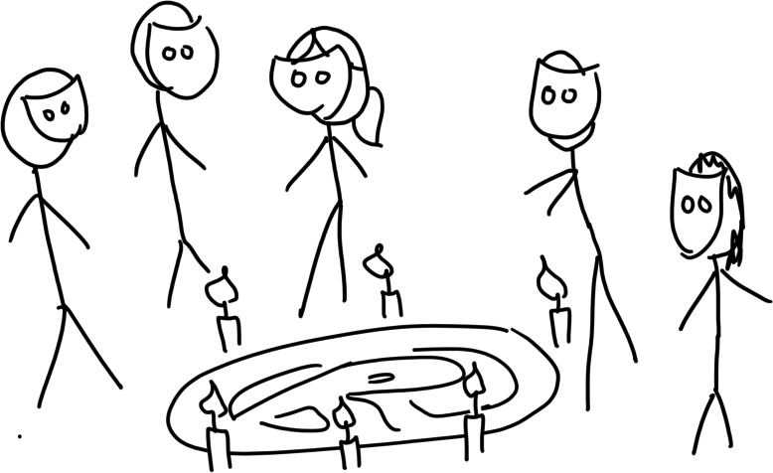
Notes:
However, teams can look like scary or biased little cabals from the outside. In order to balance the need for discussion with the need for an eventual end to even the most controversial RFC's conversation, teams judge the fate of each RFC following the No New Rationale Rule. This rule states that whether the team decides to merge, close, or postpone the RFC, "the argument supporting the disposition on the RFC needs to have already been clearly articulated, and there should not be a strong consensus against that position outside of the subteam." This rule sets a standard for when a proposal has been discussed enough, and clearly communicates to users how the teams balance debate with decisiveness. Having clear, public, and consistent rules for selecting RFCs is a lot like having clear, concrete, and consistent standards for judging candidates when hiring -- it helps ensure that selections are based on technical merit rather than on the biases of the assessors.
https://github.com/rust-lang/rfcs README

Slide 35

Notes:
Once an RFC has been merged, code implementing its suggestions is allowed to be landed in Rust. All code comes into the compiler via pull requests on GitHub. Once someone gives an approving review on a PR, a bot called Bors will run the repo's tests aginst the state of the tree with the patch applied. Bors then lands the patch if the tests all pass, or else tells the user what went wrong so they can fix it. Years before GitHub rolled out similar features, Bors was helping lessen the burden of code review for Rust's developers. When a computer would be better at part of a task than a human, whether that task is checking for use-after-free or running a test, Rust makes the computer and not the human do that work.

Slide 36

Notes:
Every 6 weeks, new Beta and Stable Rust versions ship. Although the features in them have been individually tested by Bors, we're still not totally certain what that whole combination of changes will do -- what if some difference in behavior wasn't looked for by the tests yet? How can we tell what really changed between the last compiler version and this one? Rust answers that question through computational brute force: A tool called Crater discovers all the Rust code it can find on crates.io, the Rust package registry, then uses both the old and the new version to compile all of it. It then reports any differences in the output between the old and new compiler version, which tells developers whether any language feature that's used by a published library was unexpectedly altered by the compiler changes. Why ask humans to predict code behavior when you could make a computer do it? Are humans solving any problems in your current projects that would be better addressed by computational brute force?

Slide 37

Notes:
The final piece of culture from the Rust compiler's development that I've seen propagated through its projects is a certain delight in documentation. The quality of Rust's books is a point of pride for those who work on the language, and a new feature often isn't regarded as truly finished until it's been documented well enough for users to take advantage of it. This cultural value of clear documentation shows up in the code: there are circumstances in which it would be possible to make the compiler infer a function's type signature, but the compiler authors forbid that elision due to the confusion it would cause to humans trying to read the code. You have to spell out what you mean, not for rustc's benefit, but for your own.

Slide 38
Notes:
So, those are some things to expect from prject cultures descended from the Rust compiler. Look for familiarity with working in small teams or committees, a balance between public debate and definitive decision-making, willingness to invest in good docs, and enthusiasm for transferring work from humans to machines whenever possible. These values get diluted by other constraints as they're passed along into libraries then into projects, but they're always there if you look for them. I think it's worth looking around your own projects as well, to spot the ways in which upstream developers influenced your culture -- whether that's in a positive way, by demonstrating the benefits of some technique, or in a negative way, by deterring contributors who strongly hold some conflicting ideal to the language's specifications.

Slide 39
Notes:
So, they're using an exemplary process to build this language, but what's the language itself good for? Rust might be a good choice for your project if you need a fast and memory safe language, and you're using an LLVM supported architecture.

Slide 40
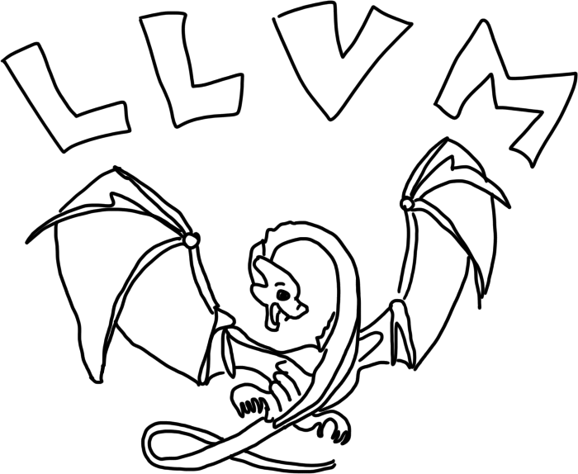
Notes:
Rust's ability to compile efficient code is built upon the work that the LLVM authors have put in -- the Rust compiler emits an intermediate representation, which LLVM transforms into an executable for the target platform. By cooperating rather than competing with the LLVM ecosystem, both projects win -- Rust gets the benefit of LLVM's work and extensive testing, and LLVM gets bug reports and fixes from a project that exercises parts of their tooling that hardly anyone has used before. And that's not even touching on the time and energy saved by not trying to write a project like LLVM from scratch.

Slide 41
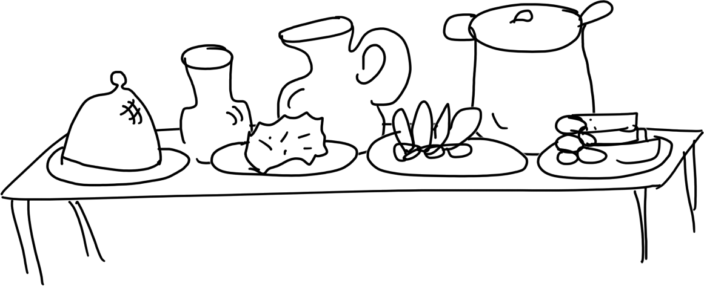
Notes:
If you start looking for a Rust version to install, you'll find that you have a smorgasboard of choices. Would you like stable, beta, or nightly? Should you use Regular Rust, or opt in to the 2018 Edition? For a language that tries to be easy to use, why are they confusing you with all these choices right at the start?
Well, every project sees different kinds of users throughout its lifecycle, because a brand new project has totally different benefits to offer its users than something at enterprise scale.

Slide 42

Notes:
At first, the users are early adopters -- people with the time and initiative to play with any brand-new technology that strikes their fancy, mostly for the fun of making the computer do what they say.

Slide 43

Notes:
As it grows, as those first adventurers produce useful and impressive things with it, ordinary users who are looking for a reliable tool with a particular feature that they need begin arriving.

Slide 44
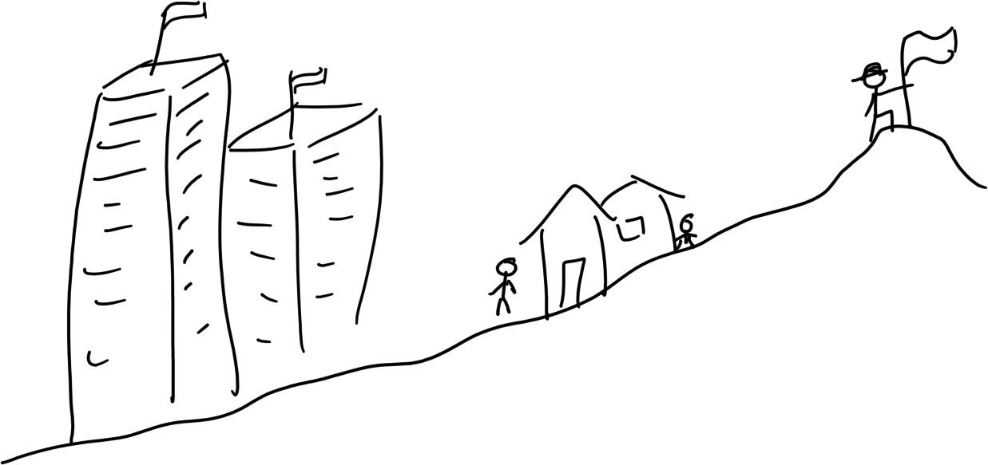
Notes:
Eventually, if a project or language gets really big, it also needs legacy support for decades after governments and corporations adopt the products that the users within them selected. With all those different sets of needs in play, which group should be the one to get what they want?

Slide 45
Notes:
As with the speed/safety "tradeoff", Rust's answer to this apparently contradiction is "why not all of them?". The stable channel of Rust represents the set of features that the project is committed to supporting long-term; the beta channel contains candidates for inclusion into stable, and nightly holds the experimental features that the compiler authors haven't yet figured out what they'll do with long term. This structure of channel definitions helps streamline communication about features, implicitly answering questions like "will this feature still be here in the next release?" and "should I expect this feature to just work, or might it still be a bit buggy?". Culturally, Rustaceans are trained to use Stable if possible, and only switch to Beta or Nightly if they need a feature which isn't available in Stable.

Slide 46
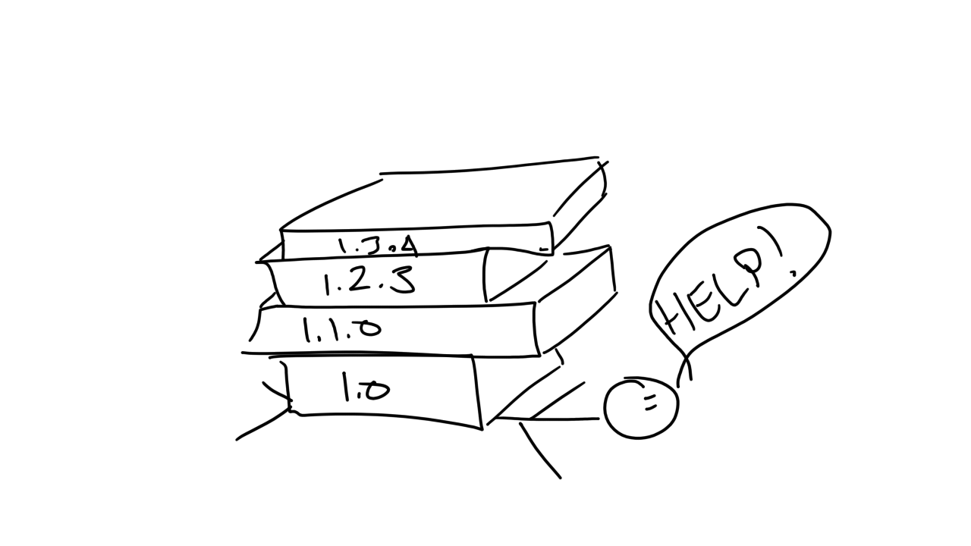
Notes:
At first, the plan for Rust was that every stable version should be backwards compatible to every previous stable, all the way back to 1.0, forever. However, as the language matured, we discovered places where a substantial usability improvement would be possible -- if only we were able to break that backwards compatibility in a limited way. So we built ourselves an escape hatch.

Slide 47
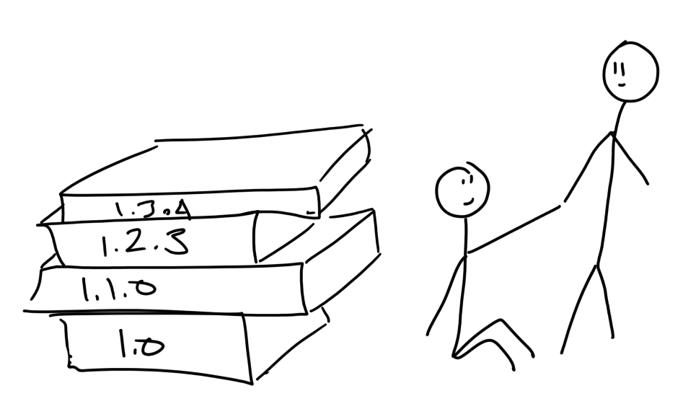
Notes:
That escape from being stuck with the usability drawbacks of backwards compatibility came in the form of editions: Each new edition is allowed to remove backwards compatibility from the previous one, where the authors need to do so to improve other aspects of the language. So, like channels, editions are a social device for communicating to users and other developers about what to expect from a given Rust. And culturally, they demonstrate a positive outcome for times when you just didn't think of everything at the start of a project. The established processes for discussing and designing changes to the language let us retrofit editions in a backwards-compatible way that meets the conflicting needs of various users.

Slide 48

Notes:
Cool, I like new things, I'm on a supported platform, I'm ready to jump on the bandwagon and rewrite everything in Rust! Wait up. The "rewrite everything in Rust" meme is one of the more inconvenient ideas to plague the world of Rust fans. For many projects, rewriting it in any language at all would be disastrous for your reliability and for your release schedule. As we've touched on before, one of the most valuable skills of Rust's leadership teams is the ability to say "no": No, our community is not the place you're looking for if you want to behave like this. No, the tradeoffs that would be required to add a particular feature are not appropriate for our language at this time. In order to attain its vision, any project has to get good at saying "no" to trends that take it further from its goals.

Slide 49

Notes:
If you find the point where your current language is unable to perform adequately under the constraints you've set for your project, don't immediately throw the whole thing out. See if you can refactor the hard part into a few separate functions, with clear expectations about their inputs and outputs. Then try rewriting those functions in a language that's better suited to their needs -- yes, that language might be rust -- and use FFI, or Foreign Function Interface, to embed the improved versions in your original codebase. You might be able to keep all the work you've invested in the rest of your project, while refactoring a former bottleneck into a language that solves its problems.

Slide 50

Notes:
What will using Rust look like from the perspective of someone who just wants to FFI to it and speed up some hot code? First, you'll need access to a Rust compiler. You can get this through an online playpen, or by installing the compiler on your system. The easy way to install and run multiple versions of the compiler locally is through a tool called Rustup -- rustup.rs. Or if you'd prefer, you can download a release directly with a standalone installer (listed on https://forge.rust-lang.org/other-installation-methods.html) or get an older release through your system's package manager. If you're allergic to curl pipe sh, please read the script between curling and executing it -- you'll find that it's probably more careful about checking the signatures and checksums of what it downloads than most of the users who yell about the problems with trusting shell scripts.

Slide 51
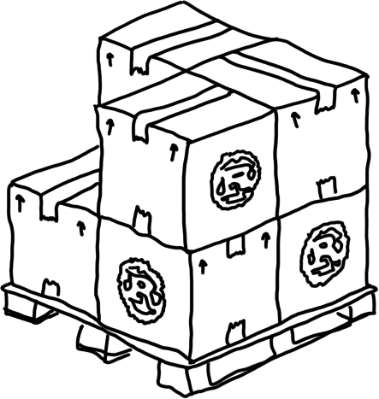
Notes:
To find published binaries and libraries to run, you can look on Rust's package repository crates.io, and on Github. When you start writing Rust, you'll probably want features like syntax highlighting and autocompletion in your favorite editor. You can check areweideyet.com for the status of Rust support for various editors. The Rust Language Server (RLS), released in 2017, exposes an intermediate representation of the Rust code to editors and offers a single interface for the compiler team to test and maintain. Adding interfaces like the RLS helps ensure that adding more users doesn't add proportionately more work for the compiler team, and helps keep the difficulty of developing the language from spiralling out of control. If the interface of the RLS hadn't been scoped well, the work of maintiaining bindings for every editor and IDE would have grown with every addition of support to Rust, which would have been a clear signal to ask whether the interface should be moved.

Slide 52
github.com/edunham/python-rust-ffi-timing
Notes:
Let's say you've found part of a Python app, maybe your Django site, that's just doing something really slowly. Maybe you have a site for people who are into numerology, and you want to sum all the digits of all the integers up to some big number to find a user's lucky digit for the day. You might have your Python looking something like this.
You can get all this code from github.com/edunham/python-rust-ffi-timing, if you'd rather read it on your screen instead of mine.

Slide 53
#!/usr/bin/env python3
from sys import argv
def sum_digits(sumthing):
total = 0
while sumthing > 0:
total += sumthing % 10
sumthing /= 10
if total >= 10:
total = sum_digits(total)
return total
def sum_up(upto):
total = 0
for n in range(0, upto + 1):
total = sum_digits(total + n)
return total
lucky = sum_up(int(argv[1]))
print("your lucky digit calculated by python is {}".format(lucky))
Notes:
So, sum.py contains some Python that solves a problem that I invented due to its ability to force a cpu to meditate for a rather long time on large numbers, while yielding an output which we can check for correctness by hand on small numbers. I wrote a little script, it's timer.py in the repo, to compare the time before and after the code runs. Here's a graph that confirms your intuition: When the inputs get big, the times get bad, and as the inputs get bigger the times get badder with no end in sight. If you're great at maths, you might be able to find a more efficient way to write code that solves the same problem, but let's pretend it's a problem that we're not able to just math our way out of.

Slide 54
Notes:
When we time that code on some big inputs, we get a graph a bit like this. That’s… not great. What can we do about it?

Slide 55
Notes:
Well, we’ve already done the first step, where we factor out the hot code – the difficult or slow bits – the heavy lifting that your primary language isn’t handling so well – out into its own function or two.

Slide 56
Notes:
Next, let's try writing that exact same pair of functions in Rust. Let’s see if the compiler’s optimizations are better at math than I am (they totally are).

Slide 57
def sum_digits(sumthing):
total = 0
while sumthing > 0:
total += sumthing % 10
sumthing /= 10
if total >= 10:
total = sum_digits(total)
return total
def sum_up(upto):
total = 0
for n in range(0, upto + 1):
total = sum_digits(total + n)
return total
fn sum_digits(mut sumthing: u64) -> u64 {
let mut total = 0;
while sumthing > 0 {
total += sumthing % 10;
sumthing /= 10;
}
if total >= 10 {
total = sum_digits(total)
}
return total;
}
fn sum_up(upto: u64) -> u64 {
let mut total = 0;
for n in 0..=upto {
total = sum_digits(n + total);
}
return total;
}
Notes:
That’s our Python from before on the left, and some equivalent Rust code on the right.
They look almost identical. There are a few places where Rust demands that you state explicitly what you mean, whereas Python is happy to take a guess and figure it'll be close enough, but on the whole it's a familiar structure with familar control flow. You can look at this Rust code and tell me what it does, just about as well as you could explain to me the Python.

Slide 58
fn sum_digits(mut sumthing: u64) -> u64 {
let mut total = 0;
while n > 0 {
total += sumthing % 10;
sumthing /= 10;
}
if total >= 10 {
total = sum_digits(total)
}
return total;
}
fn sum_up(upto: u64) -> u64 {
let mut total = 0;
for n in 0..=upto {
total = sum_digits(n + total);
}
return total;
}
fn sum_digits(mut
sumthing:u64)->
u64{let mut
total=0;let
;while sumthing
>0{total
+=sumthing%10
;sumthing/=10;}if
total>=10 {total=
sum_digits(total
)}return total
;} fn sum_up (
upto:
u64)->u64{let
mut total=0
;for n in 0..=
upto{total
=sum_digits
(n+total);
}return total
;}
Notes:
Rust's second biggest difference from Python is that whitespace only matters to separate tokens. Scopes enclosed by curly braces, and semicolons terminating expressions, serve the purpose for which Python uses spaces or tabs and newlines. This irrelevance of whitespace makes it possible to format Rust code in a number of ways bounded only by the space on your filesystem. If you did that, of course, it would be almost impossible to read..

Slide 59
rustfmt
Notes:
. When you want to write idiomatic rust, use the tools rustfmt and clippy. Rustfmt will format your code into standard indentation, and Clippy will suggest improvements. By being opinionated, these tools can standardize the boring parts of formatting code so that a reader can jump straight to the interesting part of learning about the problems that it solves.

Slide 60
fn sum_digits(sumthing: u64) -> u64 {
let mut total = 0;
while sumthing > 0 {
total += sumthing % 10;
sumthing /= 10;
}
...
Notes:
To help the compiler enforce its safety rules our Rust functions have type signatures at their starts. These say "I'll take input of this name and that type, and I promise I'll give you an output of the type after the arrow (or no output, if that part of the signature isn't there). Since the compiler checks that every possible path through the function is guaranteed to yield an output of the right type, you know some guarantees about code that you're reading just by skimming the first line. It wouldn't be technically impossible to get the compiler to figure out some of these types from context, but it turns out that humans find it helpful to be reminded of whta they'd planned to do. Just because it's possible to automate some task, doesn't mean it'd necessarily make life easier. Making people write down what they meant, rather than just guessing at it from what they said, is the best way to catch accidental mismatches between what they wanted and what they actually wrote.

Slide 61

Notes:
On the one hand, this rearranges the development process from "write, run, debug" to "write, debug, debug, debug, research, swear, debug, it compiled?!, run". On the other, you can have a level of confidence in a program that's able to compile that you would need extensive additional testing to feel about something written in a language without such strict verification.

Slide 62
fn sum_digits(sumthing: u64) -> u64 {
let mut total = 0;
while sumthing > 0 {
total += sumthing % 10;
sumthing /= 10;
}
...
$ cargo build
Compiling python-to-rust v0.2.0 (/home/edunham/repos/python-rust-ffi-timing)
error[E0384]: cannot assign to immutable argument `sumthing`
--> src/lib.rs:5:9
|
1 | fn sum_digits(sumthing: u64) -> u64 {
| -------- help: make this binding mutable: `mut sumthing`
...
5 | sumthing /= 10;
| ^^^^^^^^^^^^^^ cannot assign to immutable argument
error: aborting due to previous error
For more information about this error, try `rustc --explain E0384`.
error: Could not compile `python-to-rust`.
To learn more, run the command again with --verbose.
Notes:
Rust's first biggest difference from Python, of course, is that Rust code containing undefined behavior cannot be compiled. No matter how sure the author was that their code was right, the compiler steadfastly refuses to emit any part of a finished program until the whole thing passes all its checks.
I've personally noticed a level of humility in expert Rust programmers that's rarely matched in other language communities -- perhaps being told "no" by the compiler dozens or hundreds of times a day makes them less militant in their certainty about their beliefs. And we try to get the error messages as helpful as possible -- after all, computers are better at looking up docs than humans are in this case, so they should be the ones doing it.

Slide 63
def sum_digits(sumthing):
total = 0
while sumthing > 0:
total += sumthing % 10
sumthing /= 10
if total >= 10:
total = sum_digits(total)
return total
def sum_up(upto):
total = 0
for n in range(0, upto + 1):
total = sum_digits(total + n)
return total
fn sum_digits(mut sumthing: u64) -> u64 {
let mut total = 0;
while sumthing > 0 {
total += sumthing % 10;
sumthing /= 10;
}
if total >= 10 {
total = sum_digits(total)
}
return total;
}
fn sum_up(upto: u64) -> u64 {
let mut total = 0;
for n in 0..=upto {
total = sum_digits(n + total);
}
return total;
}
Notes:
Any Rustaceans in the audience will notice that I carefully scoped the problem to give answers that are pretty small -- Rust will let you overflow an integer, as that's not an undefined behavior. You can work around it by using a crate that adds data types for bigger numbers, but it's nicer for demonstration purposes to keep things looking as much like the Python as we can.

Slide 64
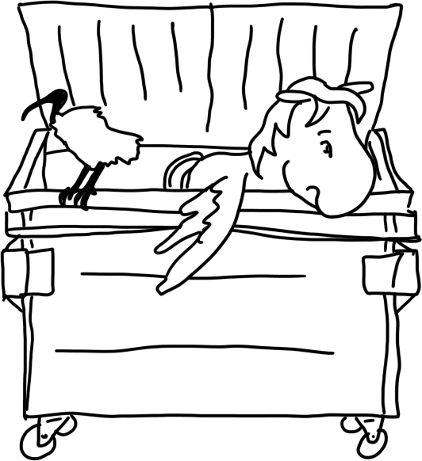
Rewrite it all?
Notes:
So, that's cool, we've got the same code in Rust that we had in Python. What have we gained? Do we have to rewrite the whole rest of the app in Rust to take advantage of these speedups? In a word, heck-no. Most established languages, Python included, have a mechanism that's meant for calling C code more or less like you'd call any other function. This tactic is called FFI, for Foreign Function Interface. So, we're going to fib to the interpreter a bit, but it'll be OK:

Slide 65
#!/usr/bin/python3
from ctypes import cdll
from sys import platform, argv
if platform == 'darwin':
prefix = 'lib'
ext = 'dylib'
elif platform == 'win32':
prefix = ''
ext = 'dll'
else:
prefix = 'lib'
ext = 'so'
lib = cdll.LoadLibrary('target/debug/{}sum_up.{}'.format(prefix, ext))
sum_up = lib.sum_up
sum_to = int(argv[1])
output = sum_up(sum_to)
print('your lucky digit calculated by rust is {}'.format(output))
Notes:
in our Python code, we're going to import cdll from ctypes, and then we're going to load the library we wrote, and then we're gonna call the desired function from within that library. The boilerplate up at the start here, I inherited from Alex Crichton's FFI examples repo, and it probably gets the names right so they also work on Mac or Windows... I don't own either of those systems, so I've only tested it on Linux so far. So this is all we'll need in Python to load that Rust, once it's ready...

Slide 66
$ cat src/lib.rs
fn sum_digits(mut sumthing: u64) -> u64 {
let mut total = 0;
while sumthing > 0 {
total += sumthing % 10;
sumthing /= 10;
}
if total >= 10 {
total = sum_digits(total)
}
return total;
}
#[no_mangle]
pub extern "C" fn sum_up(upto: u64) -> u64 {
let mut total = 0;
for n in 0..=upto {
total = sum_digits(n + total);
}
return total;
}
Notes:
Now, on the Rust side, there are a couple extra steps we've gotta make sure to do so that Rust emits a binary that looks just like a C DLL to the rest of the world.
I've done them here -- our function sum_up needs to be pub and extern so it's exposed in the library after compilation, and we specify that it's supposed to look like "C" once compiled.
And we give the compiler the no_mangle directive, which tells it: hey I'm gonna need this function to keep having the same name in the compiled library, I don't want you to optimize so much it ends up named like 3 or something.

Slide 67
$ cat Cargo.toml
[package]
name = "lucky-digit"
version = "0.2.0"
Authors = ["…”]
edition = "2018"
[lib]
name = "sum_up"
crate-type = ["dylib"]
$ cargo build
Compiling lucky-digit v0.2.0 (/home/edunham/repos/python-rust-ffi-timing)
Finished dev [unoptimized + debuginfo] target(s) in 0.26s
Notes:
We make sure that we’re telling the build system that we want to be on the 2018 edition, and that we’re going to be compiling a dynamic library, and `cargo build` is all it takes to put the shared objects into the `target` folder where we told Python to look for them.

Slide 68
$ cat timer.py
import os
import timeit
outfile = "data.csv"
start = 0
datapoints = 50
step = 100000
for i in range(start,datapoints*step,step):
print i
pre = timeit.default_timer()
os.system("python sum.py {}".format(i))
mid = timeit.default_timer()
os.system("python src/main.py {}".format(i))
post = timeit.default_timer()
with open(outfile, "a") as f:
f.write("{}, {}, {}\n".format(i, mid - pre, post - mid))
Notes:
With that, we can ask my poor laptop to contemplate the lucky digits of some bogglingly large numbers, and compare how long the Python on its own takes versus the Python that's letting Rust help out!

Slide 69
Notes:
For little tiny inputs, they're pretty close, with the native python maybe even a smidge faster because it doesn't have the overhead of calling out to some other library.
But when the inputs get larger... All this timing is just run on my laptop, nothing too scientific about it, but that's because the differences on large inputs are so big we really don't need to care if our measurements were accurate down to the microsecond... or even to the nearest second, when we get up a ways.
Sometimes speedups like this are just a testament to the compiler being better at math tricks than you, but hey, they’re still speedups!

Slide 70
Notes:
And remember -- these are both Python programs that I'm timing. The ONLY difference between the fast one and the slow one is that the fast one recognized its limitations, and asked for help when it needed it.
And me personally, as an ops guy who only got about halfway into the first CS degree before deciding a job would be a better choice than more school debt, I was really glad to be using Python for what it excels at in this FFI demo.
Rust by its nature is not a malleable, mind-reading glue like Python, which means it's harder to hack together a quickly-written terminal interface in Rust than Python, just as it's harder to craft exactly the packets you want to spit onto a serial bus in Python compared to Rust.
By playing to each language's strengths, we get a balance of performance plus ease of use that neither language offers on its own.

Slide 71

Notes:
Any language will sound great if you focus on the challenges it's solved well rather than those that it's still figuring out, Rust included.
We've toured a variety of Rust's technical and social implementations that address the interface between software and humanity.
No compiler can tell you exactly what to do here, but I hope that this talk has started you asking yourself some questions about which of Rust's recipes your own projects can reuse.

Slide 72
Notes:
Any language will sound great if you focus on the challenges it's solved well rather than those that it's still figuring out, Rust included.
We've toured a variety of Rust's technical and social implementations that address the interface between software and humanity.
No compiler can tell you exactly what to do here, but I hope that this talk has started you asking yourself some questions about which of Rust's recipes your own projects can reuse.

