Slide 1

Spreading Rust
E. Dunham (@qedunham)
RustFest Kyiv (2017-04-30)
talks.edunham.net/rustfest2017

Slide 2
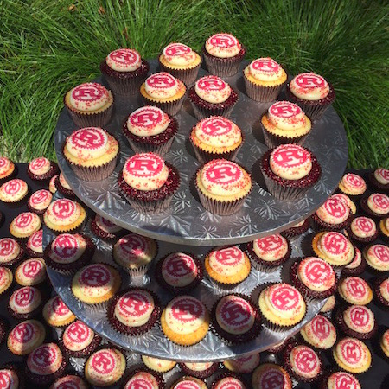
h
http://rustcamp.com/images/after/cupcakes.jpg

Slide 3
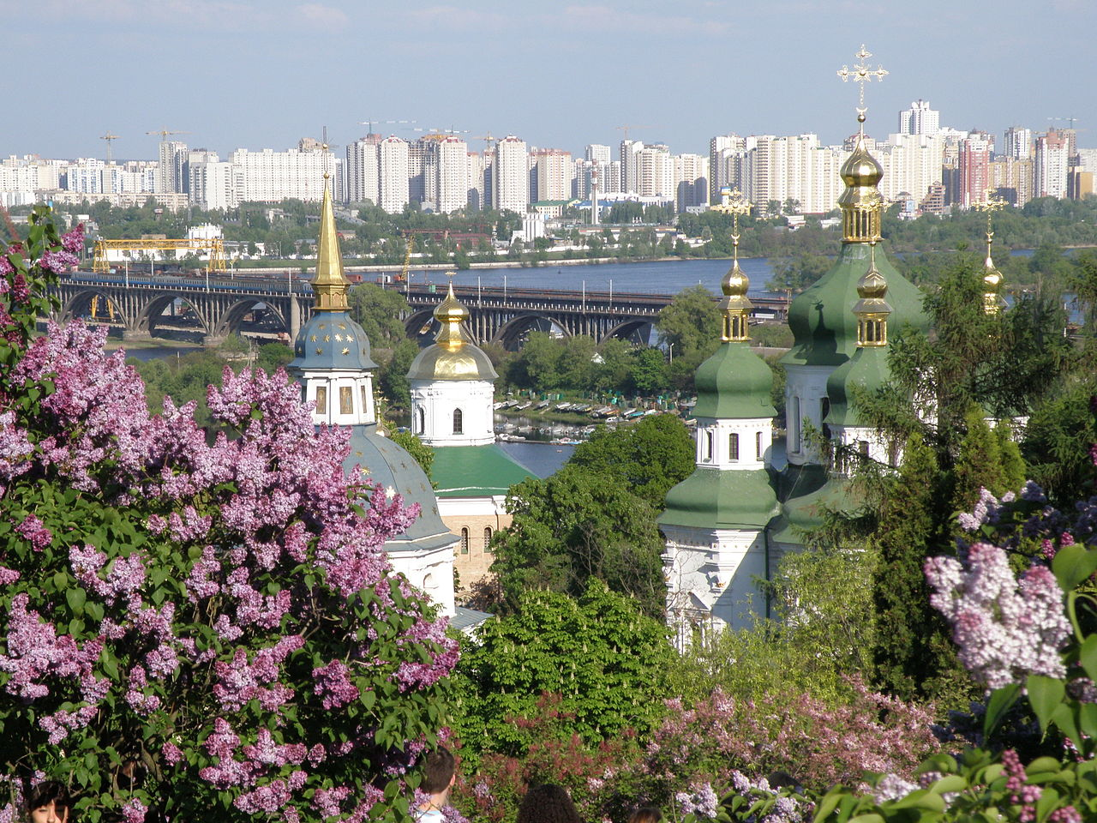
https://en.wikipedia.org/wiki/Kiev#/media/File:Vydubychi_Monastery_2008(Kiev).JPG

Slide 4
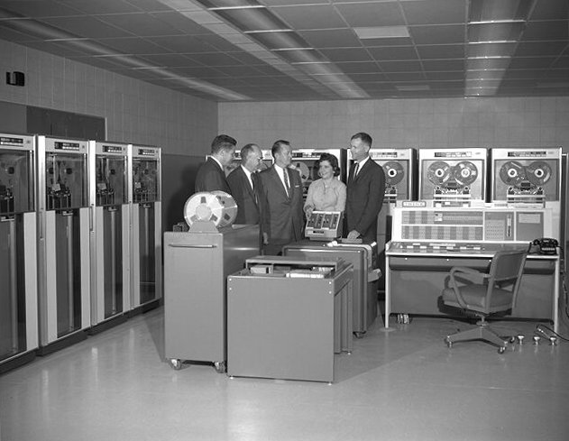
https://upload.wikimedia.org/wikipedia/commons/9/94/IBM_7090_computer.jpg (1960, $2.9 milliion)

Slide 5
Make bigger, faster computers.

Slide 6
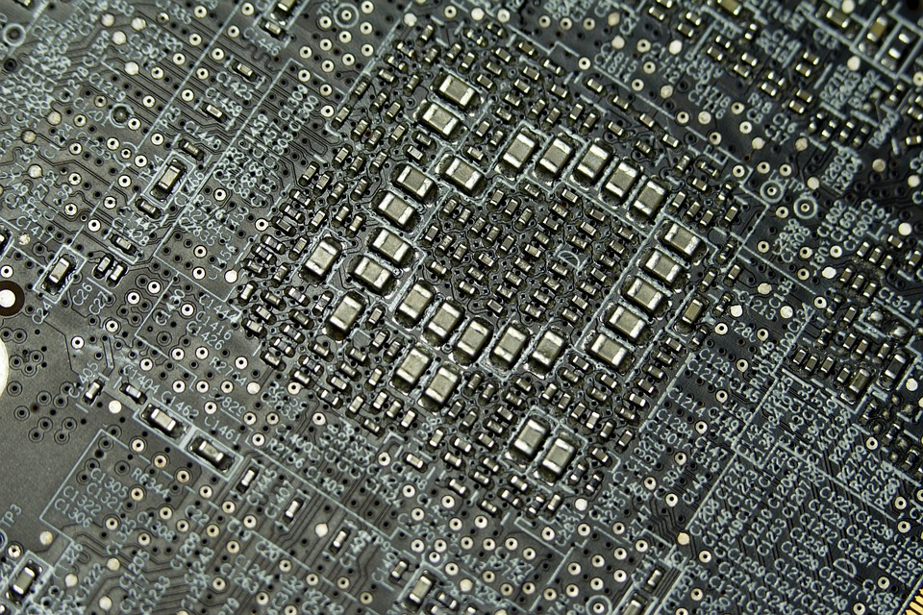
http://maxpixel.freegreatpicture.com/static/photo/1x/Pcb-Motherboard-Processor-Transistors-Logicboard-1137492.jpg

Slide 7
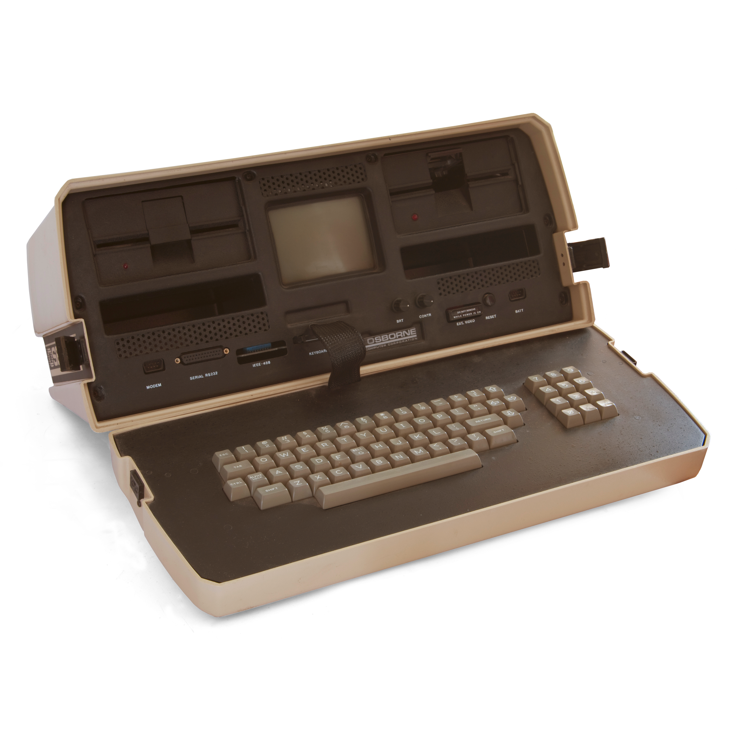
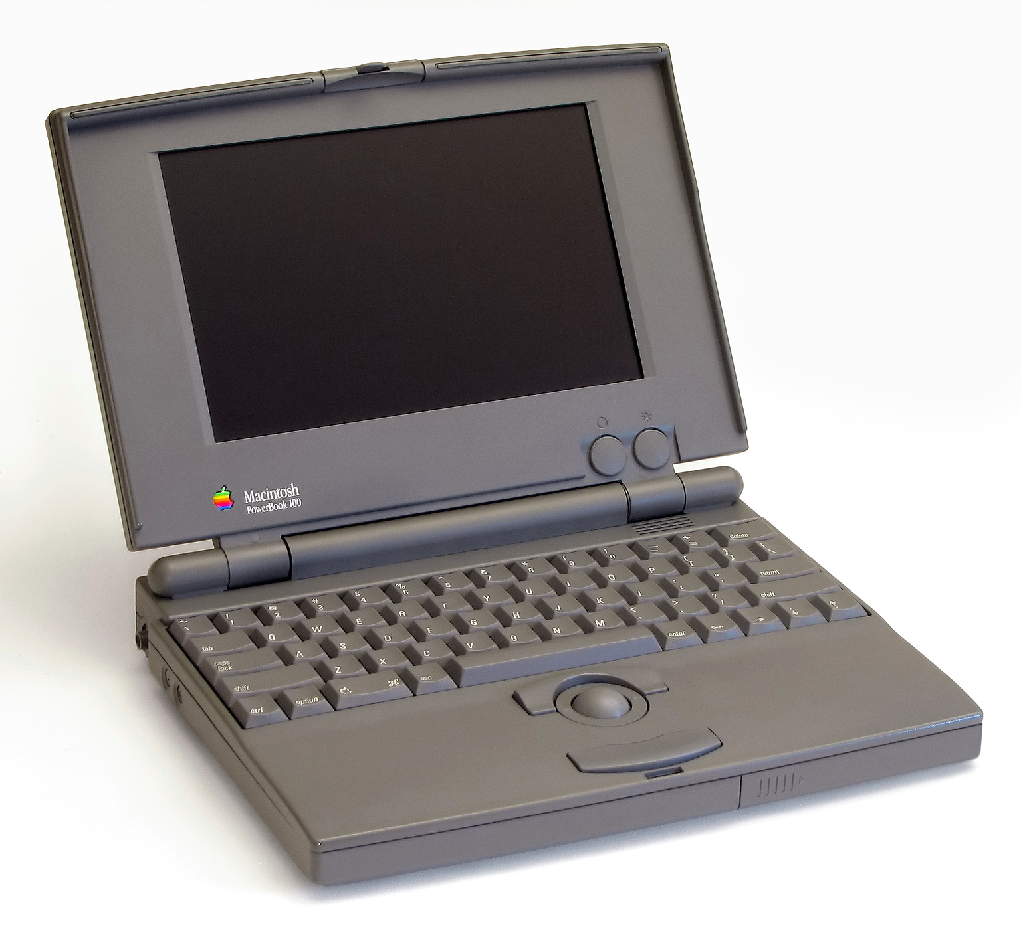
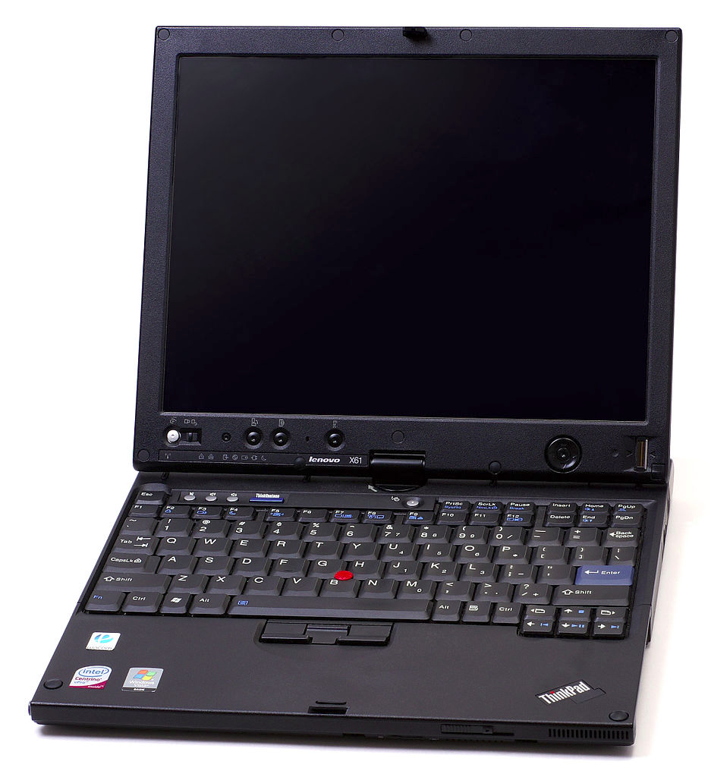

``
https://upload.wikimedia.org/wikipedia/commons/6/66/Osborne_1_open.jpg
https://upload.wikimedia.org/wikipedia/commons/5/58/Powerbook_100_pose.jpg
https://upload.wikimedia.org/wikipedia/commons/thumb/3/3f/Thinkpad-x61-tablet.jpg/937px-Thinkpad-x61-tablet.jpg
https://upload.wikimedia.org/wikipedia/commons/3/3c/Surface_Book_%281%29.jpg

Slide 8
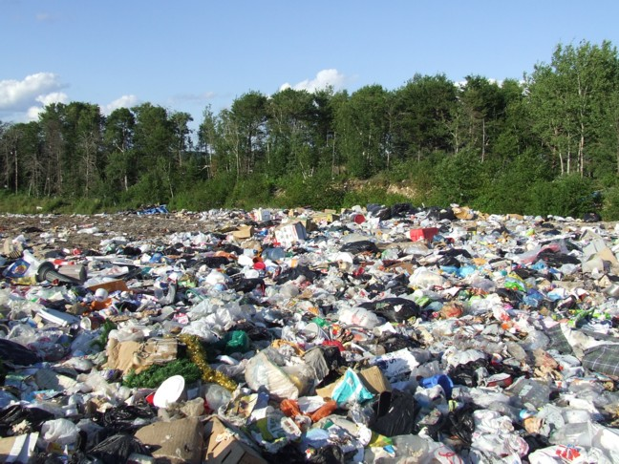
https://upload.wikimedia.org/wikipedia/commons/2/28/Landfill.jpg

Slide 9


Slide 10
Make bigger, faster computers.
Make computers do more.

Slide 11


Slide 12
Unique contributors (by email) at start of...

Slide 13
Total commits at start of...

Slide 14


Slide 15


Slide 16


Slide 17
Choosing Rust
LLVM support?
Rewrite, FFI, Bindgen, Corrode?
  https://doc.rust-lang.org/book/ffi.html
  https://crates.io/crates/bindgen
  https://github.com/jameysharp/corrode
Time?
Interest?
LLVM support?
Rewrite, FFI, Bindgen, Corrode?
  https://doc.rust-lang.org/book/ffi.html
  https://crates.io/crates/bindgen
  https://github.com/jameysharp/corrode
Time?
Interest?

Slide 18
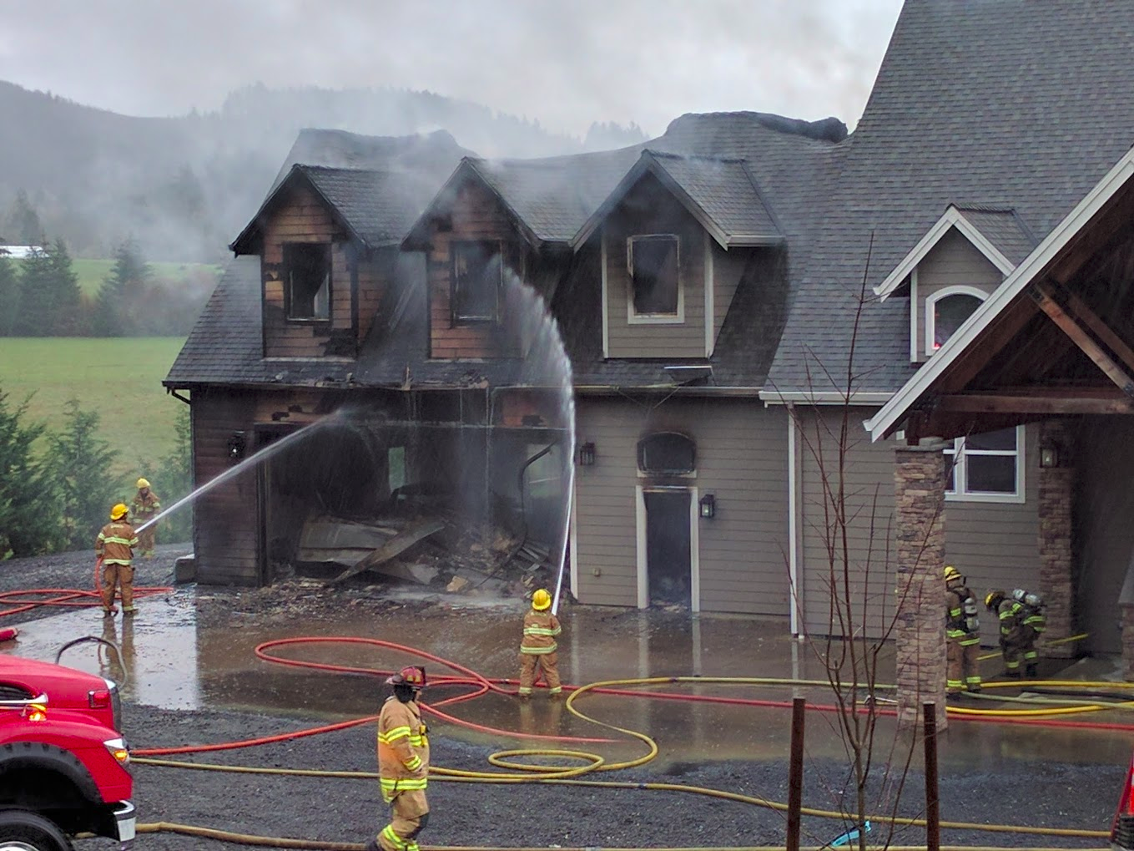

Slide 19
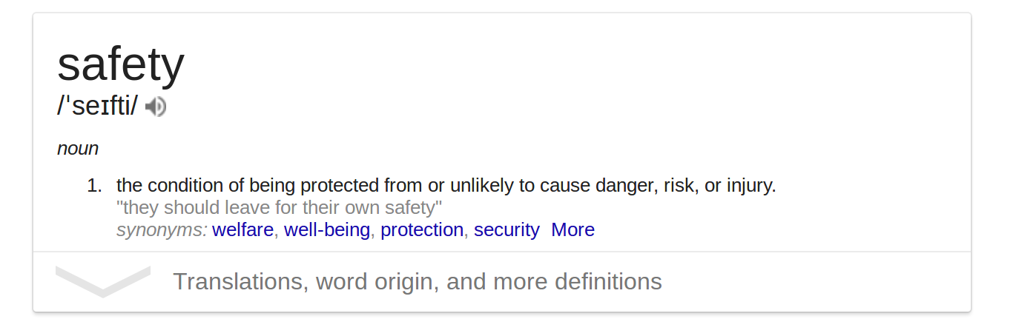

Slide 20
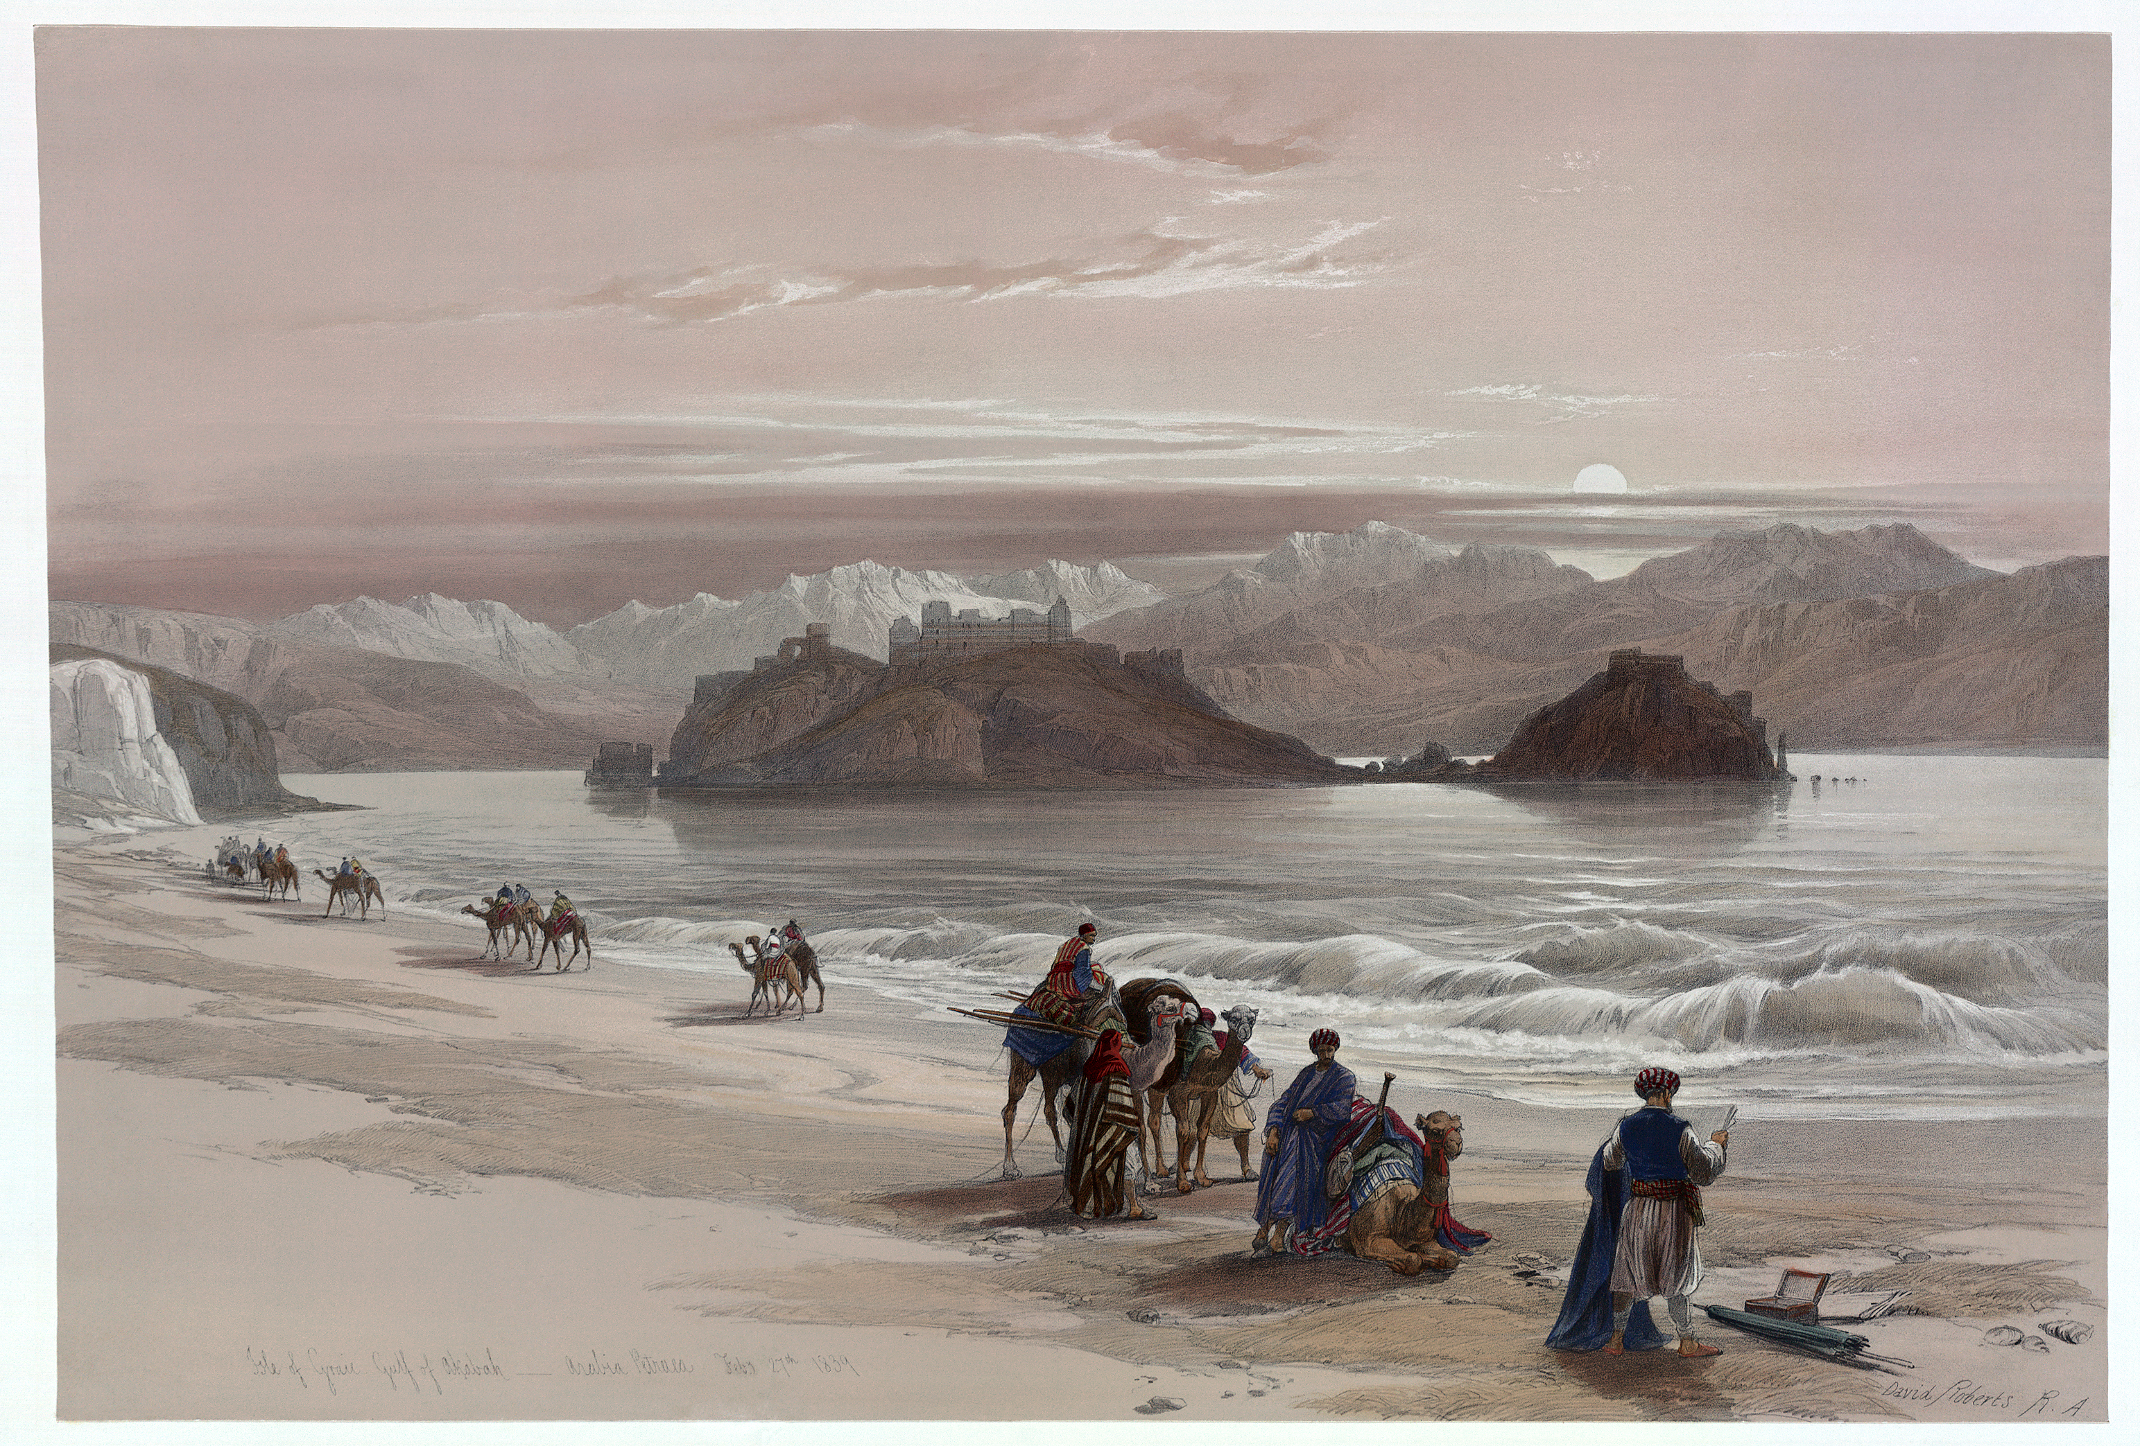
h
https://upload.wikimedia.org/wikipedia/commons/8/8f/Isle_of_Graia3.jpg

Slide 21
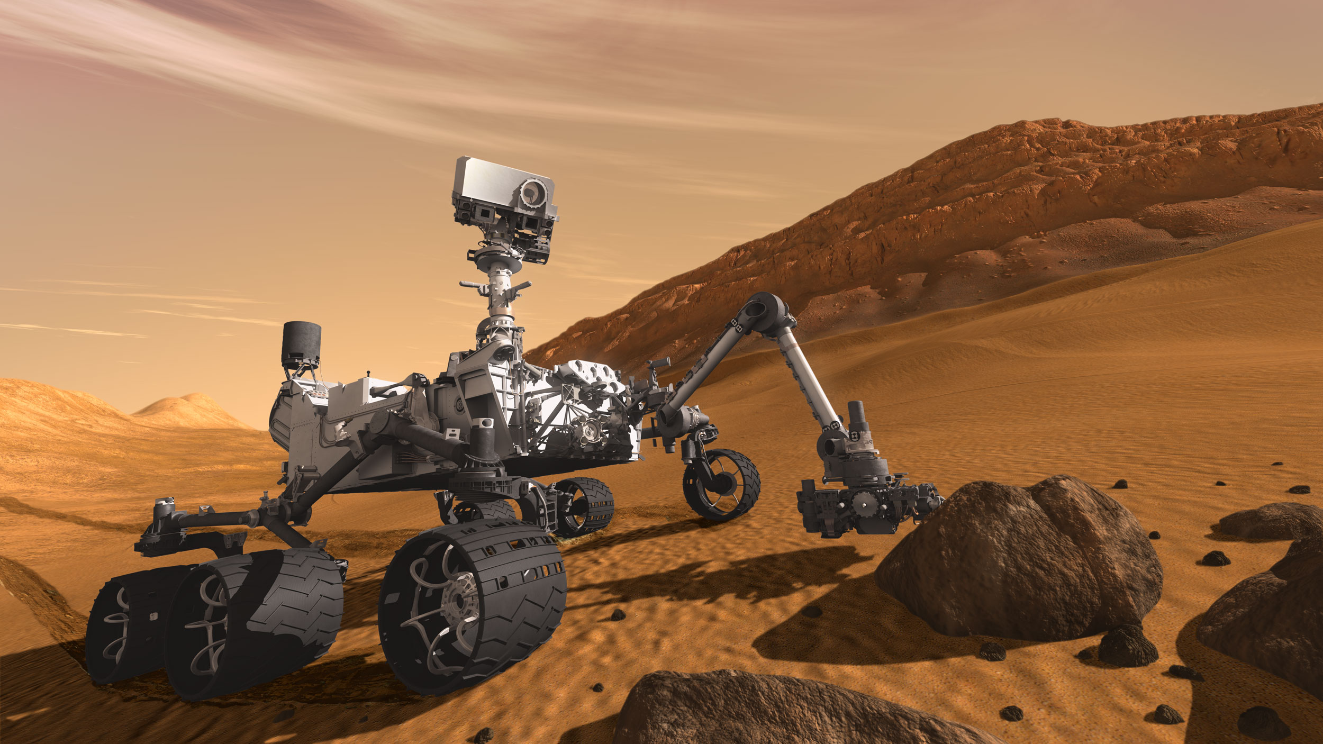
https://upload.wikimedia.org/wikipedia/commons/a/a9/Mars_Science_Laboratory_Curiosity_rover.jpg

Slide 22
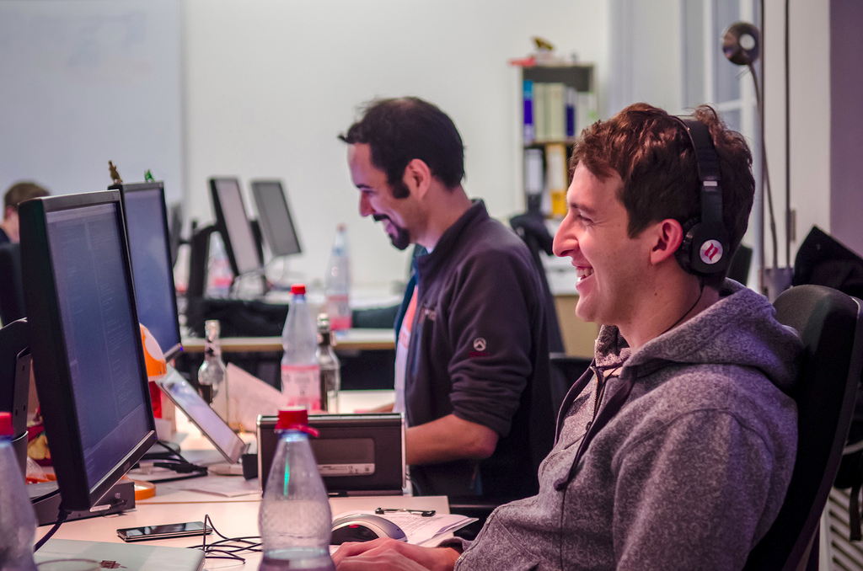
https://c1.staticflickr.com/9/8083/8408220671_22438e9046_b.jpg

Slide 23
“Fail fast!”

Slide 24
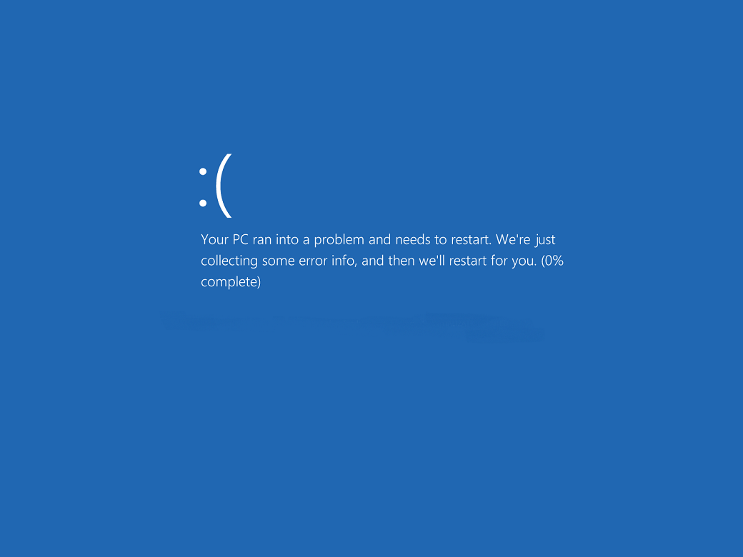

Slide 25
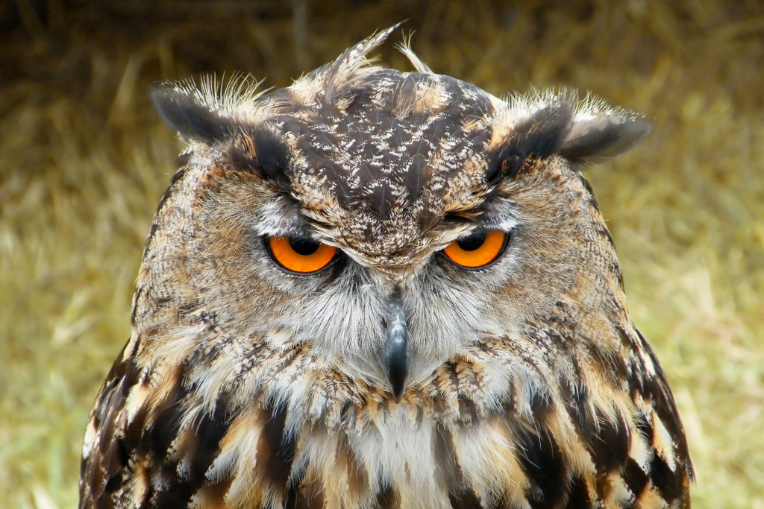
https://c1.staticflickr.com/7/6005/5927758528_a2060423e7_b.jpg

Slide 26

https://cdn.pixabay.com/photo/2013/07/12/14/28/chart-line-148256_960_720.png

Slide 27
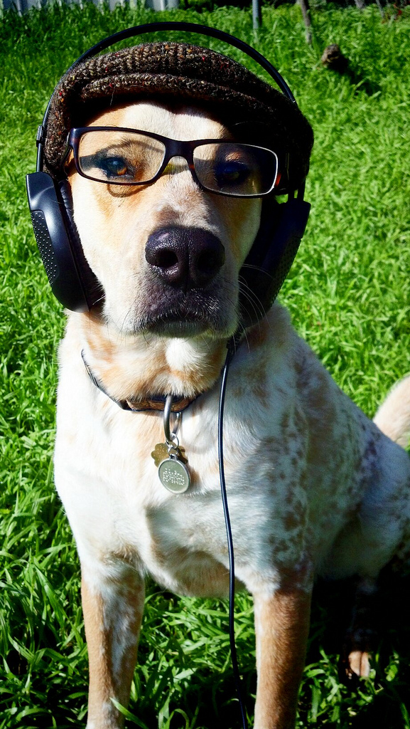

https://c1.staticflickr.com/8/7199/6905027587_6fb2ae550b_b.jpg
https://c1.staticflickr.com/8/7255/8162501205_d70a86d6ac_b.jpg

Slide 28
Safe code means you can take better risks.

Slide 30
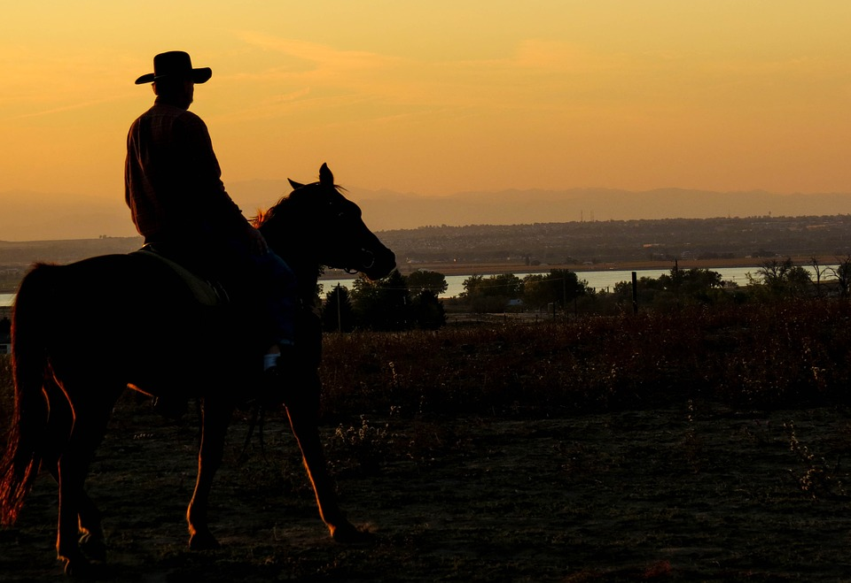
http://maxpixel.freegreatpicture.com/static/photo/1x/Sunset-Cowboy-Lake-Dusk-Country-Western-283449.jpg

Slide 31

https://cdn.pixabay.com/photo/2014/10/16/01/31/thank-you-490606_960_720.png

Slide 32
Need volunteers?
http://yourfirstpr.github.io/
http://openhatch.org/
http://24pullrequests.com/
https://www.codemontage.com/
http://issuehub.io/
http://up-for-grabs.net
http://yourfirstpr.github.io/
http://openhatch.org/
http://24pullrequests.com/
https://www.codemontage.com/
http://issuehub.io/
http://up-for-grabs.net

Slide 33


Slide 35
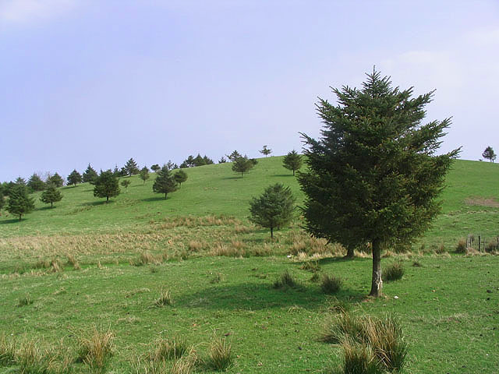
© Copyright Walter Baxter and licensed for reuse under the Creative Commons Licence

Slide 36
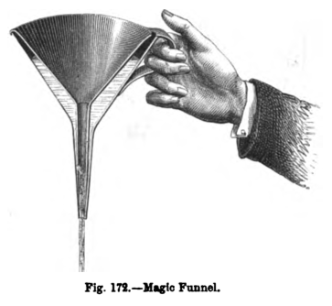
https://upload.wikimedia.org/wikipedia/commons/d/da/Magic_Funnel_from_Deschanel.png

Slide 37
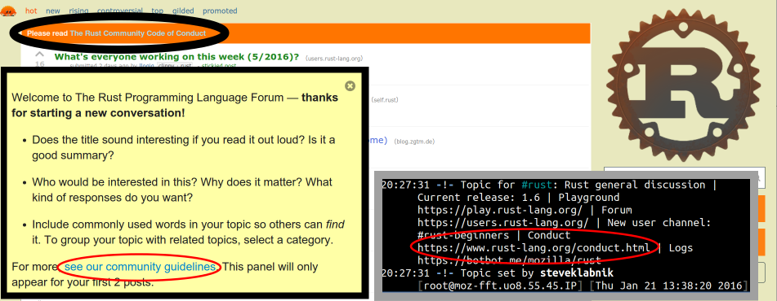
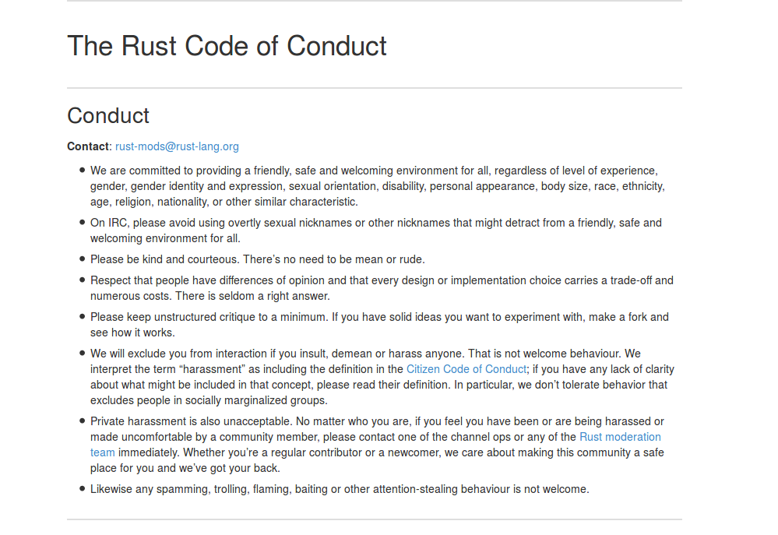

Slide 38

The Not Rocket Science Rule of Software Engineering: Seehttp://graydon.livejournal.com/186550.html

Slide 39
Automatically maintain a repository of code that always passes all the tests.

Slide 40


Slide 41
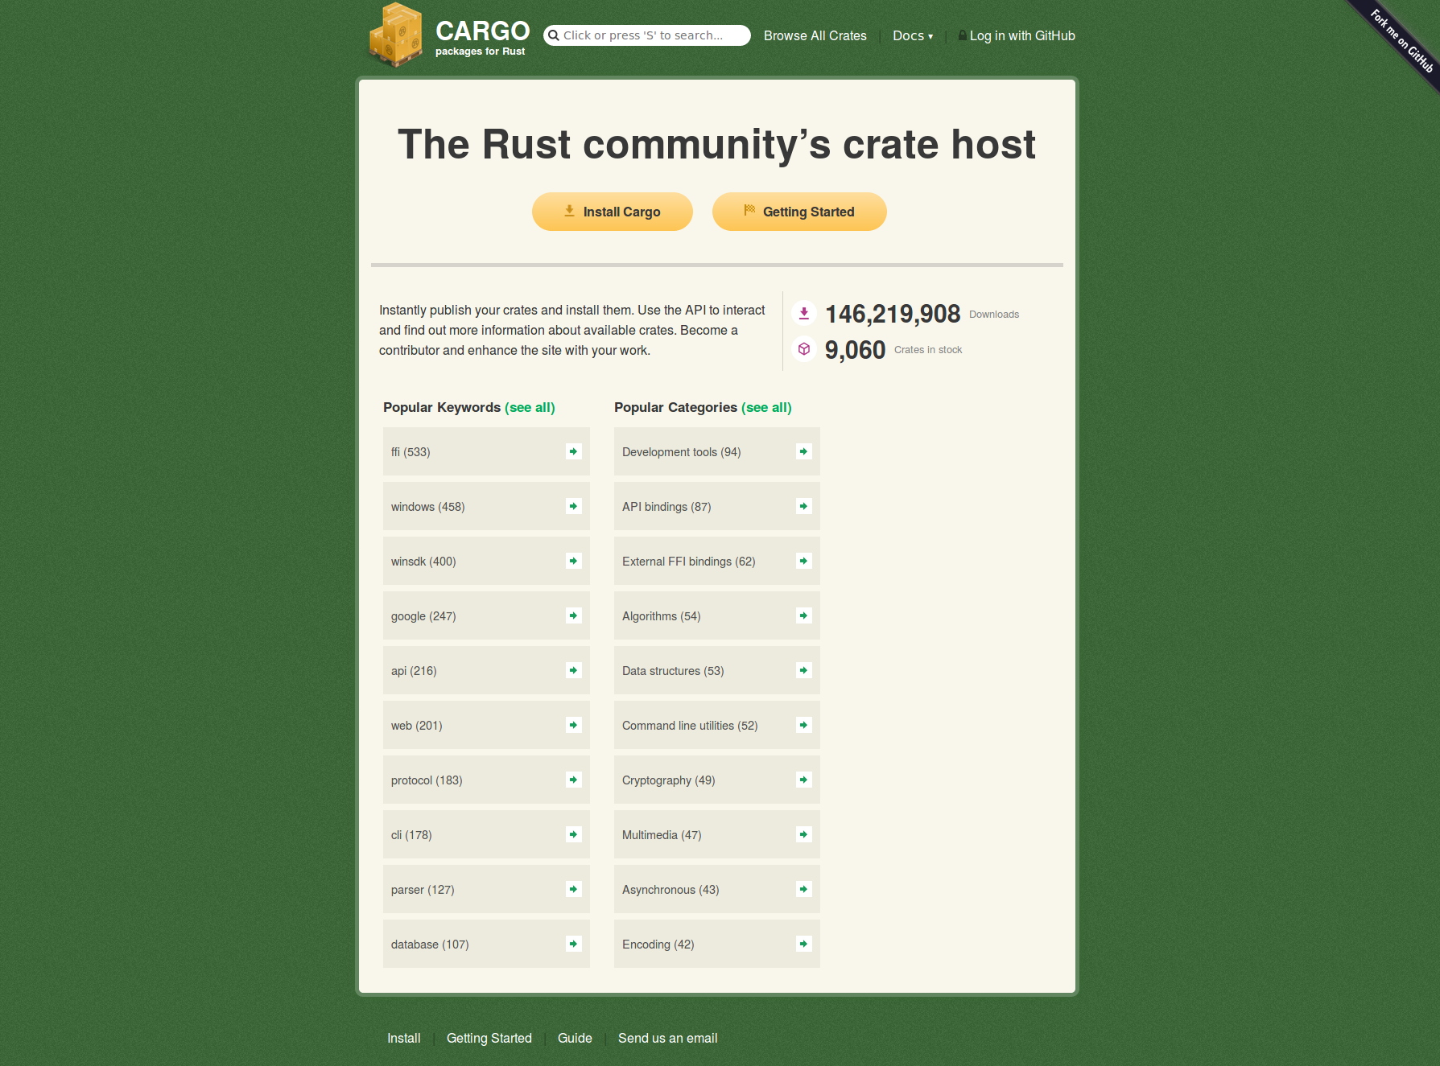

Slide 42
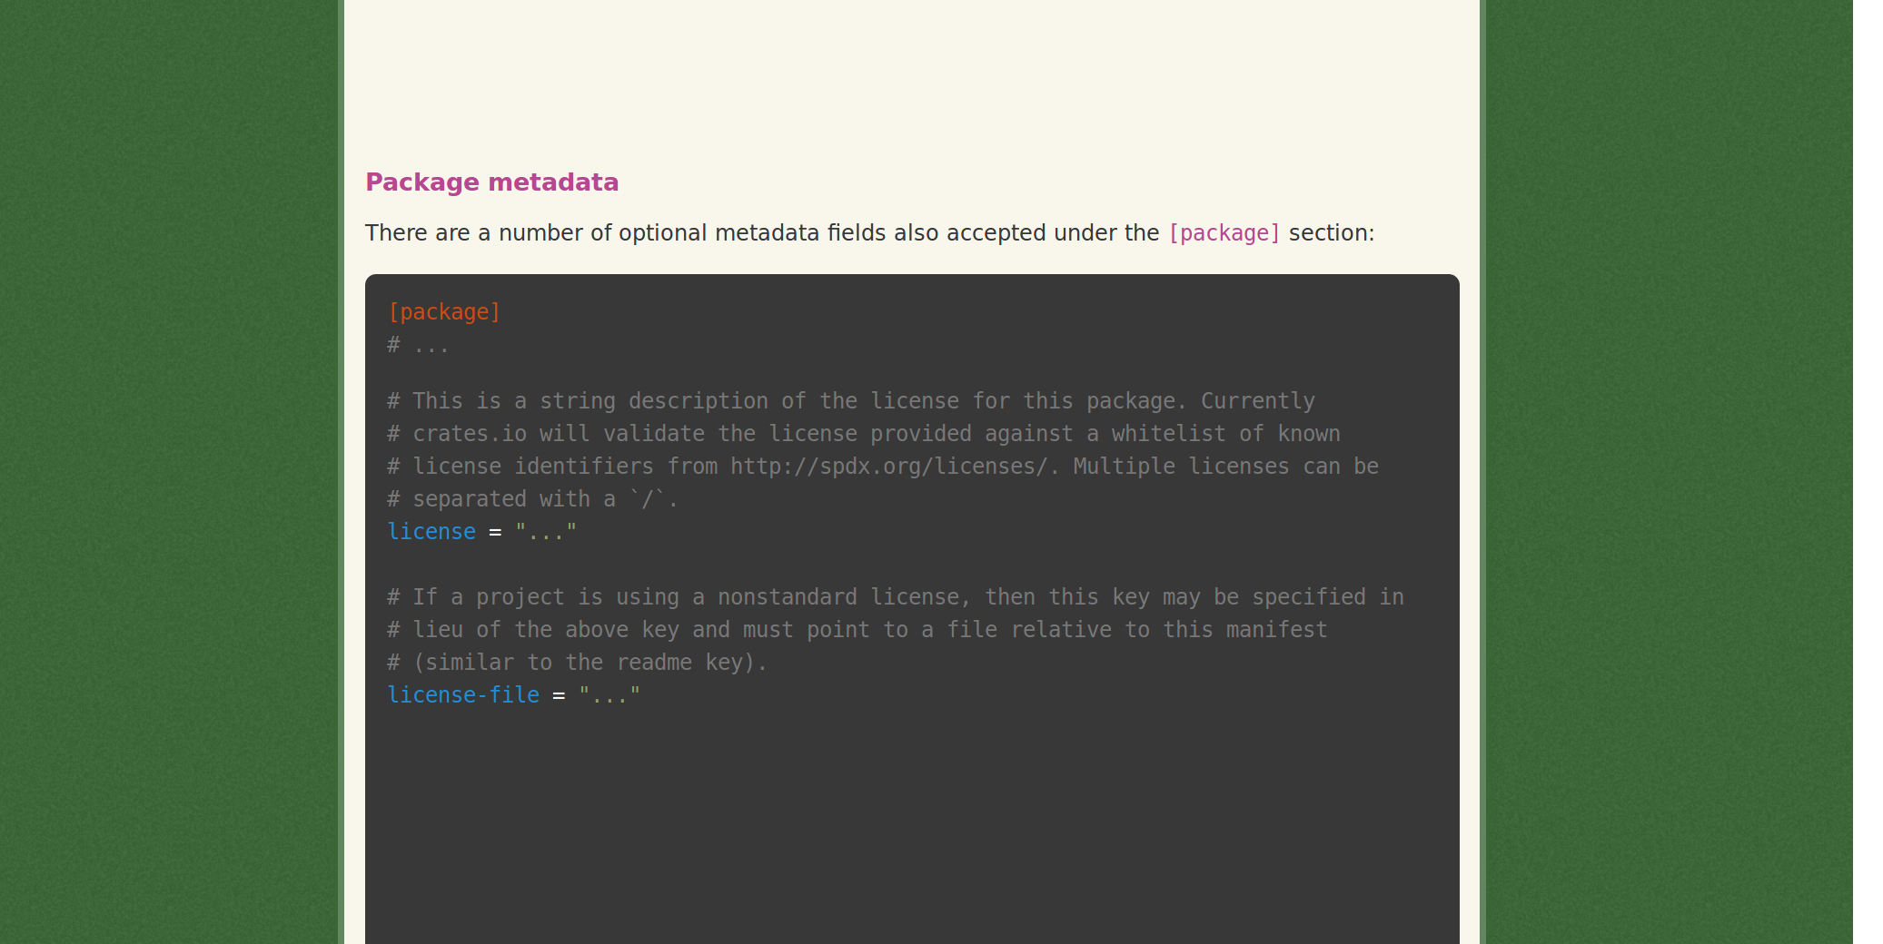
http://doc.crates.io/manifest.html

Slide 43
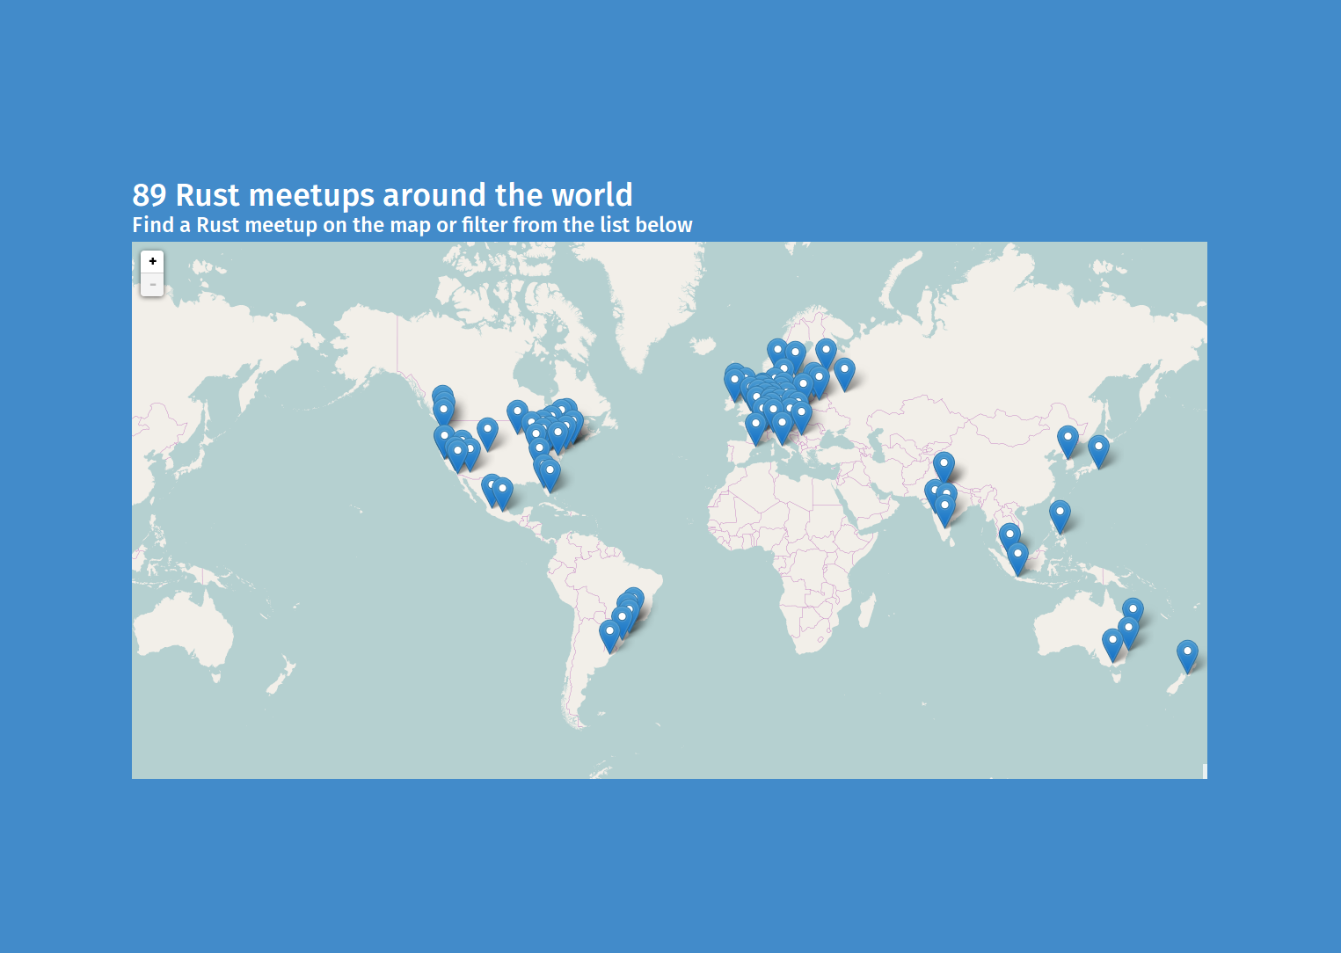
https://community.rs/meetup-map/

Slide 44
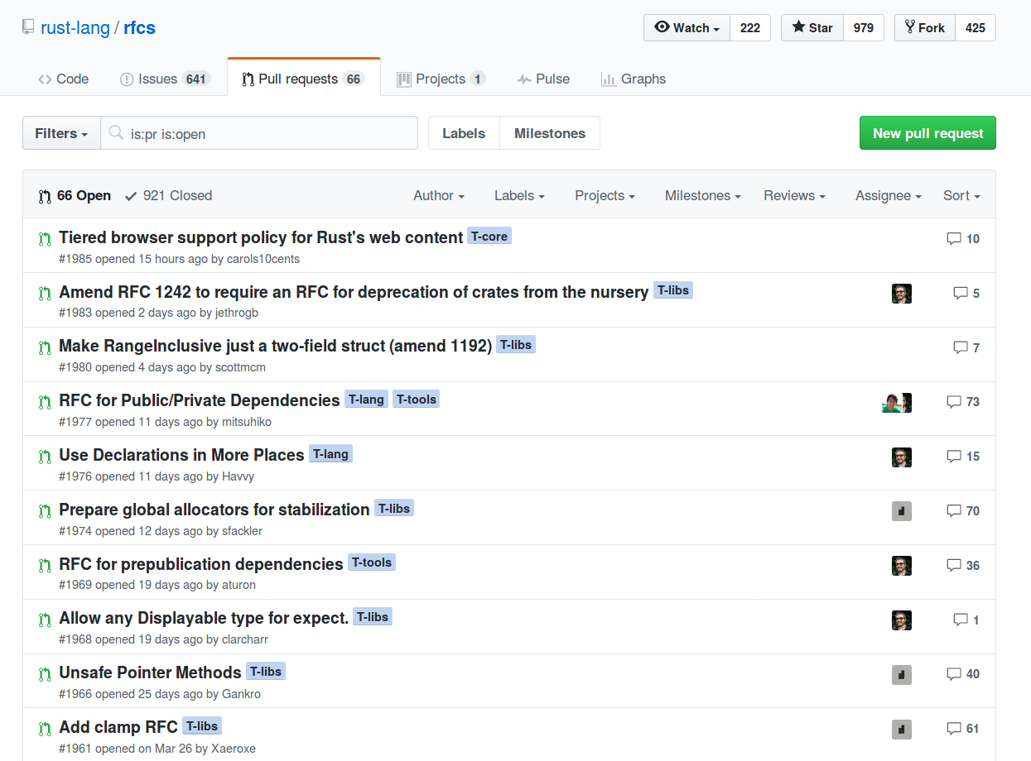

Slide 45
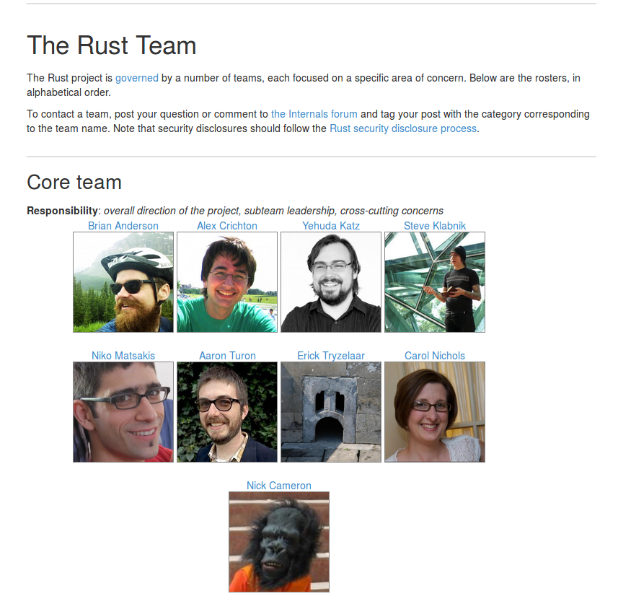
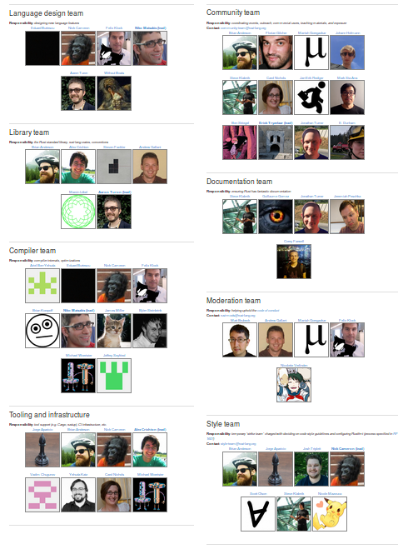

Slide 46
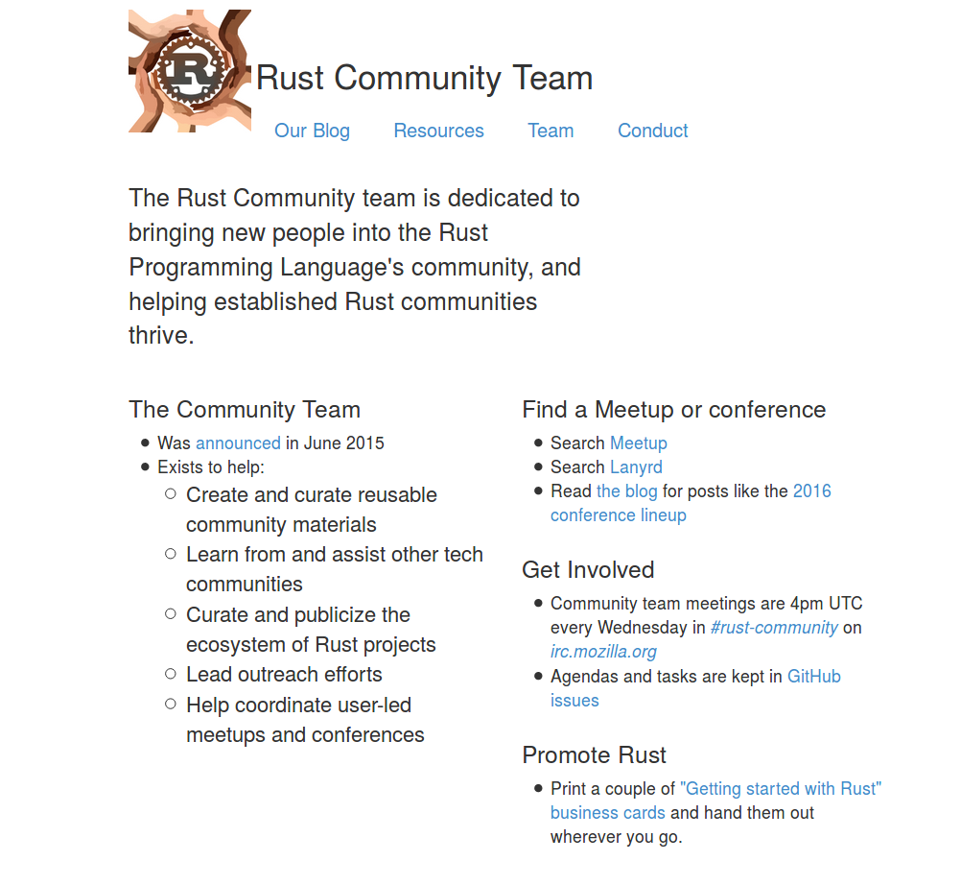
https://community.rs/

Slide 47
Rust contributors by email address

Slide 48
Rust commits by email address

Slide 50
Make your computer do all it can.

Slide 51
Share what you learn.

Slide 52
Build the
CODE and COMMUNITY that you want to see in the world. talks.edunham.net/rustfest2017
@qedunham

