Slide 1

CS Skills
(that they don’t teach in school) talks.edunham.net/UpSCALE2017
@QEDunham
https://www.flickr.com/photos/wocintechchat/25497622260/in/album-72157665958495865/

Slide 2
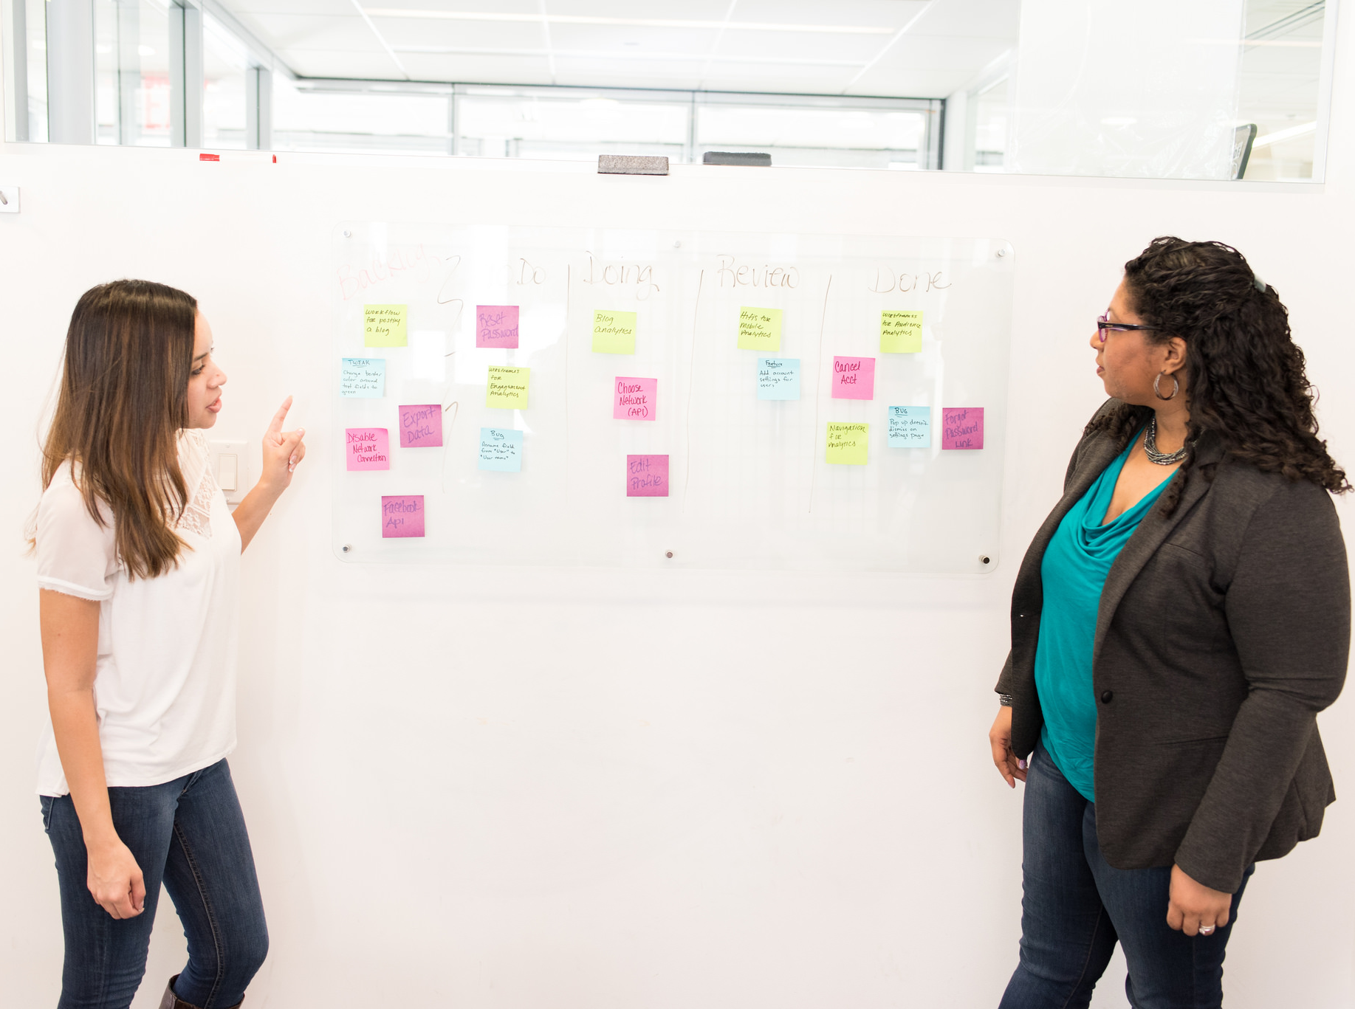
COMMUNICATING
WITH
HUMANS
https://www.flickr.com/photos/wocintechchat/25497481510/in/album-72157665958495865/
Notes:
Understand & communicate with humans

Slide 3

“Understanding people still is, and forever will be, more important than understanding computers.”
- tveastman
Reading and trying to understand the code of a library that you use (or that you don’t!) is a great way to learn stuff
- SimonSapin
Being able to communicate effectively and work with others matters way more than shaving a few clock cycles or lines of code.
- LGnome
https://www.flickr.com/photos/hubble_esa/12445539985

Slide 4
THEIR
NEEDS

Slide 5

NEGOTIATION
https://www.flickr.com/photos/wocintechchat/25497481510/in/album-72157665958495865/
Notes:
Understand & communicate with humans

Slide 6

ASK FOR HELP
https://www.flickr.com/photos/wocintechchat/25497468270/
in/album-72157665958495865/
Notes:
Understand & communicate with humans

Slide 7

1000x most-important habit/skill, being ok saying "I don't know how XYZ works / what ABC is"
- graydon_pub
It's OK not to know something. It's OK to ask questions.
- glasnt
http://www.publicdomainpictures.net/view-image.php?image=192482&picture=&jazyk=EN

Slide 8

BE
YOUR
OWN
ADVOCATE
https://www.flickr.com/photos/wocintechchat/22518591062/in/album-72157658101276193/
Notes:
Understand & communicate with humans

Slide 9

You can make more money managing windows clusters, at the expense of your sanity
- theskorm
Management will usually not tell you ahead of time when something bad is going to happen, like a sale of the company or layoffs.
- richburroughs
Most founders don't actually care about the humans.
- rjw1
https://static.pexels.com/photos/2154/sky-lights-space-dark.jpg

Slide 10

Between hardware-driven obsolescence, business model & tech trend cycles, legacy sys and bitrot, much effort is "running to stand still"
- graydon_pub
"Driving your own career" should include some off-roading. Sometimes staying on the freeway just sends you in circles.
- bitwiseman
Most sub-fields have >50 years of history, keep revisiting same problems, often scrambling & failing to remember lessons learned.
- graydon_pub
https://commons.wikimedia.org/wiki/File:THE_EARTH_SEEN_IN_OUTER_SPACE.jpeg

Slide 11

MAKE FRIENDS WITH FAILURE
https://commons.wikimedia.org/wiki/File:ShadowRidgeRoadFire.JPG
Notes:
Understand & communicate with humans

Slide 12
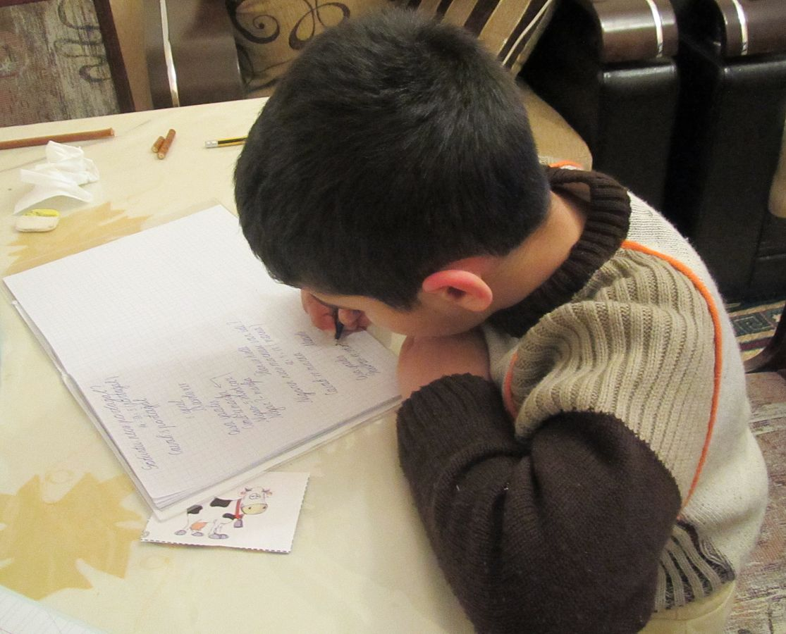
It's ok to fail. It truly is the only way to learn.
- JJAsghar
https://commons.wikimedia.org/wiki/File:Az-Writing_boy_e-citizen.jpg

Slide 13

GET GOOD TOOLS
https://commons.wikimedia.org/wiki/File:Rusty_tools.JPG
Notes:
Understand & communicate with humans

Slide 14











http://www.publicdomainpictures.net/pictures/30000/velka/green-fields-1351063140pg3.jpg

Slide 15

DELEGATE
https://commons.wikimedia.org/wiki/File:Rusty_tools.JPG
Notes:
Understand & communicate with humans

Slide 16
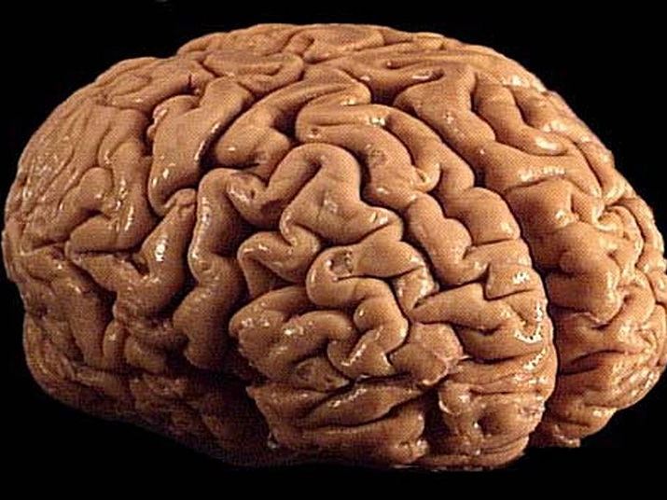
THINK INTERDISCIPLINARY
https://commons.wikimedia.org/wiki/File:Brain_01.jpg
Notes:
Understand & communicate with humans

Slide 17

https://www.flickr.com/photos/wocintechchat/25171631713/in/album-72157665958495865/
Notes:
Understand & communicate with humans

Slide 18

GROWTH MINDSET
https://static.pexels.com/photos/36063/pexels-photo.jpg
Notes:
Understand & communicate with humans

Slide 19

http://www.thebluediamondgallery.com/wooden-tile/t/teach.html

Slide 20
Thanks!
CS Skills
(that they don’t teach in school) talks.edunham.net/UpSCALE2017
@QEDunham
LGnome
SimonSapin
asajeffrey
bitwiseman
glasnt
graydon_pub
jjasghar
onoforpono
pastcompute
richburroughs
rjw1
theskorm
tveastman

