Slide 1


How To Learn Rust
5/19/2016

Slide 2

talks.edunham.net/oscon2016 oscon2016@edunham.net

Slide 3

Two Talks In One
Notes:
My & others’ best practices for learning a language.
How to choose a language
Finding YOUR best practices
Popular resources & how to find them
Troubleshooting
Advice from others
When’s Rust the right language?
Here are Rust’s resources
Troubleshooting

Slide 4
Thanks

Slide 5

Today’s Audience
Notes:
How many of you:
* Don’t feel fluent in 1 language yet?
* Could FizzBuzz without docs in 1-2 languages
* 3-5 languages?
* More than 5?
* Have already started w/ Rust?
* Here because you want to learn another language?
* Here specifically because Rust is cool?

Slide 6
Your Next Language

Slide 7

Curiosity

Slide 8

Features

Slide 9
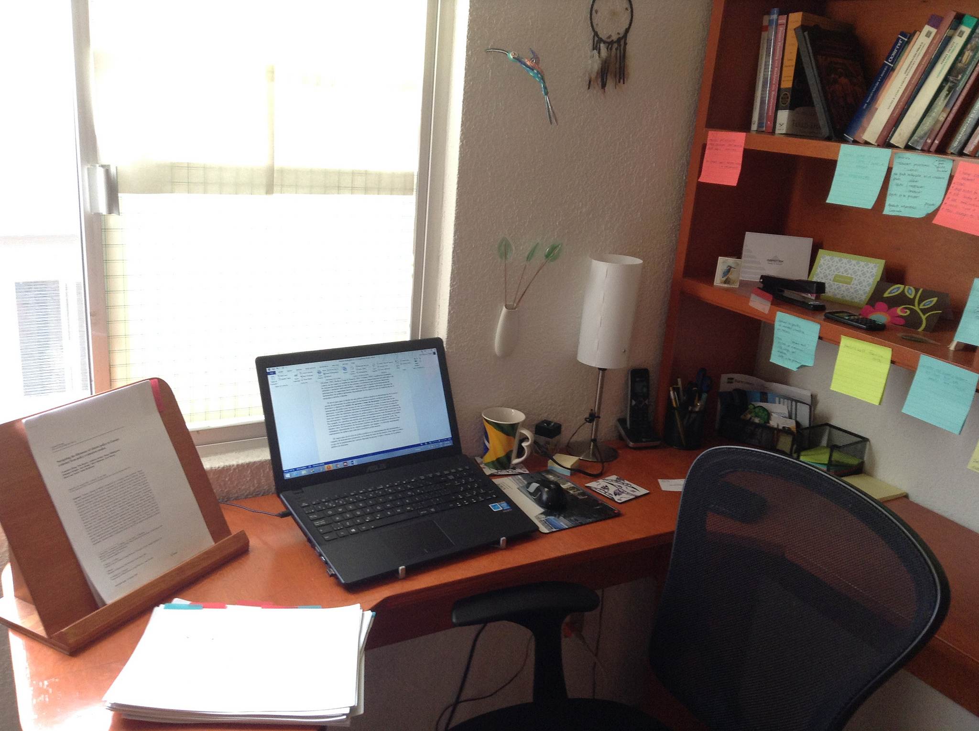
Work

Slide 10

Why?

Slide 11
Seeing Patterns

Slide 12

Your Next Language

Slide 13
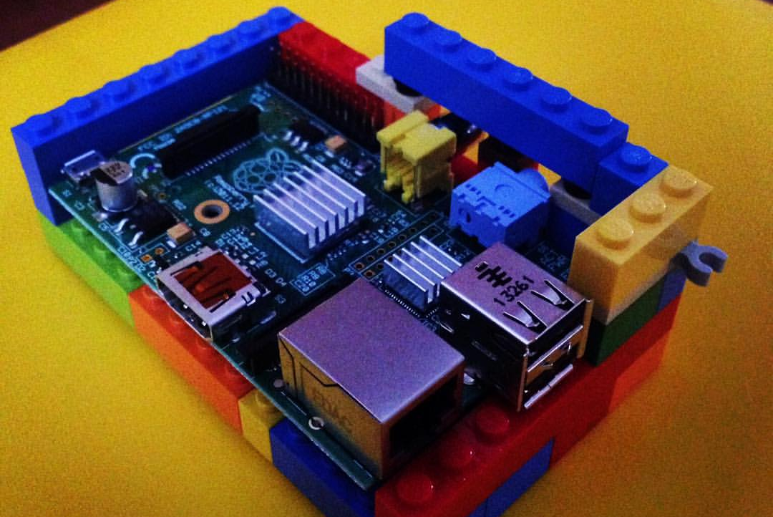
Learning Styles

Slide 14
Tasks You Enjoy

Slide 15
Tasks You Despise

Slide 16
Successful Projects

Slide 17
Failed Projects

Slide 18
Failure & Frustration

Slide 19
What will you achieve?

Slide 20
When?

Slide 21
Which Language?

Slide 22
Popularity

Slide 23
Community

Slide 24
Resources

Slide 25
Features

Slide 26
Old & New Concepts

Slide 27
“My next language has _____”

Slide 28
Which languages have it?

Slide 29
It’s worth taking time from...

Slide 30
Family?

Slide 31
Hobbies?

Slide 32
Sleep?

Slide 33
Capture Your Motivation

Slide 34
12 Learning Techniques

Slide 35
1) Language’s Docs

Slide 36
2) Similar Languages

Slide 37
3) Community Support

Slide 38
4) Write Real Code

Slide 39
5) Read The Books

Slide 40
5) Examine Examples

Slide 41
7) Find Good Tools

Slide 42
8) Read Real Code

Slide 43
9) Write Toy Programs

Slide 44
10) Google & Stackoverflow

Slide 45
11) Watch Lectures & Courses

Slide 46
12) Maintain Enthusiasm

Slide 47
Troubleshooting

Slide 48
Community Interaction

Slide 49
Time

Slide 50
Language features

Slide 51
It Gets Better

Slide 52
Advice

Slide 53
Learn by Doing

Slide 54
Practice Consistently

Slide 55
Start with the Basics

Slide 56
Build Something You Love

Slide 57
Respect Languages’ Differences

Slide 58
Learning Rust!

Slide 59
Are You Ready?

Slide 60
About Rust

Slide 61
Why Rust?

Slide 62
Popularity

Slide 63
Community

Slide 64
Features

Slide 65
Worth it?

Slide 66
“I am learning @rustlang to ___”

Slide 67
<recap all 12 strategies w/ links>

Slide 68
Troubleshooting

Slide 69
It Gets Better

Slide 70
Thank You talks.edunham.net/oscon2016

