Slide 1


How To Learn Rust
5/19/2016

Slide 2

talks.edunham.net/oscon2016 oscon2016@edunham.net

Slide 3

Two Talks In One
Notes:
My & others’ best practices for learning a language.
How to choose a language
Finding YOUR best practices
Popular resources & how to find them
Troubleshooting
Advice from others
When’s Rust the right language?
Here are Rust’s resources
Troubleshooting

Slide 4

Thanks
@anjuan
@Azuxul
@bulba_zord
@echorand
@EnamsuoBarry
@FranklinWaller
@gansai9
@glasnt
@gmebarthe
@hectorjcorrea
@iamed2
@IanBertolacci
@Ignoreintuition
@itsAhmedWay
@jackyboen
@joaomello
@jsookha
@l.d.walker
@llogiq
@macaronique
@mayaskme
@megamatman
@Mike_Fal
@proogey
@robn
@sundayayandokun
@Vinatorul http://agares.info/

Slide 5
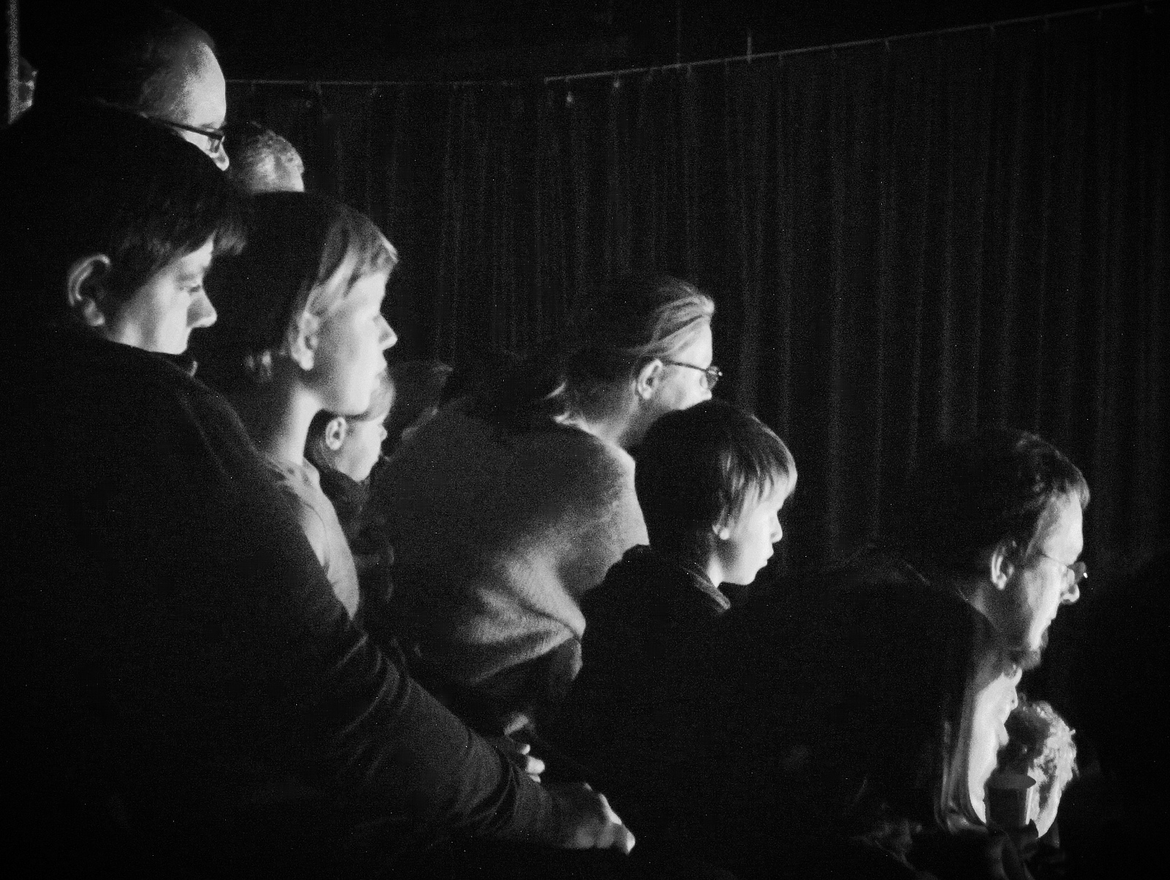
Today’s Audience
Notes:
How many of you:
* Don’t feel fluent in 1 language yet?
* Could FizzBuzz without docs in 1-2 languages
* 3-5 languages?
* More than 5?
* Have already started w/ Rust?
* Here because you want to learn another language?
* Here specifically because Rust is cool?

Slide 6

Your Next Language

Slide 7

Curiosity

Slide 8

Features

Slide 9
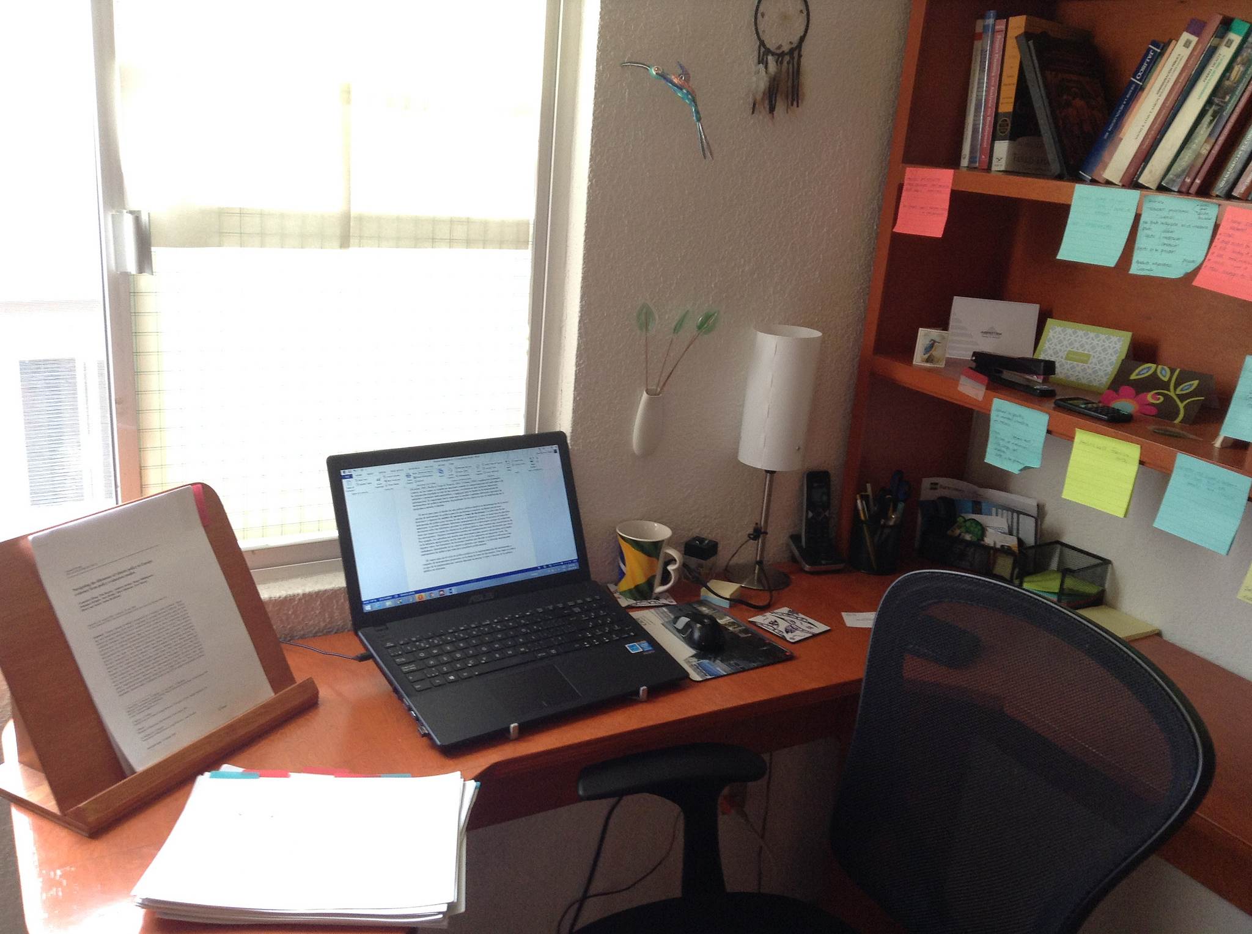
Work

Slide 10

Why?

Slide 11

Pattern Recognition

Slide 12

Your Next Language

Slide 13
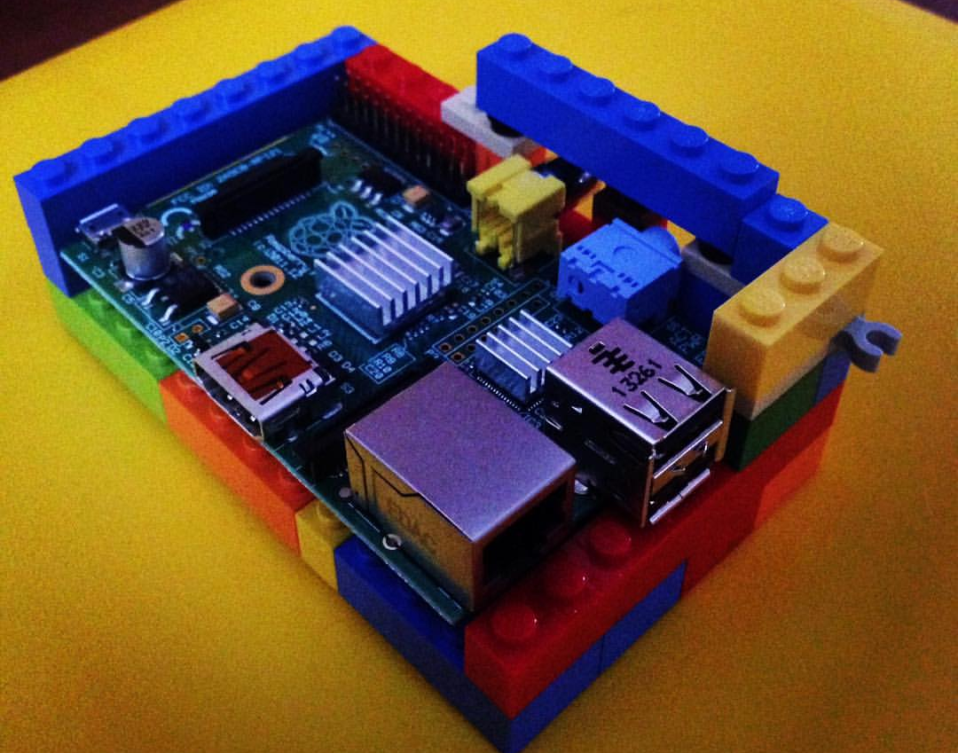
Learning Styles

Slide 14
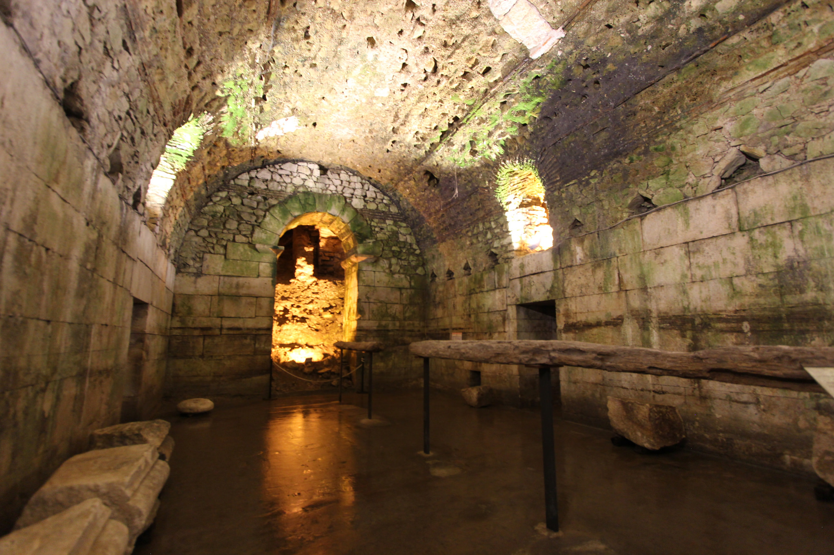
Tasks You Enjoy vs
Tasks You Despise

Slide 15

Successful Projects vs
Unsuccessful Projects

Slide 16

What will you achieve?
&
When?

Slide 17
Which Language?

Slide 18
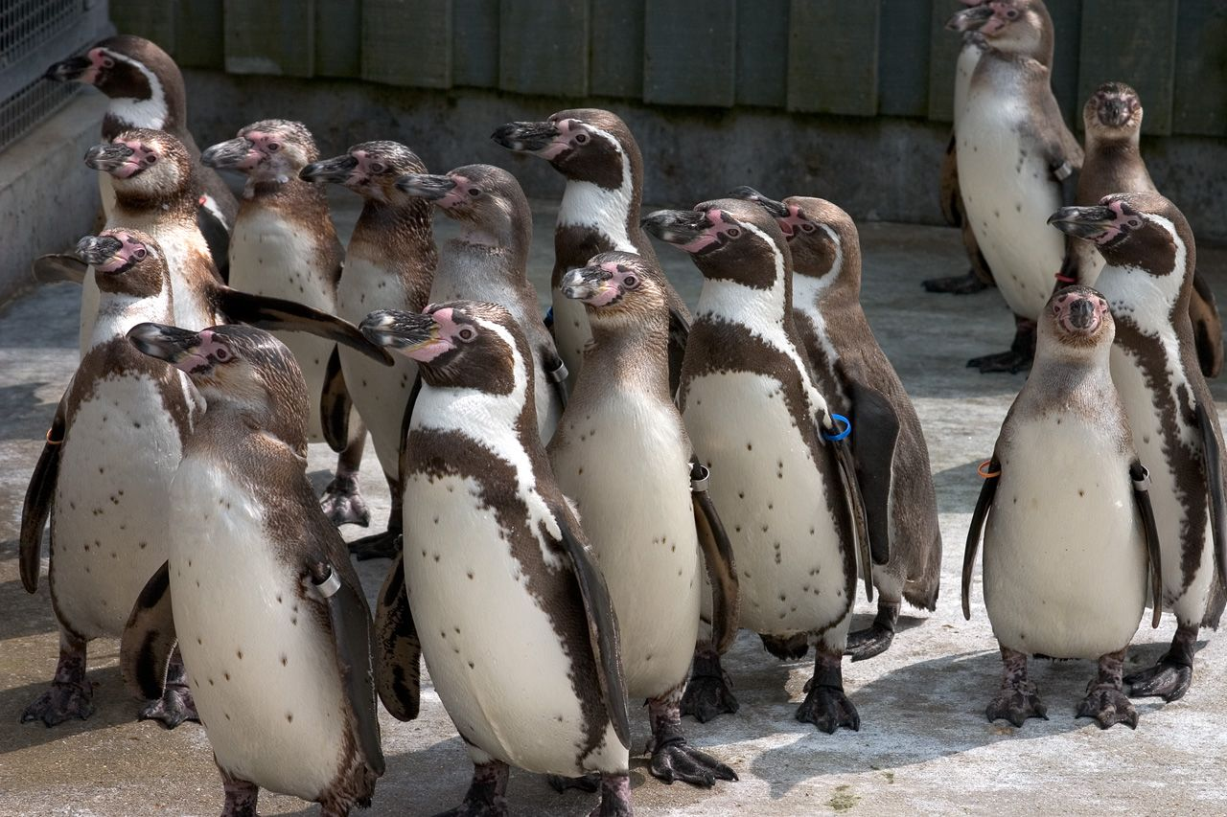
Popularity

Slide 19

Community

Slide 20

Resources

Slide 21

Features

Slide 22
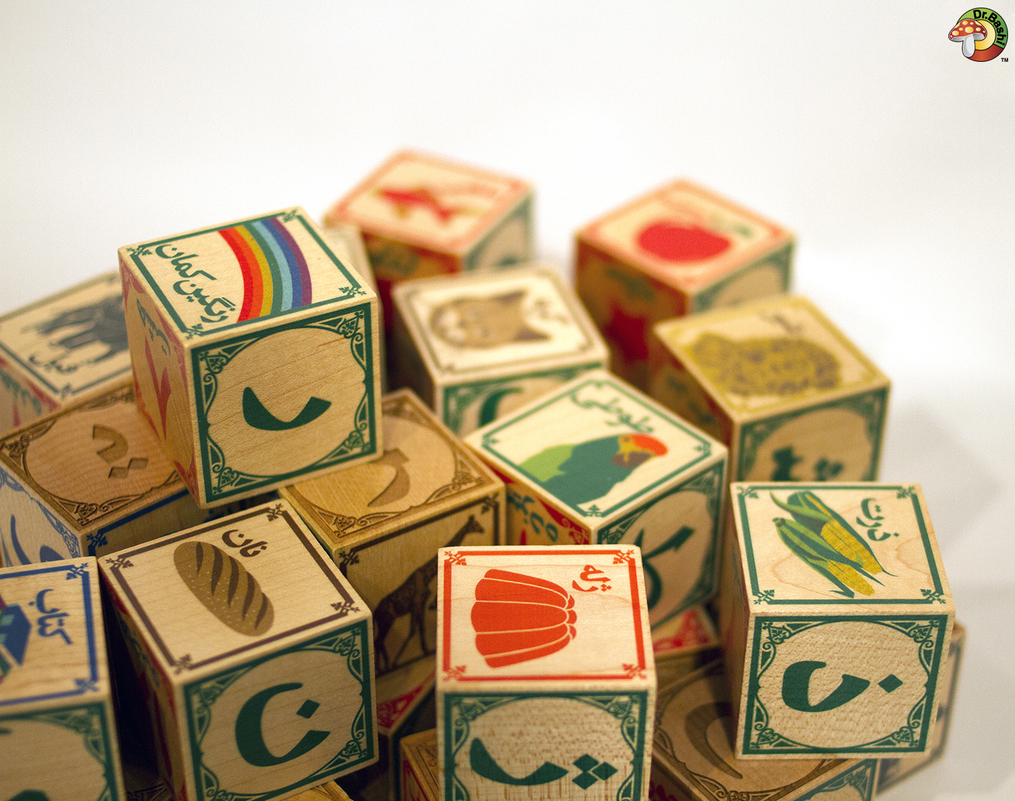
Old & New Concepts

Slide 23
“My next language _____”

Slide 24
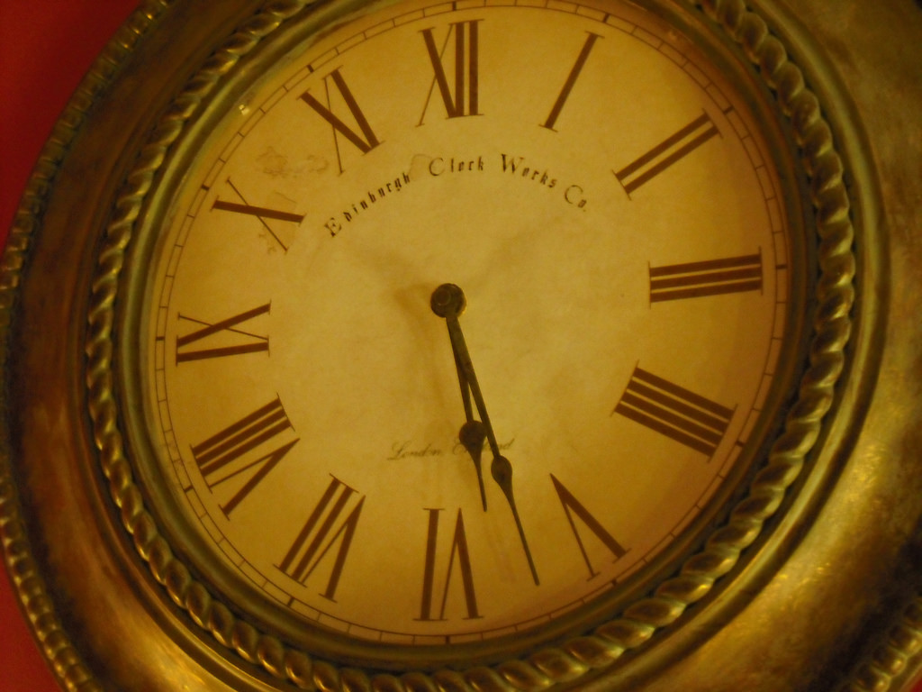
It’s worth taking time from...

Slide 25
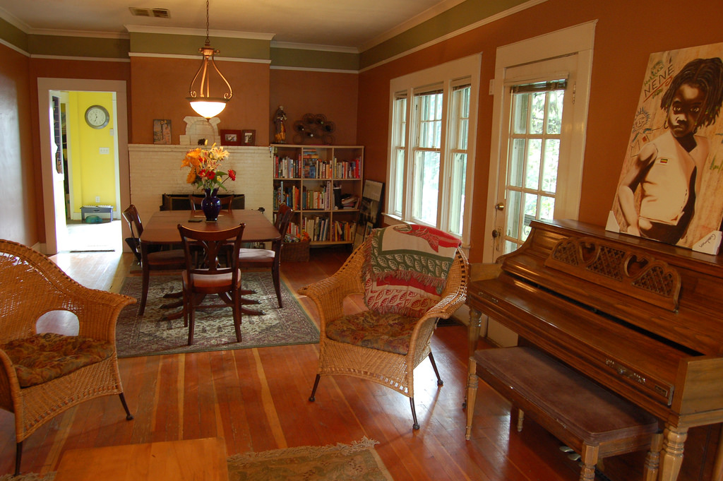
Family? Hobbies? Sleep?

Slide 26

Capture Your Motivation

Slide 27
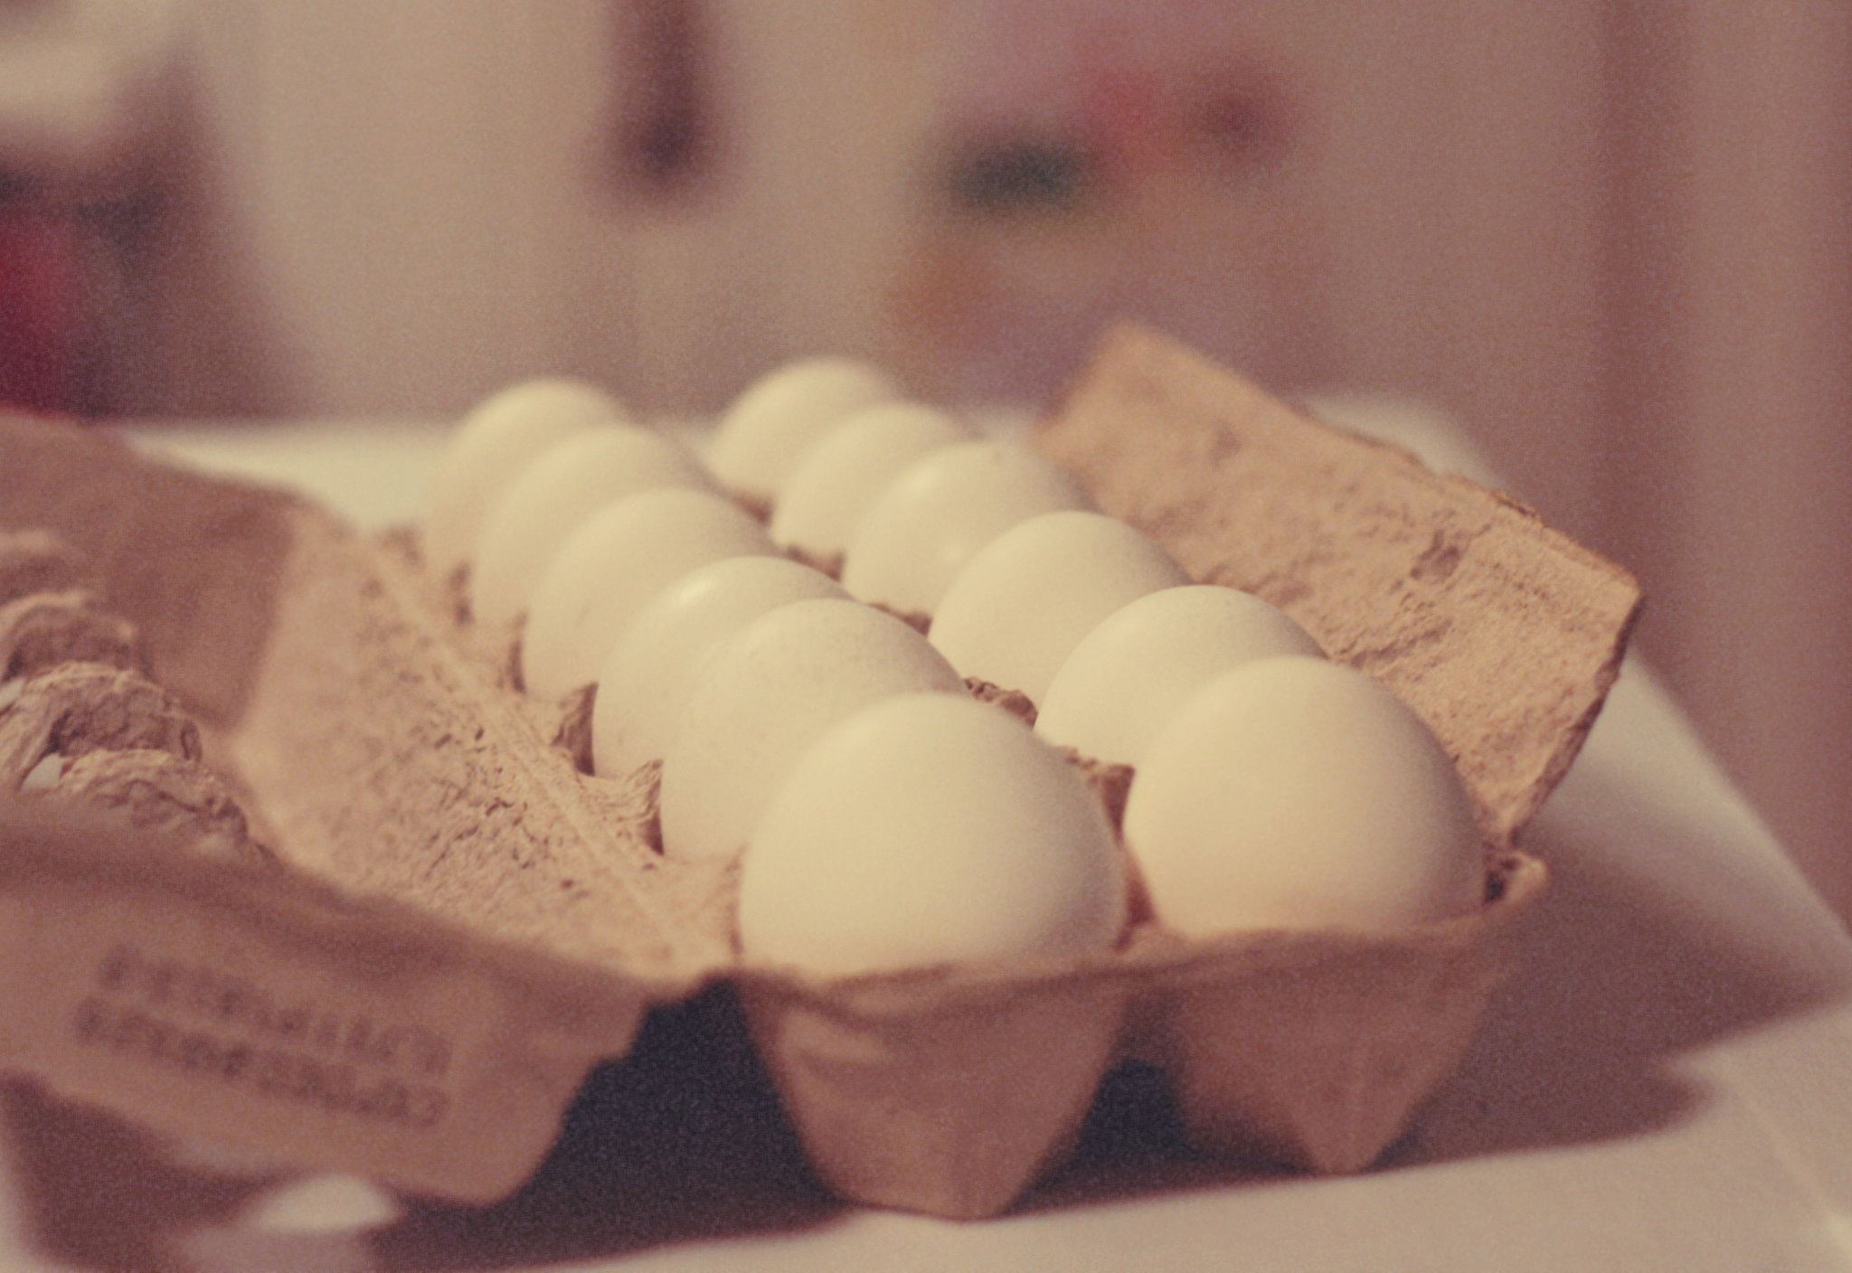
12 Study Techniques

Slide 28

1) Language Docs

Slide 29

2) Similar Languages

Slide 30

3) Community Support

Slide 31

4) Write Real Code

Slide 32
5) Read The Books

Slide 33

6) Examine Examples

Slide 34

7) Find Good Tools

Slide 35

8) Read Real Code

Slide 36
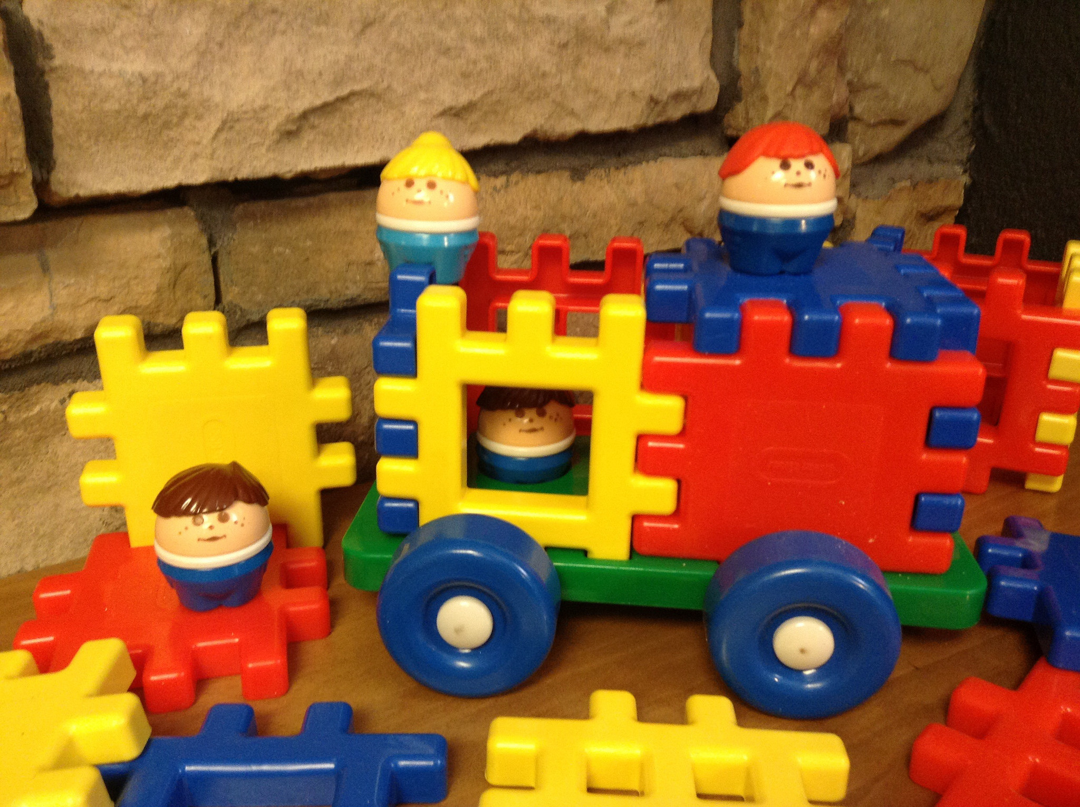
9) Write Toy Programs

Slide 37

10) Google & Stackoverflow

Slide 38
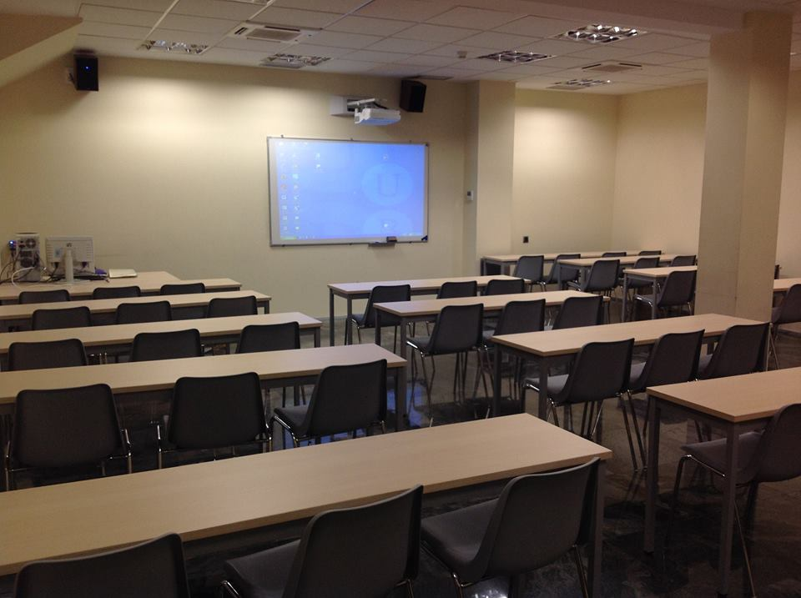
11) Watch Lectures & Courses

Slide 39

12) Maintain Enthusiasm

Slide 40

Troubleshooting

Slide 41
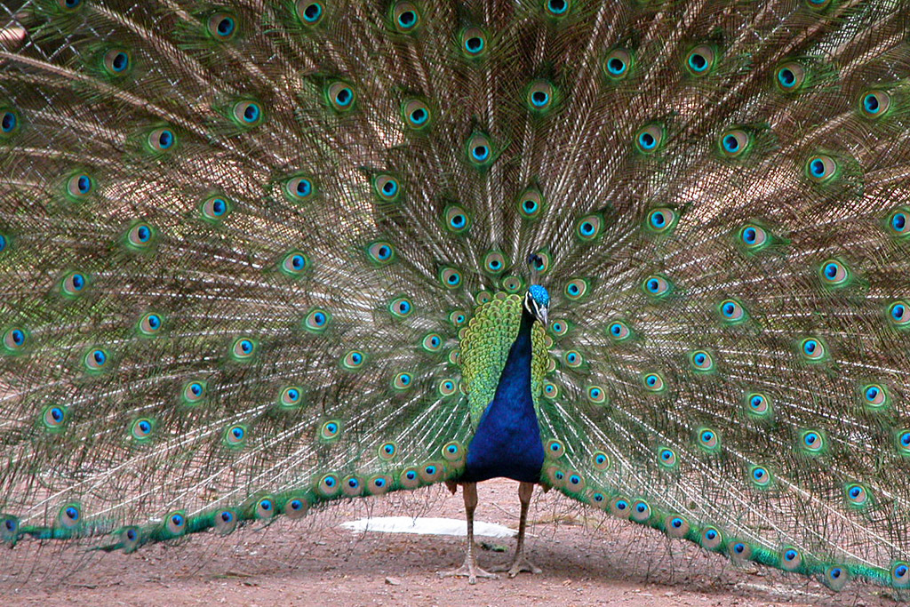
Community Interaction

Slide 42
Time

Slide 43
Language features

Slide 44

Advice

Slide 45

Learn by Doing

Slide 46

Practice Consistently

Slide 47
Start with the Basics

Slide 48

Build Something You Love

Slide 49
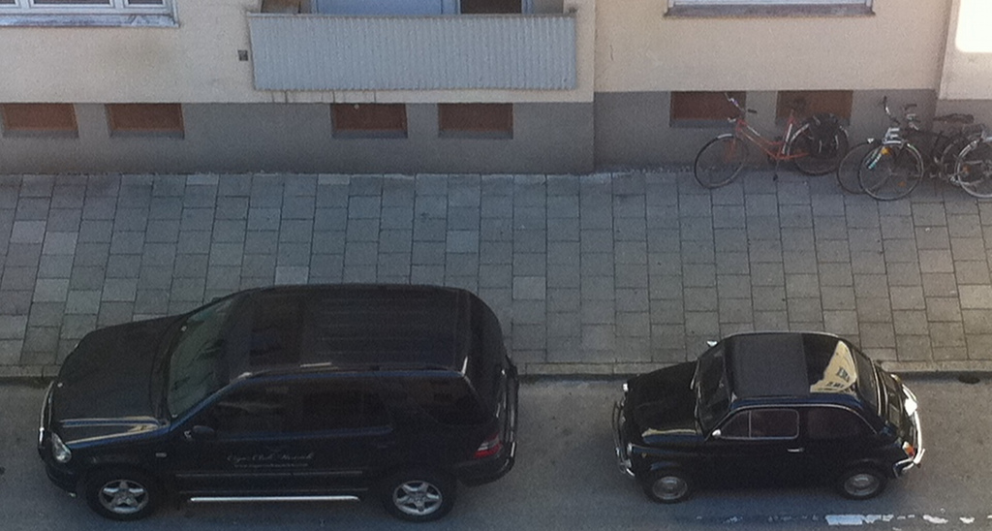
Respect Languages’ Differences

Slide 50

It Gets Better

Slide 51
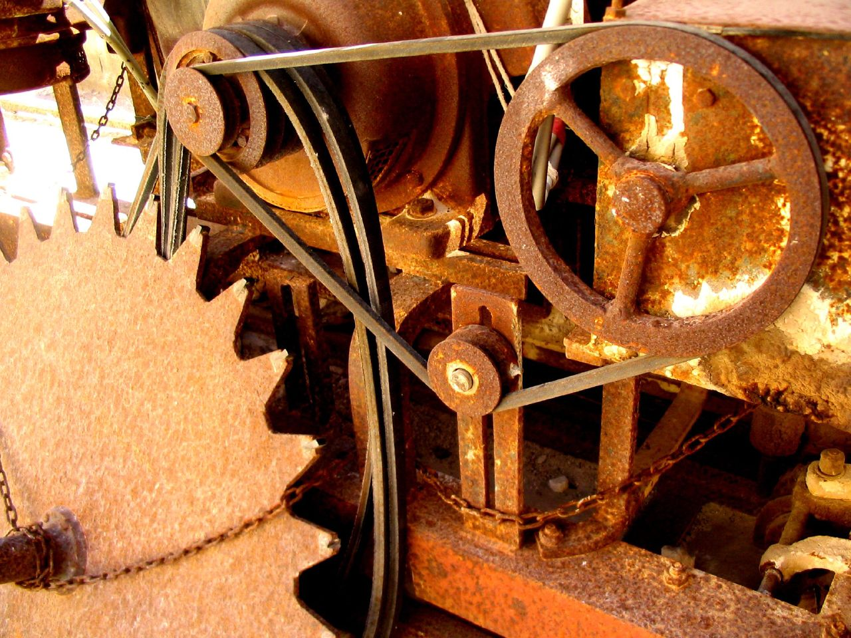
Learning Rust!

Slide 52
Are You Ready?

Slide 53
www.rust-lang.org
1.0 on May 15, 2015

Slide 54
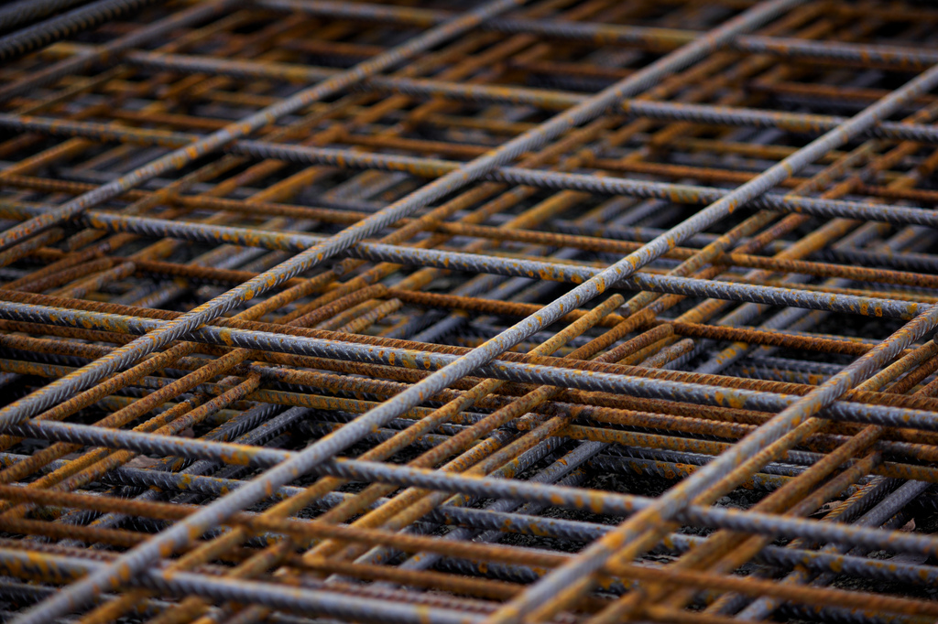
Systems Programming.
Safe, Concurrent, Fast.

Slide 55

Memory Safety, no GC.
Ownership + Lifetimes.
Types & Traits.

Slide 56
“I am learning @rustlang to ___”

Slide 57
1) Language Docs doc.rust-lang.org

Slide 58
2) Similar Languages github.com/ctjhoa/rust-learning/

Slide 59
3) Community Support www.rust-lang.org/community.html users.rust-lang.org
#rust-beginners on irc.mozilla.org

Slide 60
4) Write Real Code
GitHub search “is:open is:issue language:rust” starters.servo.org

Slide 61
5) Read The Books doc.rust-lang.org/book
O’Reilly, Programming Rust
Packt Publishing, Rust Essentials

Slide 62
6) Examine Examples rustbyexample.com
Carol’s rustlings
Rosetta Code

Slide 63
7) Find Good Tools play.rust-lang.org
Clippy and Rustfmt
IDE support

Slide 64
8) Read Real Code crates.io popular libraries
The Rust Compiler
Rust in Production

Slide 65
9) Write Toy Programs
Rust by Example exercism.io
Project Euler
Hackerrank

Slide 66
10) Google & Stackoverflow
Stackoverflow Rust tag

Slide 67
11) Watch Lectures & Courses rust-learning list

Slide 68
12) Maintain Enthusiasm
Rust subreddit
This Week In Rust

Slide 69
Errors are here to help

Slide 70
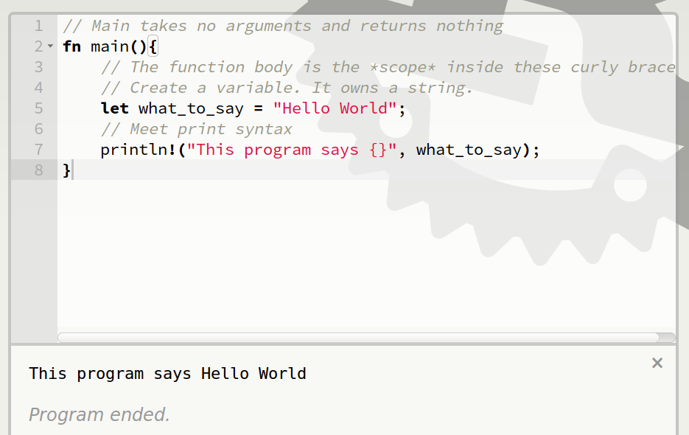
Basic Syntax

Slide 71
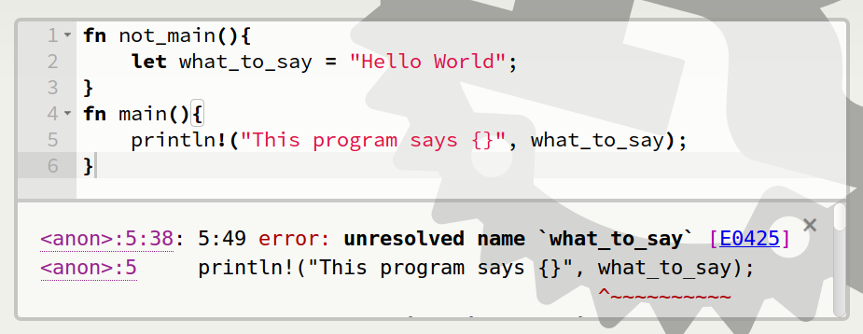
Scope Errors!

Slide 72
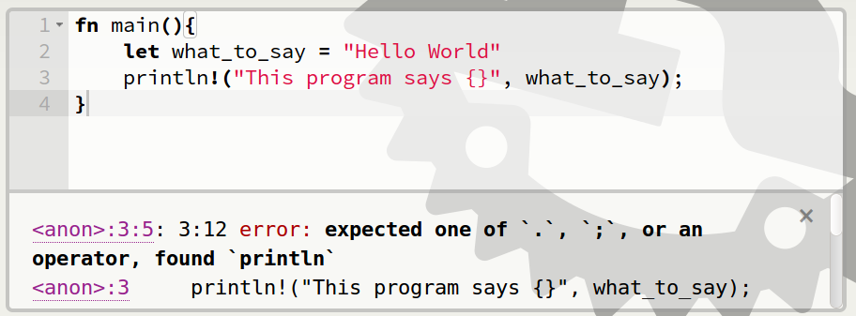
Punctuation Errors

Slide 73
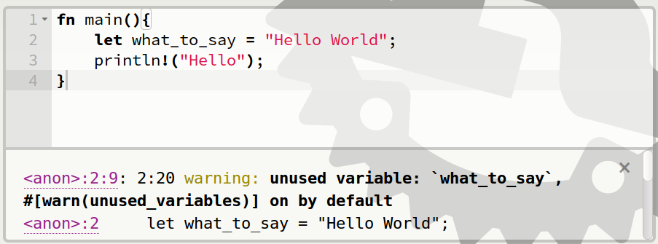
Unused Variables

Slide 74
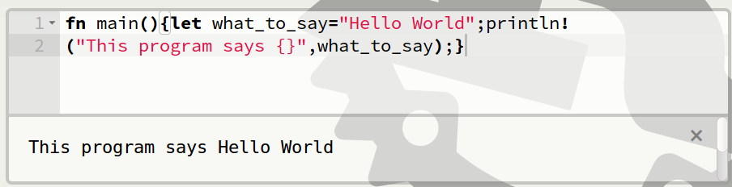
Hey, Pythonistas!

Slide 75
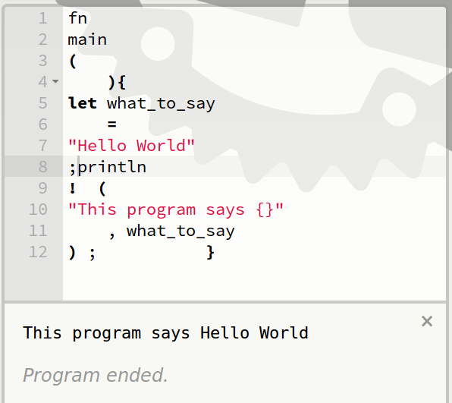
Hey, Pythonistas!

Slide 76
Primitive types (built-in)
bool
char
i8, i16, i32, i64
u8, u16, u32, u64
f32, f64
isize, usize
str
tuple
https://doc.rust-lang.org/book/primitive-types.html

Slide 77
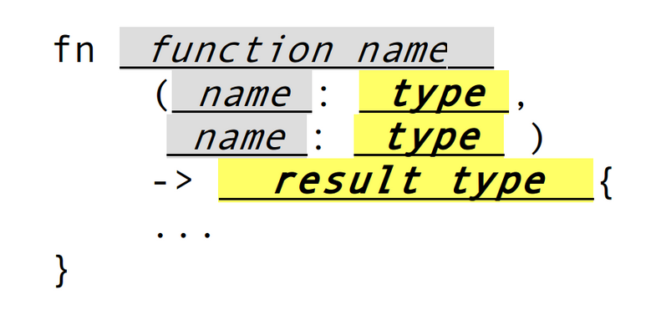
Function Type Signatures

Slide 78
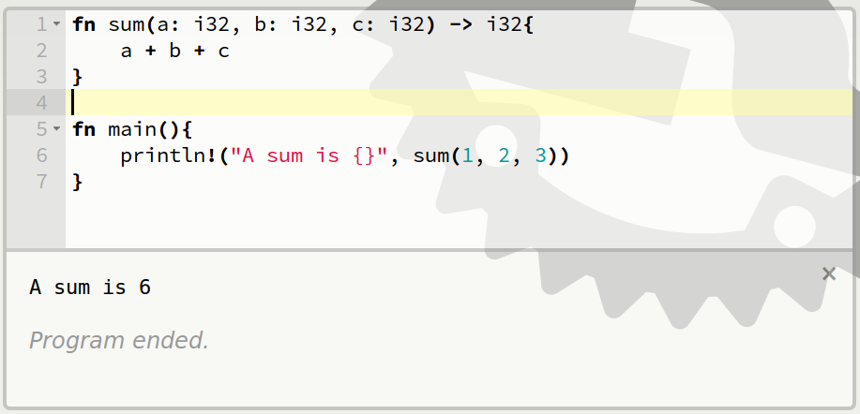
Function with a type signature

Slide 79
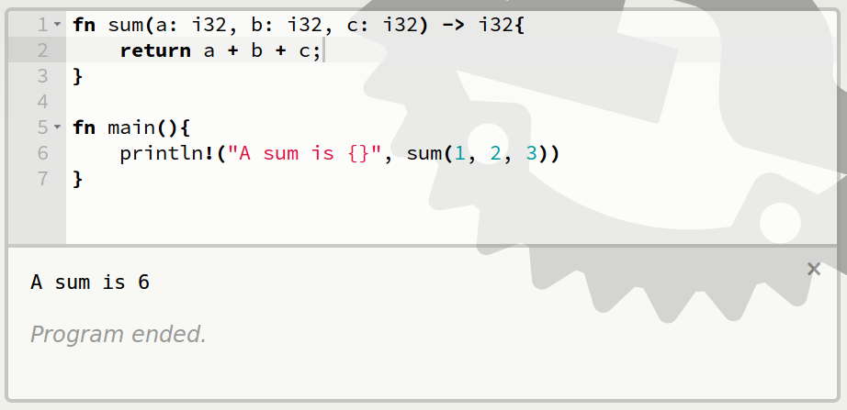
Synonymous return

Slide 80
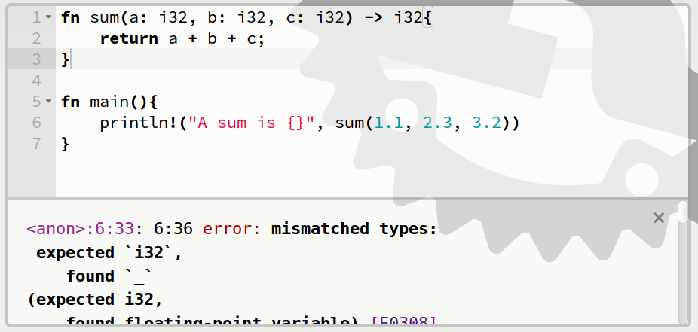
Type Errors

Slide 81
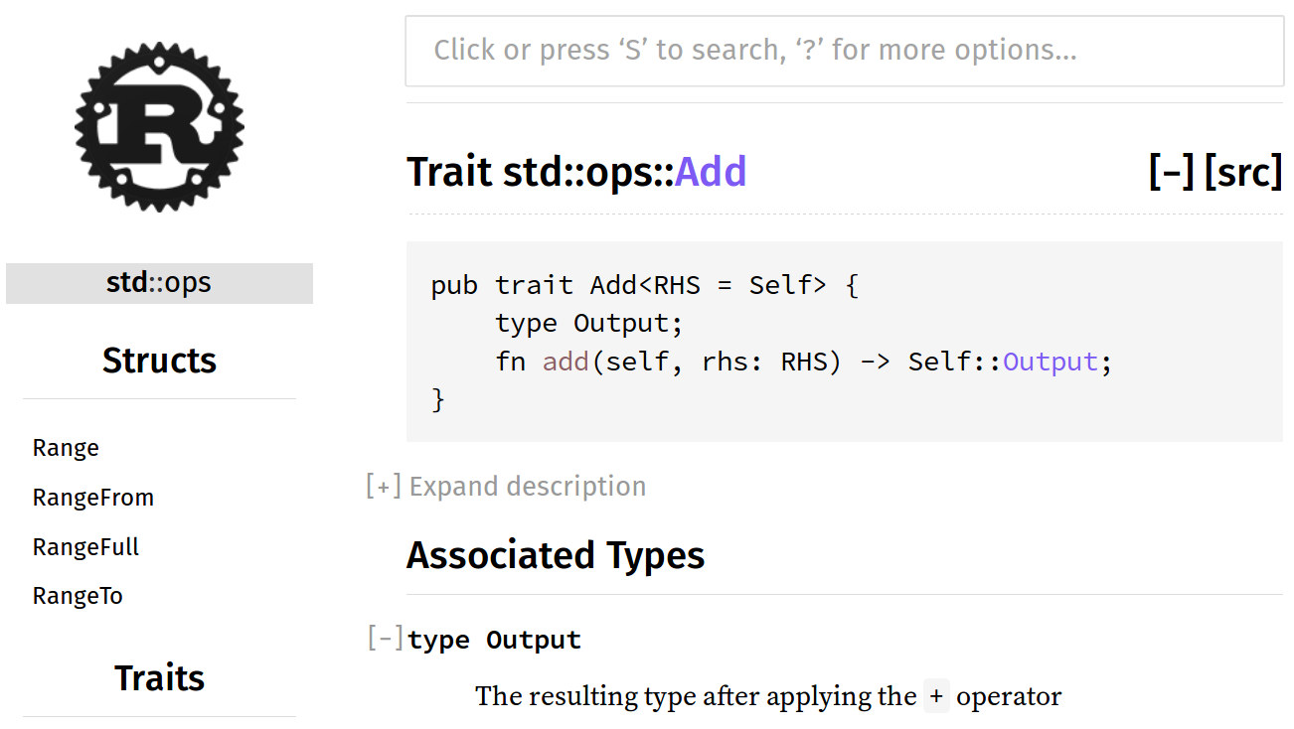
Anything you can add...
https://doc.rust-lang.org/std/ops/trait.Add.html

Slide 82
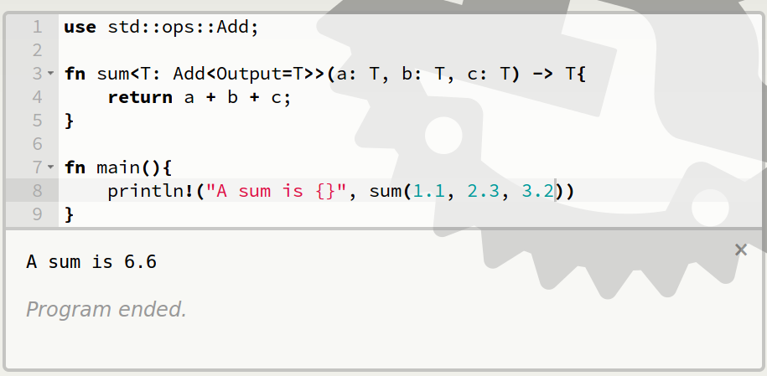
Traits

Slide 83
Additional Resources
https://doc.rust-lang.org/book/traits.html
http://blog.rust-lang.org/2015/05/11/traits.html
http://rustbyexample.com/trait.html
http://pcwalton.github.io/blog/2012/08/08/a-gentle-introduction-to-traits-in-rust/

Slide 84
Ownership Rules
No borrow may outlive value's owner
Exactly 1 mutable reference (&mut T)
  OR
As many read-only references (&T) as you want

Slide 85
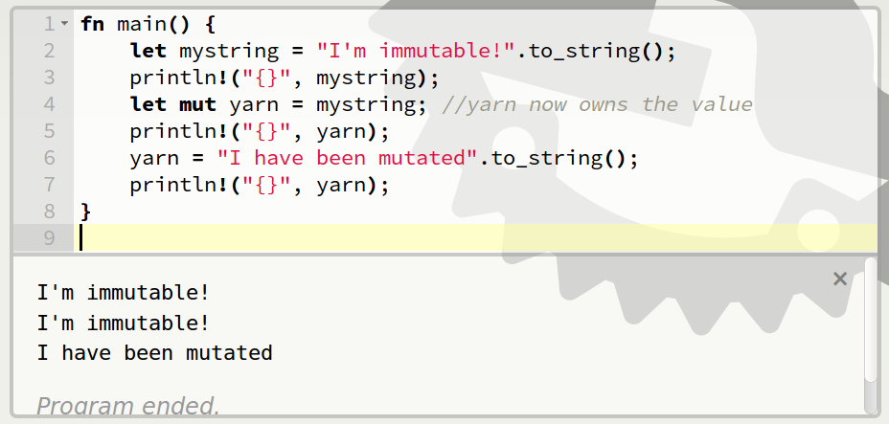
Giving Away a Value

Slide 86
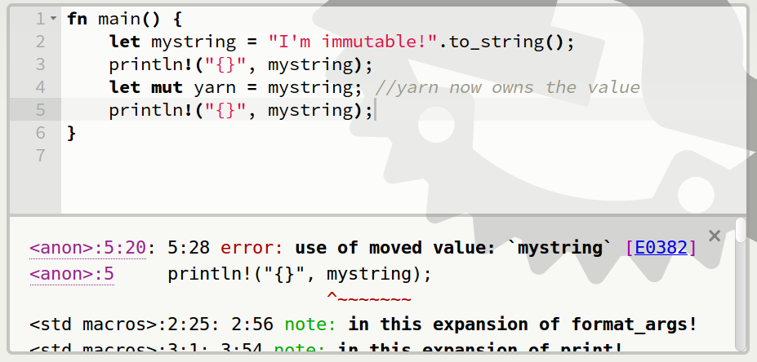
Given away means gone

Slide 87
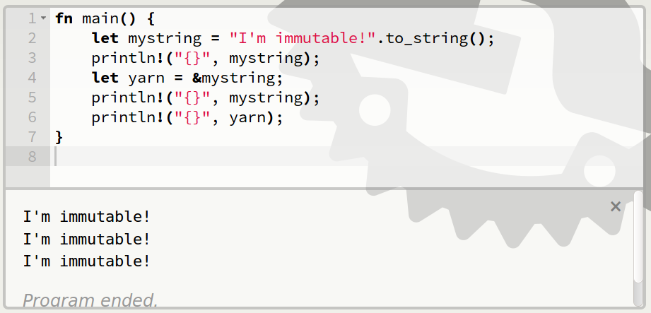
Borrow the value

Slide 88
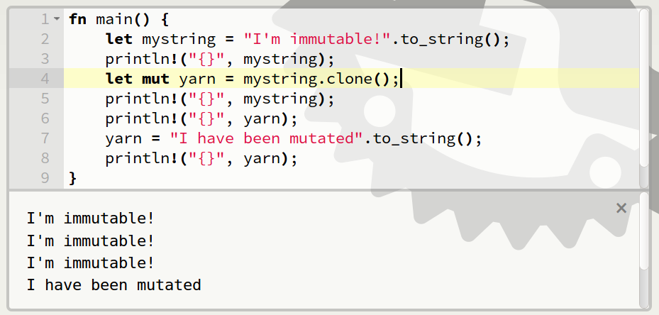
Make a mutable copy

Slide 89
Review
Only owner can access value
1 mutable reference or unlimited read-only references to each value
Borrow may not outlive owner

Slide 90
Additional Resources
http://doc.rust-lang.org/stable/book/ownership.html
http://doc.rust-lang.org/stable/book/references-and-borrowing.html
Why the to_string()? http://hermanradtke.com/2015/05/03/string-vs-str-in-rust-functions.html
http://rustbyexample.com/trait/clone.html
https://www.reddit.com/r/rust/comments/2xxjda/when_should_my_type_be_copy/

Slide 91
It Gets Better

Slide 92
Thank You talks.edunham.net/oscon2016
Photos at https://www.flickr.com/photos/143305168@N08/favorites

