Slide 1
Starting Rust from a Scripting Background
5/10/2016
oreilly@edunham.net
edunham.net
github.com/edunham
@qedunham

Slide 2
I...
You...
DevOps engineer for Mozilla Research
  Rust
  Servo
~6 years FOSS
CS Education
“How to learn Rust” talk at OSCON
Have coded a bit
Interpereted language
  Python
  Ruby
  JavaScript
  Shell scripts
Want to learn Rust!

Slide 3
This Webcast
Current as of 5/10/2016
Rust 1.8.0 is the latest Stable version
What's a systems language?
When should you use Rust?
How to install & use Rust

Slide 4
When should you use Rust?

Slide 5
A System
Application
Server

Slide 6
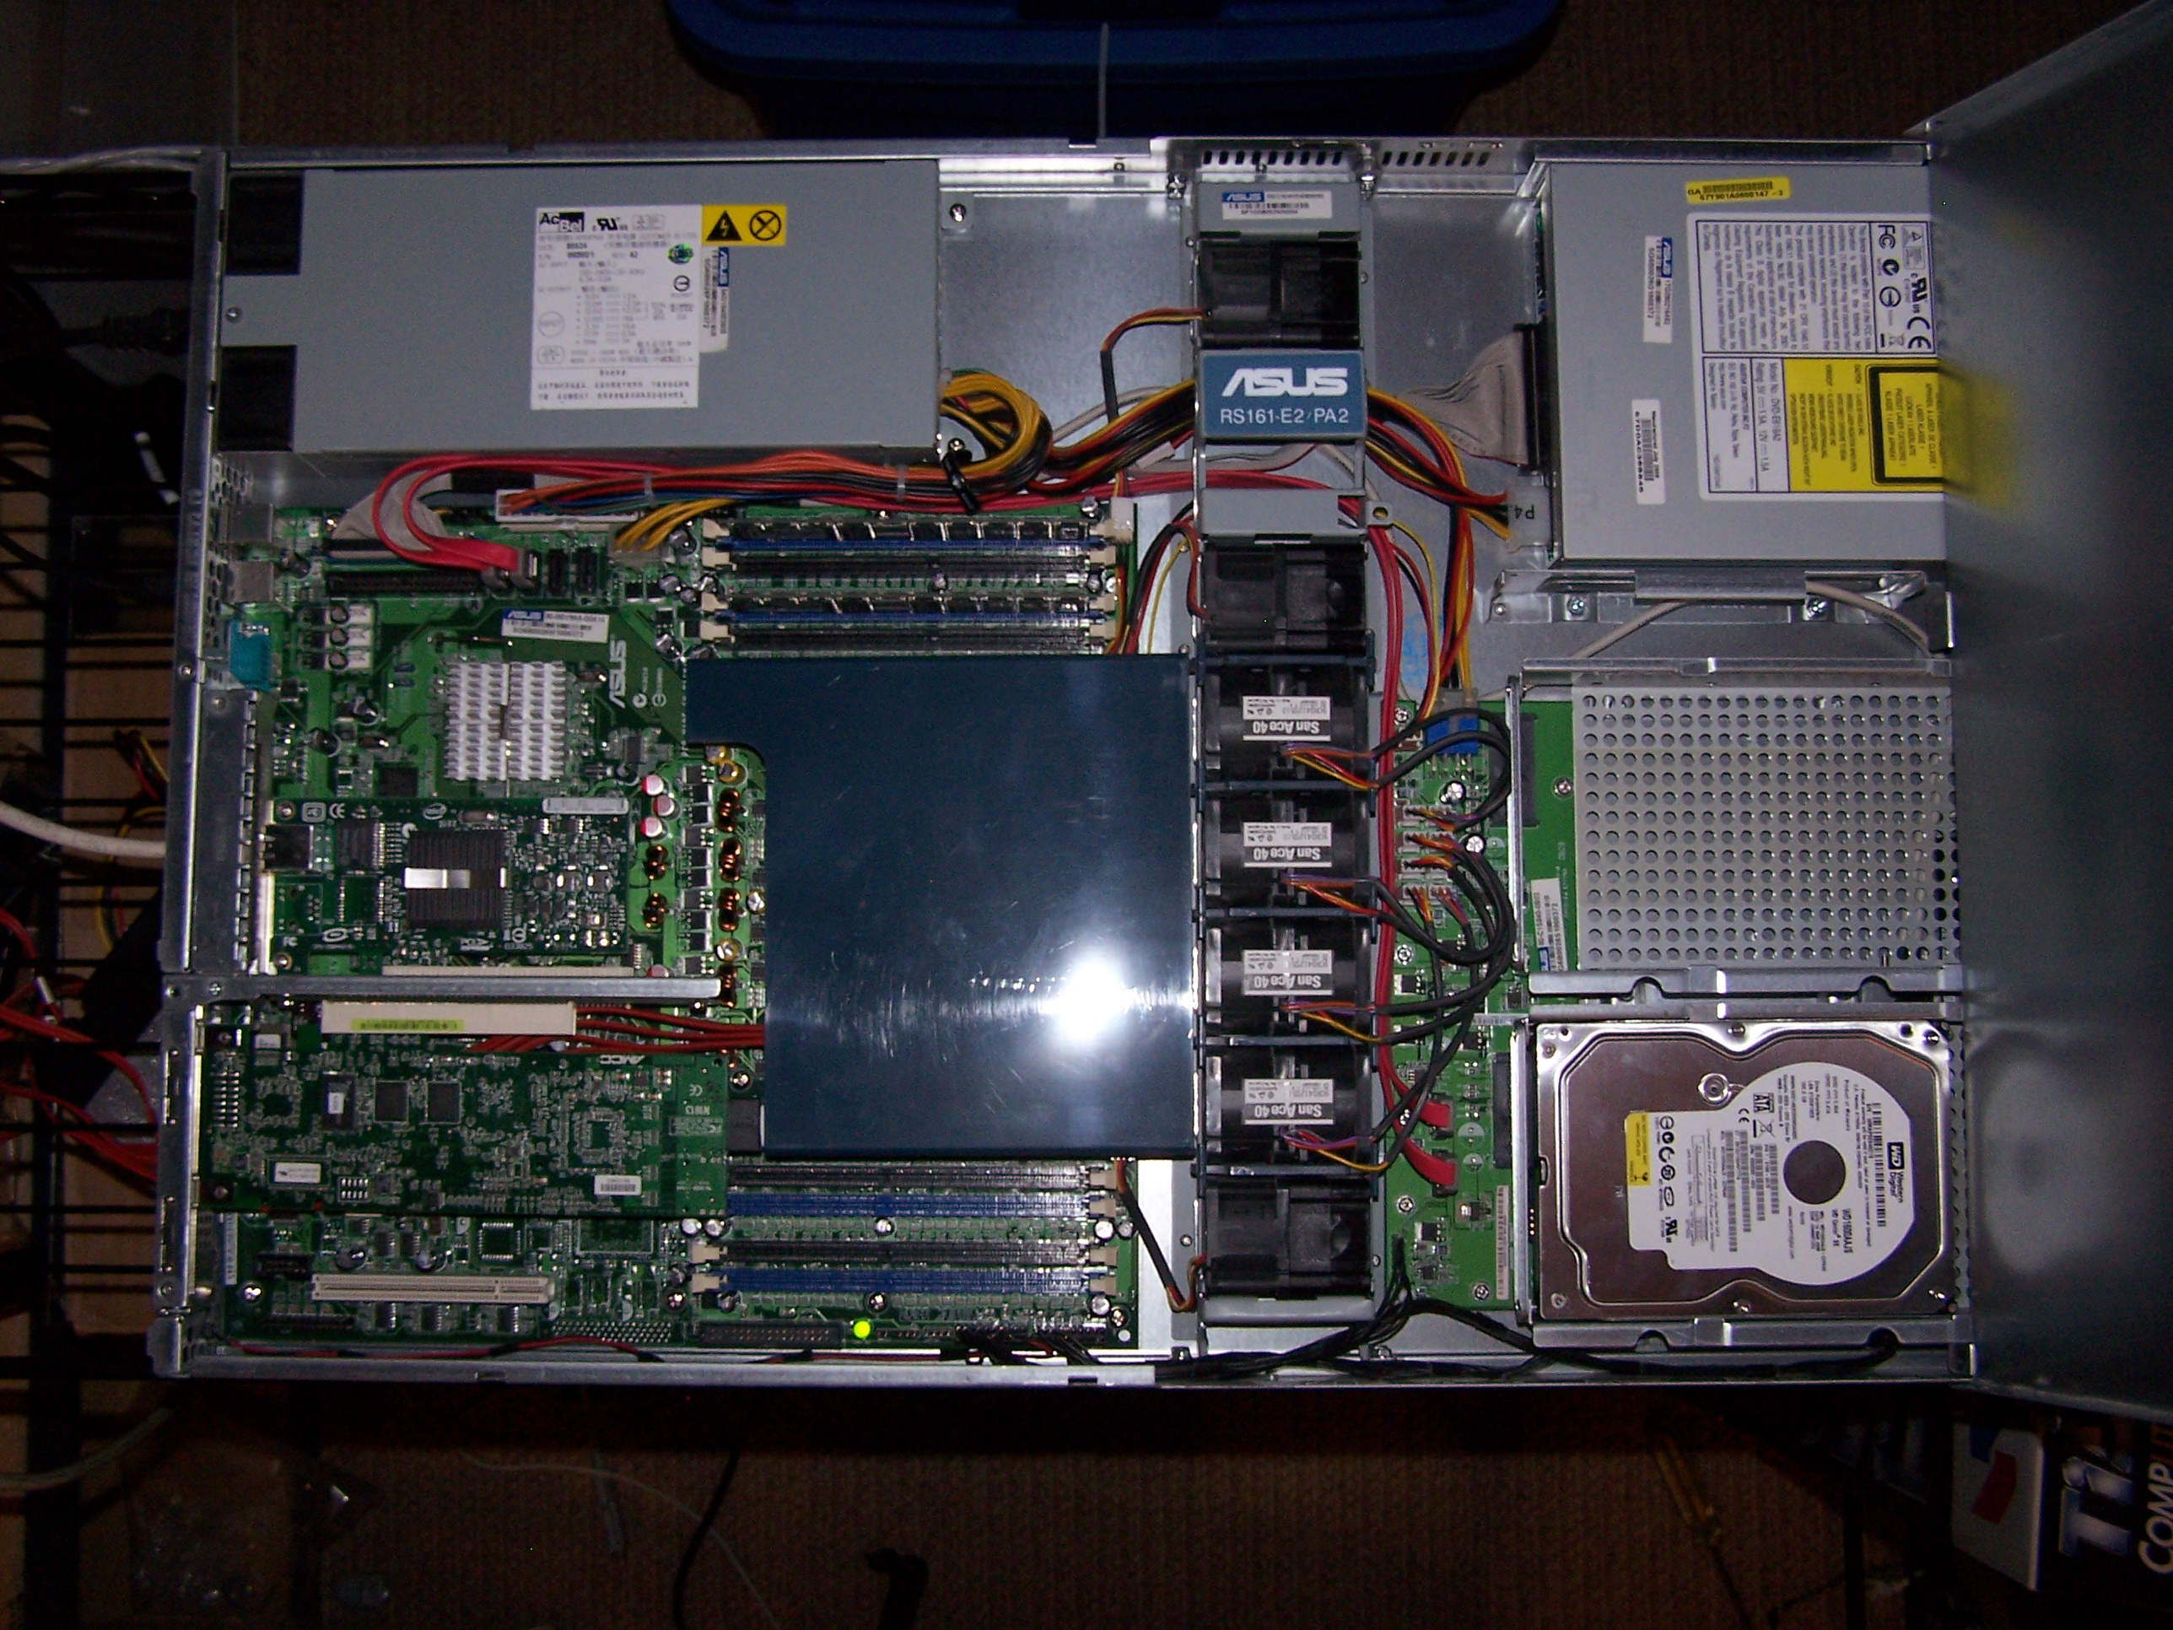
A System
https://upload.wikimedia.org/wikipedia/commons/a/ae/Rs161-e2-inside.jpg

Slide 7
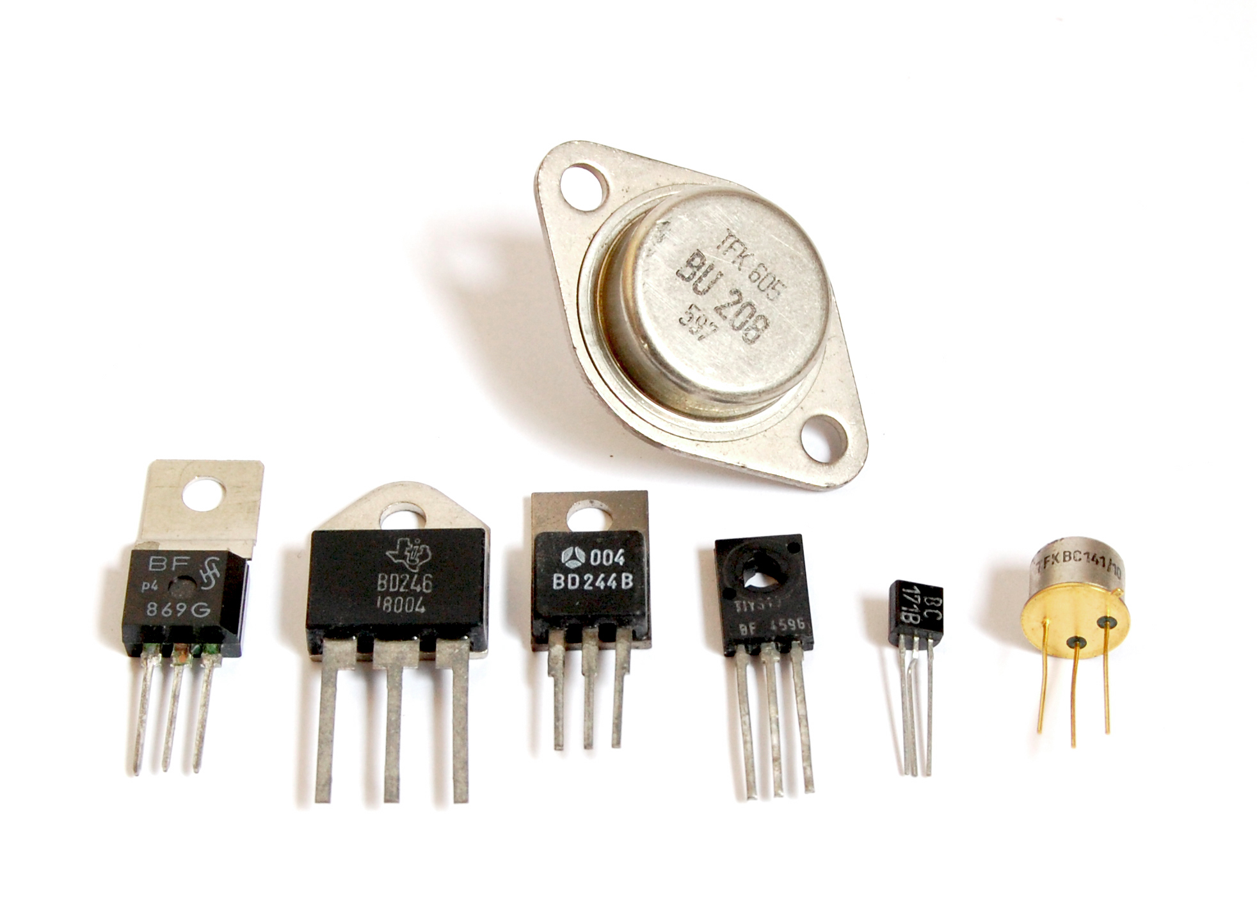
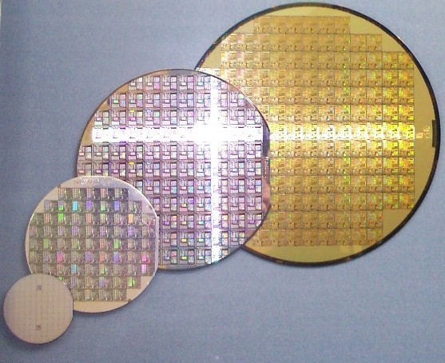
Transistors
https://upload.wikimedia.org/wikipedia/commons/0/0e/Transistors-white.jpg
https://upload.wikimedia.org/wikipedia/commons/d/d7/Wafer_2_Zoll_bis_8_Zoll_2.jpg

Slide 8
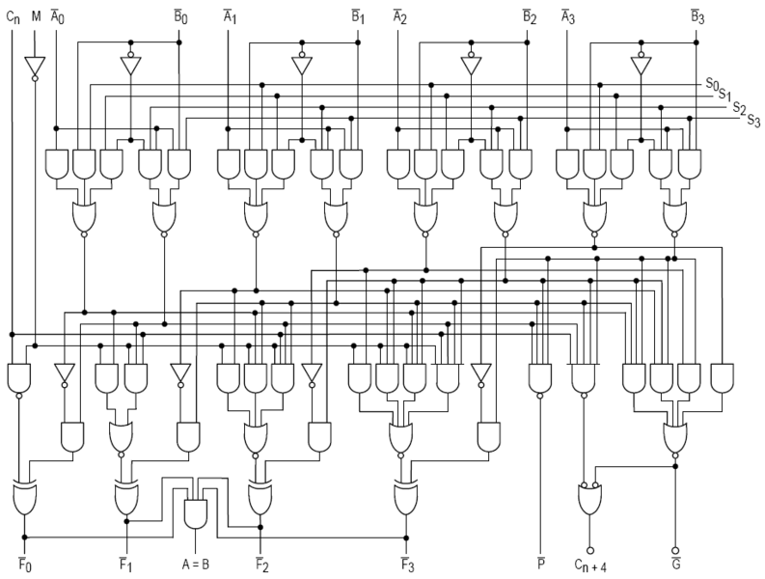
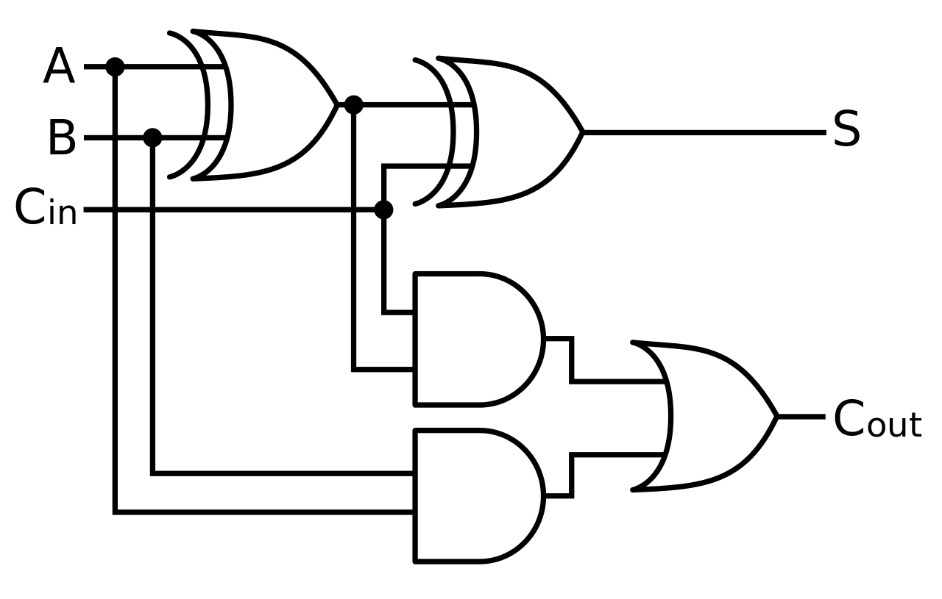
Gates & Components
https://commons.wikimedia.org/wiki/File:Full-adder.svg
https://commons.wikimedia.org/wiki/File:74181aluschematic.png

Slide 9
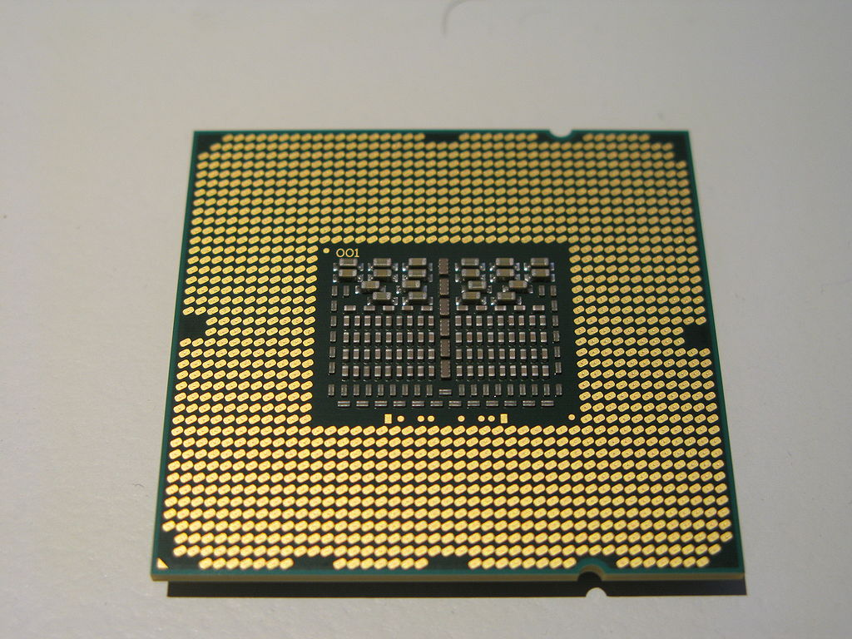
The CPU
Get an instruction
Read or store a number
Add, multiply, or negate numbers
Fast & parallel
https://en.wikipedia.org/wiki/List_of_Macintosh_models_grouped_by_CPU_type#/media/File:Intel_Core_i7-940_bottom.jpg

Slide 10
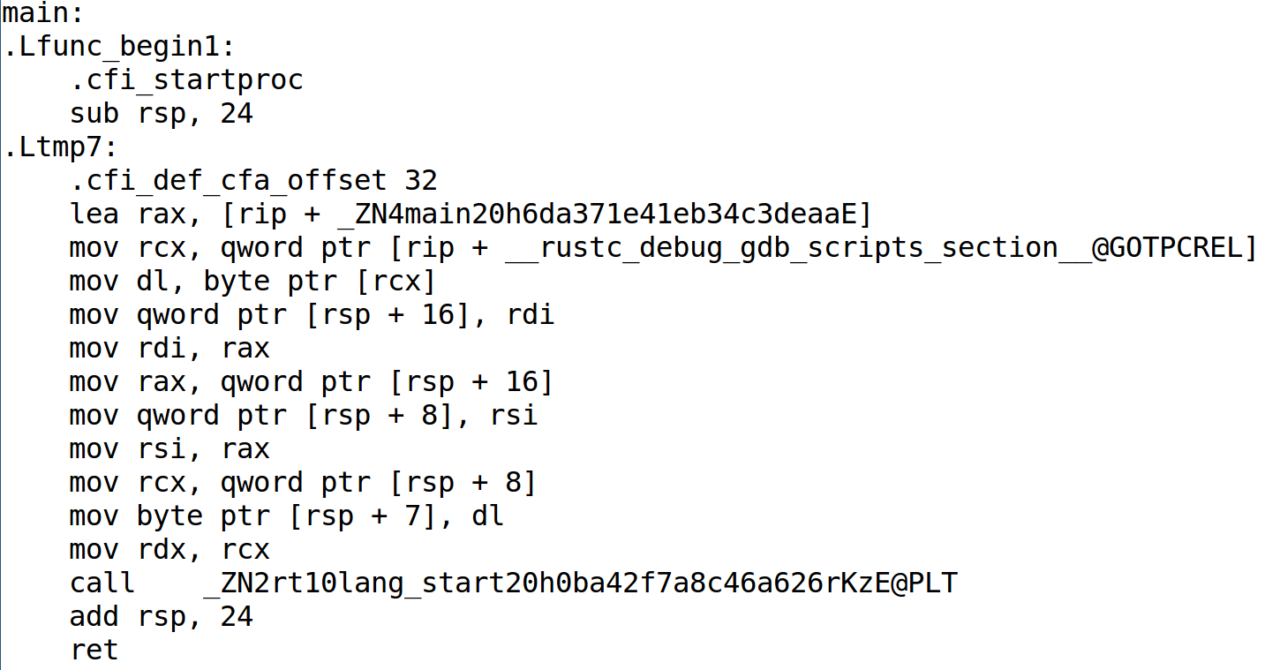
Assembly Language
For this code, run http://is.gd/d9xXAK and under settings choose Intel assembly. It's 219 lines.

Slide 12
Smaller, faster programs
take closer control of the hardware
and require greater understanding
of the hardware
to reason about them.

Slide 13
Systems vs Application
Programming Programming
Direct hardware access
Operating Systems
Embedded
Language needs:
  Minimal overhead
  Max performance
  Sacrifice ease of use
Userland
  No direct hardware access
  Runs on OS
Language needs:
  Easy to write
  Easy to read
  Sacrifice performance

Slide 14
Compiled vs Interpreted
Turn into machine language then execute
Platform-specific
C, C++, Go, Rust, Swift
Runs directly on VM or emulator
Now, compiled to IR
  Java
  Python
  Ruby
Platform-agnostic

Slide 15
Rust vs
Other Systems Languages
Code which compiles has no memory errors
Simpler concurrency
Helpful compiler
Younger language
Manually prevent errors
Concurrency as last resort
Obscure platform support

Slide 16
Safe vs Unsafe Rust
TODO put that diagram in, maybe building

Slide 17
The Rust Ecosystem

Slide 18
Channels
Stable
Beta
Nightly
"The stable release channel will provide pain-free upgrades, and the nightly channel will give early adopters access to unfinished features as we work on them."

Slide 19
Libraries
Cargo is the package manager (pip, gem, npm, bower are package managers)
Libraries are called crates
http://doc.rust-lang.org/stable/book/crates-and-modules.html

Slide 20
Code of Conduct

Slide 21
Find Rustaceans...
Users.rust-lang.org
Reddit.com/r/rust
Twitter.com/rustlang
Irc.mozila.org (#rust, #rust-beginners)
Github.com/rust-lang
Stackoverflow.com/questions/tagged/rust

Slide 22
Getting Rust

Slide 23
Try it Out
Play.rust-lang.org

Slide 24
One Version
Rust-lang.org/downloads.html

Slide 25
Several Versions
Github.com/brson/multirust

Slide 26
Your First Project
Cargo new myproject
Multirust run stable cargo new myproject
Vim myproject/src/lib.rs
Areweideyet.com

Slide 27
Resources for Writing Rust
http://rustbyexample.com/
http://doc.rust-lang.org/stable/book/
https://github.com/carols10cents/rustlings
https://github.com/ctjhoa/rust-learning

Slide 28
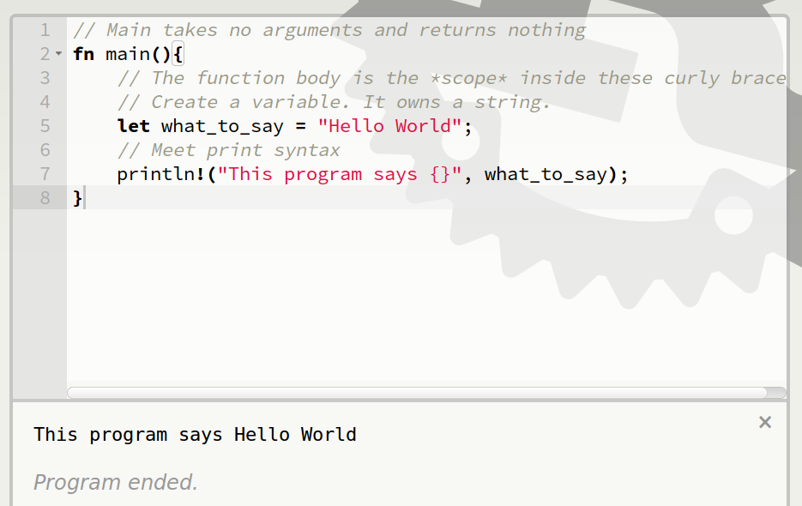
Basic Syntax

Slide 29
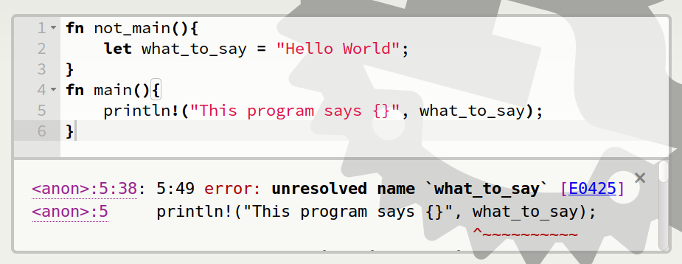
Scope Errors!

Slide 30
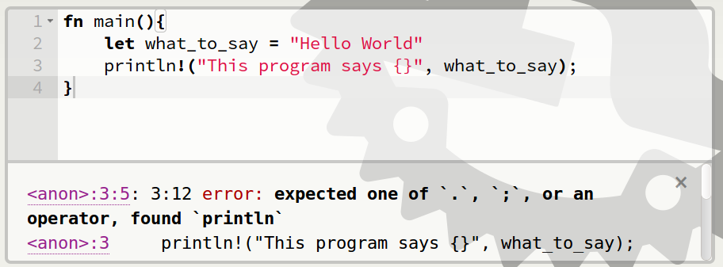
Punctuation Errors

Slide 31
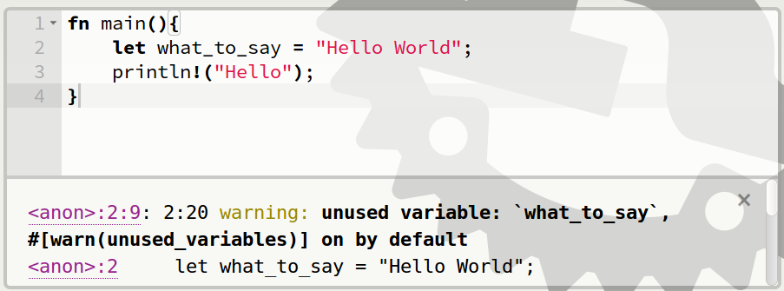
Unused Variables

Slide 32
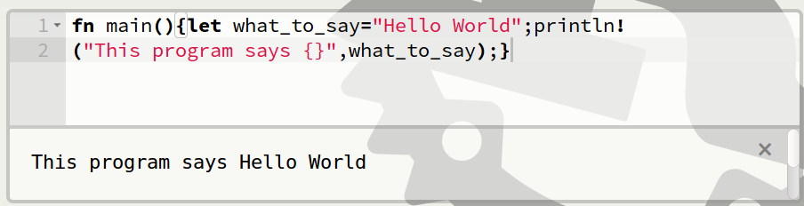
Hey, Pythonistas!

Slide 33
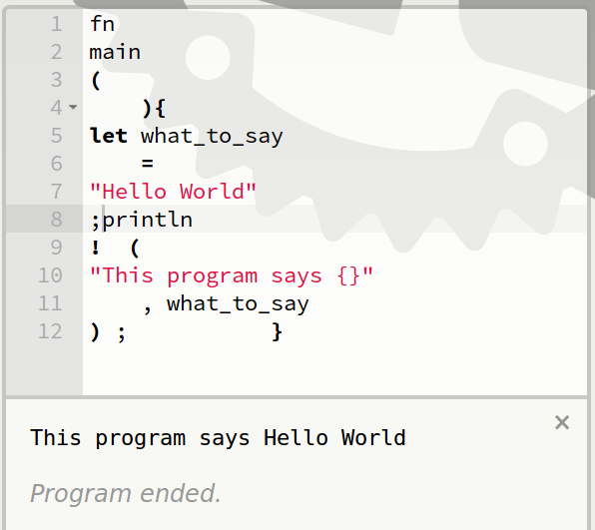
Hey, Pythonistas!

Slide 34
Review

