Slide 1

Automating More Of The Things
pdxdevops@edunham.net
@QEDunham
Talks.edunham.net/pdxdevops2017

Slide 2

DevOps

Slide 3
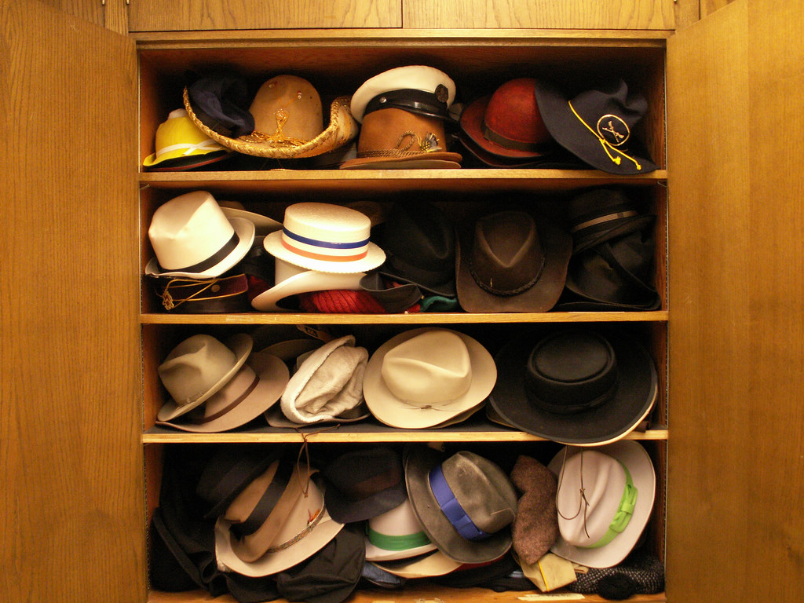

Slide 4


Slide 5
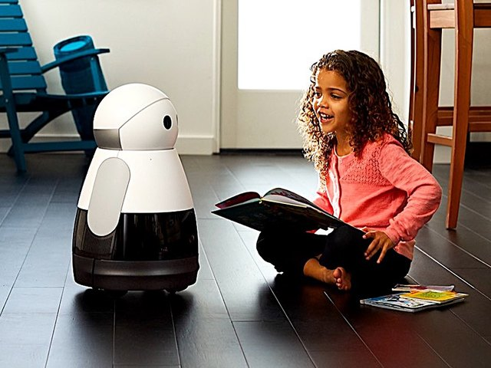

Slide 6


Slide 7


Slide 8


Slide 9


Slide 10
Humans behave unpredictably.

Slide 11
Reduce conflicts by setting expectations.

Slide 12
Rust’s Expectations
“...most impressive aspect of Rust is the welcoming community that supports it. This community could become Rust’s not-so-secret weapon.”
  http://www.infoworld.com/article/2947214/open-source-tools/two-reasons-the-rust-language-will-succeed.html
“The Rust community seems to be populated entirely by human beings. I have no idea how this was done.”
  http://scattered-thoughts.net/blog/2015/06/04/three-months-of-rust/

Slide 13
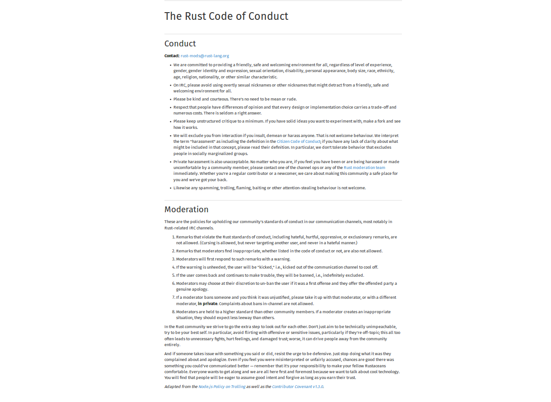

Slide 14
You can set expectations
Local laws & company policy are MVP
Get buy-in for explicit guidelines
Build on positive in-jokes / culture
Put reminders where they’re needed
CONTRIBUTING.txt in public projects

Slide 15
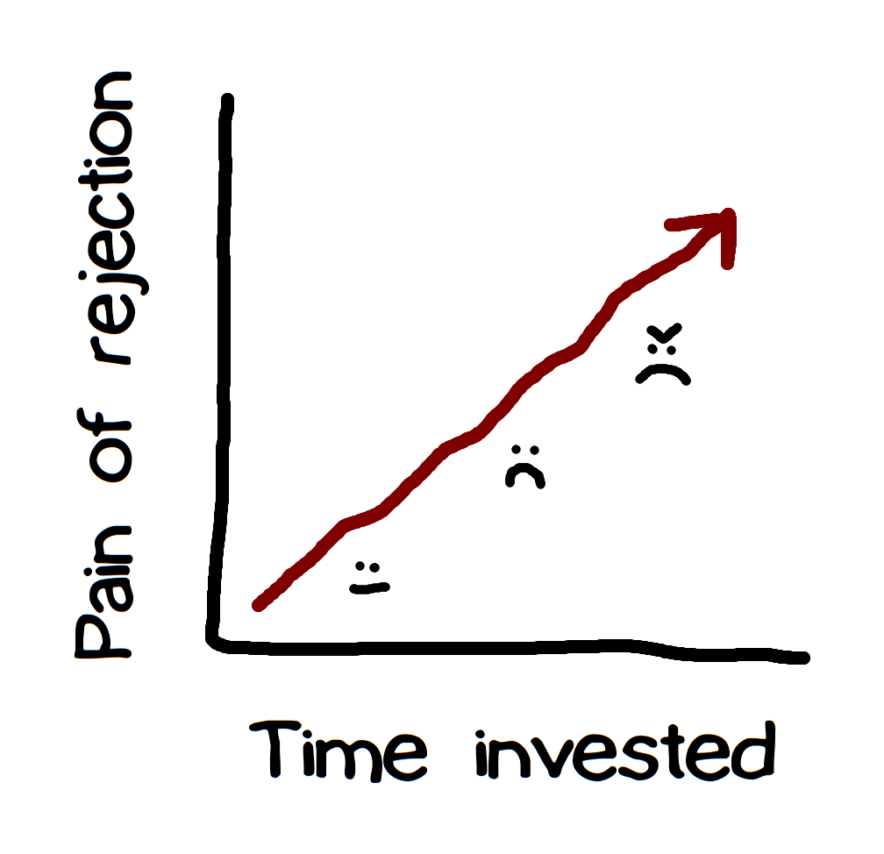
Rejecting changes can cause conflicts.

Slide 16
Communicate (& document) early and often about what to do and who’s doing it.

Slide 17
Rust’s RFC process
“We ask that [larger changes] be put through a bit of a design process and produce a consensus
… so that all stakeholders can be confident about the direction the language is evolving in.”
https://github.com/rust-lang/rfcs/

Slide 18

Rust & Servo’s Distributed Teams

Slide 19
You can require communication
Require design docs before landing changes
Ask docs first; answer from docs
Identify & reduce penalties for communication

Slide 20
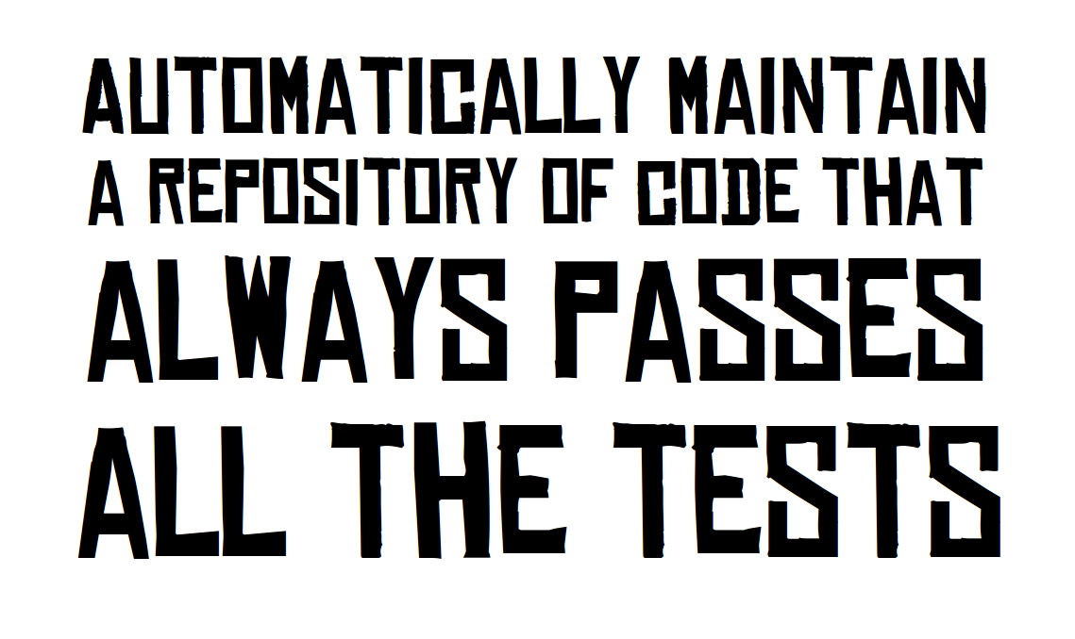
http://graydon.livejournal.com/186550.html

Slide 21
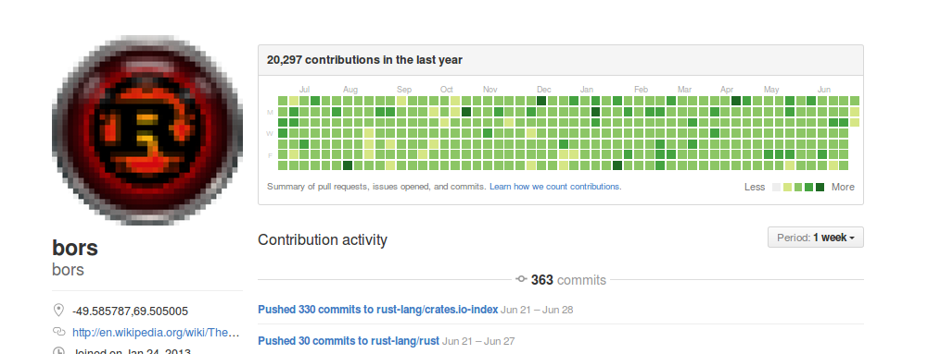
Rust & Servo use Homu
https://github.com/servo/homu
Test tree’s state after landing r+’d PR

Slide 22
You can, too!
Test all changes
Prevent landing code that fails
Maintain your tests
danger.systems (code review automation)

Slide 23
Being polite and welcoming requires repeating yourself a lot

Slide 24
Get help from a friendly robot.

Slide 25
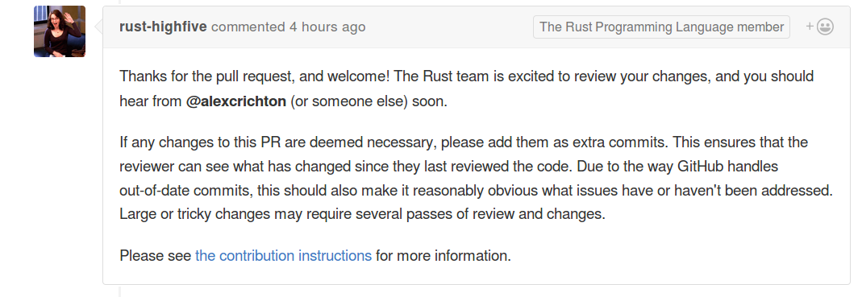
Rust’s Friendly Robots
https://github.com/nrc/highfive
Offer guidance & assign reviewer

Slide 26
Your friendly robots
Use pull request & issue templates
Enable notifications
https://github.com/facebook/mention-bot
Github.com/servo/highfive

Slide 27
Mentoring newbies takes experts’ time away from their work

Slide 28
Distribute & automate onboarding and basic mentorship

Slide 29
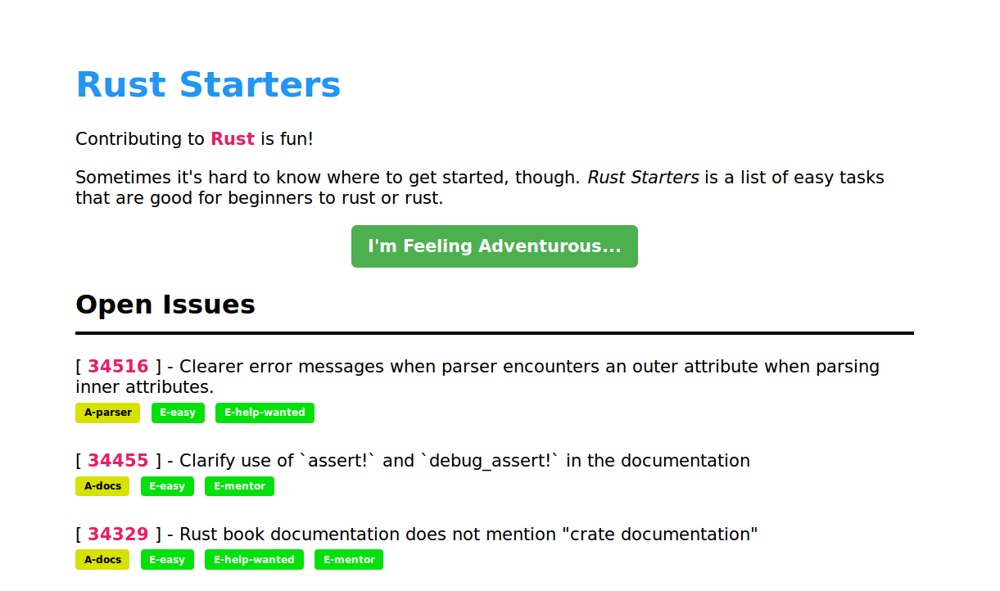
Rust & Servo’s mentorship automation
http://edunham.github.io/rust-starters/, https://starters.servo.org/

Slide 30
You can automate your pipeline
CONTRIBUTING.txt
https://www.codemontage.com/
http://www.codetriage.com/
http://issuehub.io/
http://up-for-grabs.net/
http://yourfirstpr.github.io/
https://openhatch.org

Slide 31
Thank you!
https://cdn.meme.am/cache/images/folder885/1121885.jpg
http://theawesomedaily.com/wp-content/uploads/2014/10/i-have-no-idea-what-im-doing-dog-feat-1-620x400.jpg
https://www.flickr.com/photos/mamluke/2615624085
https://registrar.ku.edu/sites/registrar.ku.edu/files/images/general/delegate-subpage.jpg
http://media.thelisttv.com/photo/2017/01/27/16x9/3_Cute_Robots_Changing_the_Way_We_Live_a_0_54121831_ver1.0_640_480.jpg
http://chitinc.com/img/cloud%20computing%20sidebar.jpg
http://www.druckerinstitute.com/wp-content/uploads/2014/10/time-management.png
https://cdn.shutterstock.com/shutterstock/videos/22741963/thumb/1.jpg
http://static.jeffbullas.com/wp-content/uploads/2015/08/Tools-for-content-marketers-header-image.jpg
http://geology.com/store/wall-maps/world-physical-map-lg.jpg

