Slide 1
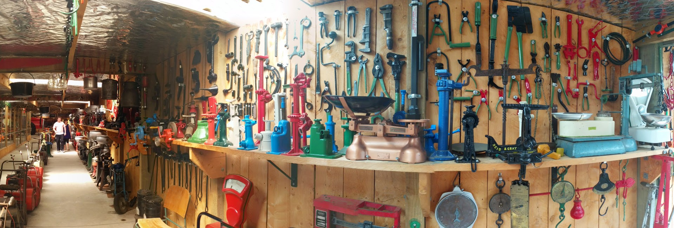

Rust’s Community Automation
6/28/2016

Slide 2

talks.edunham.net/codeconfLA2016
@QEDunham codeconfLA@edunham.net

Slide 3
Rust
Started ~2010
1.0 Stable May 15, 2015
54380 commits, 1582 authors
79.1% “loved”, https://stackoverflow.com/research/developer-survey-2016
Safe, Concurrent, Fast.

Slide 4
Community
https://www.rust-lang.org/
https://github.com/rust-lang/
https://www.reddit.com/r/rust/
https://users.rust-lang.org/
http://stackoverflow.com/questions/tagged/rust
irc.mozilla.org #rust #rust-beginners
http://rustaceans.org/
https://twitter.com/rustlang

Slide 5
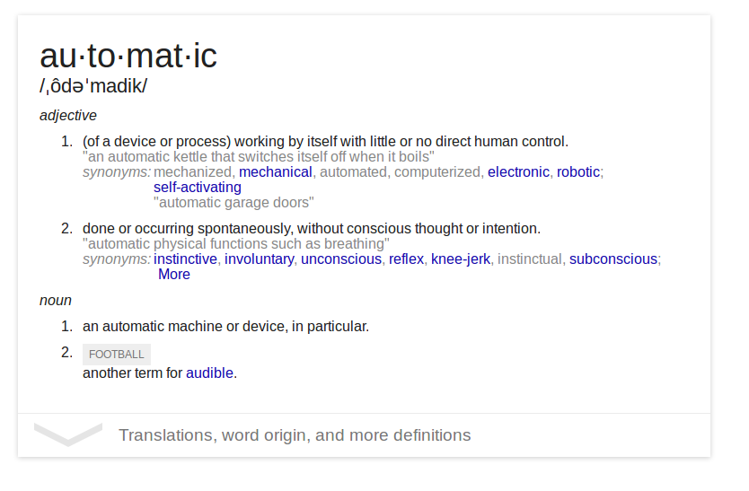
Automation

Slide 6

Processes

Slide 7
Expectations
“...most impressive aspect of Rust is the welcoming community that supports it. This community could become Rust’s not-so-secret weapon.”
  http://www.infoworld.com/article/2947214/open-source-tools/two-reasons-the-rust-language-will-succeed.html
“The Rust community seems to be populated entirely by human beings. I have no idea how this was done.”
  http://scattered-thoughts.net/blog/2015/06/04/three-months-of-rust/

Slide 8
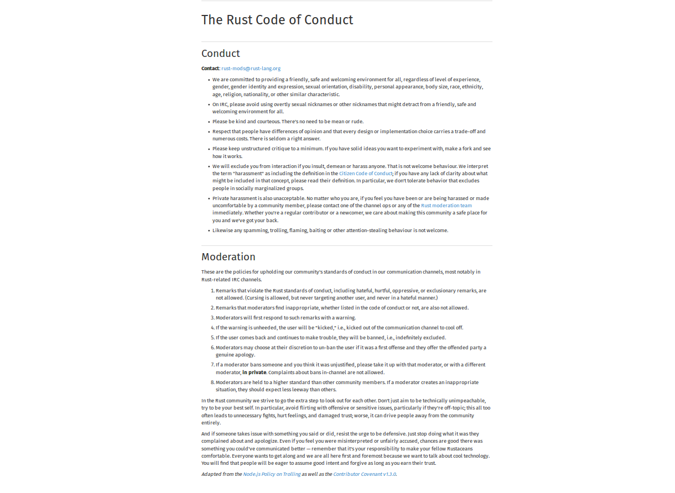

Slide 9
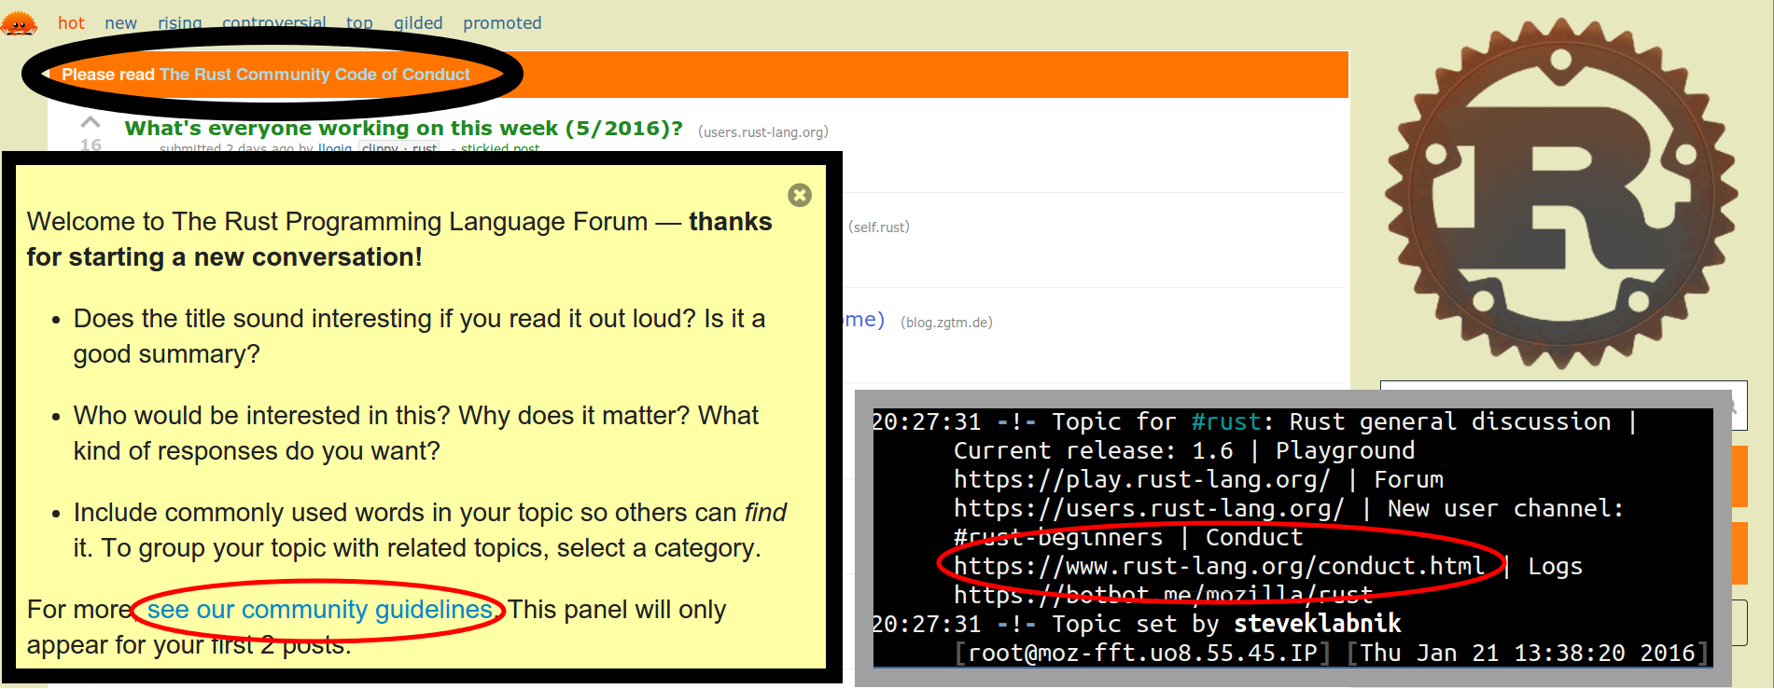
Automatic Reminders

Slide 10
Exclusion
“The Rust community gives me a particularly bad feeling. They're rather tyrannical about enforcing their code of conduct. They even have a moderation attack squad to go after anyone they deem to be an enemy! ... This sets off warning alarms for me.”
  https://developers.slashdot.org/comments.pl?sid=8652809&cid=51352141

Slide 11
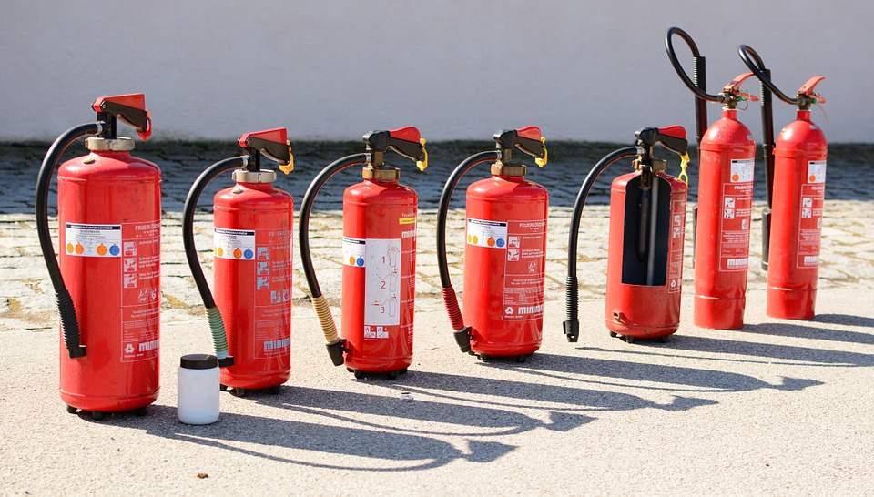
https://pixabay.com/static/uploads/photo/2015/04/08/16/19/fire-extinguisher-712975_960_720.jpg

Slide 12
Communication
“We ask that [larger changes] be put through a bit of a design process and produce a consensus
… so that all stakeholders can be confident about the direction the language is evolving in.”
https://github.com/rust-lang/rfcs/

Slide 13
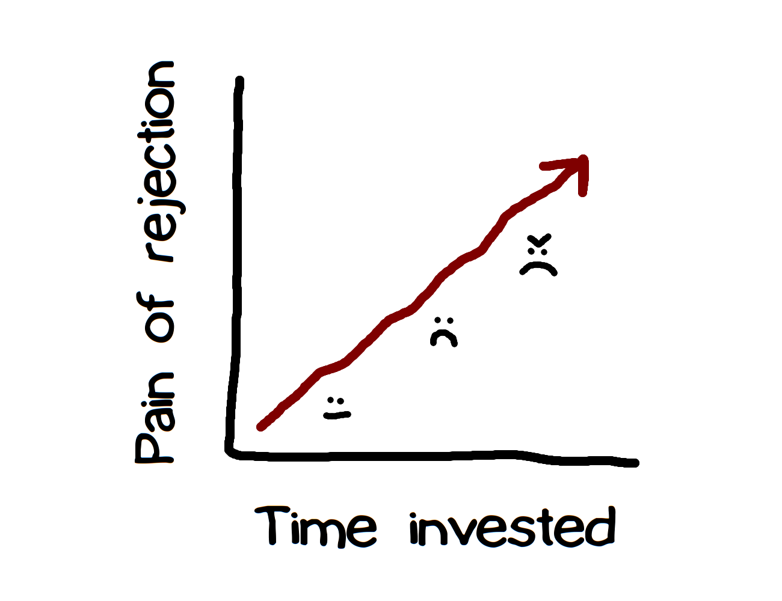

Slide 14


Appreciation
https://this-week-in-rust.org/
http://blog.rust-lang.org/
“Friends of the Tree”

Slide 15
Processes Recap
High expectations
Exclude the immoderate
Require & simplify communication
Show appreciation

Slide 16
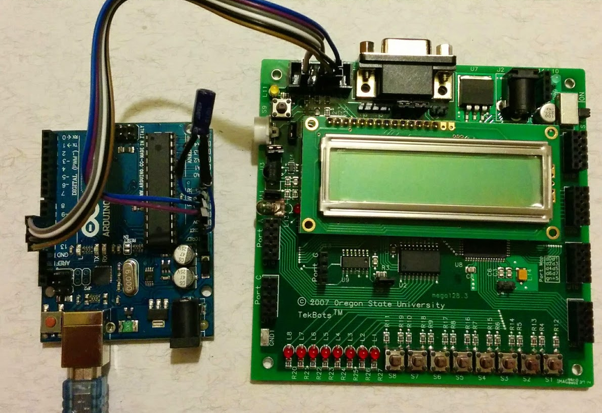
Robots

Slide 17
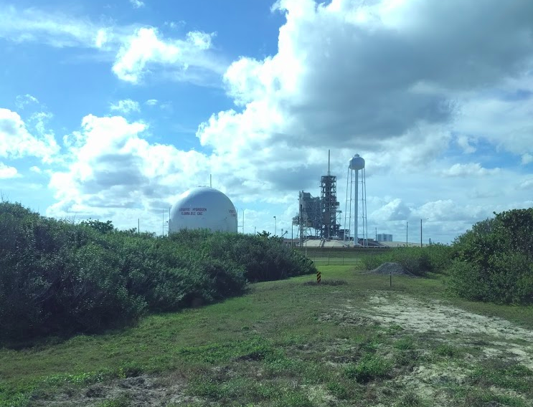

Slide 18
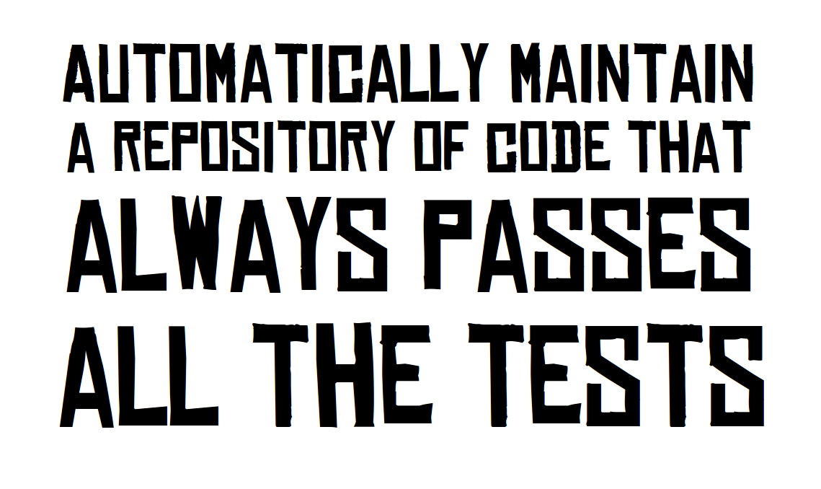
http://graydon.livejournal.com/186550.html

Slide 19
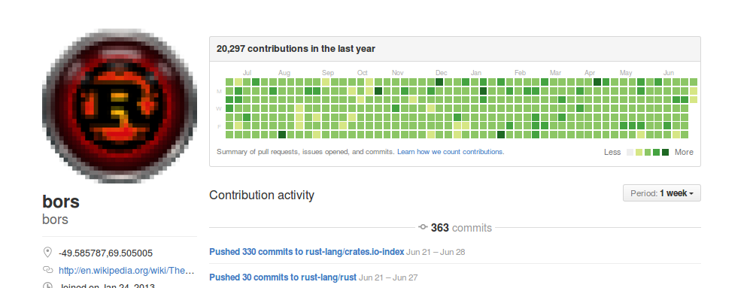
Rust: Bors & Homu
https://github.com/servo/homu
Test tree’s state after landing r+’d PR

Slide 20
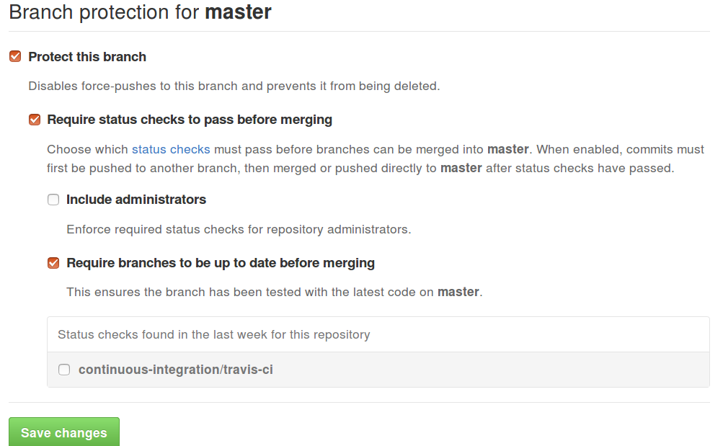
Starting out…
Test every PR!
  https://docs.travis-ci.com/user/getting-started/
Protected branches help…
  github.com/user/repo
  /settings/branches

Slide 21
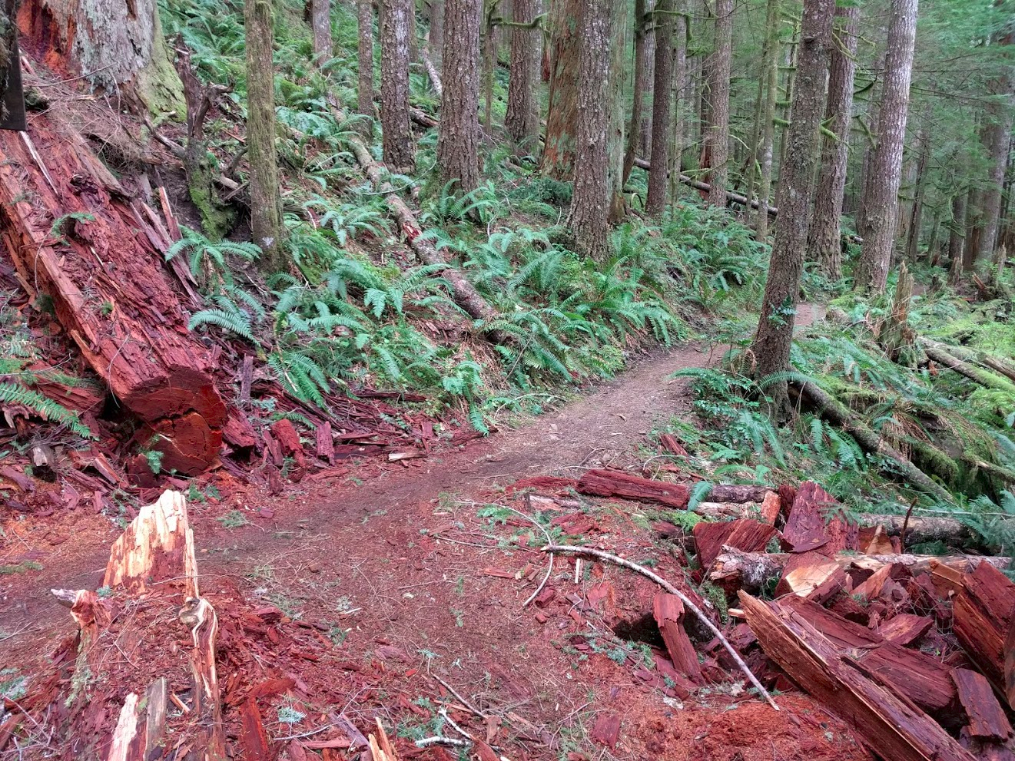

Slide 22
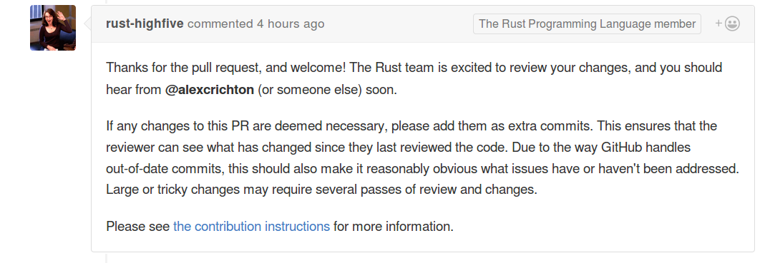
Welcoming Newbies
https://github.com/nrc/highfive
Offer guidance & assign reviewer

Slide 23
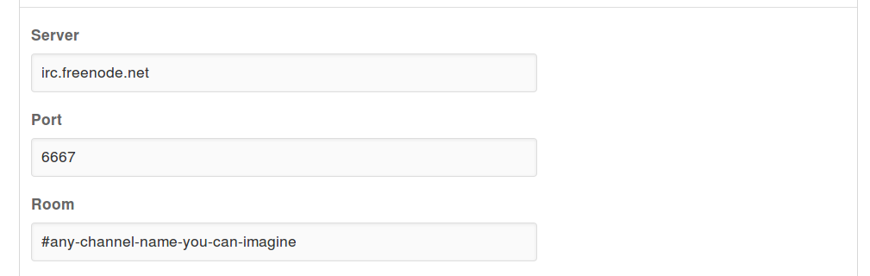
For Your Repos
Use PR templates
  https://github.com/blog/2111-issue-and-pull-request-templates
Enable notifications
  github.com/user/repo/settings/hooks

Slide 24
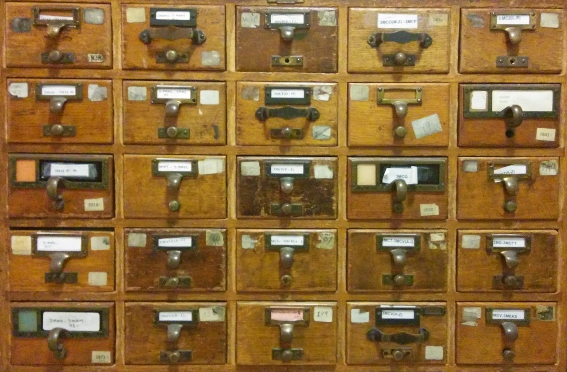

Slide 25
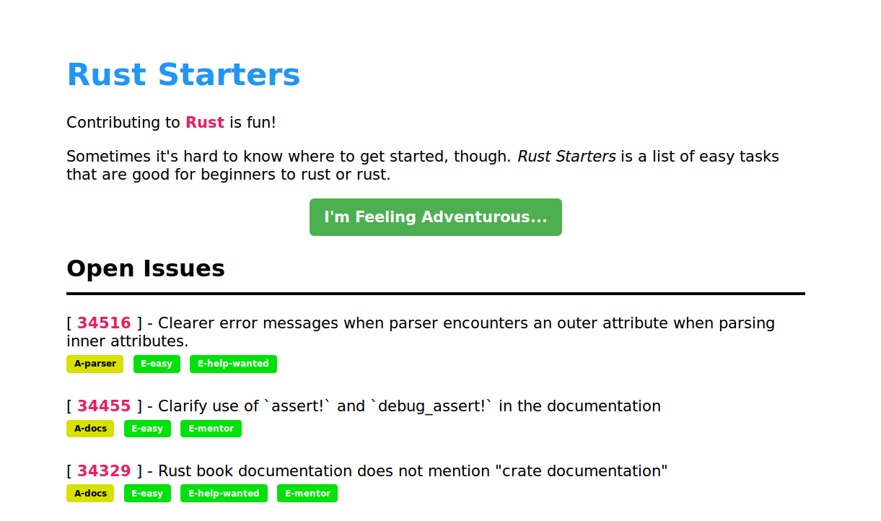
Mentorship & Guidance
http://edunham.github.io/rust-starters/, https://starters.servo.org/

Slide 26
Automate your pipeline!
CONTRIBUTING.txt
https://www.codemontage.com/
http://www.codetriage.com/
http://issuehub.io/
http://up-for-grabs.net/
http://yourfirstpr.github.io/
https://openhatch.org

Slide 27
Robots Recap
Automatically maintain a repository of code that always passes all the tests
Welcome & guide new contributors
Mark & share introductory bugs

Slide 28
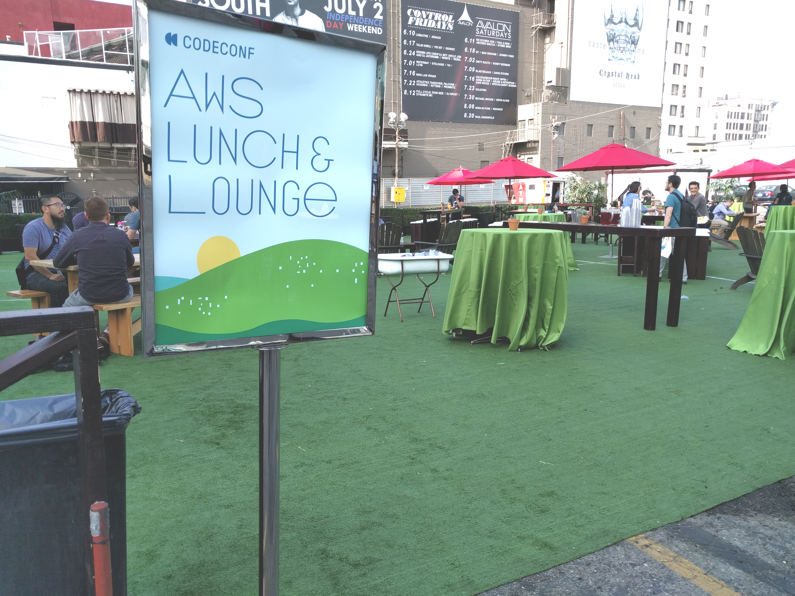
talks.edunham.net/codeconfLA2016
@QEDunham codeconfLA@edunham.net

