Slide 1
Servo DevOps Stuff

Slide 2
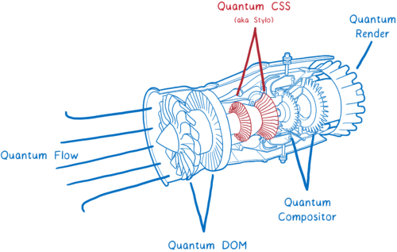
https://tctechcrunch2011.files.wordpress.com/2017/09/01-500x317.png
Notes:
Like how a compiler turns words for humans into words for computers, a browser engine turns the web’s HTML, CSS, and JavaScript into something meant for people to look at. It’s called the engine because the browser doesn’t go without it, and it has a lot of complicated moving parts.

Slide 3

https://pixabay.com/en/tools-spanner-old-rusty-concepts-1552787/
Notes:
Graydon noticed that when he and his colleagues wrote C++, the language would let them introduce all kinds of errors. For instance, you could point your pointers at values that your code had no business reading, and if you wanted to return exactly the right type of data from a function you’d have to be very skilled at memorizing different sections of the codebase and holding them all in your head at once. The daunting task of building a fast, modern browser was made even more difficult because their tools weren’t helping.

Slide 4

Notes:
Graydon’s solution to this problem was to try to build a new language that would make it harder to break the rules of writing good systems code. He showed his employer Mozilla the project, and they encouraged him to keep putting time into it. Eventually the Rust project grew to being a whole team within the Research division of Mozilla.

Slide 5
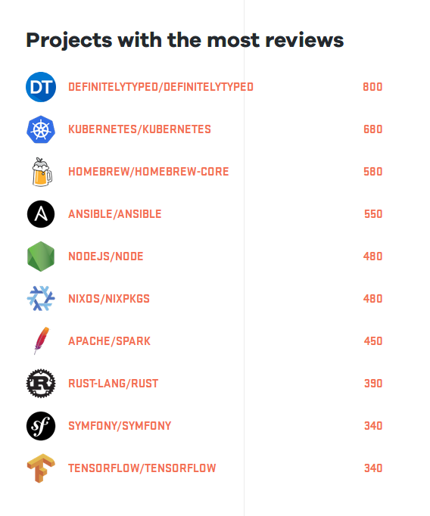
octoverse.github.com
Notes:
Rust is a community project that some people get paid to work on. The enthusiasm of this community shows in the latest State Of The Universe report.
This is the first of many interruptions from yesterday’s keynote throughout this talk.

Slide 6

rust-lang.org
Safe, concurrent, fast
Systems programming, fewer footguns
Hack Without Fear
Notes:
Rust 1.0, the first version of Stable Rust, was released in May 2015. Stable comes out like clockwork on a 6-week cycle – 1.21 just released this morning..
Rust is an outstanding piece of software, but above and beyond that it’s also really unique as an open source project. Only a few of you might ever need to write safe systems code, but I’ll bet almost everyone here gets involved with a software project at some time or another. I’d like to talk a bit about what sets the Rust culture and community apart.

Slide 7
Community
"The Rust community seems to be populated entirely by human beings. I have no idea how this was done."
http://scattered-thoughts.net/blog/2015/06/04/three-months-of-rust/
Notes:
The community is renowned for its open and welcoming nature.
I have a clear idea how this was done: It was done by starting out with clear values, acting on them, and both passively and actively removing people unwilling to abide by those values.

Slide 8
Conduct
"Please be kind and courteous."
"Please keep unstructured critique to a minimum"
Dedicated moderation team
"We will exclude you from interaction if you insult, demean or harass anyone"
https://www.rust-lang.org/conduct.html
Notes:
Rust has prioritized constructive, positive interaction from its inception, so people who feel they need a more combative environment to get work done tend to opt out of the community. Establishing these shared values helps us find common ground to build better code on.

Slide 9
Communication
Weekly updates
Mandatory RFC process
Consistent PR review
Distributed team & public discussions
Notes:
Also, Rust is an internationally distributed project, so most of its communication is asynchronous and held in public forums.
Starting with these good community habits means that projects implemented in Rust by Rust community members tend to have fewer antipatterns to un-learn than you’d expect to find in open source.

Slide 10
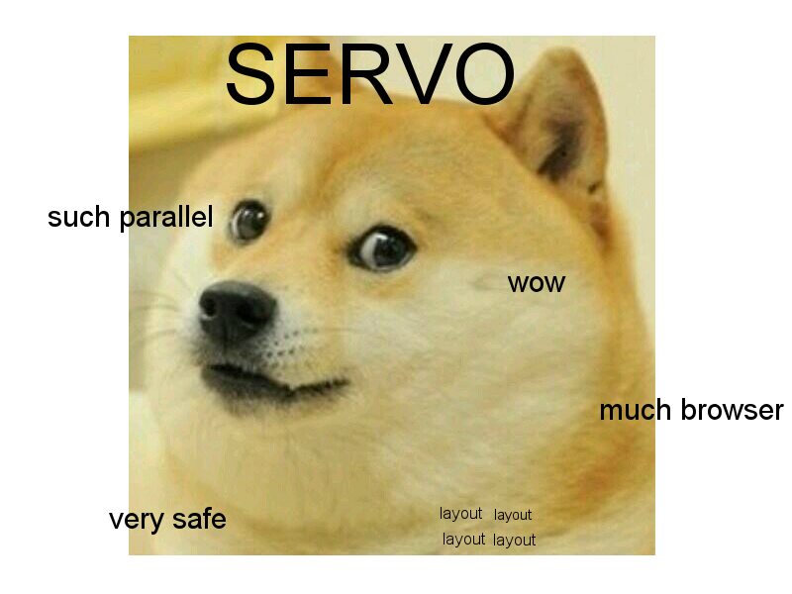
http://lucywyman.me/servo.org/static/img/doge-servo.jpg
Notes:
As well as offering thought leadership in meme technology, Servo is pushing the boundaries of what’s possible for parallelizing how the browser renders the web.

Slide 11
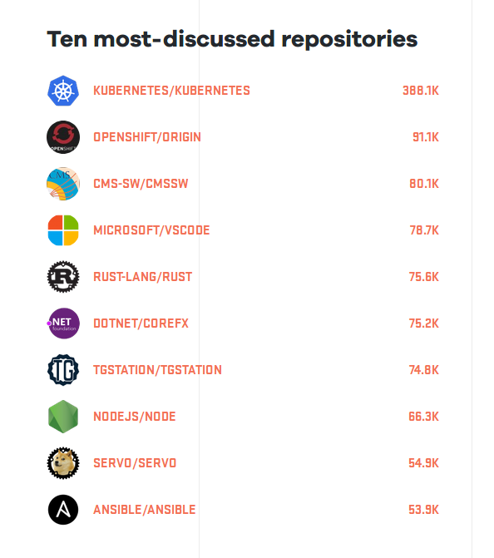
octoverse.github.com
Notes:
The Servo project is holding its own in this year’s Octoverse report as well, beating Ansible for 9th place on the list of most-discussed repositories.

Slide 12
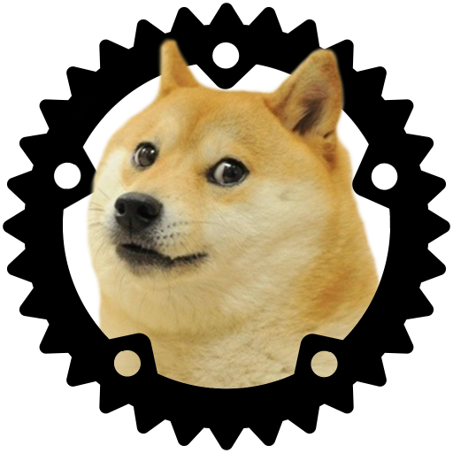
servo.org
~12 full-time engineers
~612 code contributors
~21k commits into servo/servo
~4% of contributors, ~25% of commits from @mozilla.com
Notes:
I think Servo is in a really unique place because it’s unequivocally a corporate project – its purpose is for Mozilla to explore possibilities for the next generation of browser engine – and yet it’s also this extremely healthy open source software community. It’s getting the kind of contributions and involvement that pretty much any open source project would dream of, and that’s uncommon for such a small project belonging to a company.

Slide 13

Open
The Pipeline
Mentor New
Contributors
Communicate Issue State
Automatically maintain a repository
of code that always passes all the tests.
Code In Public.
Notes:
I’m going to walk you through what I consider the 5 essential success strategies that have gotten Servo to where it is today.
Each one builds on the next – the advanced techniques I’ve placed at the top of the pyramid will do you little good, and sometimes even hurt your project long-term, if you’re doing poorly at the steps below them.

Slide 14
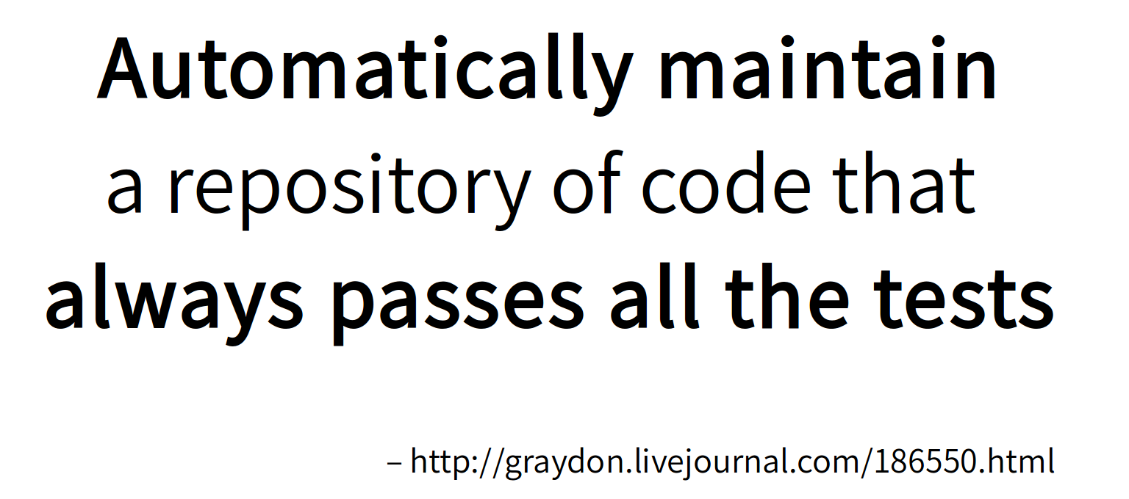
Notes:
You can’t talk about any Rust project’s infrastructure, and expecially not Servo’s, without discussing the Not Rocket Science Rule of Software Engineering. This was coined by that cool insigtful dude who invented the Rust programming language, and it’s a piece of culture that permeates Rust’s entire downstream ecosystem.
Why should you automatically maintain a repo of code that always passes all the tests? Think about what happens if you don’t.

Slide 15

https://c1.staticflickr.com/8/7160/6588151679_5ea9e64703_b.jpg
Notes:
What if you didn’t?
No tests → introduce same bug over and over
No always passing them all → No bisection through history, hard to quantify if change made things meaningfully worse
Manually maintaining → excess work, burnout, hostility, resentment
How?

Slide 16
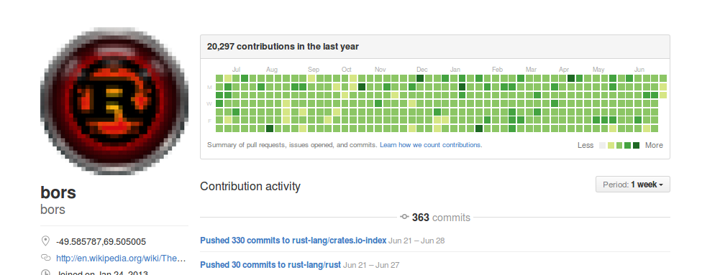
Bors & Homu
“Would the tests pass if we landed this?”
Github.com/servo/homu
Notes:
We use friendly robots
Monotone, Bors, Homu (Servo’s)
Answers one simple question – would tests pass if landed?
Then lands the code if human says it should
Auto-landing upon r+ is only? one of our tools GH hasn’t obsoleted
How can you?

Slide 17
Write pass/fail tests.
Notes:
Can’t get the benefits of automatically maintaining a repository of code that always passes all the tests if there aren’t tests to pass.

Slide 18
Run the tests
(before landing code!)
Notes:
Early, often, automatically.

Slide 19
Use the results, ASAP.
Notes:
If a test fails in your tree and nothing happens as a result, was the test really there?
For GitHub projects, this means using (or telling your tools to use) the status API to report the results on a given PR straight back to it.

Slide 20
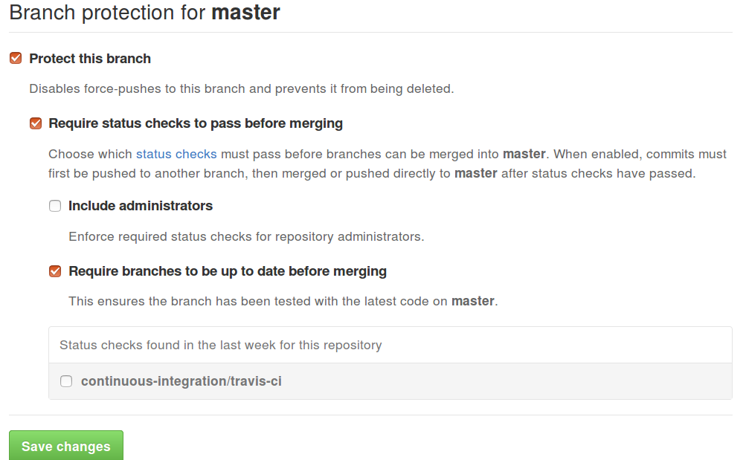
On GitHub, protect branches.
Notes:
Hook up status checks
Turn on protected branches. This forbids landing code which fails any test, which is the first 90% of the way to auto-landing.

Slide 21
Notes:
But following the Not Rocket Science Rule of Software Engineering isn’t enough. It helps you get consistently working code, but it doesn’t guarantee the working code will work for the things your business or project needs it to. It hits the gas pedal, without worrying about the steering wheel.

Slide 22
Communicate Issue State.
Notes:
The way you steer your project’s improvement is through good communication. Communication is a huge topic, and since this talk is only 40 minutes I’m going to skip a lot of the social nuances in favor of some takeaways that you can apply to your own projects.
Quick warning, if you aren’t automatically maintaining a repository of code that always passes all the tests… You won’t really know what’s going on in your codebase, and so it’ll be difficult if not impossible to communicate truthfully about what it’s doing.
With that warning out of the way, why does communication matter?

Slide 23
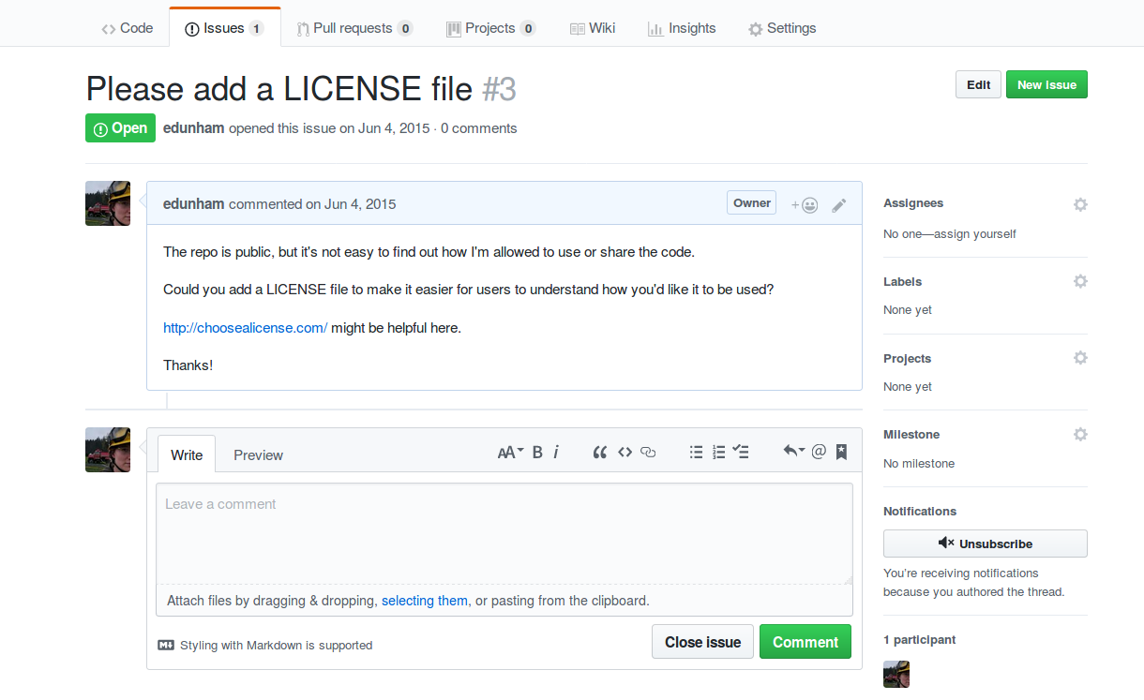
Notes:
Here’s an issue I filed awhile back on a repo with poor communication.
What’s wrong with this issue?
(yeah, I’m an owner, that happened later)

Slide 24
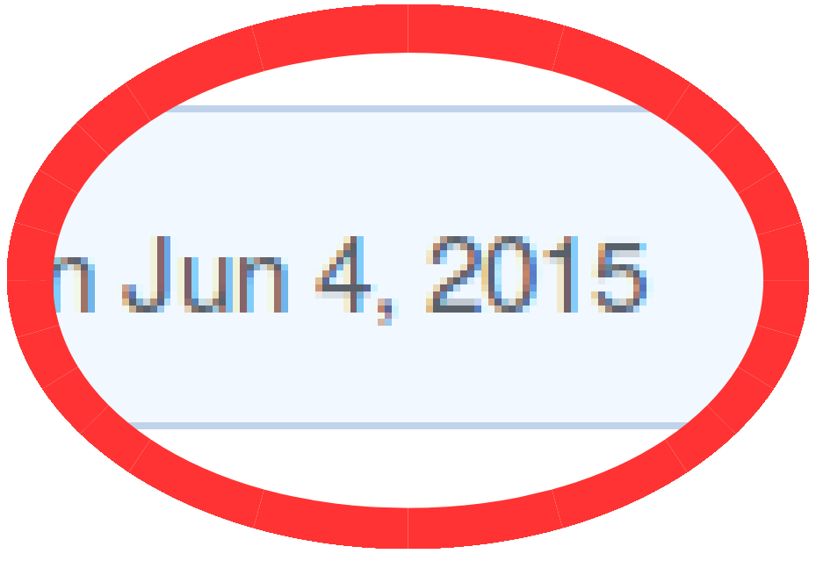

Notes:
That octocat, that’s me.
That sadface, that’s my face when my issue gets ignored for more than 2 years.
Radio silence on an issue is a huge problem. It’s a big enough contributor deterrrent to inspire GitHub to add the first time contributor badge.
If I was a first-time contributor instead of a grumpy old FOSS nerd, I probably wouldn’t still be on GitHub 2 years later. I might think I’d done something wrong, and leave entirely.
How does Servo address this?

Slide 25
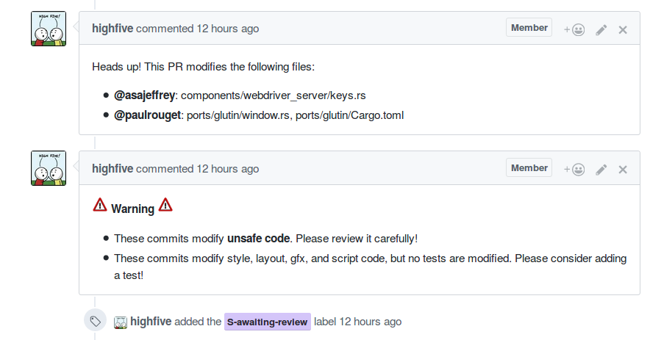
Highfive the Robot
Notes:
Before that 1st-timer badge was available, we took advantage of GitHub’s extensibility to add a friendly local robot who does basically the same thing. Highfive not only greets new contriburors and shows them around, but it also gives lists of contributors the heads up when a patch touches files that they care about.
Come to think of it, GitHub implemented the “notify me if someone changes this file” thing lately as well… Anyways, it helps us out a lot.
Another essential part of communicating about an issue’s state, on a globally distributed team, is to open the issue at the right time.

Slide 26
File → Discuss → Implement
Notes:
The right time to open an issue is BEFORE you have finished discussing or started implementing its solution.
Doing this right leaves an easily searchable historic record of all the major changes you’ve intentionally made in your code, and invites all project members to have an impact on those discussions they care abt
If you mix it up – maybe you come up with a fix by yourself then merge it straight in, maybe you chat over coffee, file a bug once you already know the fix and ignore the comments, merge the solution… that’s a problem.
Breaking the file,discuss,implement lifecycle excludes everybody who wasn’t there and might have wanted to help out. You’re excluding everyone who might ever want to do some historical research on “why?”.
How to file well?

Slide 27
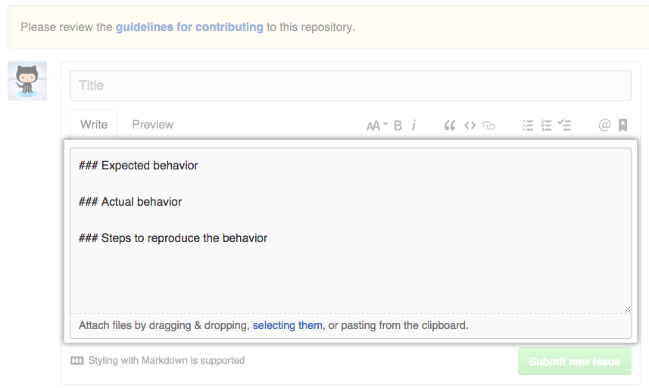
Use Issue & PR Templates.
Notes:
* Clarify what the discussion will need
* Easier, cleaner to ask once than go around and around
* Standardizing simplifies search, “forensics”
* Thank the user
* Set expectations about when to expect a response
How to discuss well?

Slide 28
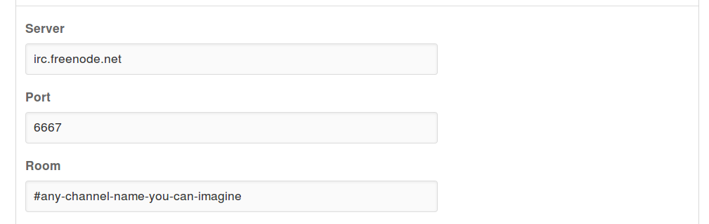
Enable notifications.
Notes:
Figure out what works for you – how do you need to be contacted to reply to issues in a timely manner?
Equally, turn OFF any unneeded notifications rather than letting them train you to ignore them.
So, this gets you a good issue opened, at the right time. Once it’s open, social processes come into play.

Slide 29
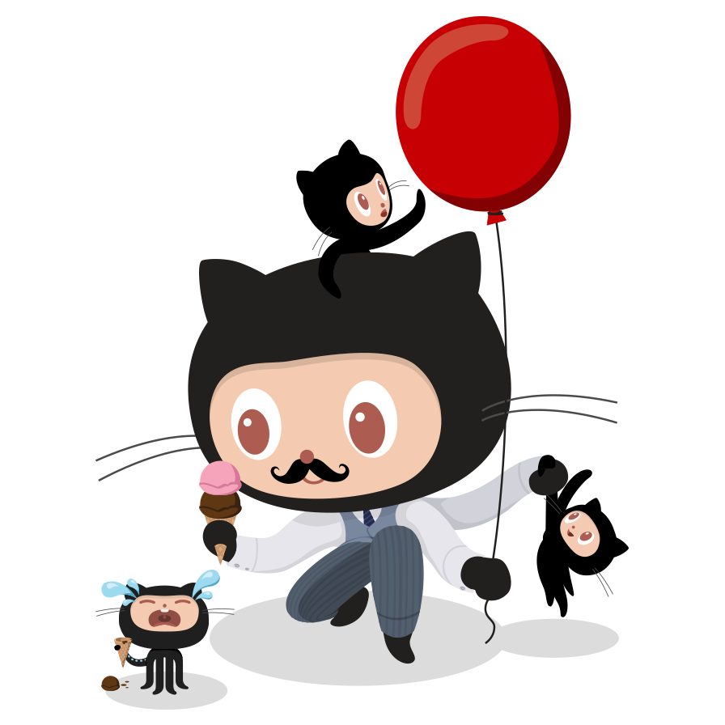
Manage expectations.
Notes:
There’s no tech solution for this one, it’s social and personal. Yep, in other words it’s a hard problem.
Other person needs to know roughly what they should expect you to do and when. If they don’t, they will be either quietly or loudly disappointed, both of which are bad for your project.
You need to know what you can do and when as well. Setting realistic expectations will help you say “no” at the right times. Why say no? avoid getting overwhelmed / overcommitting / scope creep / burnout.
Expecting way too much of yourself, or way too little, is bad for you and for your software.

Slide 30
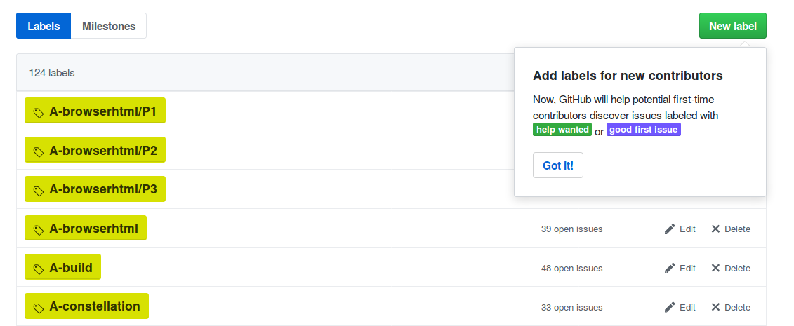
Categorize issues.
Notes:
Whew, let’s get back to communication challenges that the computers can help us with. Answering “how far through our standard process is this issue or PR?”
An essential trick for communicating an issue’s state between team members and contributors is to make some labels, agree on what they mean, and then apply them to issues consistently.
Servo has 124 labels, most of which we even use – we used them as projects and milestones before those features were released. Plus there are perks to using the standardized help wanted and good first bug labels, which are coming up next.

Slide 31
Mentor New Contributors.
Notes:
Human lives are finite, and human patience to keep dealing with the same project day in and day out is shorter than that.

Slide 32
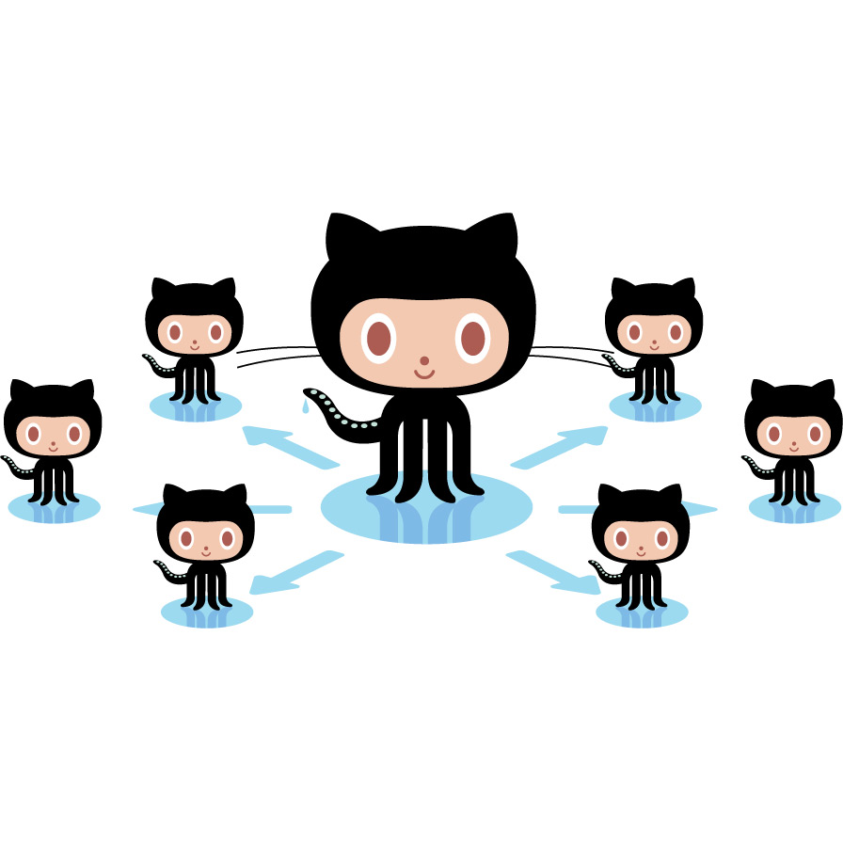
Notes:
For a healthy ecosystem and a proejct that outlives its initial creator’s interest and involvement, you have to bring new people on board.
Why mentor a bunch of new contributors, instead of just a handful of future core folks?
Just as you probably haven’t become a core member of every community you’ve ever touched, most communities interact with dozens or even hundreds of new members for every one who “sticks” .
How do we mentor new contributors?

Slide 33
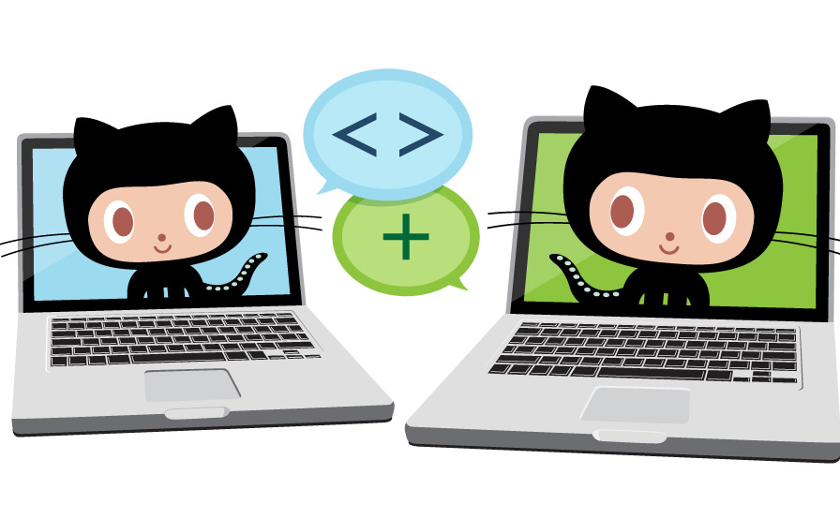
Value mentorship.
Notes:
The central part of how Servo manages to mentor a bunch of new contributors is that we cultivate a culture that values mentorship. We’re awed by contributors like Josh and Manish, who not only mentor constantly but even teach mentorship skills as well.
Not everyone has to mentor. But everyone can show they value mentorship by taking little steps that make life easier for those who do mentor.
How can you make your project a better place for mentors to work their magic?

Slide 34

Documentation gardening.
https://www.flickr.com/photos/usdagov/5908589011
Notes:
Make life easier for anyone mentoring incoming community members by keeping your docs in shape.
Writing your docs once and then never touching them again works exactly as well as planting a garden and then leaving it alone all season without any maintenance. Sure, some bits of your docs will stay correct, just like some of the plants you started in the garden might outcompete the weeds…
But abandoned documentation will get more and more inaccurate and dangerous to its users, just like an abandoned garden. Treat reports of difficulty or inaccuracy in your docs as seriously as you’d treat reports of invasive weeds or crumbling infrastructure in a garden that you wish to keep welcoming and beautiful.

Slide 35
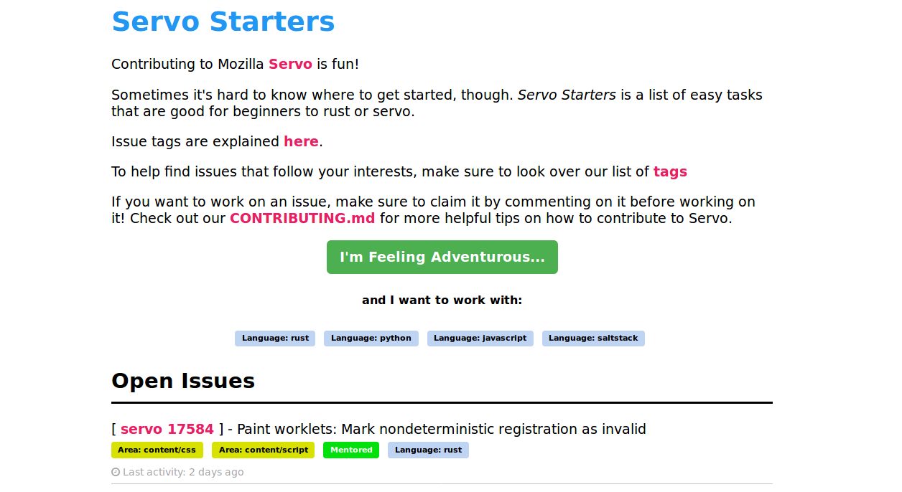
Starters.servo.org
Notes:
(those of you who were looking away to not see scorpions on the screen can look back now)
Before GitHub solved issue aggregation for us, we used this little app written by a contributor which finds all “helpwanted” bugs across the Servo organization.
The average life of an easy issue in Servo is less than a day. This is a testament to the accuracy with which core folks tag the “easy” bugs as “easy”, and the enthusiasm with which newcomers love to fix them.

Slide 36
whatcanidoformozilla.org

Slide 37
Open The Pipeline.
Notes:
To open the pipeline means to give more people, from all over the world, with all kinds of different backgrounds and experiences, the opportunity to find their way into your project and help make it even better.
If you don’t have everything up through good mentorship worked out, don’t focus on opening your pipeline yet! Your project only gets one shot to make a first impression, and if someone finds their way in and has a bad experience, they’ll not only leave but warn others away from getting involved.

Slide 38
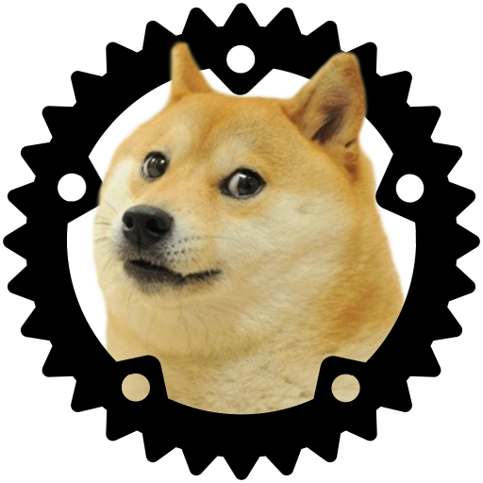
~12 full-time
engineers
~612 code contributors
Notes:
Servo is a really small project with a really big community, and this didn’t just happen. We’ve been making a concerted effort for over 5 years to be a great project to join, and to help others learn this.
There are 2 main categories of pipeline-opening techniques. Before using either, double check that your project is actually an appealing place to work or volunteer….

Slide 39

Meaningful mission
Notes:
It helps Servo a lot that we’re working on something that’s easy to explain, and that our mission is instantly relatable to pretty much anyone who uses a computer.
“Better, faster browser”? Sign me up!
Figure out why your project matters to people who aren’t already working on it, and make sure the first page a potential contributor will see when they visit your site explains that in a way they’re likely to understand.
Use your human words, not your engineer words. Your project needs many kinds of humans, not just engineers.

Slide 40
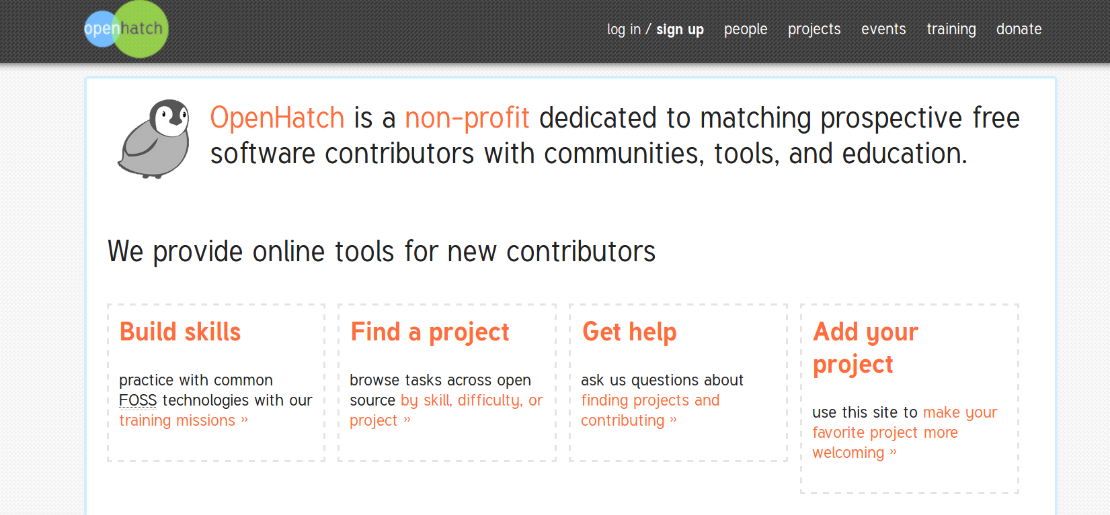
Openhatch.org
Notes:
All year round, you can reach out to novice FOSS contributors through openhatch.org. Openhatch is great if you have the resources to mentor people who might be new to Git and your programming language; less great if you can only take on contributors who are already trained.

Slide 41

Internships
Notes:
If you’re at a company or working on proprietary code, don’t despair! You can get new eyes on your code and new brains into your project by taking on interns.
These are the other category of pipeline-openers: Straight-up paying somebody who might not otherwise have touched your code to put time into it. These are super important from a diversity perspective for reaching into groups who don’t have the privelidge of enough leisure time to code for free, such as the primary caregivers for children and the elderly.
Even if your work is open source, try to use any internship programs available at your institution to pay people to write some code!

Slide 42
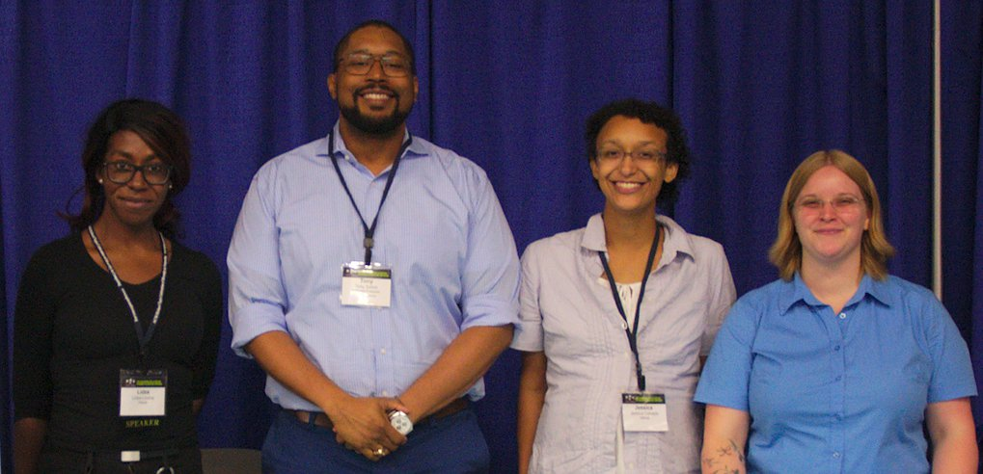
Outreachy.org
Photo CC-BY-NC-SA Sarah Sharp.
Notes:
In addition to Google Summer of Code, Outreachy is a fantastic program for paying people from underrepresented groups to hack on free and open source software.

Slide 43
Infrastructure As Code
github.com/servo/saltfs
(saltstack.com)

Slide 44
Need Improvement:
Monitoring & Alerting
Perf tracking
Infra reproduceability, especially Windows

