Slide 1

Where's The Cloud? seagl2017@edunham.net
@QEDunham talks.edunham.net/seagl2017
http://maxpixel.freegreatpicture.com/Blue-Day-Clear-Background-Field-Clean-Freedom-21717
Notes:
Hi! I'm edunham everywhere that matters, and qedunham in some places that don't, and I'm here to talk to you about... The Cloud!

Slide 2
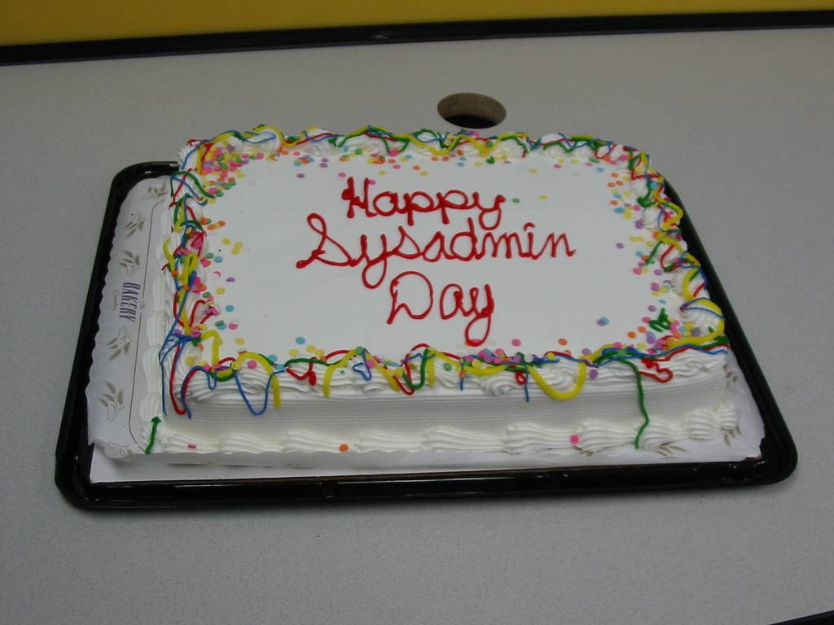
Photo by Quinn Norton, https://www.flickr.com/photos/quinn/38426
Notes:
Now, I'd like to take a couple slides to get to know my audience.
By a show of hands, who here identifies as a Real Sysadmin? Cool, you already know this stuff and you can nap or check email. But look up sometimes; there'll be a cute turtle.

Slide 3
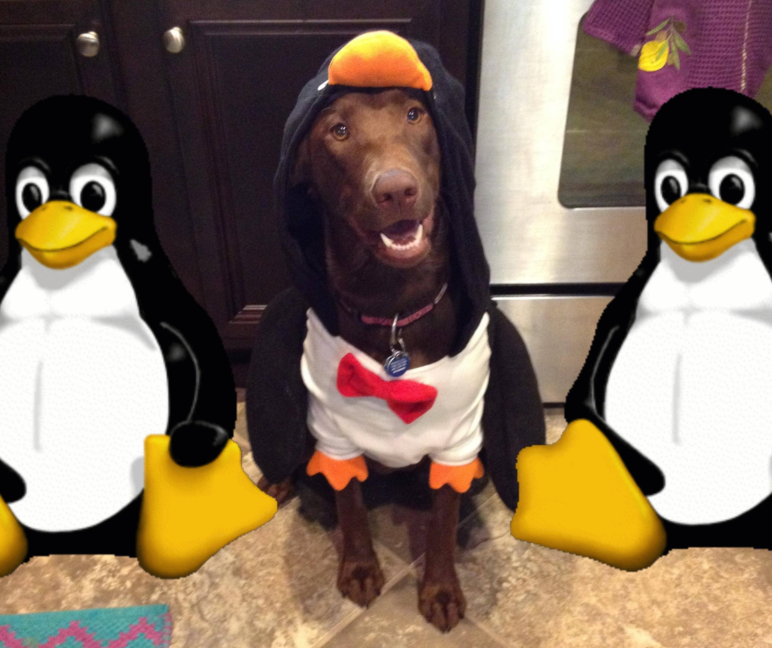
http://imgur.com/7HBXMX2, https://en.wikipedia.org/wiki/Tux#/media/File:Tux.png
Notes:
Ok, now who here just wears a sysadmin hat sometimes? You manage one or two servers, but you don't need any of those complicated techniques like redundancy, because you're using

Slide 4
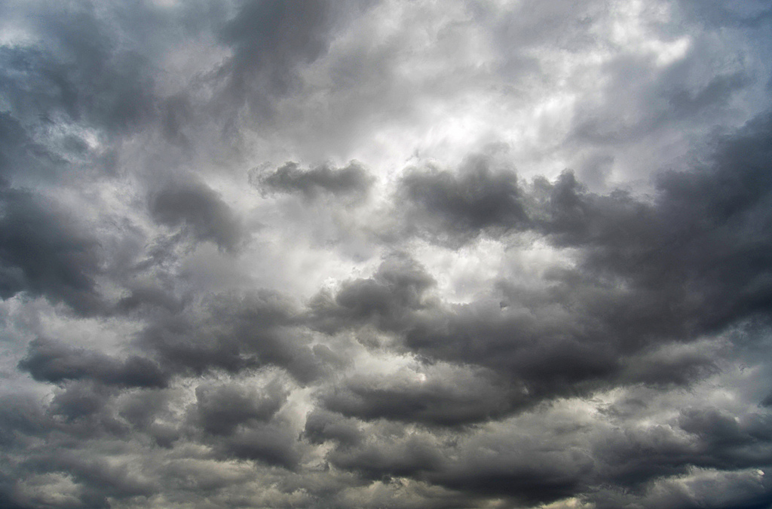
Photo by Edmund Garman, https://www.flickr.com/photos/3cl/5975465375
Notes:
The Cloud! The Cloud, for those new to this decade's trends and jargon, is often represented as a technological panacea. But what does it mean?

Slide 5
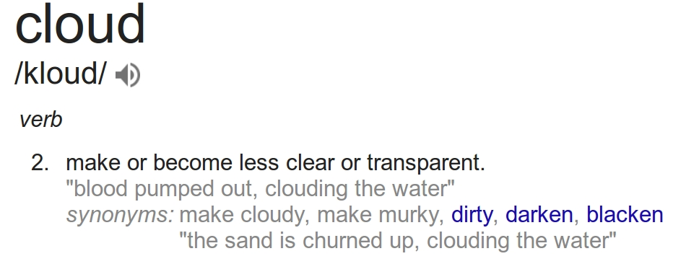
Notes:
The Cloud is a sophisticated system for abstracting away your servers. There's a flavor of cloud to suit everyone's obscure use case, from Cirrus to Altocumulus to Stratocumulus... Wait, this isn't the meteorology talk.

Slide 6

127.0.0.1
http://www.homedepot.com/p/HY-KO-15-in-x-19-in-Plastic-For-Lease-Sign-SP-115/100124055
Notes:
Using “The Public Cloud” refers to renting a subset of someone else's server's resources. Someone Else, in this case, is usually a Cloud Hosting Company.

Slide 7
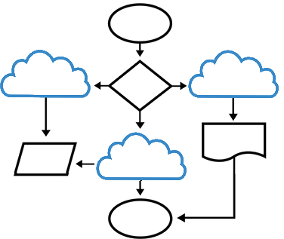
http://soft9000.com/blog9000/index.php?category=40
Notes:
The Private Cloud is what you get when you run Virtual (aka imaginary) servers in servers that you own. You like servers, so you put servers in your servers, and if the servers break, the servers can fix it!

Slide 8

https://pixabay.com/en/turtle-green-sea-turtles-animals-2159454/
Notes:
But it's not turtles all the way down. At some point, your computation gets done on transistors. Transistors subsist on electricity, and reside in servers, and servers live in....

Slide 9
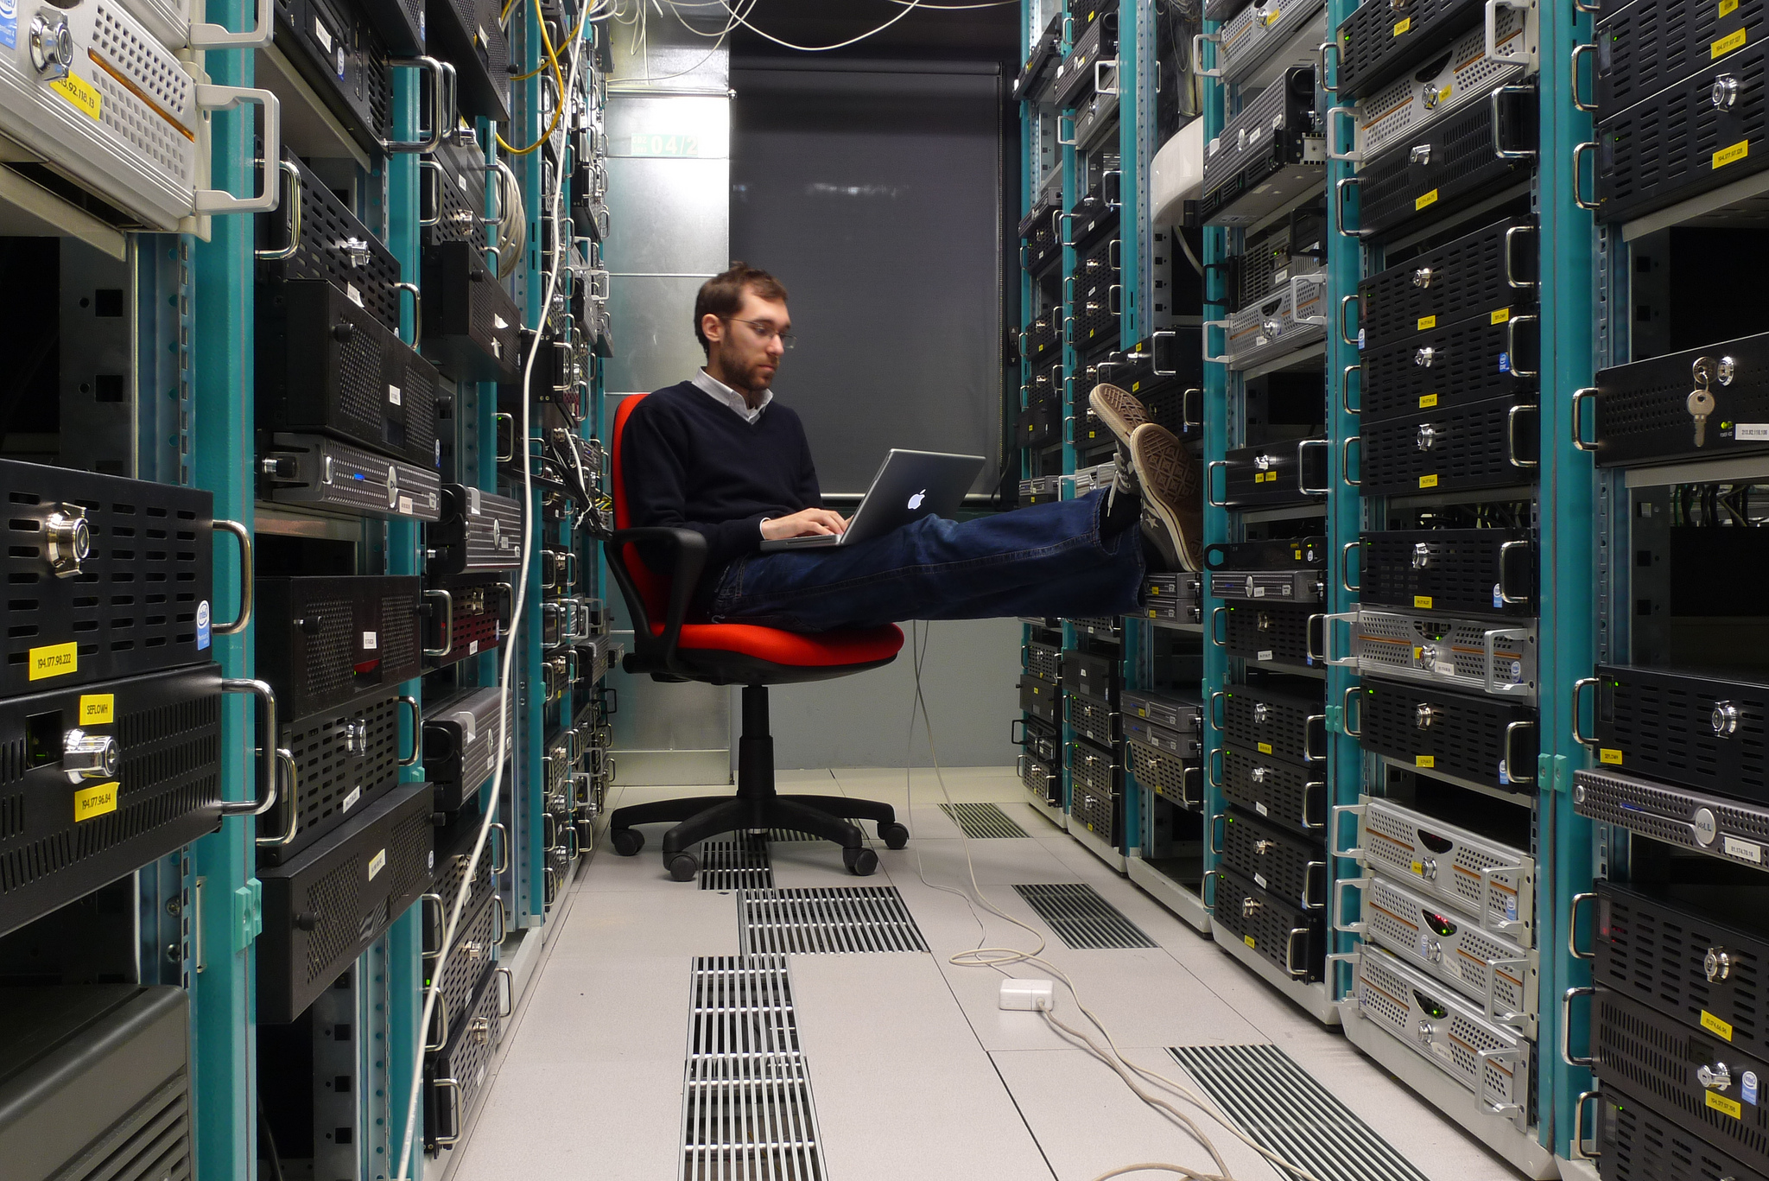
This image is the property of Leonardo Rizzi: www.flickr.com/photos/29479498@N05/
The original Image can be seen at the url: www.flickr.com/photos/stars6/4381851322/
Notes:
Datacenters! The internet as we know it requires a bunch of different servers to all talk to each other. This means we've got to link all those datacenters up, and keep them in contact. This is done with...

Slide 10
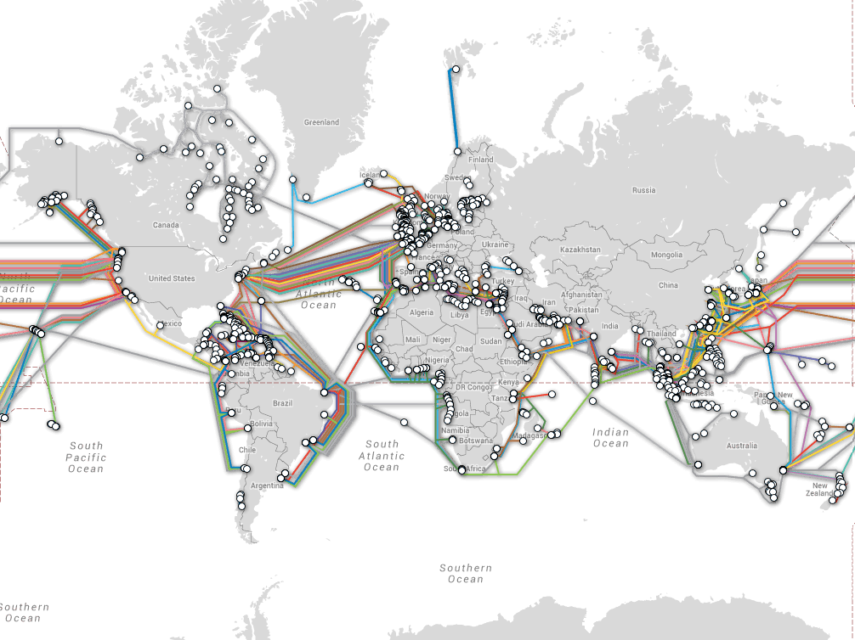
Fiber optic cables!
Fiber optic cables!
http://www.submarinecablemap.com/
Notes:
Fiber optic cables! There are a bunch of different organizations that control the cables, and the continued functionality of the whole network relies on the politics between those organizations, but it's better than the alternative.

Slide 11
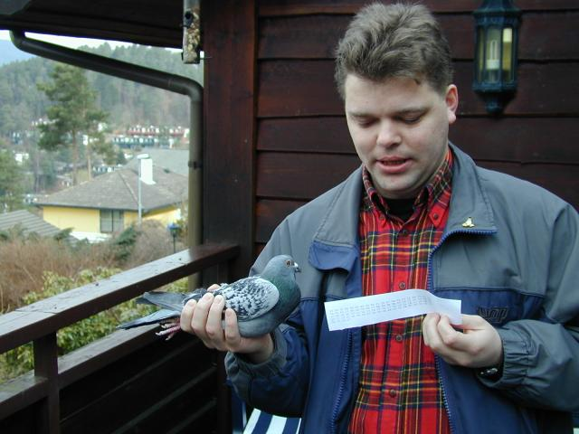
Karl Magnus with a test-packet. http://www.blug.linux.no/rfc1149/vegard_bilder/
.
Notes:
While you can get decent bandwidth with a box of hard drives in the mail or an SD card on a pigeon or some copper wire, it's generally accepted that the latency doesn't compete with sending your packets at the speed of light.

Slide 12



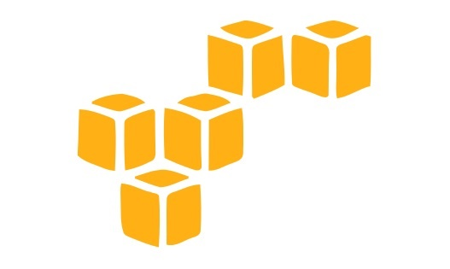

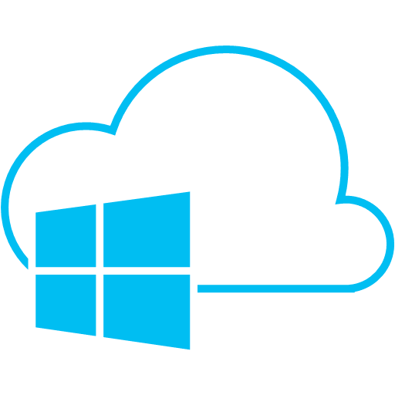

Notes:
So, about those packets that we care about, where do they come from? Does anyone here have a single server in any of these big popular “clouds” that you care about not losing?

Slide 13
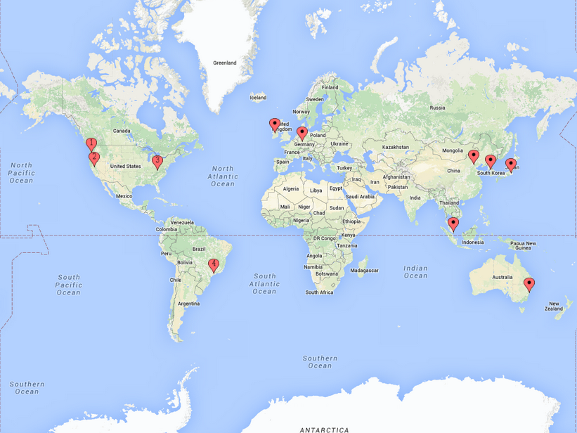
AWS
https://aws.amazon.com/about-aws/global-infrastructure/
Notes:
Your AWS instance or Heroku app lives in one of these datacenters. US-West regions are a popular choice for developers in North America, and are conveniently located in an area that geologists identify as “overdue” for a catastrophic earthquake!

Slide 14
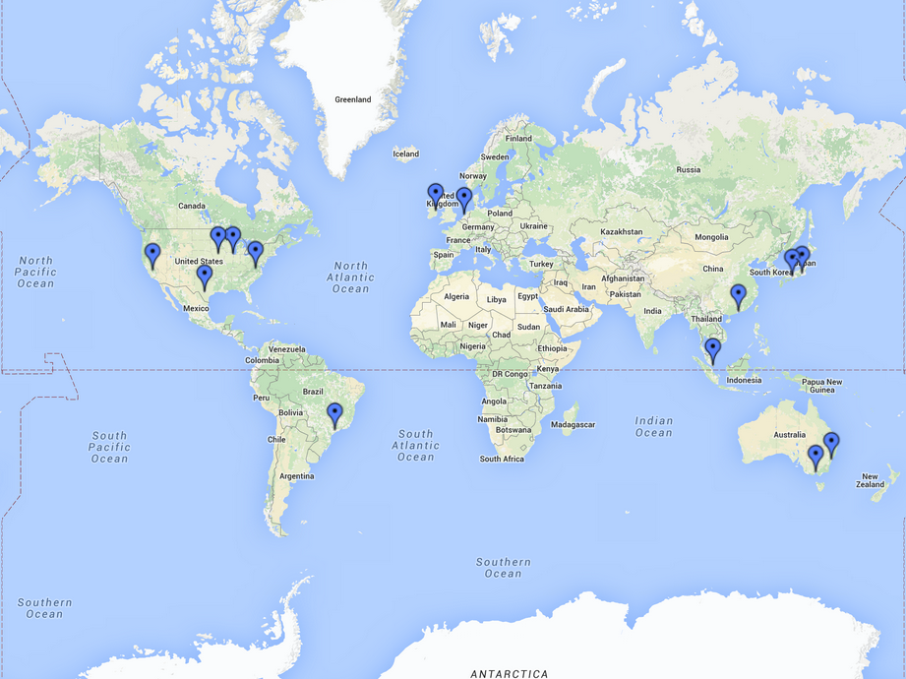
Azure
https://www.google.com/maps/d/u/0/viewer?mid=zM2uqako3ipc.kqOGsydsQSSA&hl=en_US
Notes:
Microsoft's Azure data centers draw a beautiful line along the Pacific Rim, a region poetically described as the Ring of Fire for its prevalence of earthquakes and volcanic activity. Maybe you should put your server in Europe instead...

Slide 15
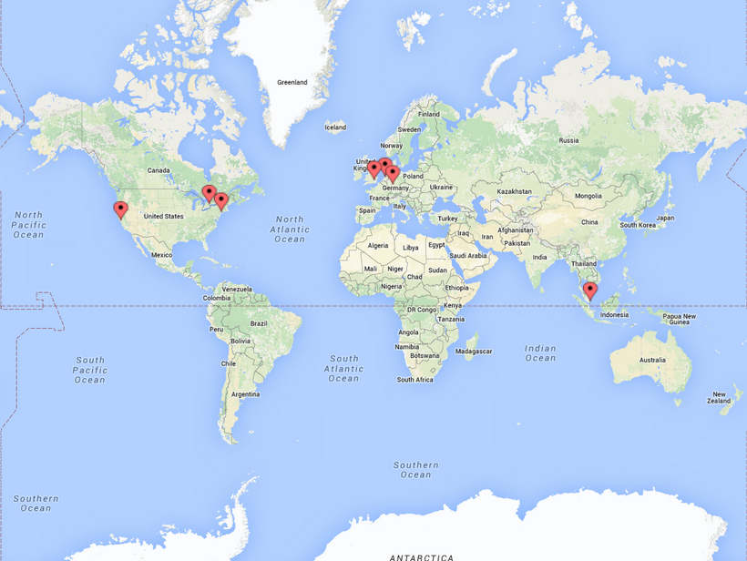
DigitalOcean
https://cloud.digitalocean.com/droplets/new
Notes:
When your computations are done on hardware located in the EU and you involve users' personal data, you could be legally required to remove all traces of a user who invokes their right to be forgotten.

Slide 16
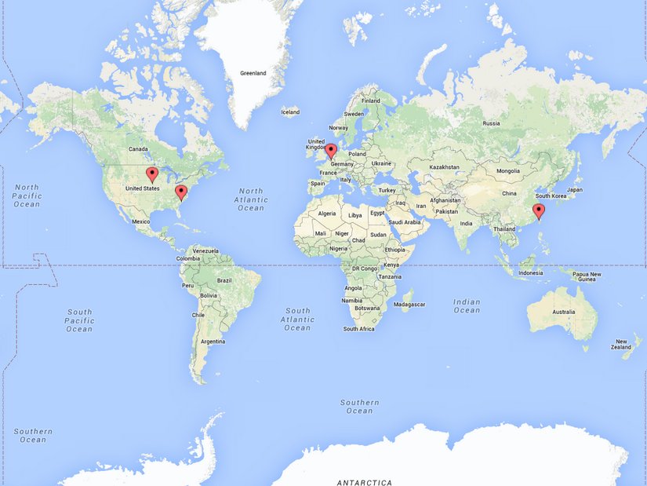
Google Cloud
https://cloud.google.com/about/datacenters/
Notes:
There are also laws in many jurisdictions requiring data retention, but think twice before blindly instructing your Cloud to copy your data everywhere, if your data includes secrets that you'd rather keep away from state actors in certain regions.

Slide 17
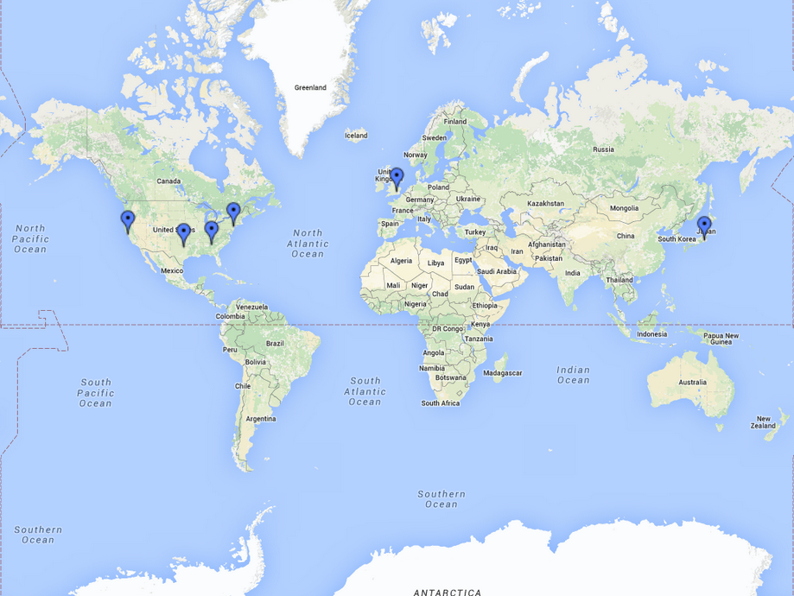
Linode
https://www.google.com/maps/d/u/0/viewer?mid=z90iOZ-V43Ko.k1XtnY8XJEXA&hl=en
Notes:
There can be all kinds of problems with locating your “cloud” servers overseas! Let's just stick to the safety of datacenters in the midwestern United States, where government surveillance is a known unknown and you're unlikely to get earthquakes or tsunamis.

Slide 18
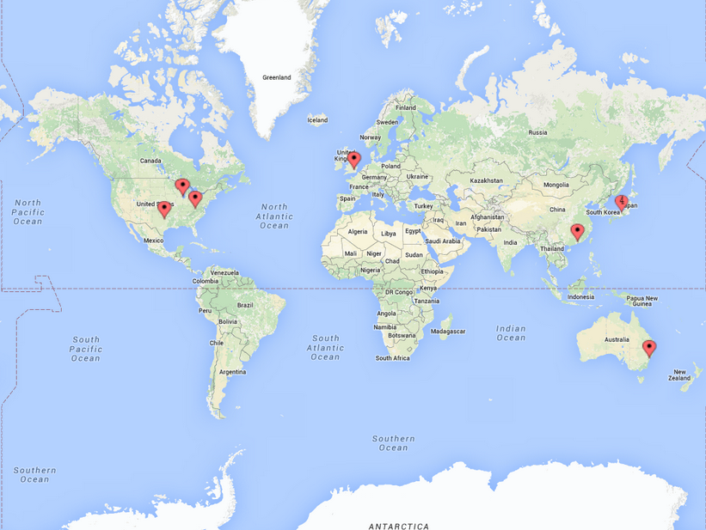
Rackspace
https://www.rackspace.com/en-us/about/datacenters
Notes:
The region featuring Linode's Atlanta and Dallas Datacenters and Rackspace's Virginia, Dallas, and Chicago locations is popularly known as Tornado Alley, and is fraught by a variety of seasonal storms.

Slide 19
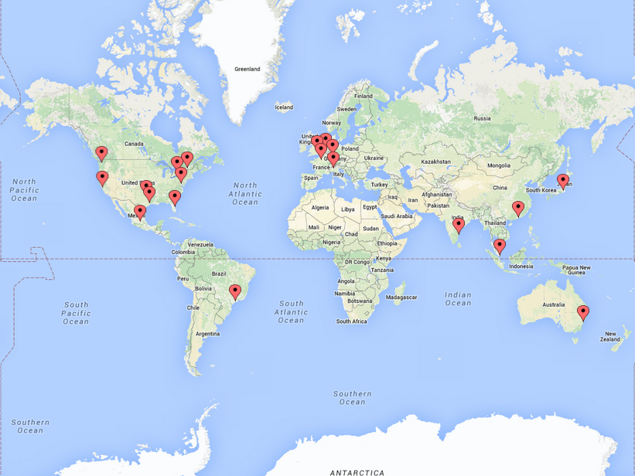
Softlayer
http://www.softlayer.com/Data-centers
Notes:
Datacenters usually have backup generators with enough fuel to keep them powered for a while, and redundant networking. Everything might be okay. Just remember that when you get down-to-earth about this cloud thing, your servers and data are still located somewhere, and preventing disaster takes more work than just “using the cloud”.

Slide 20
seagl2017@edunham.net
@QEDunham talks.edunham.net/seagl2017
http://maxpixel.freegreatpicture.com/Blue-Day-Clear-Background-Field-Clean-Freedom-21717

