Slide 1
Should you rewrite in Rust?
E. Dunham
Linux.conf.au
Jan 24, 2018
talks.edunham.net/lca2018

Slide 2
What do you think I’ll say?
(show of hands)
Notes:
Who thinks I’ll say you SHOULD rewrite your code in Rust?
Who here thinks I’ll say you SHOULD NOT rewrite your code in Rust?
(count up for the video)

Slide 3
What’s a rewrite?

Slide 4
Mini: Regex, refactor, cleanup

Slide 5
Moderate: architecture or API alteration

Slide 6
Massive: Burn it all down and start from scratch

Slide 7
Assume peoples’ time and happiness are valuable.
I know about time, & guess about happiness.

Slide 8
Tiny changes: Cheap but constrained

Slide 9
Huge changes: Expensive

Slide 10
Bugs come from code.
New bugs come from new code.
Bugs are bad.

Slide 11
Before any change, ask:
What does this code do?
What should it do?

Slide 12
If the code “works”, why change?

Slide 13
If code “doesn’t work”, where’s the problem?
- invalid problem definition
- architecture & integration
- tooling and dependencies
- the code itself

Slide 14
A rewrite can yield understanding or code.

Slide 15
Rewrite to understand or examine:
- A new language
- Confusing code

Slide 16
Rewriting to understand costs your time:
- Writing
- Thinking
- Researching

Slide 17
Rewriting to deploy costs everyone’s time:
- Writing
- Thinking
- Researching
- Tooling and automation
- New bugs
- Communication
- Team education
- Backwards compatibility

Slide 18
Deploy a rewrite to reduce risk.

Slide 19
Risks which deploying a rewrite can reduce:
- Frequent vulnerabilities
- Slow code
- Architecture problems
- Missing institutional knowledge

Slide 20
Obstacles to deploying a rewrite:
- Time
- Reintroduce tricky bugs
- Community buy-in
- Proving adequacy or correctness

Slide 21
Value of rewrite depends on who it would affect.

Slide 22
Do what you like with your own time,
but try not to waste anyone else’s.

Slide 23
Rewrite shared code as little as possible.

Slide 24
First, identify a specific and measurable problem.

Slide 25
Then, look for the smallest (or cheapest) change likely to fix it.

Slide 26
But, please don’t ask a community
to throw everything out and start over.

Slide 27
Please don’t ask a community
to throw everything out and start over.
Even in Rust.

Slide 28
Please don’t ask a community
to throw everything out and start over.
Even Especially in Rust.

Slide 29
Please don’t ask a community
to throw everything out and start over.
Especially in Rust.
It’s disrespectful and embarrassing.

Slide 30
Shared maintainership requires
communication about code changes.

Slide 31
When people are helping you code,
(and you want them to keep helping you,)
you must communicate about major changes.

Slide 32
A big rewrite is a major change.
Adding a new language is a major change.

Slide 33
Costs of adding a language:
- Developer training
- Community impact
- New bugs
- Tooling, testing, deployment changes

Slide 34
Seek the smallest (or cheapest) change to fix a problem.

Slide 35
A big rewrite is a major change.
Adding a new language is a major change.

Slide 36
Costs of adding a language:
- Developer training
- Community impact
- New bugs
- Tooling, testing, deployment changes

Slide 37
Taking more simultaneous gambles
decreases the odds of success.

Slide 38
If your current language cannot solve a problem:
- Isolate the problem
- Add a good solution
- Test rigorously for new bugs

Slide 39
Picking a language to add:
- Can it solve the poblem?
- What new problems will it add?
- Do you want to learn it?
- Can you integrate it with extant systems?

Slide 40
If you must rewrite, should you use Rust?

Slide 41
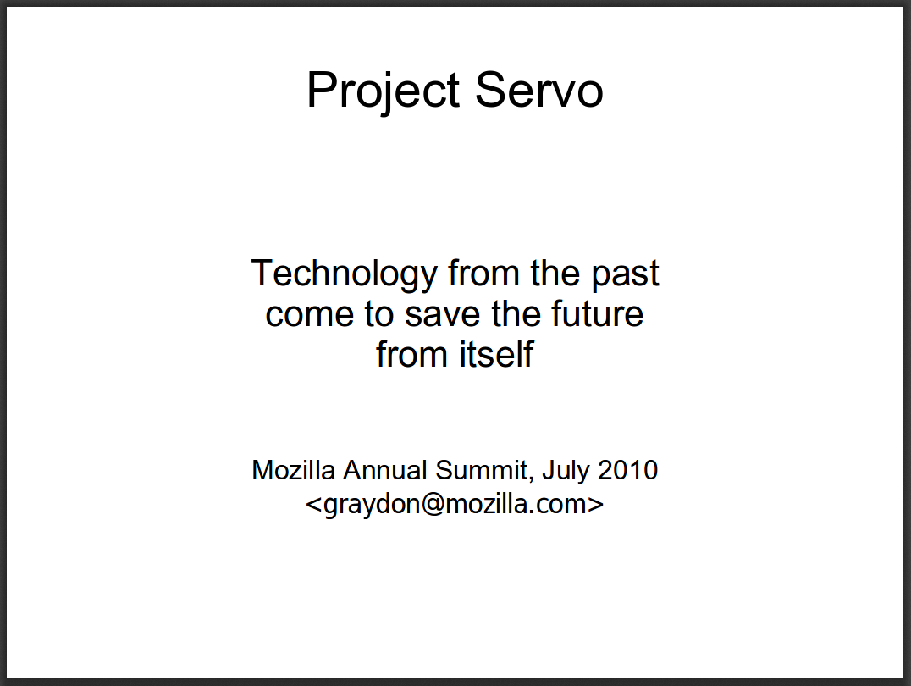
http://venge.net/graydon/talks/intro-talk-2.pdf

Slide 42
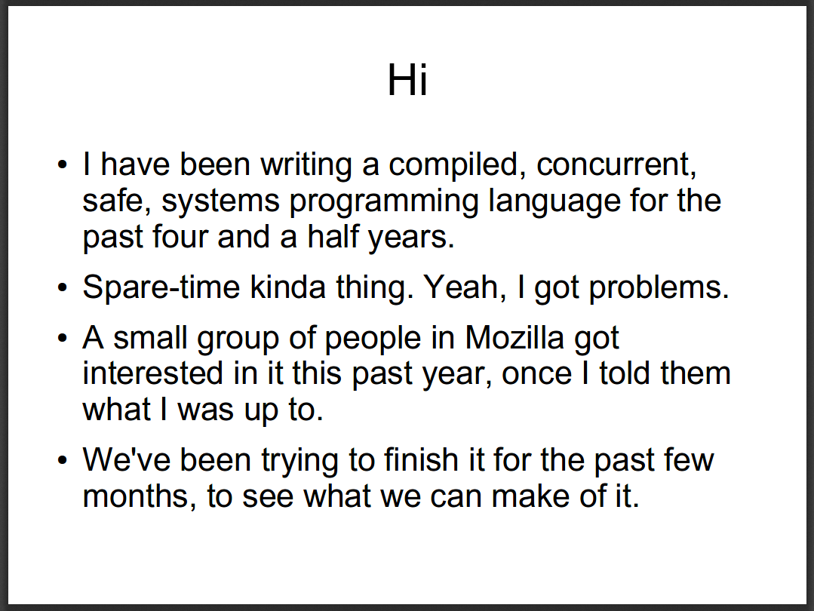

Slide 43
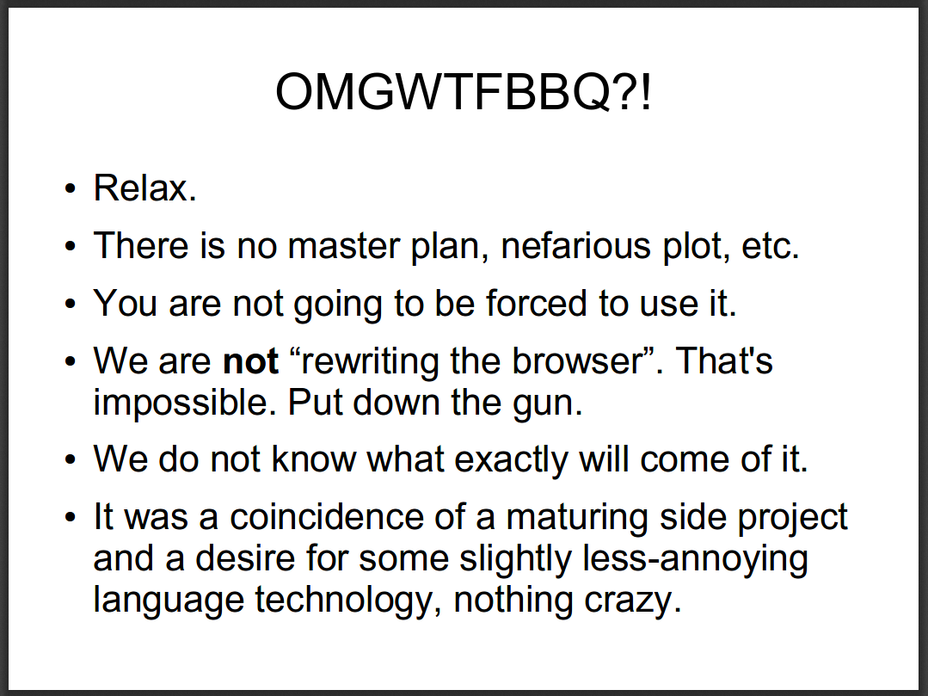

Slide 44
Choices in Rust:
- Stable vs nightly
- Safe vs unsafe
- Static vs dynamic linking

Slide 45
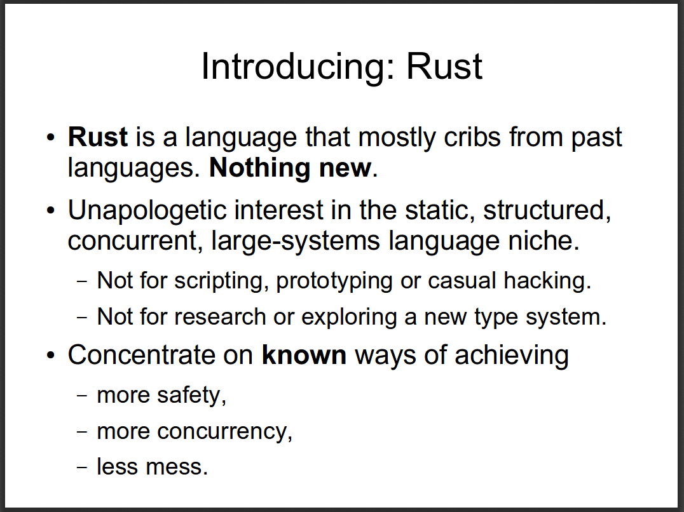

Slide 47
Rust Today:
<perks from unhandledexpression.com>

Slide 48
System langs are like driving a manual.
Scripting langs are like driving an automatic.

Slide 49
Techniques for integrating Rust

Slide 50
Rewrite functions, microservices, or services.

Slide 51
Can you add a well-documented API boundary?

Slide 52
How does your host language do FFI to C?
https://doc.rust-lang.org/1.2.0/book/rust-inside-other-languages.html
https://doc.rust-lang.org/1.2.0/book/ffi.html

Slide 54
What has worked for others?

Slide 55
Mozilla’s Project Quantum

Slide 56
Red Hat – William Brown, Directory Server

Slide 57
NPM – rewrote perf bottlenecks

Slide 58
Who else uses Rust in production?
https://www.rust-lang.org/en-US/friends.html

