Slide 1
DevOpsing Your Résumé
DevOpsDays PDX 2016
edunham@edunham.net
@qedunham
talks.edunham.net/devopsdays/PDX2016
Notes:
Hi! I’m Emily Dunham, and I’m here to talk about those pieces of paper you have to submit when you’re following up with a company who’s hiring.
My current job, which I <3, is infra for Rust+Servo.

Slide 2

Notes:
My resume is a piece of code that helped me find a role I love.
We’re fortunate to work in a field that often has more jobs than qualified candidates to fill them, but who here has ever had a DevOps role that you disliked?

Slide 3

Boring Office
Notes:
When you find yourself in a job you’d rather get out of, the best solution is to ask your friends who’s hiring, but sometimes you just have to throw a resume into a pile.

Slide 4

Long long list
Notes:
Who here hates having to update your resume?
<pause>
A one-off document that’s rarely useful is like an unmaintained server or code base – but fortunately, we know some things about fixing that!

Slide 5

Pic of unicorn
Notes:
So to talk about DevOpsing your Resume, we should start with defining what DevOps actually means.
On the technical side, DevOps is about automation. DevOps emerged as we started to build and reuse tools that make life easier.

Slide 6

Pic of rhino
Notes:
Socially, DevOps is about charging past the sometimes-crippling bureacracy of silos to work with whoever you need to and get stuff done.
What’s this got to do with your resume?

Slide 7

Notes:
The first goal of treating your resume as code is to let you use the same tools that help you maintain code quality.

Slide 8

Pic of printing press
Notes:
But a resume isn’t judged on the same metrics as code. Readability and content matter, but the aesthetics of its typesetting also contribute to the first impression that it makes on your behalf.

Slide 9

Notes:
My favorite tool for treating a resume as a single code file is LaTeX. You control everythign about the typesetting, and can write macros to ensure style consistency between sections.

Slide 10
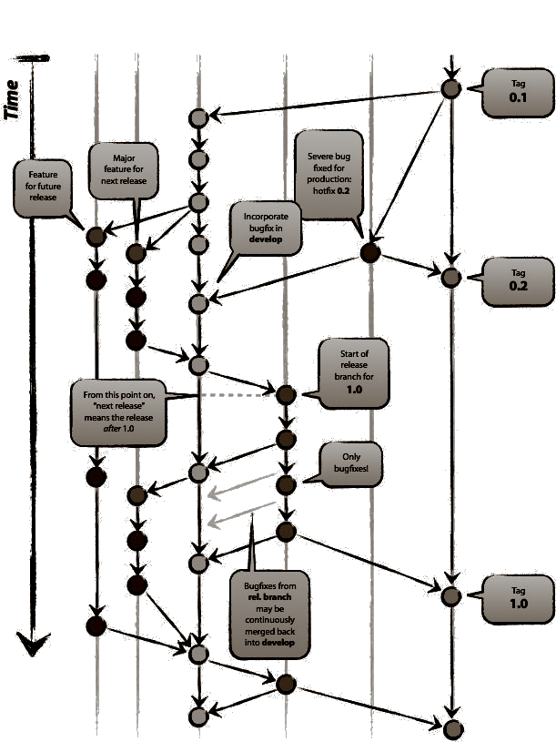
Notes:
Once your resume is a text file that you can compile into a beautifully typeset PDF, you can use your favorite version control tooling to manage its source!
Use separate branches to track the variants of your resume that correspond to different hats you wear, or emphasize the skills that matter most to each place you’re applying.

Slide 11

Notes:
As well as letting you develop features in parallel with each other, version control is a time travel technology.
Want to know what your resume looked like on a certain date, or undo removing a section?
Just `git checkout` the right commit!

Slide 12

Tests
Notes:
Once your resume is a file of code that’s kept in version control, you can think about testing it.
You can automatically spell check every change (use a whitelist of correctly-spelled technical terms) to avoid embarrassing mistakes, or verify that it still renders without errors into a single page.

Slide 13
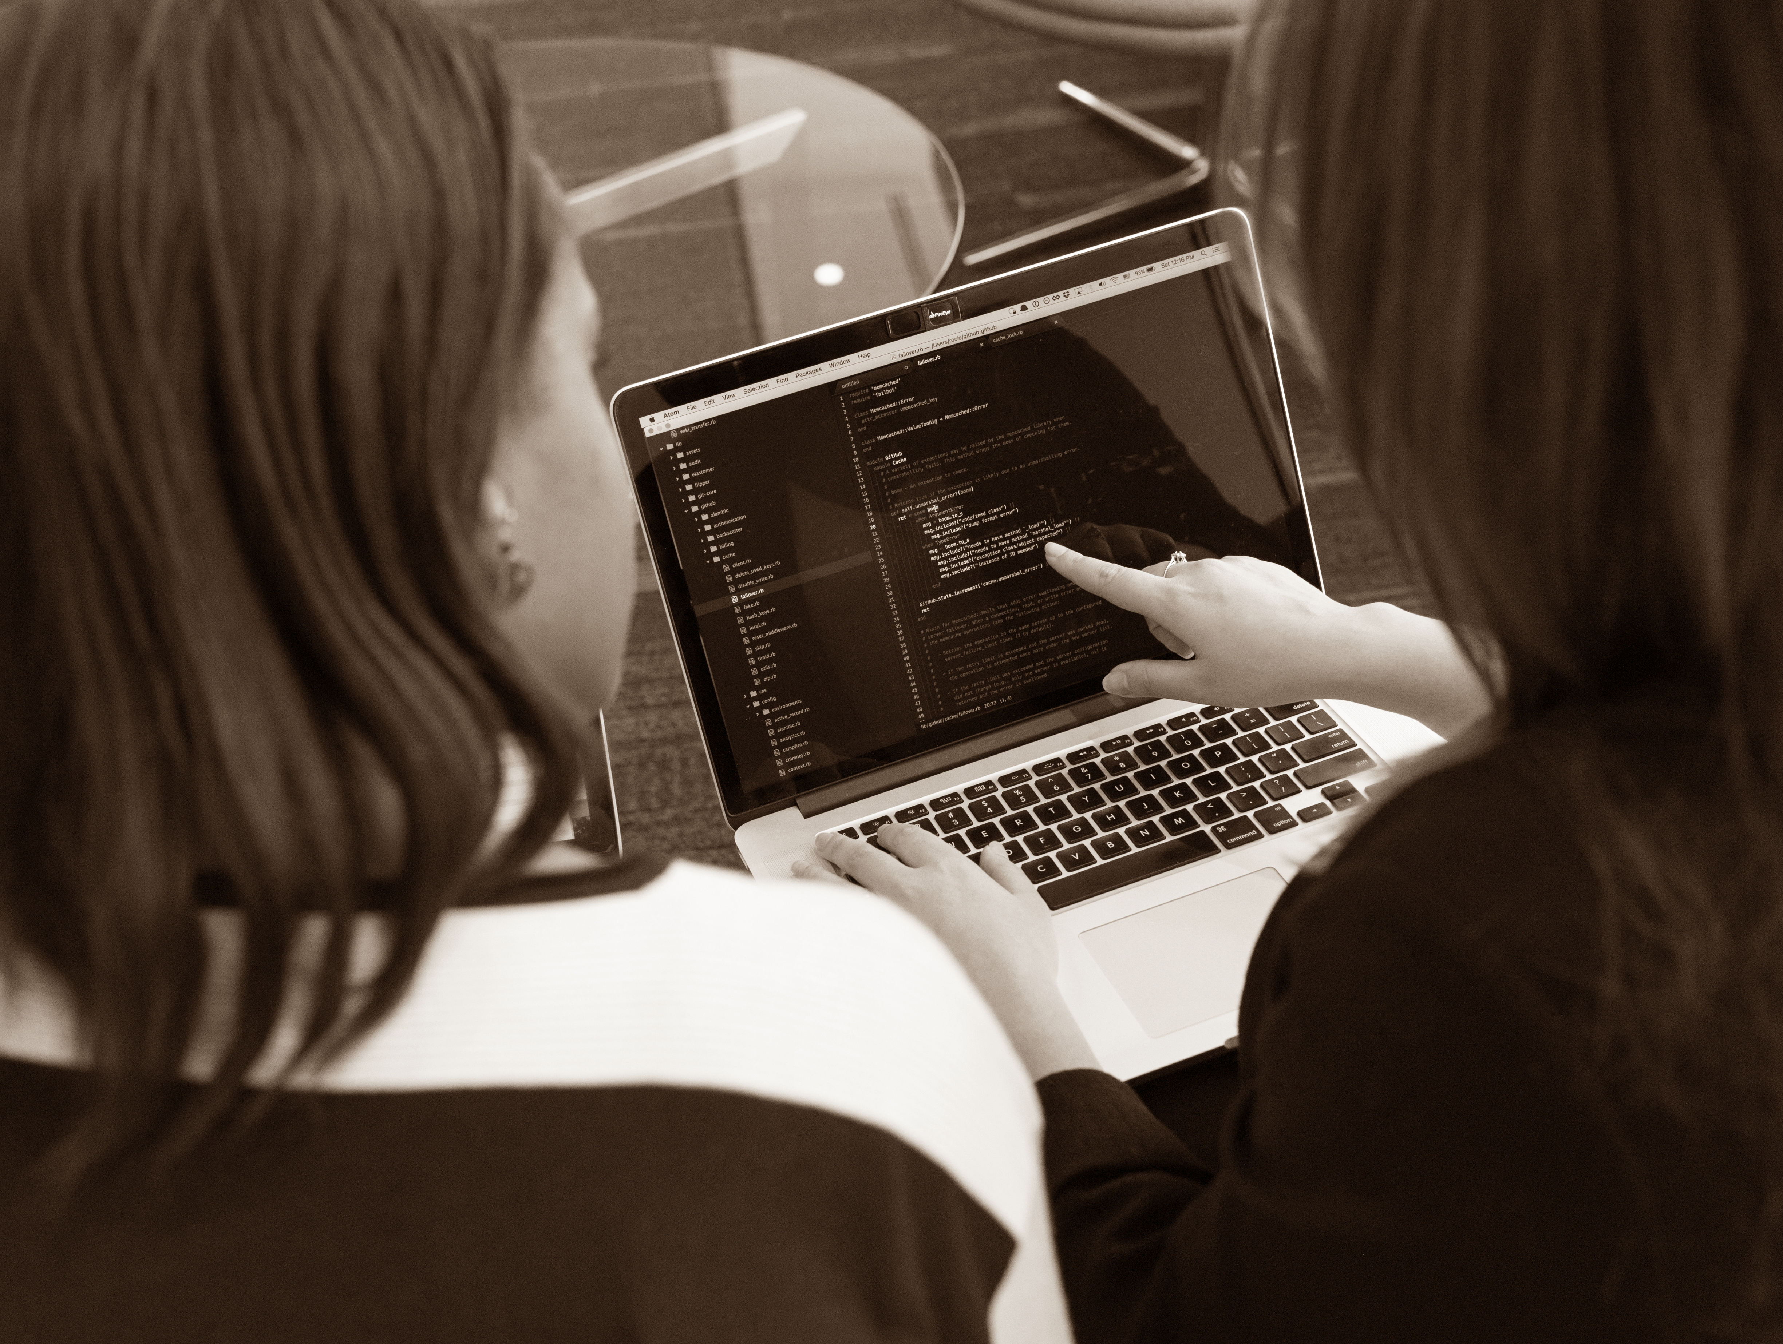
Peer Review
Notes:
And once you’re automatically catching obvious errors like spelling issues, the tools you already use to get feedback on your code can accelerate the process of having a peer or mentor review changes to your resume’s content!

Slide 14
Jail (vendor lock-in)
Notes:
You should use whatever tools you’re comfortable with, but I’d suggest preferring Free/Libre technologies for a long-lived project like your resume.
Otherwise, you’re in for a lot of work if a vendor discontinues their proprietary offering!

Slide 15

End User (king/queen?)
Notes:
That’s how to DevOps your resume, but what do you put in it?
One of a DevOp’s most important tasks is to identify their projects’ end users and communicate with them about what they need.
You can use this skill to make your resume more useful to its readers.

Slide 16
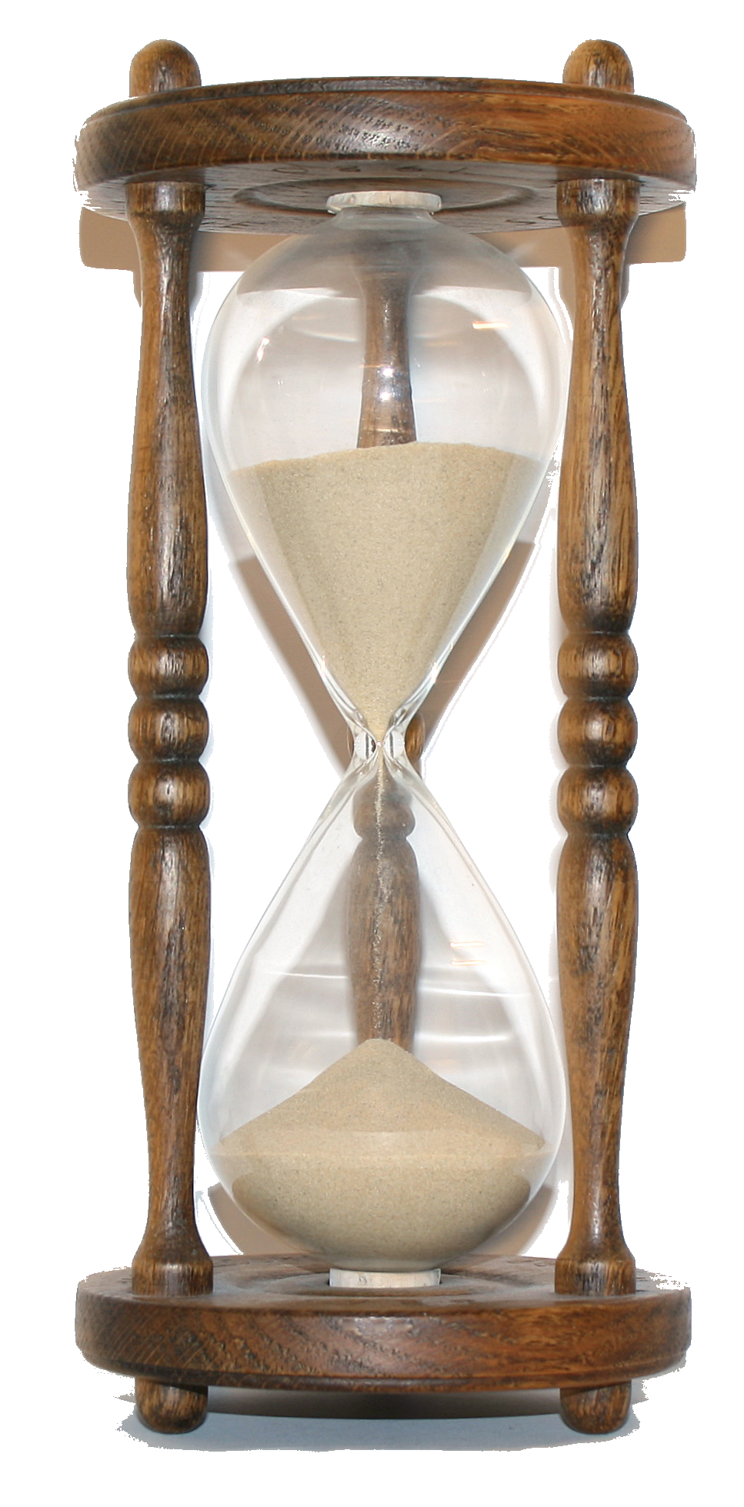
Notes:
Consider that your resume’s readers will often be pressed for time.
Meet their needs by prioritizing the most relevant content, keeping sentences short or replacing them entirely with bulleted lists, and only including information that tells them something they need to know about you.

Slide 17

Person w/ magnifying glass
Notes:
Scrutinize your resume from its reader’s perspective and see what kind of prospective colleague it makes you look like. And if you have too much content, remove any technology that it would make you sad to work with every day.

Slide 18

Notes:
Once you’ve put all this work into developing your resume’s content, the last step is to recycle it!
Fill out a LinkedIn profile if you like getting contacted by recruiters, and use your resume’s content to keep the “about me” page of your personal web site up to date.

Slide 19
Notes:
Tending your resume like any other piece of code can help it benefit from the very skills that it showcases.
Your reward for investing care and attention in this process is a resume that’s ready when you need it, instead of an out-of-date document whose mountain of overdue updates deter you from pursuing great career opportunities.

Slide 20
Thank you!
DevOpsDays PDX 2016
edunham@edunham.net
@qedunham
talks.edunham.net/devopsdays/PDX2016
Notes:
But remember, talking to other humans is still the best way to make sure you’re applying for a role that’ll meet your goals.
When you tell people that you’re job hunting, let them know what you’ve loved about your best jobs and hated about your worst.
Reach out to me if you have resume questions or just want to chat!

