Slide 1

Rust

Slide 2

E. Dunham
DevOps Engineer, Mozilla Research
  Rust, Servo CI & Infrastructure
Rust Community Team member
Portland, Oregon, USA
Open Source nerd

Slide 3
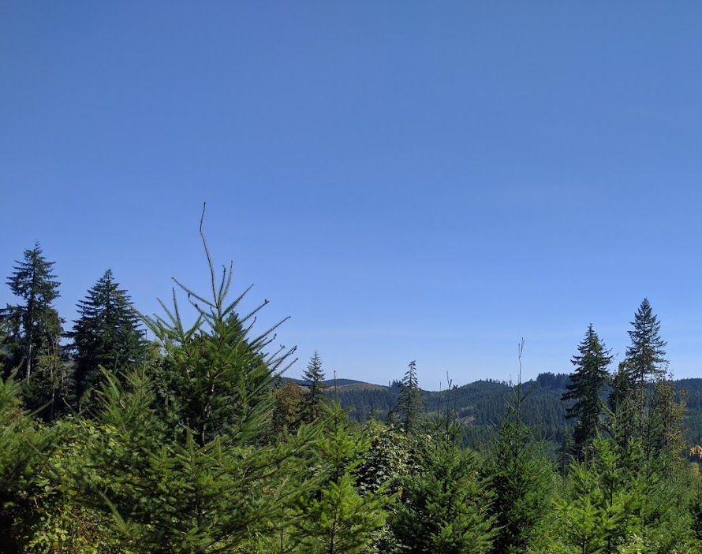

Slide 4

The Rust Programming Language
Started ~2010
1.0 Stable May 15, 2015
54380 commits, 1582 authors
79.1% “loved”, https://stackoverflow.com/research/developer-survey-2016
Safe, Concurrent, Fast.
Unofficial mascot: Ferris the Rustacean

Slide 5
Why Rust?
Memory safety
Easier concurrency
Performance of C, C++ with 0-cost abstraction
Hot code and resource-constrained systems
Open development process & community

Slide 6
Why not Rust?
Web pages
Teams with expertise elsewhere
Esoteric systems (PRs welcome!)
Libraries/dependencies in other languages lose Rust’s benefits
When slow & buggy is ok

Slide 7
Community Links
https://www.rust-lang.org/
https://github.com/rust-lang/
https://www.reddit.com/r/rust/
https://users.rust-lang.org/
http://stackoverflow.com/questions/tagged/rust
irc.mozilla.org #rust #rust-beginners
http://rustaceans.org/
https://twitter.com/rustlang

Slide 8

Rust’s Social Processes

Slide 9
Setting Expectations
“...most impressive aspect of Rust is the welcoming community that supports it. This community could become Rust’s not-so-secret weapon.”
  http://www.infoworld.com/article/2947214/open-source-tools/two-reasons-the-rust-language-will-succeed.html
“The Rust community seems to be populated entirely by human beings. I have no idea how this was done.”
  http://scattered-thoughts.net/blog/2015/06/04/three-months-of-rust/

Slide 10
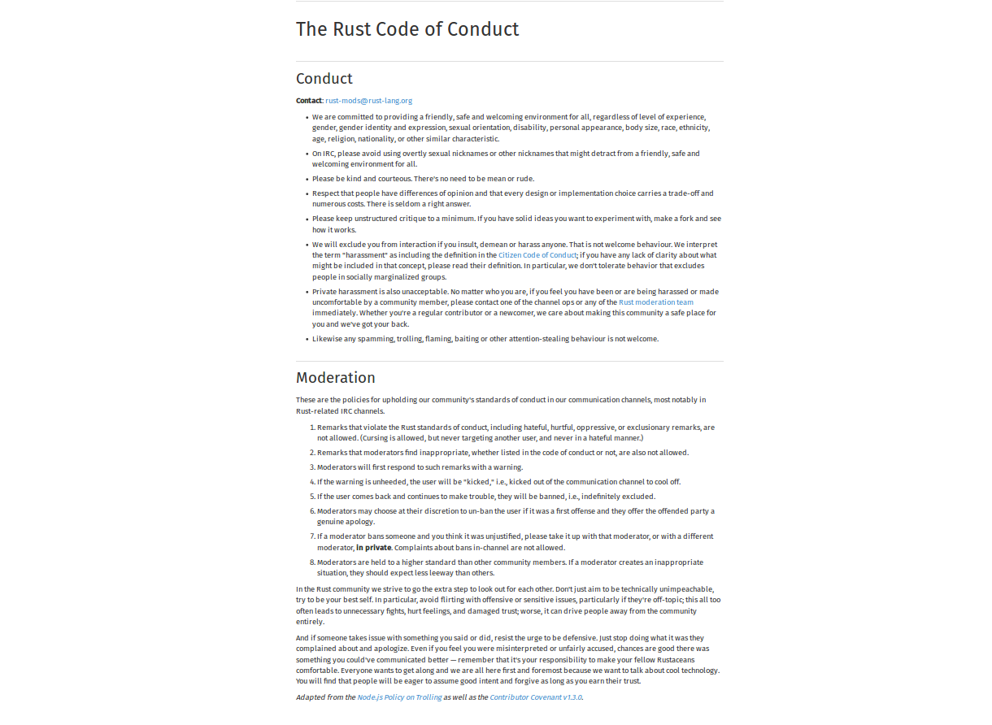

Slide 11
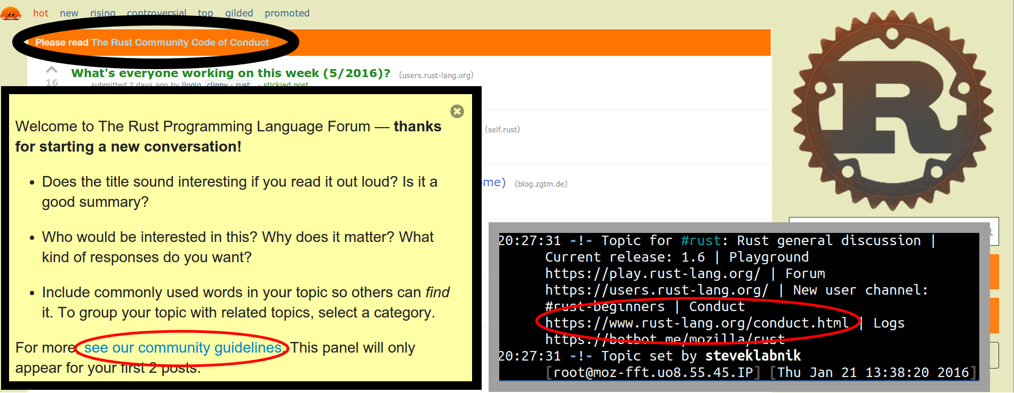
Automatic Reminders

Slide 12
Exclusion
“The Rust community gives me a particularly bad feeling. They're rather tyrannical about enforcing their code of conduct. They even have a moderation attack squad to go after anyone they deem to be an enemy! ... This sets off warning alarms for me.”
  https://developers.slashdot.org/comments.pl?sid=8652809&cid=51352141

Slide 13
Communication
“We ask that [larger changes] be put through a bit of a design process and produce a consensus
… so that all stakeholders can be confident about the direction the language is evolving in.”
https://github.com/rust-lang/rfcs/

Slide 14
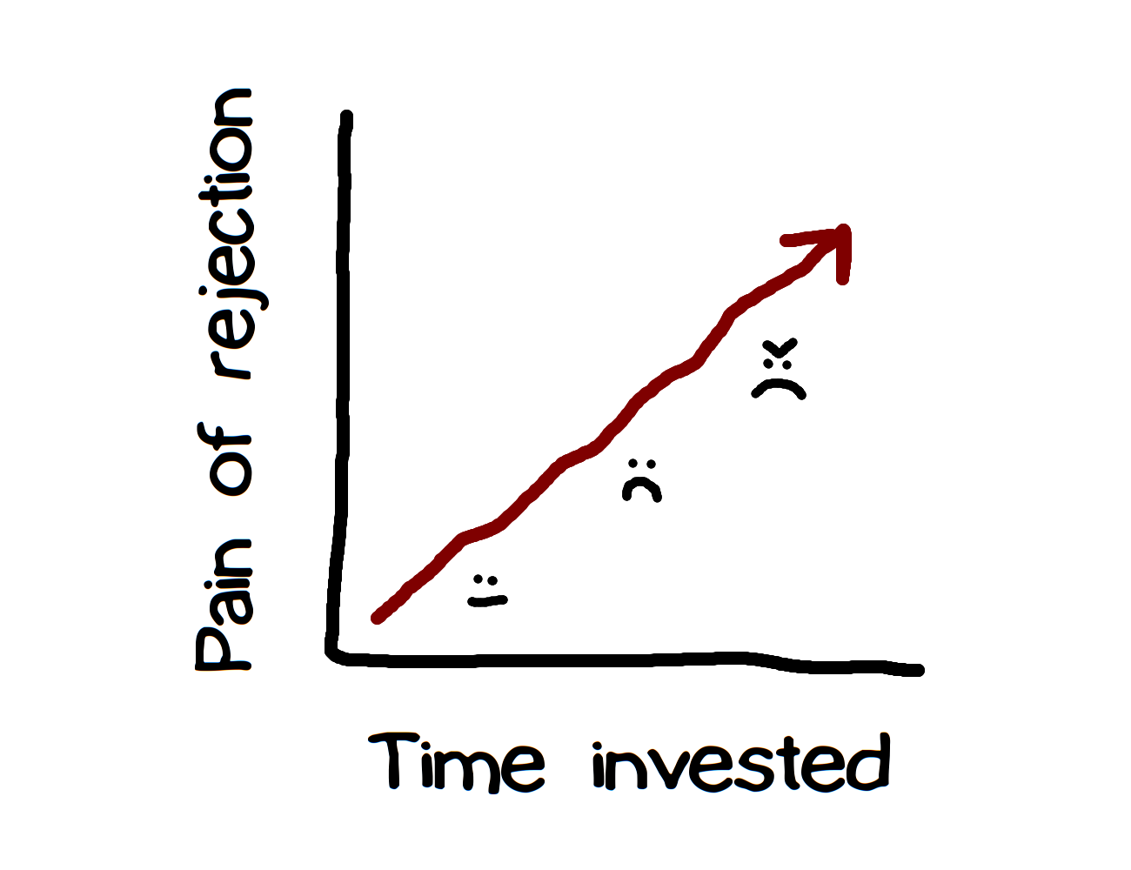

Slide 15
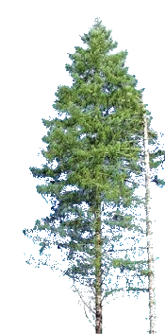
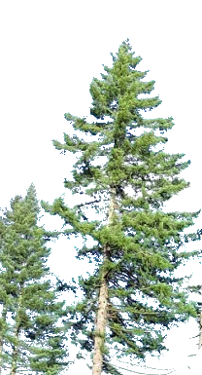
Appreciation
https://this-week-in-rust.org/
http://blog.rust-lang.org/
“Friends of the Tree”

Slide 16
Processes Recap
High expectations
Exclude the immoderate
Require & simplify communication
Show appreciation

Slide 17
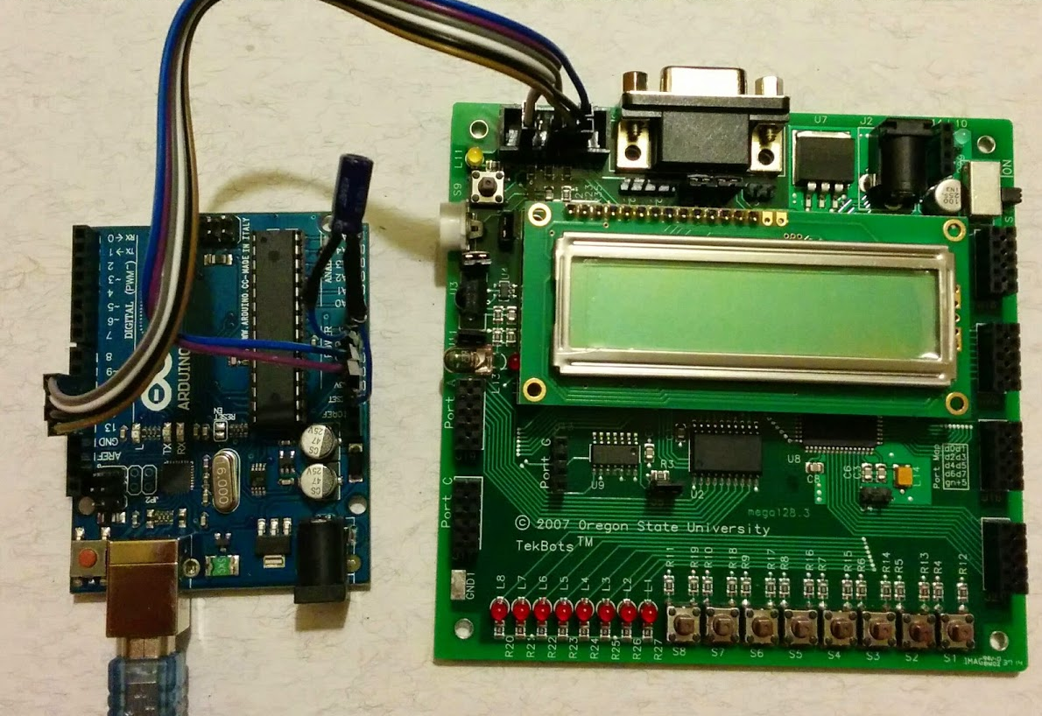
Rust’s Robots

Slide 18
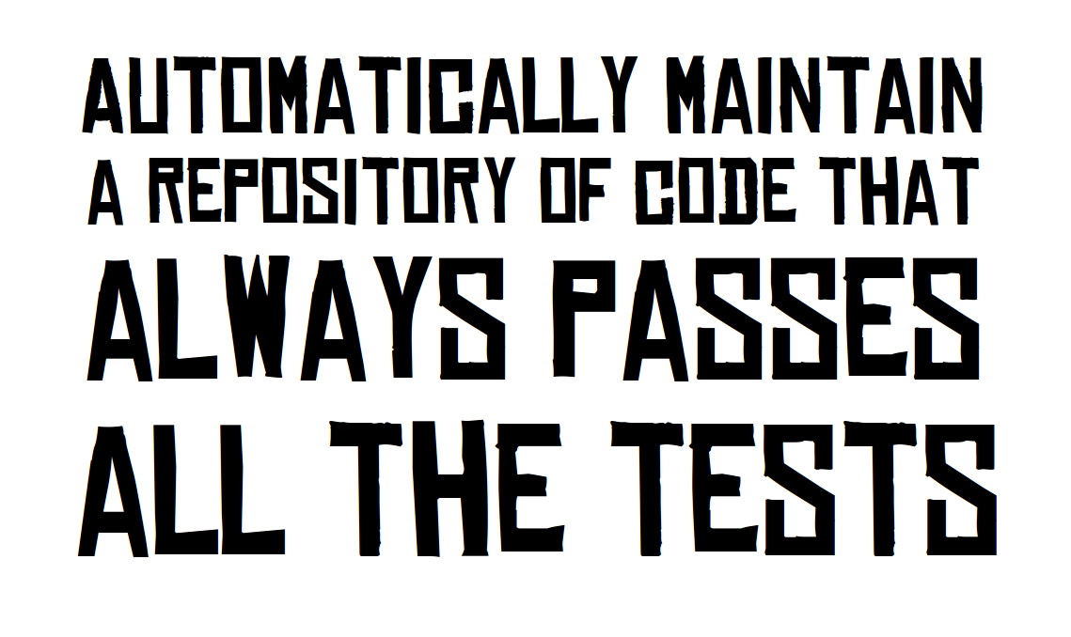
http://graydon.livejournal.com/186550.html

Slide 19
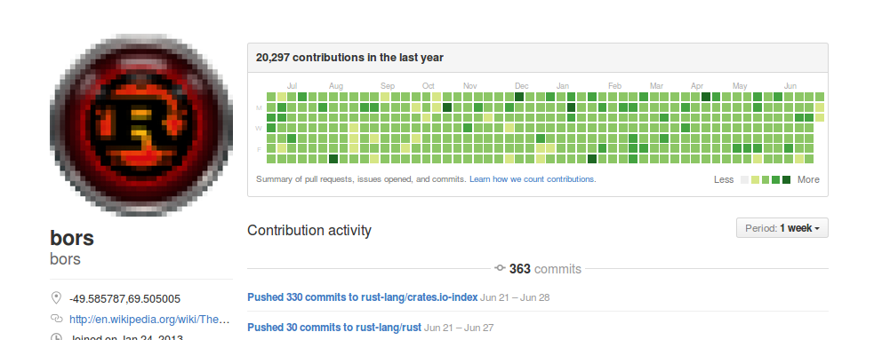
Rust: Bors & Homu
https://github.com/servo/homu
Test tree’s state after landing r+’d PR

Slide 20
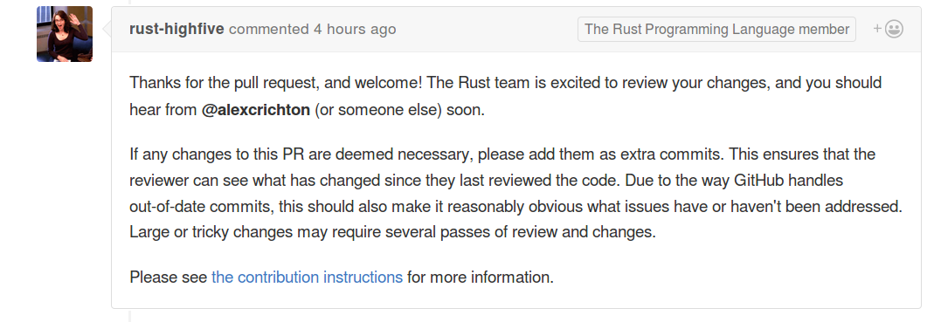
Welcoming Newbies
https://github.com/nrc/highfive
Offer guidance & assign reviewer

Slide 21
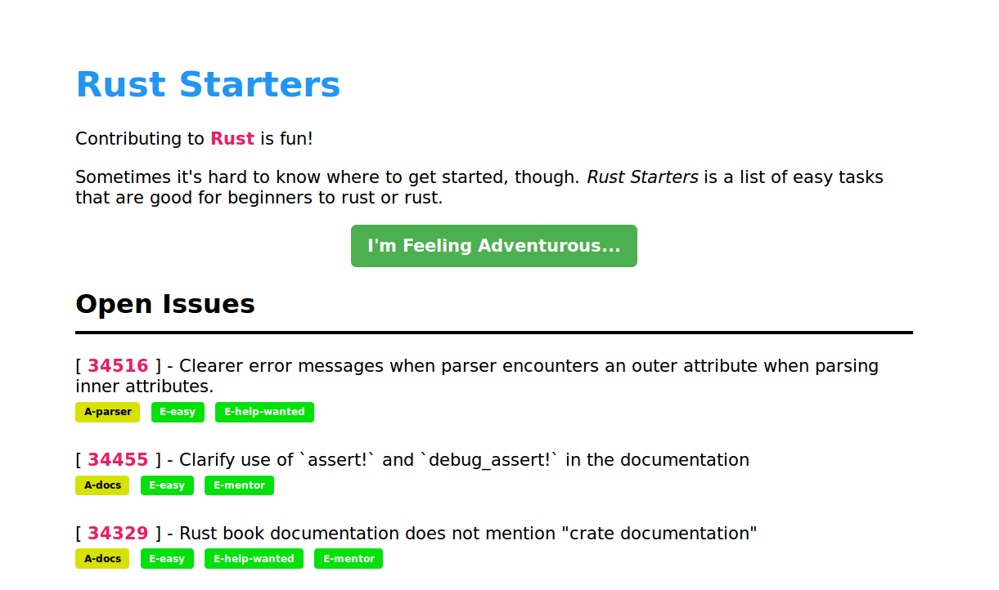
Mentorship & Guidance
http://edunham.github.io/rust-starters/, https://starters.servo.org/

Slide 22
Where do good first bugs go?
CONTRIBUTING.txt
https://www.codemontage.com/
http://www.codetriage.com/
http://issuehub.io/
http://up-for-grabs.net/
http://yourfirstpr.github.io/
https://openhatch.org

Slide 23
Robots Recap
Automatically maintain a repository of code that always passes all the tests
Welcome & guide new contributors
Mark & share introductory bugs

Slide 24
Rust Learning Resources

Slide 25
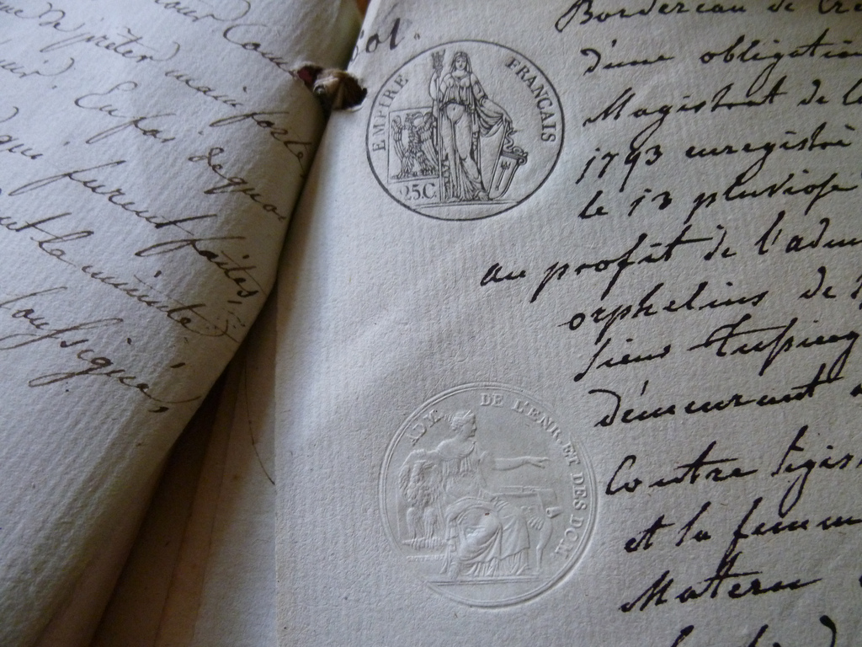
Language Docs doc.rust-lang.org

Slide 26

Compare Similar Languages github.com/ctjhoa/rust-learning/

Slide 27
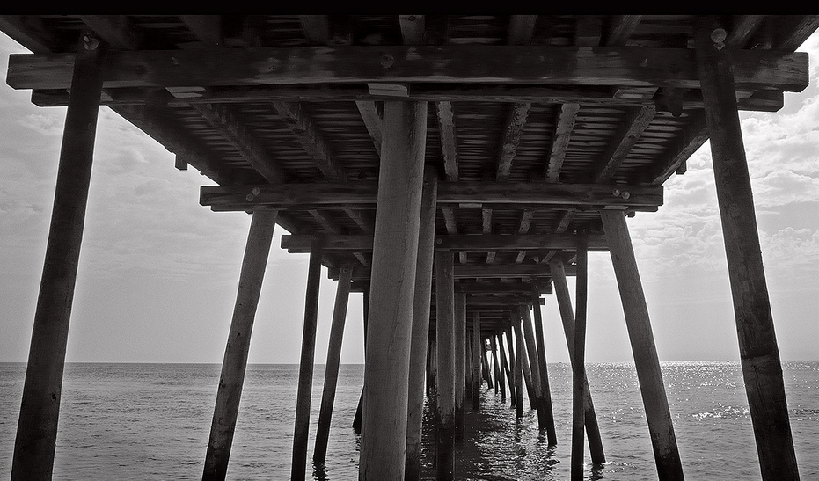
Community Support www.rust-lang.org/community.html users.rust-lang.org
#rust-beginners on irc.mozilla.org

Slide 28
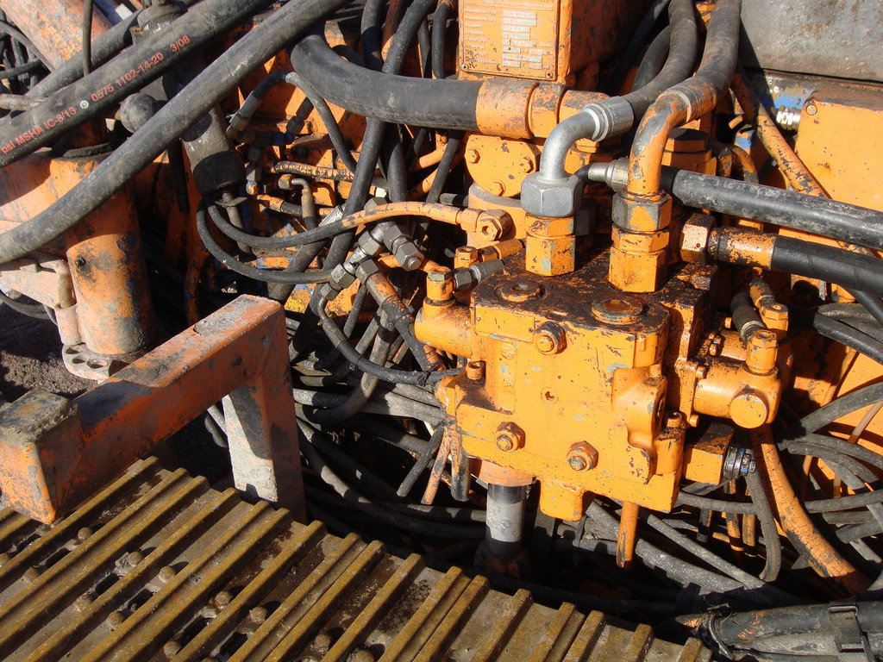
Write Real Code
GitHub search “is:open is:issue language:rust” starters.servo.org

Slide 29

Read The Books doc.rust-lang.org/book
O’Reilly, Programming Rust
Packt Publishing, Rust Essentials

Slide 30
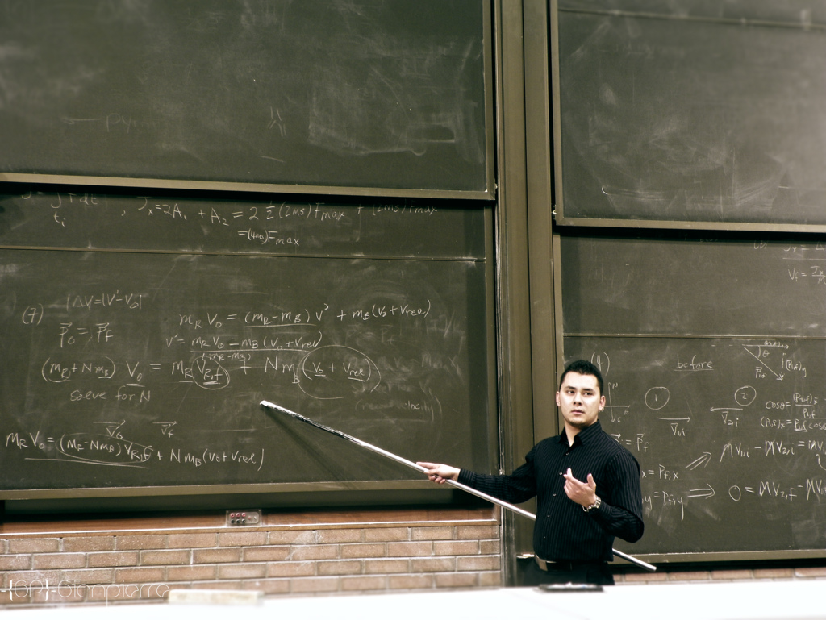
Examine Examples rustbyexample.com
Carol’s rustlings
Rosetta Code

Slide 31

Find Good Tools play.rust-lang.org
Clippy and Rustfmt
IDE support

Slide 32

Read Real Code crates.io popular libraries
The Rust Compiler
Rust in Production

Slide 33
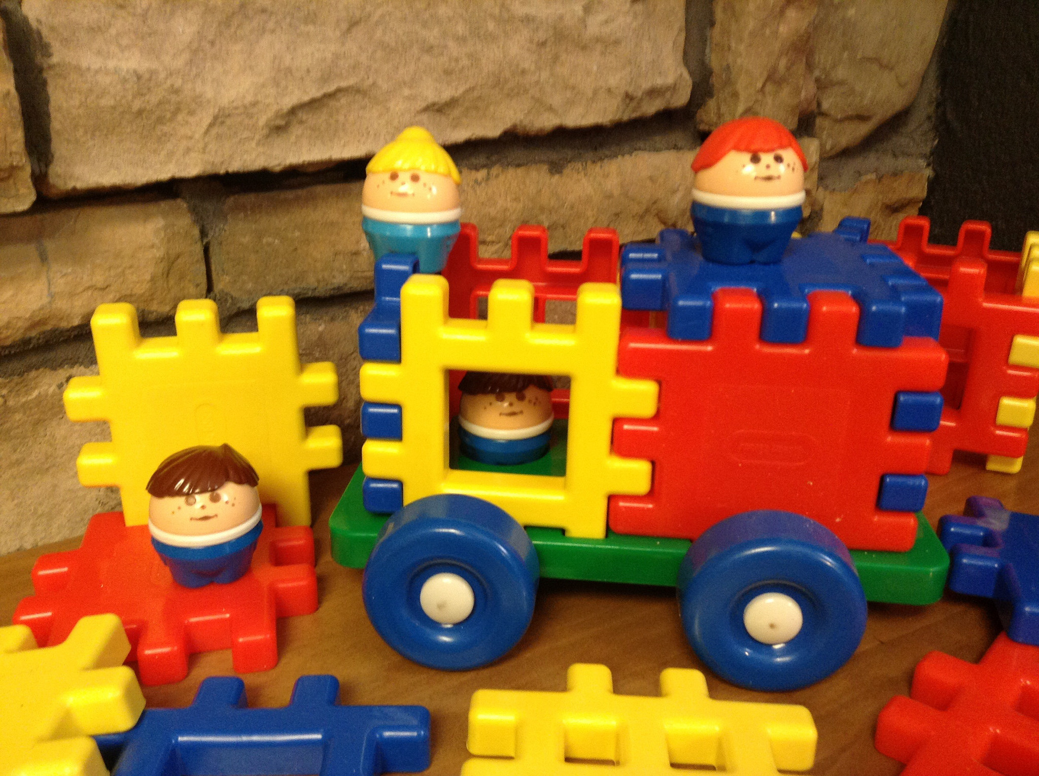
Write Toy Programs
Rust by Example exercism.io
Project Euler
Hackerrank

Slide 34
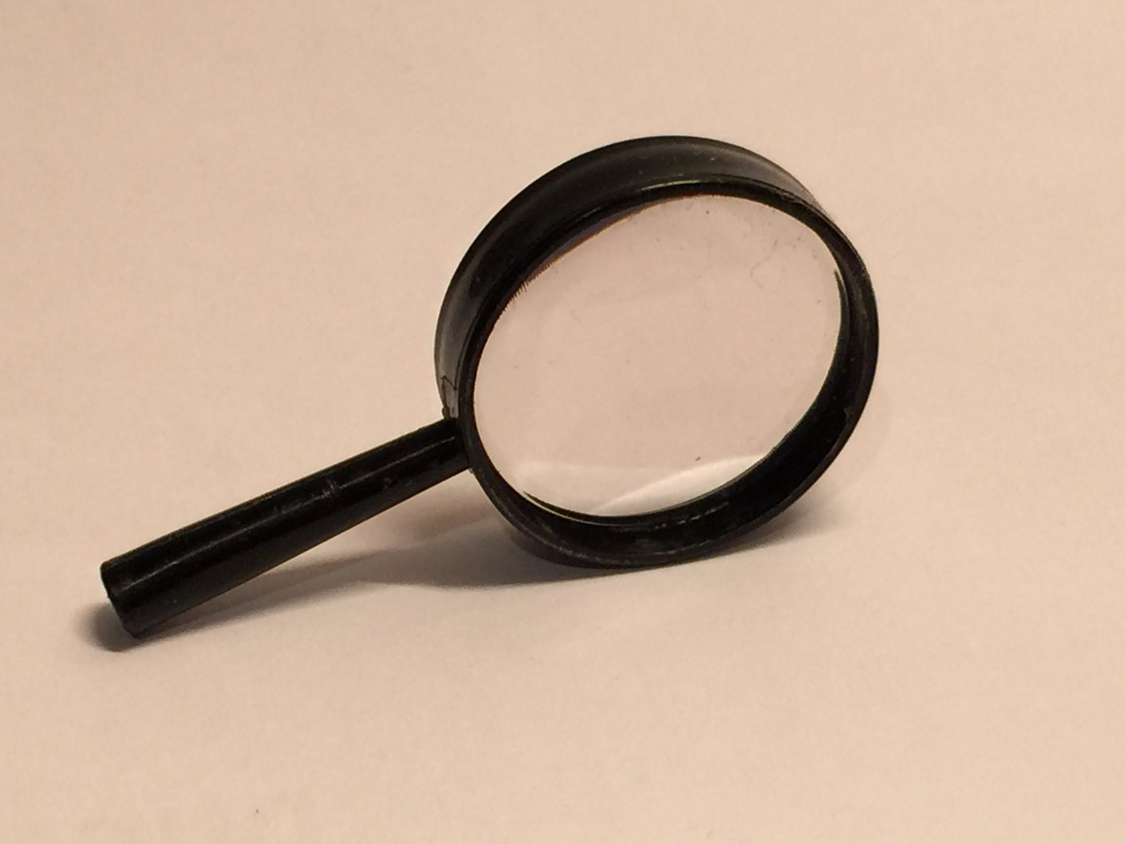
Google & Stackoverflow
Stackoverflow Rust tag

Slide 35
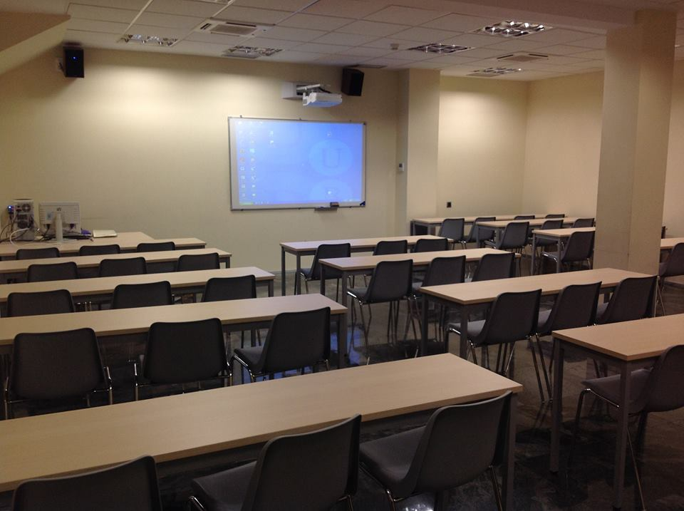
Watch Lectures & Courses rust-learning list

Slide 36
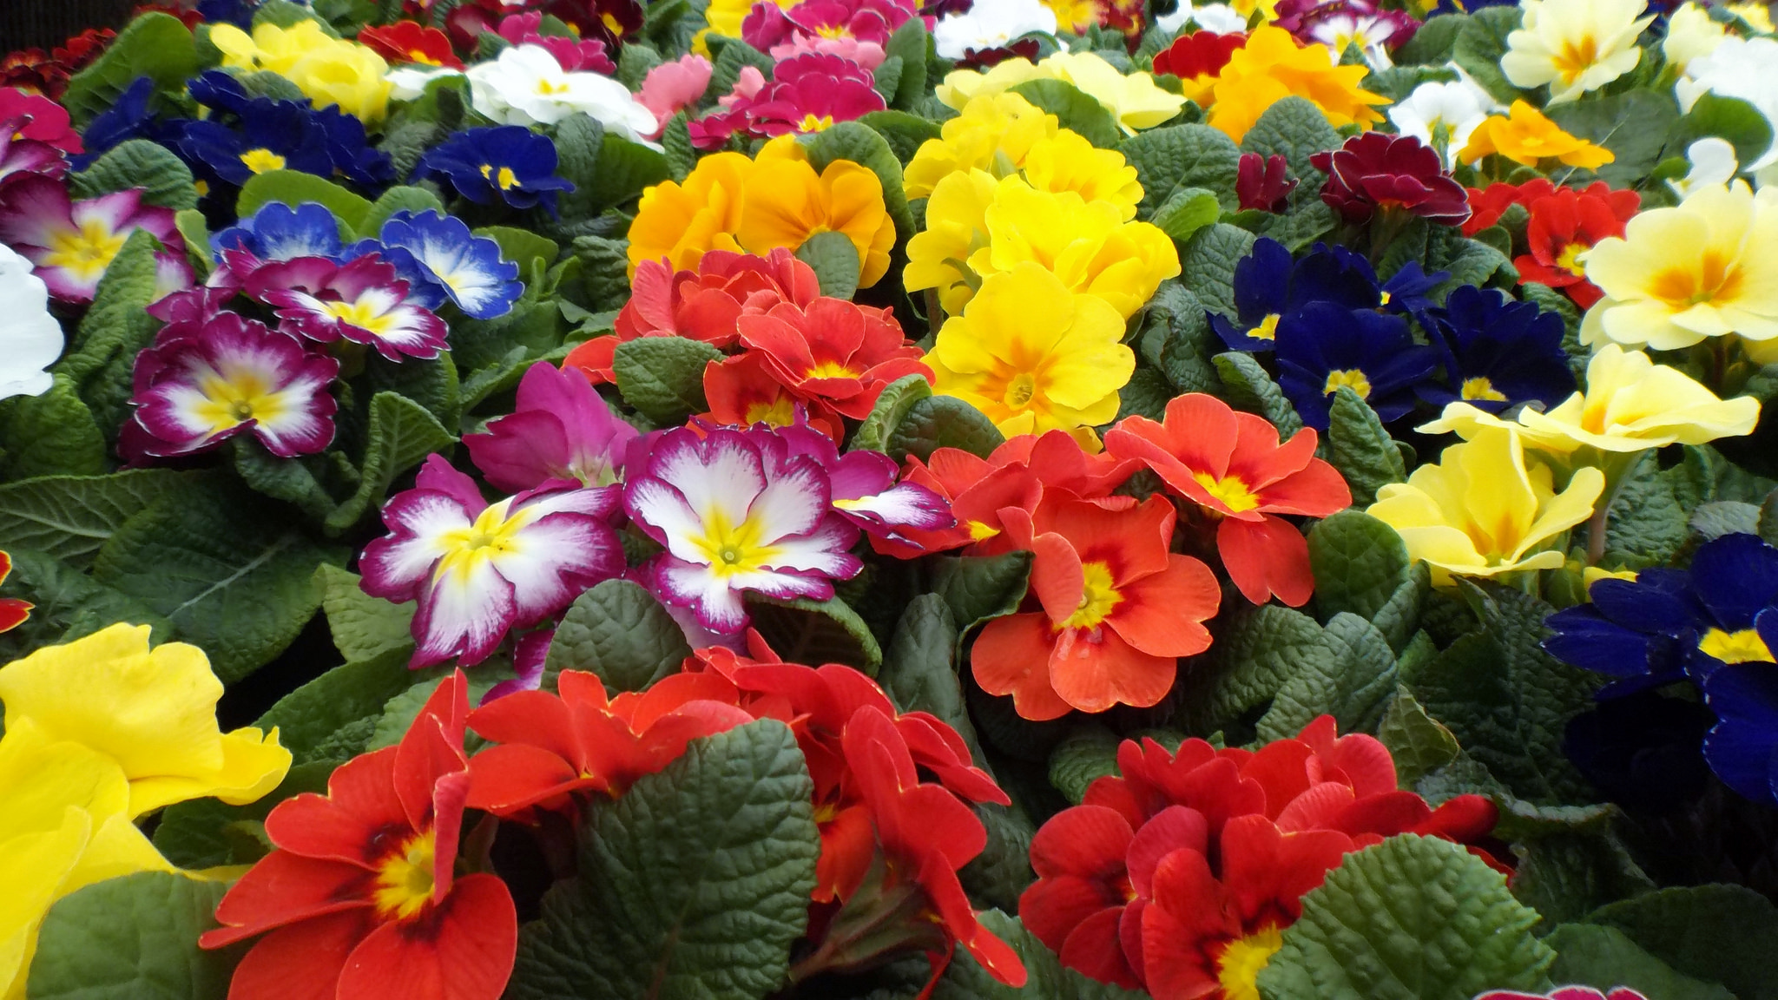
Participate!
Rust subreddit
This Week In Rust

Slide 37
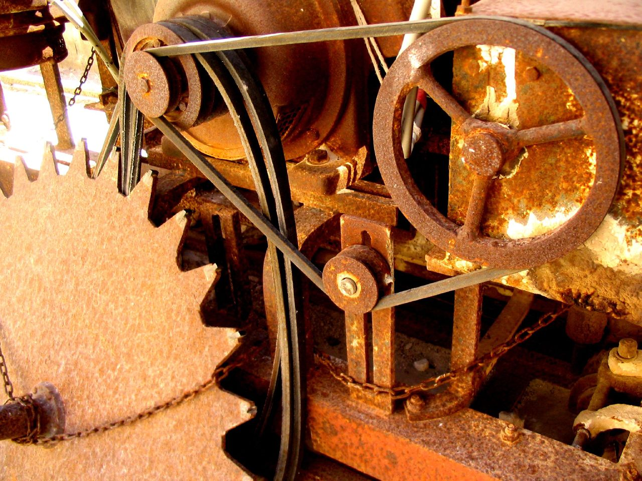
Errors are here to help

Slide 38
Getting Rust
https://github.com/rust-lang-nursery/rustup.rs (manage multiple versions)
http://rust-lang.org/downloads.html (single version)
http://play.rust-lang.org (official, no libraries)
http://play.integer32.com/ (has some popular crates)

Slide 39
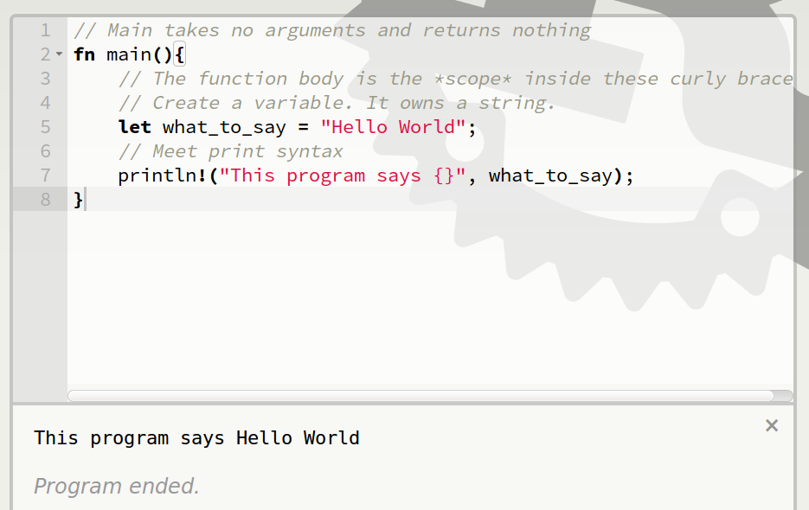
Basic Syntax

Slide 40
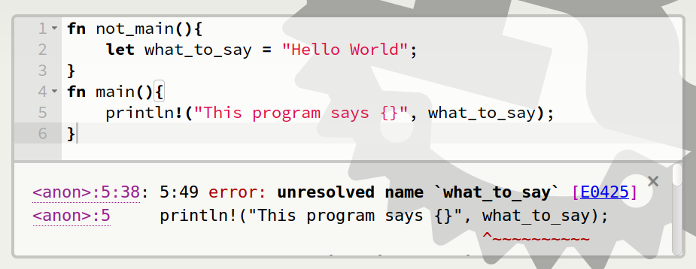
Scope Errors!

Slide 41
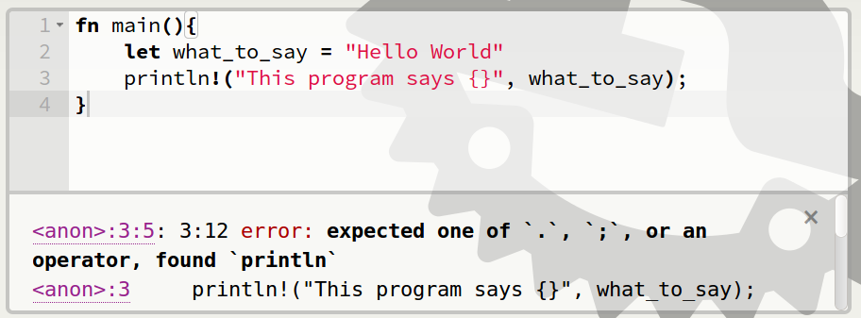
Punctuation Errors

Slide 42
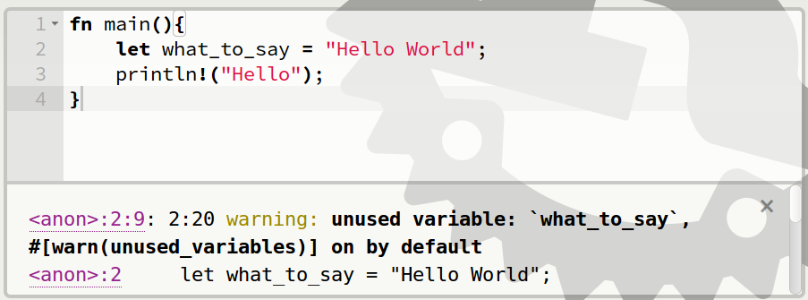
Unused Variables

Slide 43
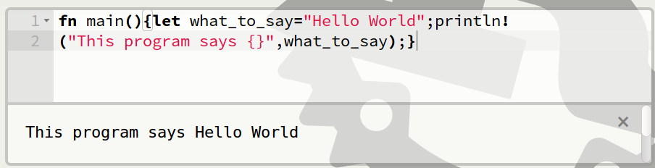
Hey, Pythonistas!

Slide 44
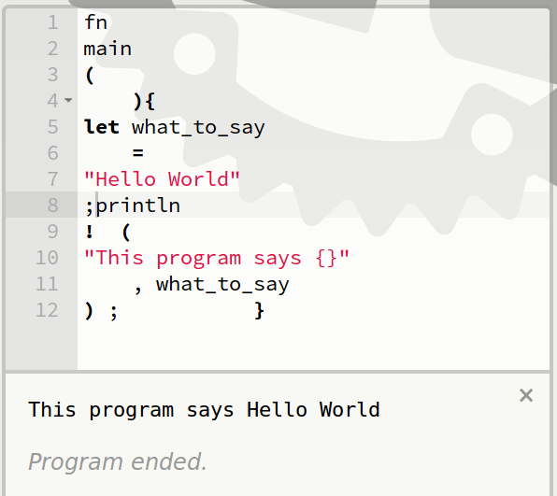
Hey, Pythonistas!

Slide 45
Primitive types (built-in)
bool
char
i8, i16, i32, i64
u8, u16, u32, u64
f32, f64
isize, usize
str
tuple
https://doc.rust-lang.org/book/primitive-types.html

Slide 46
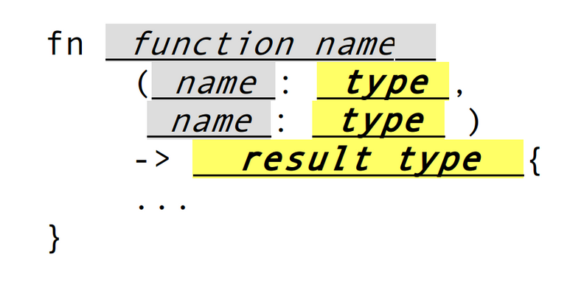
Function Type Signatures

Slide 47
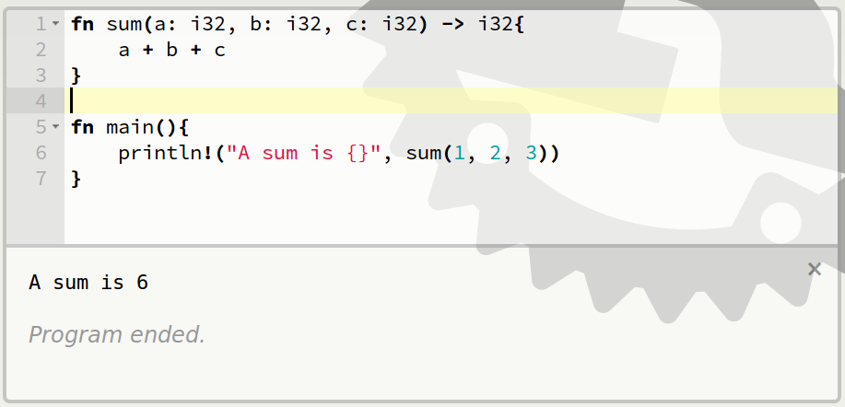
Function with a type signature

Slide 48
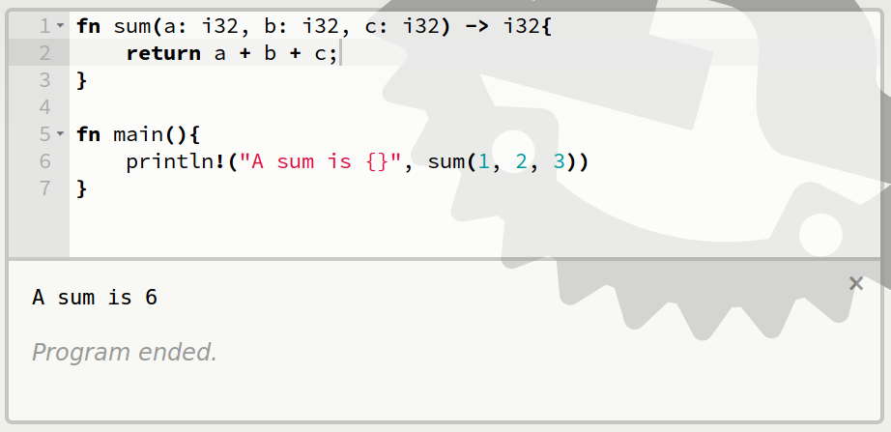
Synonymous return

Slide 49
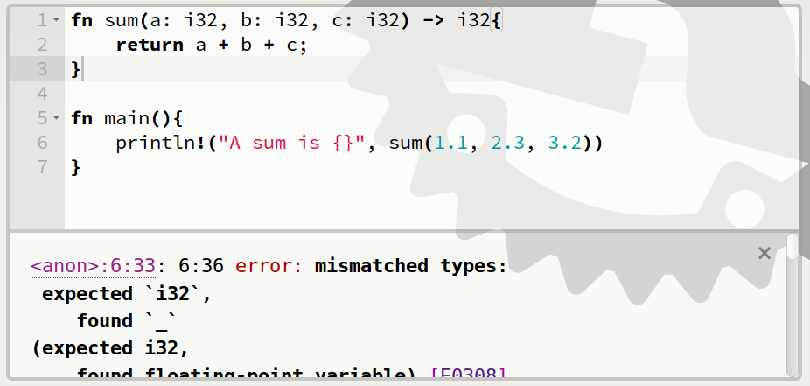
Type Errors

Slide 50
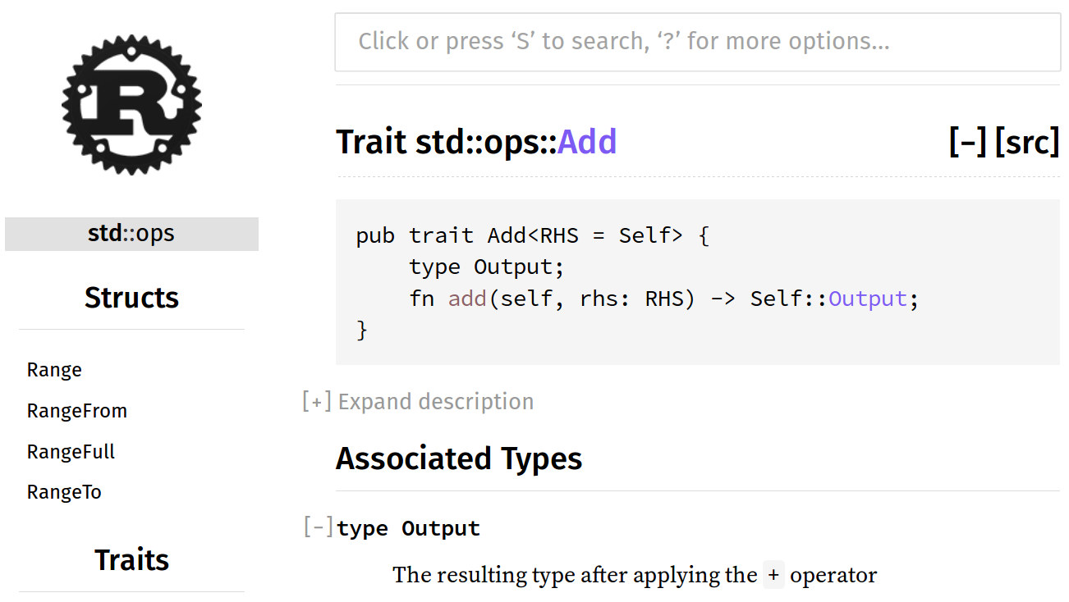
Anything you can add...
https://doc.rust-lang.org/std/ops/trait.Add.html

Slide 51
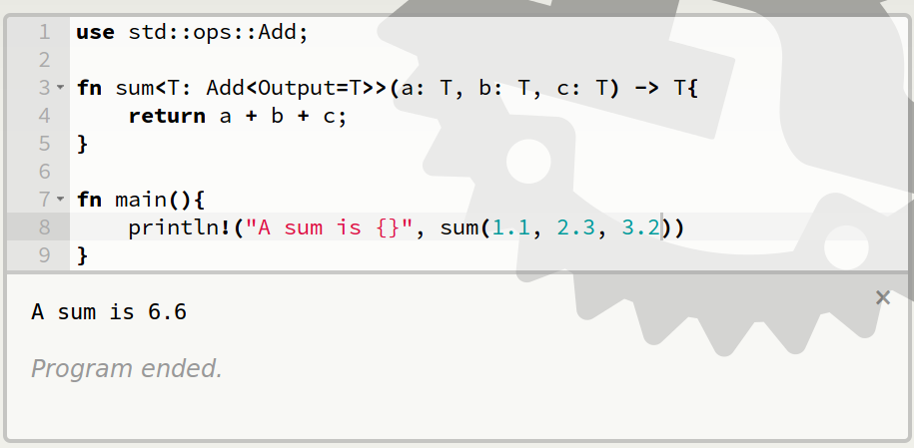
Traits

Slide 52
Additional Resources
https://doc.rust-lang.org/book/traits.html
http://blog.rust-lang.org/2015/05/11/traits.html
http://rustbyexample.com/trait.html
http://pcwalton.github.io/blog/2012/08/08/a-gentle-introduction-to-traits-in-rust/

Slide 53
Ownership Rules
No borrow may outlive value's owner
Exactly 1 mutable reference (&mut T)
  OR
As many read-only references (&T) as you want

Slide 54
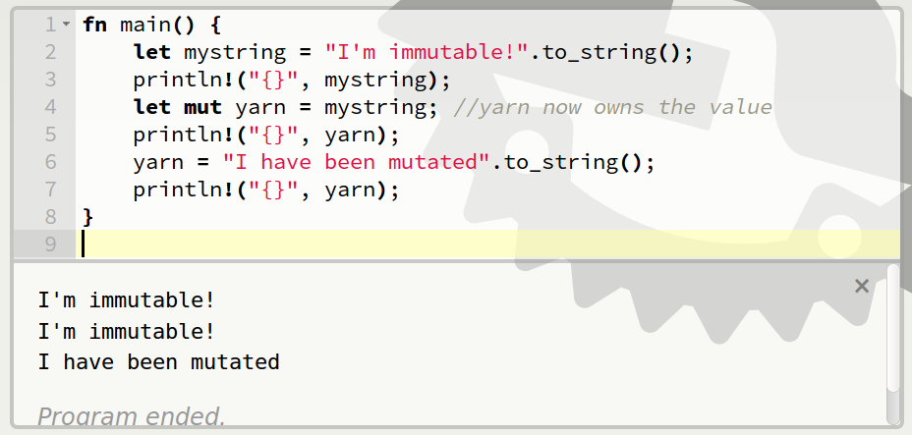
Giving Away a Value

Slide 55
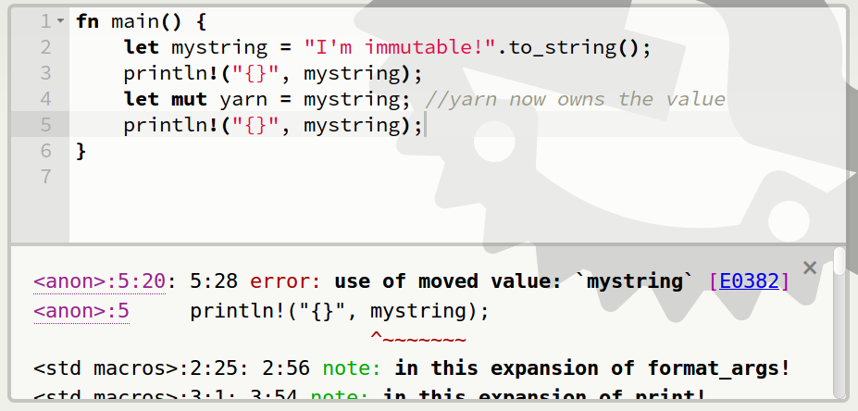
Given away means gone

Slide 56
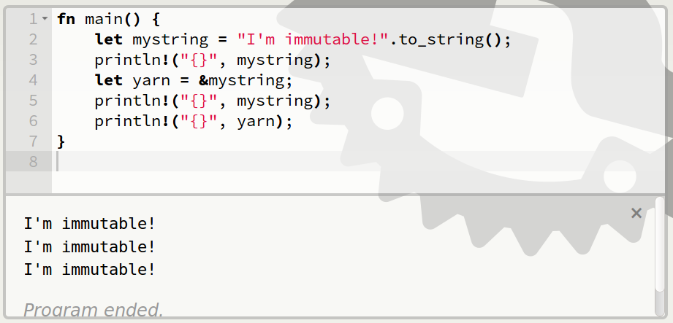
Borrow the value

Slide 57
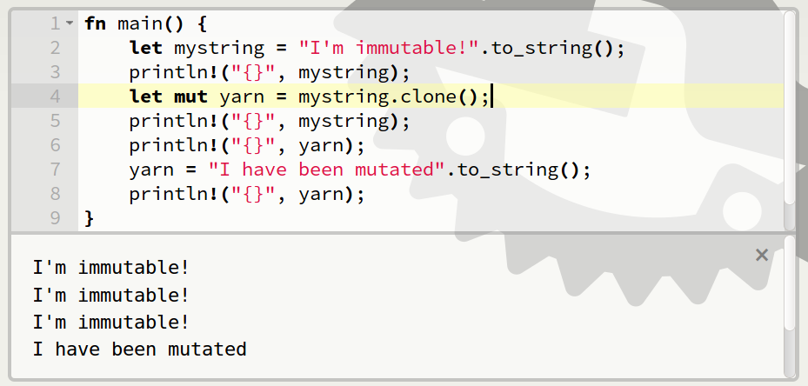
Make a mutable copy

Slide 58
Review
Only owner can access value
1 mutable reference or unlimited read-only references to each value
Borrow may not outlive owner

Slide 59
Additional Resources
http://doc.rust-lang.org/stable/book/ownership.html
http://doc.rust-lang.org/stable/book/references-and-borrowing.html
Why the to_string()? http://hermanradtke.com/2015/05/03/string-vs-str-in-rust-functions.html
http://rustbyexample.com/trait/clone.html
https://www.reddit.com/r/rust/comments/2xxjda/when_should_my_type_be_copy/

Slide 60
How can we help?
Email community-team@rust-lang.org
IRC #rust-community on irc.mozilla.org
Email me: edunham@mozilla.com or mozcommunity@edunham.net

Slide 61

Thank You talks.edunham.net/mozcommunity-rust
Photos at https://www.flickr.com/photos/143305168@N08/favorites

