Slide 1

Building a Better Browser Engine on GitHub
E. Dunham
@qedunham
October 2017

Slide 2


DevOps at
  Emerging Technologies
Opinions mine, not theirs
FOSS background, OSUOSL

Slide 3


Slide 4

http://maxpixel.freegreatpicture.com/Lost-Places-Castle-Ruin-Excalibur-Knight-Fairytale-2322406

Slide 5
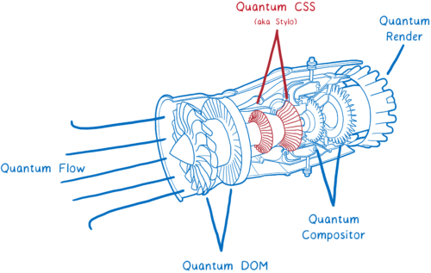
https://tctechcrunch2011.files.wordpress.com/2017/09/01-500x317.png

Slide 6

https://pixabay.com/en/tools-spanner-old-rusty-concepts-1552787/

Slide 7


Slide 8

rust-lang.org
Safe, concurrent, fast
Systems programming, fewer footguns
Hack Without Fear

Slide 9
Community
"The Rust community seems to be populated entirely by human beings. I have no idea how this was done."
http://scattered-thoughts.net/blog/2015/06/04/three-months-of-rust/

Slide 10
Conduct
"Please be kind and courteous."
"Please keep unstructured critique to a minimum"
Dedicated moderation team
"We will exclude you from interaction if you insult, demean or harass anyone"
https://www.rust-lang.org/conduct.html

Slide 11
Communication
Weekly updates
Mandatory RFC process
Consistent PR review
Distributed team & public discussions

Slide 12

https://gallery.yopriceville.com/Free-Clipart-Pictures/Silhouettes-PNG/Sailboat_Silhouette_PNG_Clip_Art

Slide 13
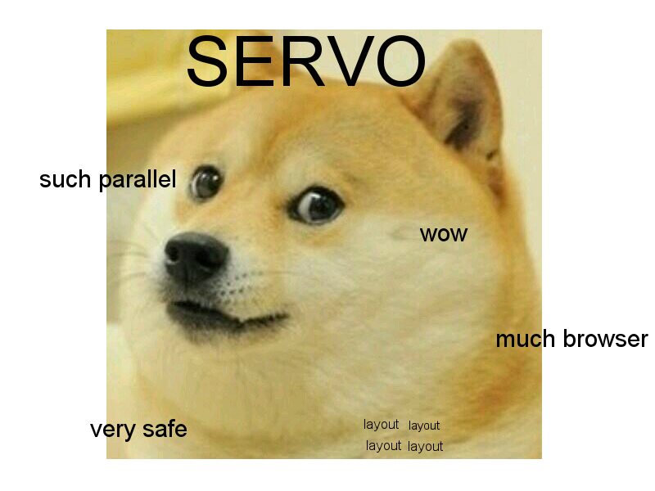
http://lucywyman.me/servo.org/static/img/doge-servo.jpg

Slide 14


Slide 15
servo.org
~12 full-time engineers
~612 code contributors
~21k commits into servo/servo
~4% of contributors, ~25% of commits from @mozilla.com

Slide 16
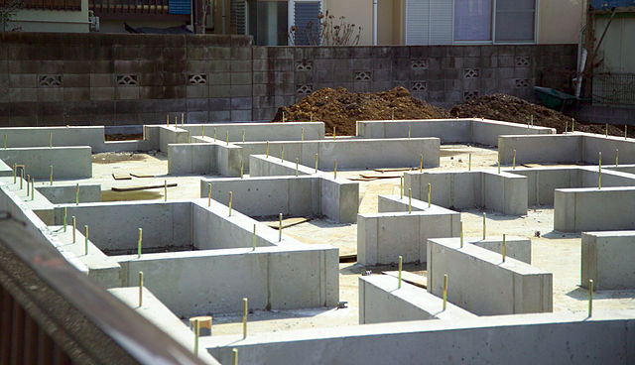
https://commons.wikimedia.org/wiki/File:Foundation-M2325.jpg

Slide 17


Slide 18

Why GitHub? (2012)
Adequate functionality
Easy for developers
Extensible
Everyone has accounts

Slide 19


