Slide 1
Hearing Aid Fitting With a Genetic Algorithm*
Eric Durant, Milwaukee School of Engineering
Greg Wakefield, University of Michigan
Dianne Van Tasell
Martin Rickert, Indiana University
– work sponsored in part by Starkey Laboratories –
IHCON 2002
Friday 23 August 2002
* Patent pending.

Slide 2
Acknowledgments
Advanced Research group at Starkey, especially
  Ms. Melanie Gregan
  Mr. Stephen MacLennan
  Dr. Jon Kindred
  Mr. Steven Lund
…and many others

Slide 3
Motivation
Increasing hearing aid processing power
enables sophisticated signal processing with many (interacting) parameters.
  Even after initial prescriptive fitting, parameters must be further optimized subjectively.
  Simultaneous adjustment of several parameters yields too many settings to be tested.

Slide 4
Motivation
The genetic algorithm (GA) is a promising solution.
  Allows automated, in-field…
    fine tuning of prescriptive parameters and
    search for good subjective parameter settings

Slide 5
Background: Genetic Algorithms
GAs borrow biological concepts such as
natural selection, mutation, and crossover
Parallel search
  Refines a “population” of solutions
Stochastic
  Solutions chosen randomly for refinement, with higher quality solutions more likely to be chosen
  Refinement method chosen randomly:
  global and local search
Can work well on multimodal and discontinuous surfaces

Slide 6
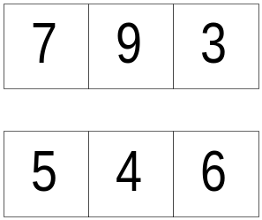
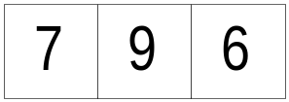
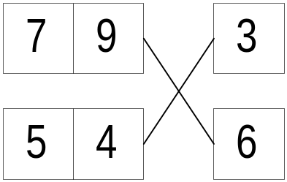
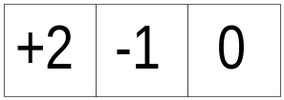
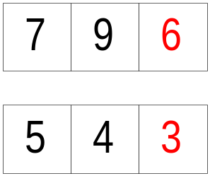
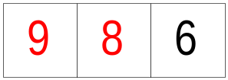
Crossover and Mutation
3 parameters
Original gene
2 genes or hearing aid memories
Randomly chosen
crossover point
Random mutation
New genes
New gene

Slide 7
Background: Adaptive Fitting
Neuman et al. (1987): Compared 3 adaptive methods
  Simplex, double elimination, and iterative round robin
Takagi and Ohsaki (1999)
  GA hearing aid fitting in compressive amplification space, level × frequency → level, sum of 2-D Gaussian distributions
  Population size 20
  5-level absolute scale

Slide 8
Background: Adaptive Fitting
Improvements beyond (Neuman, 1987)
  Cope with higher dimensionality (3-6⁺ vs. 2)
  Cope with multiple local optima
  Combine attributes of multiple genes/memories
Improvements beyond (Takagi, 1999)
  Switched from absolute scaling to paired comparisons (dominance judgments) for easier in-field use

Slide 9
Methods
Inferencing via paired comparisons
Data collected
  Alternatives in each pair
  Decisions
  Listening time
  GA actions
Notes:
Inferencing: connect user input to GA (estimate rank order from a short series of carefully chosen paired comparisons)
GA actions: which genes in the population were replaced with which new genes?

Slide 10
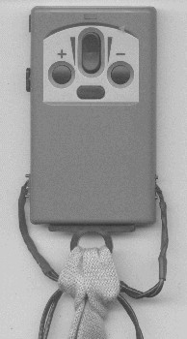
Methods: Portable Prototyping Device and User Interface
Motorola 56303 DSP
  Up to 66 MHz
  8 k × 24 b on-chip RAM
32 kB non-volatile, field-writable memory
2-color LED
Connects to custom ear modules
Runs for about 4 hours on 3 AAA batteries
5.5 cm
Prefer current
Solutions equal
Volume
Toggle/reset

Slide 11
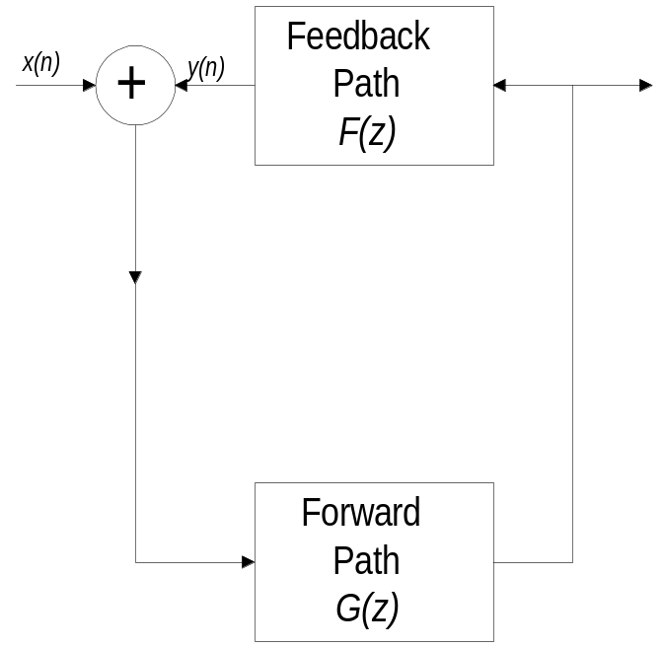
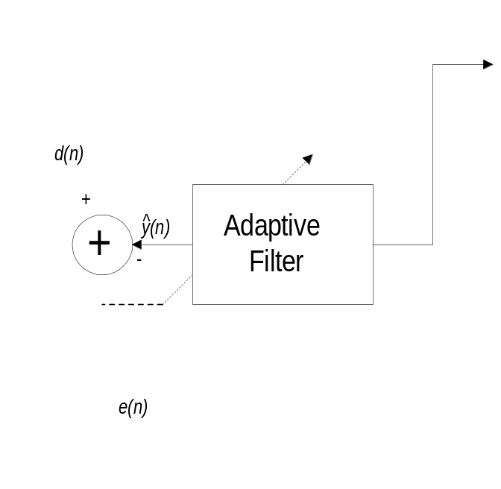
Methods:
Feedback Canceller Fitting
Cancel acoustic feedback using a digital filter
NLMS filter
  L – filter length
  α – adaptation time constant
  ρ – update decimation factor

Slide 12
Methods
Subjects
  8 experienced hearing aid users w/ mild/moderate losses
  8 normal hearing
Instructions
  Toggle between 2 genes/memories
  Create feedback (subjects were told how to do this)
  Evaluate cancellation and sound quality/artifacts
  Make a selection (algorithm then chooses 2 alternatives for next comparison)
Notes:
Stopping criteria: run until no difference can be heard for several (8+) comparisons

Slide 13
Results: Measures of Success
Type | Examples | Pros | Cons
Objective / Direct | Gain margin | Direct, rigorous | Limited scope
Indirect / ensemble | Population variation | Derivable, simulatable | Abstract, indirect

Slide 14
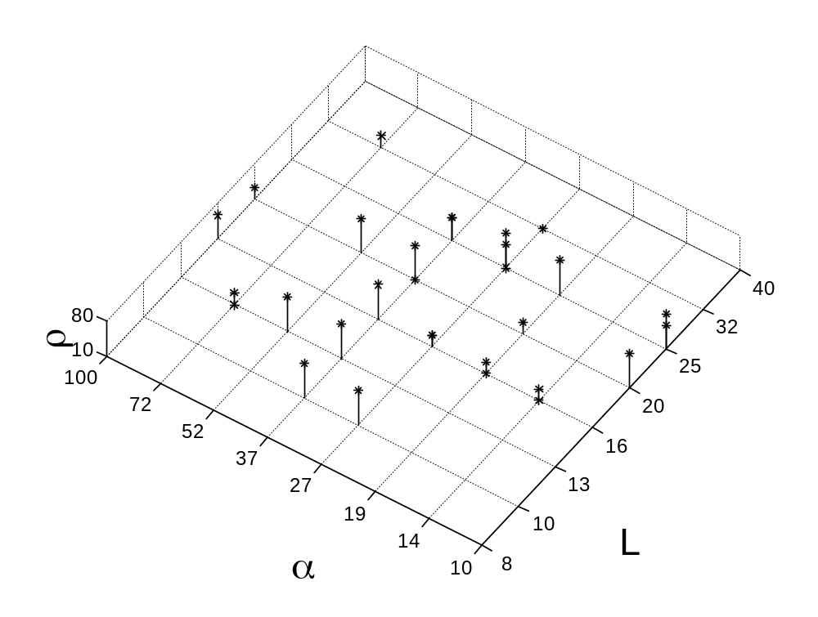
Results: Favorite Solutions for Hearing Impaired
Average of 50 comparisons
Less frequent filter updates
Longer digital filters
Quicker adaptation
Note: f_{s} = 20 kHz
Notes:
Note: no L=8 [not enough frequency resolution?] or L=40
Run time was between 20 minutes and 1 hour

Slide 15
NLMS Gain Margins for
Hearing-Impaired Subjects
Subject | 1.0 kHz | 1.6 kHz | 2.5 kHz | Mean
I1 | 6.1 | 13.3 | 10.6 | 10.0
I2 | 10.0 | 10.1 | 13.3 | 11.1
I3 | 16.8 | 11.2 | 7.1 | 11.7
I4 | 11.6 | 14.4 | 10.9 | 12.3
I5 | 15.0 | 19.4 | 18.0 | 17.5
I6 | 12.4 | 12.9 | 13.9 | 13.1
I7 | 12.0 | 14.0 | 11.0 | 12.3
I8 | 15.3 | 14.3 | 12.5 | 14.0
Mean | 12.4 | 13.7 | 12.2 | 12.8
Notes:
A wide variety of settings gave very similar gain margins. Does this mean any setting would do? No, subjects were making methodical decisions (diversity, next slide) and their favorites were reliable (+2 slides).

Slide 16
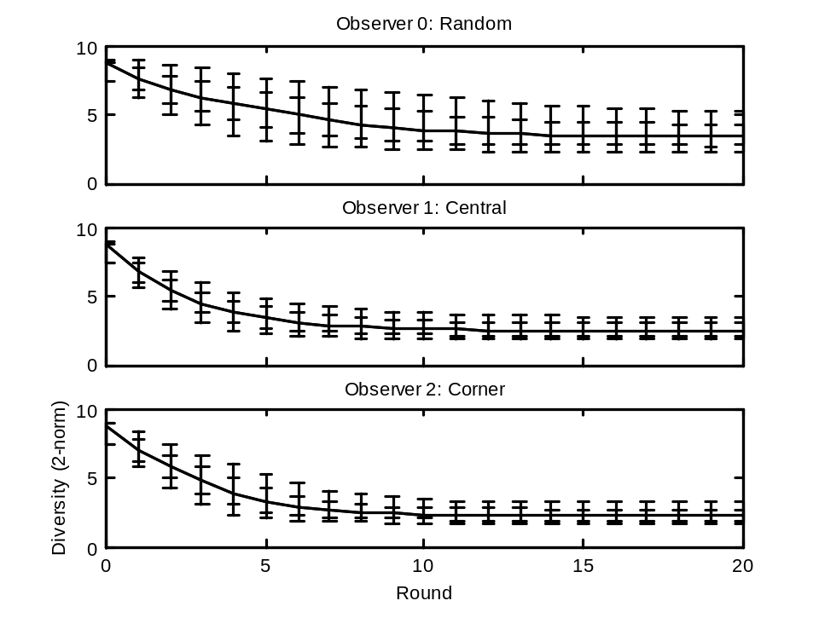
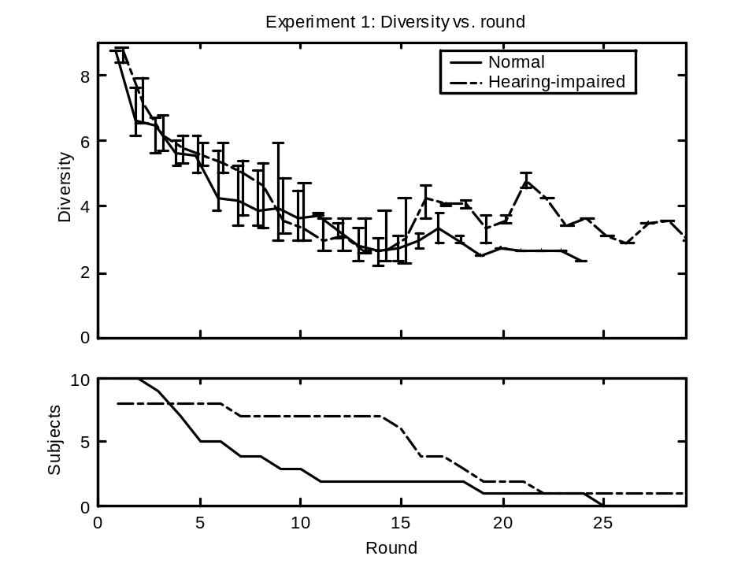
Diversity for Feedback Canceller Fitting Experiment
Ensemble performance is closer to simulated perfect rational observers than to random observers
3.3___
2.5____________________
2.4___
2.2___

Slide 17
Feedback Canceller Fitting
Follow-up: Reliability
Each subject compared his or her favorite setting and 4 settings representative of the favorites across all subjects
Total of 20 comparisons
Subjects indicated preference
Subjects ranked similarity on a scale of 1 (“clearly different”) to 5 (“identical”)

Slide 18
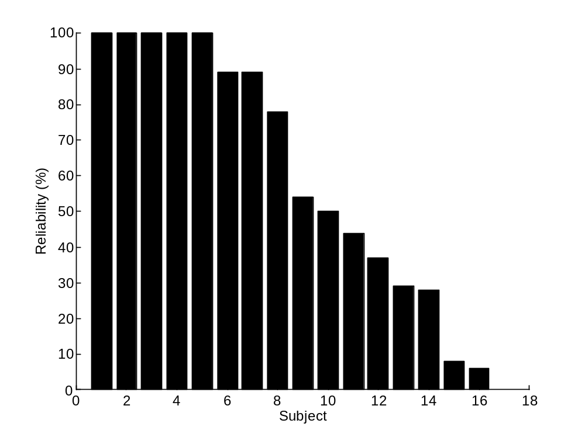
Feedback Canceller Fitting
Follow-up: Reliability
An “optimal” ranking of the alternatives was determined for each of the 16 subjects based on their responses
5 subjects clearly preferred original selection
3 subjects’ responses very consistent with preferring original selection
Change in objective?
Notes:
Some of the remaining subjects described training effects causing a change in objective
Conclusions
1. Reliable
2. Avoided potential suboptimal local maxima

Slide 19
Multiband Expansion Fitting
Goals
  Test the method at higher dimensionality
  Test with an idiosyncratic component
We experimented with slow acting expansion, on which much less prior work has been done and which seems to primarily affect subjective quality.
8 hearing-impaired and 8 normal hearing subjects
Notes:
Idiosyncratic: a lot of variation among subjects – hence an area in which fitting beyond the initial prescription is needed

Slide 20
Multiband Expansion Fitting:
6 Parameters Varied
Expansion ratios in 3 bands
Signal level estimation time constant
2 parameters controlling expansion thresholds in 3 bands

Slide 21
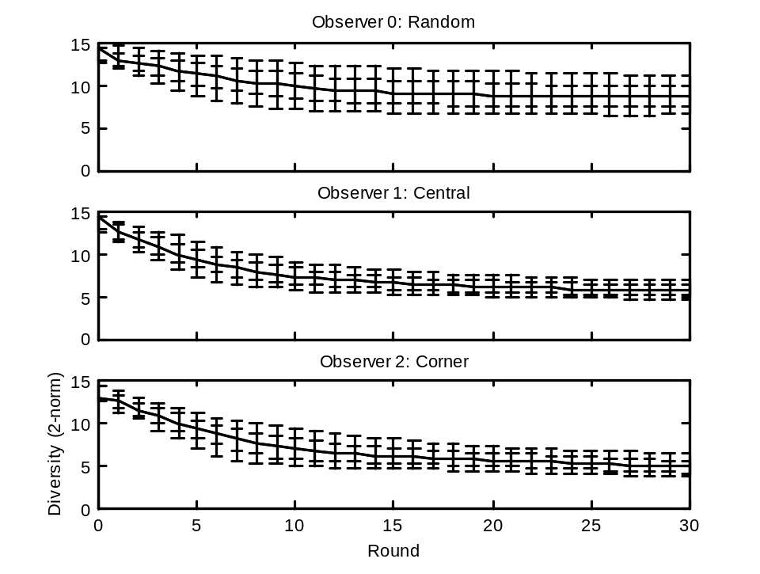
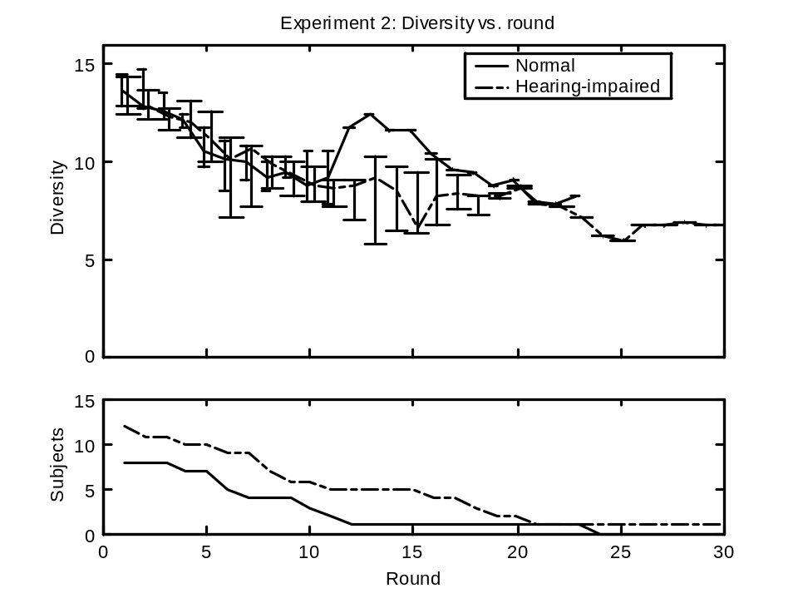
Diversity for Multiband Expansion Fitting Experiment
Ensemble performance is between simulated perfect rational observers and random observers.
9___
____________________
7-8____________________
5___
5___
Notes:
Slower decrease in variation after 5th round along with the large inter-run differences for some parameters and difficulty in discrimination suggest that the JNDs were much larger than the sampling spacings for those parameters.
This suggests that subjects converged perceptually even though objective diversity was somewhat higher than that of the rational observers.

Slide 22
Repeatability for Multiband Expansion Fitting Experiment
Four HI subjects reran the experiment from different initial populations. Each subject’s favorite solutions from both runs were compared.
Param. | Dev. | p
time const. | 1.42 | 0.8
mid-band XR | 1.66 | 0.8
Exp. thresh. | 1.94 | 0.7
For each parameter, we computed a statistic measuring the difference between the solution for run 1 and run 2.
Even though many runs were short, 2 parameters were controlled with 80% confidence.

Slide 23
Summary and Conclusions
First experiment – feedback cancellation
  Most users found reliable settings
  Preferred settings varied greatly between users, but all provided roughly equivalent gain margin
  Non-random performance
Second experiment – multiband expansion
  Users found repeatable settings for 2-3 parameters
  Results not as strong as in first experiment due to increase in complexity and parameter space oversampling (JNDs larger than estimated)

Slide 24
Future Directions
Future work suggested by experimental results
  Choosing optimal mutation rate (fixed or adaptive)
  On-line adaptation of coarseness of parameter tilings in response to observed discrimination ability
  Enhancing inferencing method to use some redundancy might improve performance for highly error-prone subjects
Focus has been on in-field optimization, but the method could also be used:
  Clinically
  Or, for complete self-fitting of hearing aids

Slide 25
Notes:
Intentionally blank at end

