Slide 1
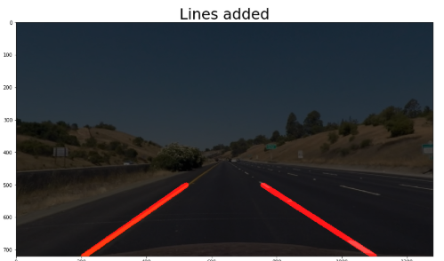
[537.4,450]
[742.6,450]
P2
P3
Coeficiente
[158,720]
[1122,720]
P1
P4

