Slide 1

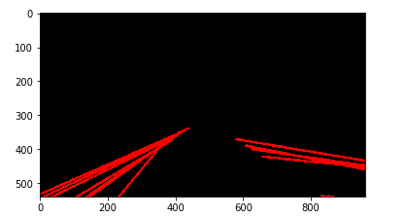

Slide 2
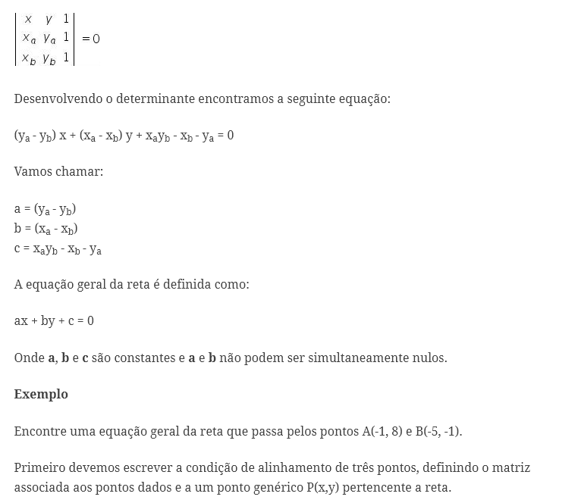

Slide 3
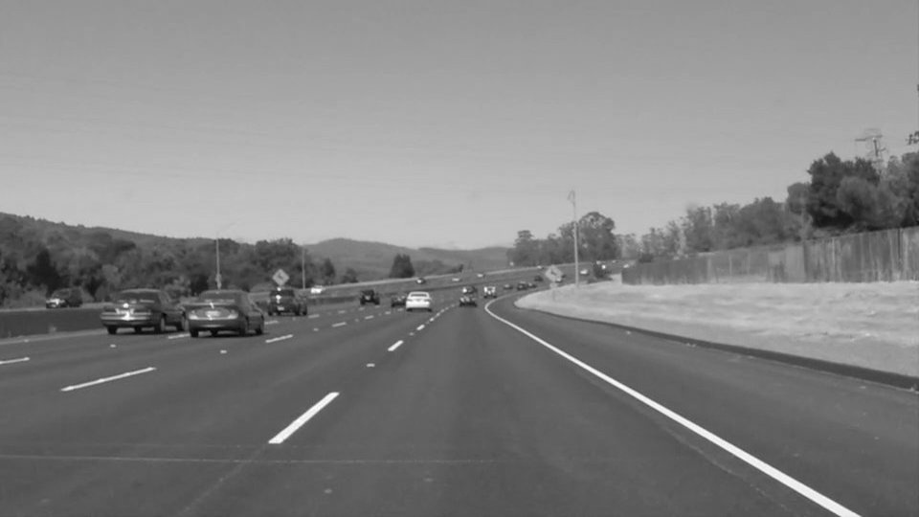

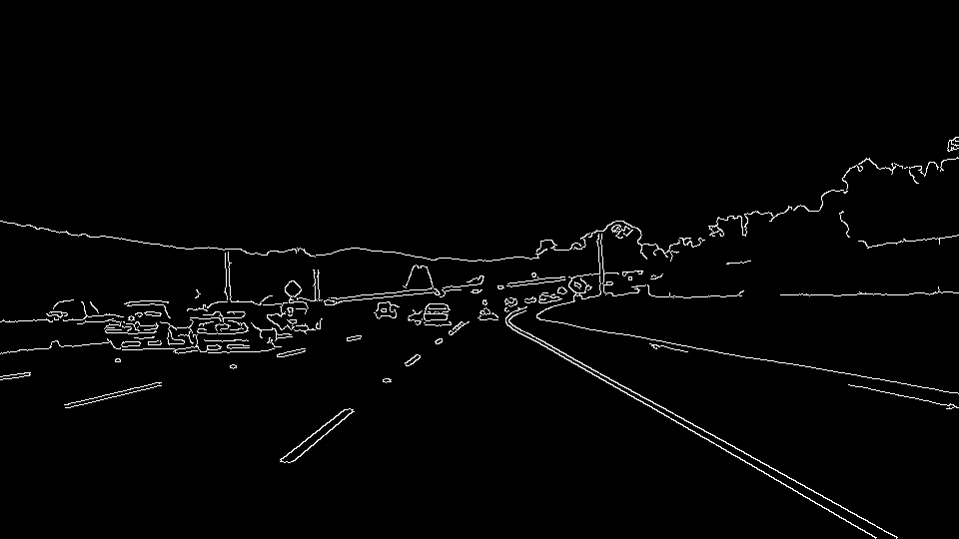
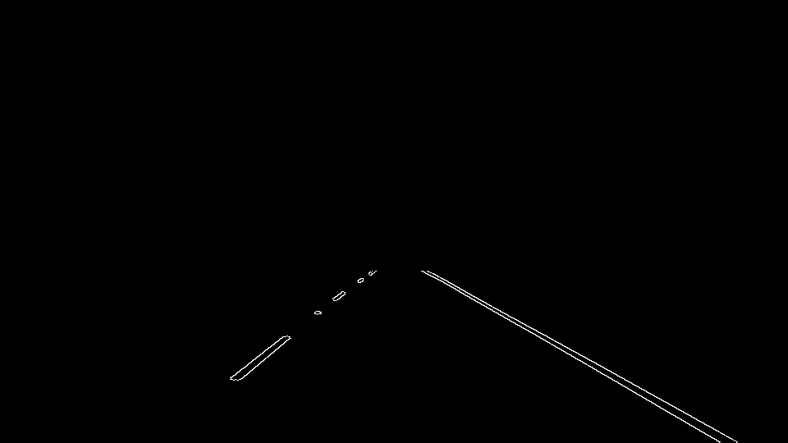
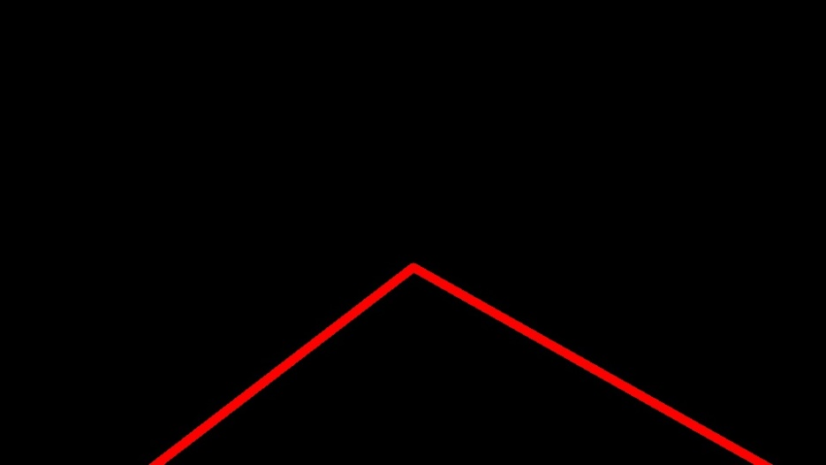
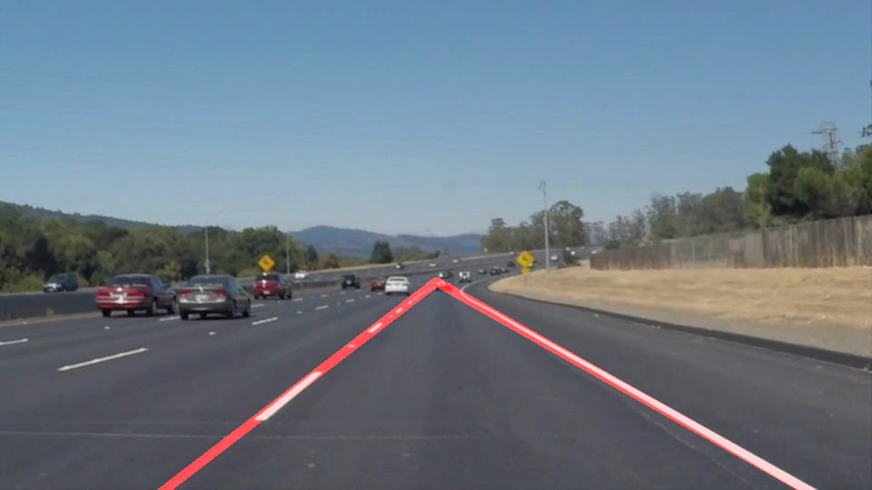
STEP 1
STEP 2
STEP 3
STEP 4
STEP 5.1
STEP 6.1

Slide 4
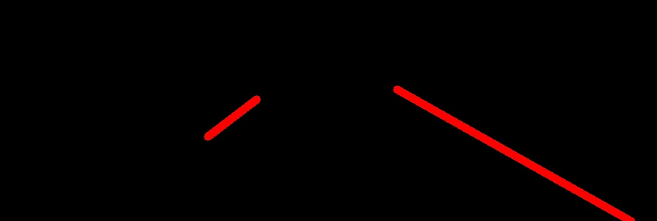




x
avg ($x_{p2},y_{p2})$
P2
P3
avg ($x_{p3},y_{p3})$
y
Ө
Ө
Left Lane line
Right Lane line
P1
P4
avg ($x_{p1},y_{p1})$
avg ($x_{p4},y_{p4})$

