Slide 1
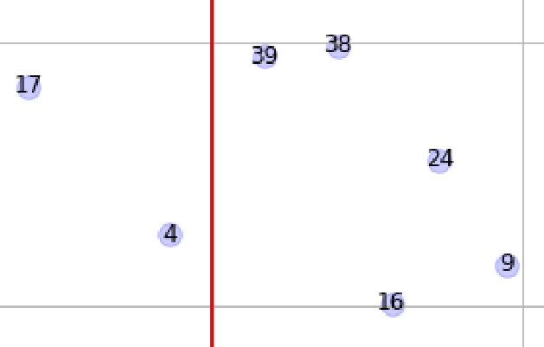
Nearest
Landmark
LandMark_id = 39
Minimal distance = d3
d2
d4
Car Predicted position
d3
d5
d1
d6
d7

Slide 2
ID
Landmarks from map data
Observed landmarks transformed to Map coordinate system
Landmark ID association.

Slide 3
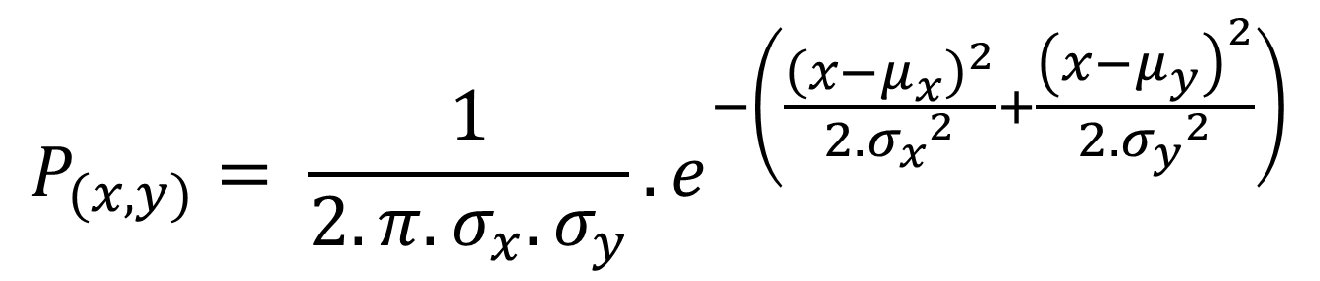
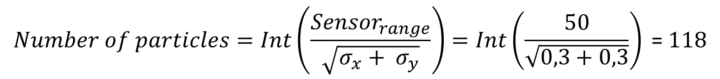
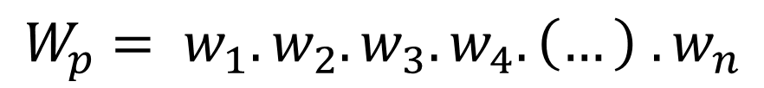
$$Number of particles=Int\left(\frac{{Sensor}_{range}}{\sqrt{σ_{x}+ σ_{y}}}\right)=Int\left(\frac{50}{\sqrt{0,3+0,3}}\right)\text{ = }118$$
$$P_{(x,y)}= \frac{1}{2.π.σ_{x}.σ_{y}}.e^{−\left(\frac{{\left(x−μ_{x}\right)}^{2}}{2. {σ_{x}}^{2}}+\frac{{\left(x−μ_{y}\right)}^{2}}{2. {σ_{y}}^{2}}\right)}$$
$$W_{p}= w_{1}.w_{2}.w_{3}.w_{4}. \left(…\right) . w_{n}$$

Slide 4





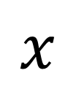








standard deviation of yaw [rad] =
0,01
Estimated position from GPS
$$y^{′}$$
0,3
$$y^{′}$$
standard deviation of y[m]
(Sensor)
$$p_{n}$$
$$x^{′}$$
$$p_{1}$$
$$x^{′}$$
$N$ particle numbers
$$x$$
$$y^{′}$$
$$y^{′}$$
$$p_{2}$$
$$x^{′}$$
$$p_{3}$$
$$x^{′}$$
0,3
standard deviation of x [m]
(Sensor)

Slide 5
ID
Landmarks from map data
Observed landmarks transformed to Map coordinate system
Landmark ID association.

Slide 6
ID
Landmarks from map data
Observed landmarks transformed to Map coordinate system
Landmark ID association.
Car Predicted position
Maximum sensor range
Landmark observed and associated with n.16

Slide 7
Landmark Id’s inside sensor range
[4 ,16,24,39,38]
Car Predicted position
d4
d2
d3
d5
d1
d6
d7
Maximum sensor range

Slide 8





ID
Landmarks from map data
Observed landmarks transformed to Map coordinate system
$$w_{1}$$
$$w_{2}$$
Particle
$$w_{3}$$
$$w_{n}$$
$$w_{4}$$
Maximum sensor range
Vector weight for each particle = [$w_{1}$, $w_{2},w_{3}$, $w_{4}$, …, $w_{n}$]

