Slide 1

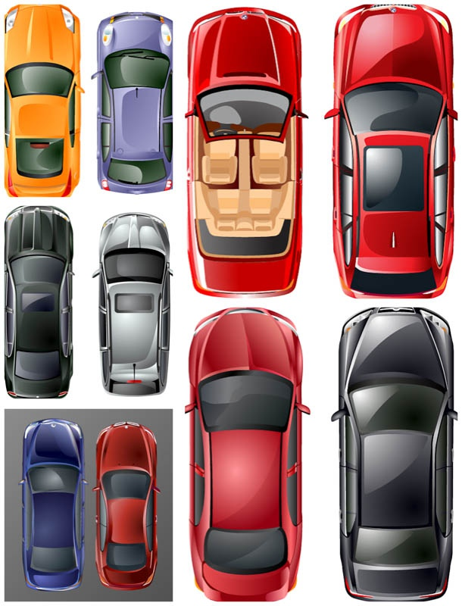

Slide 2
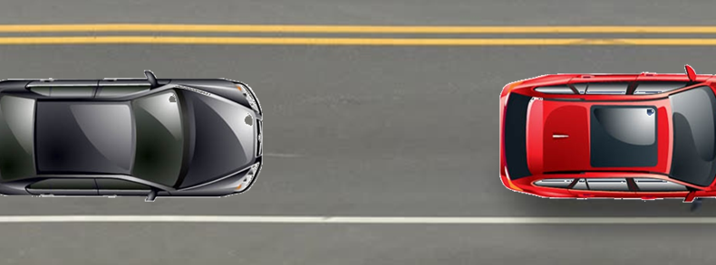
3 measurements regions
Xmin A
Xmin B
Xmin C
Vehicle distance

Slide 3
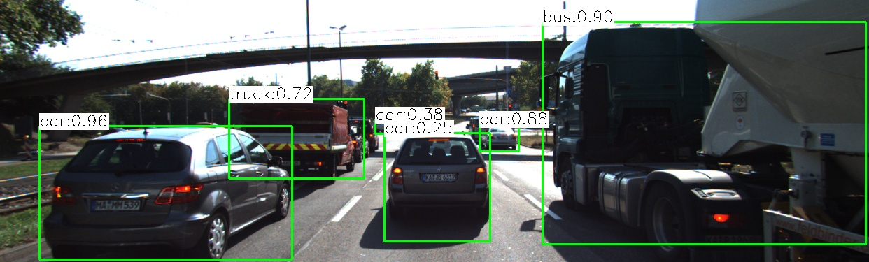
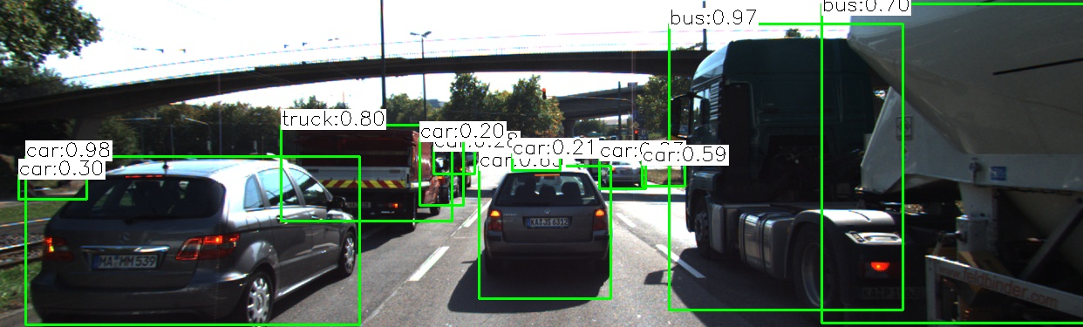
Vector results
bBoxID 1
bBoxID 5
,
bBoxID 2
Previous
,
Matched
Descriptors
Keypoints
bBox ID previous
Inserted on position
of bBox ID current
bBoxID 3
,
5
bBoxID 4
5,4,5,5,5,6,5,5,5
n = same quantity of bounding boxes on current frame
,
5,6,3,5,7,5,3,5,5
bBoxID 5
,
bBoxID 4
Current
...
,
At the end of iterate through al matches descriptor keypoints, according this schematic example, the bounding Box current ID=4, must be matched with the bounding Box previous ID=5 from the previous frame. (5 had more occurrences).
bBoxID n
Vector size = n

