Slide 1


FIREBASE DATABASE SECURITY
NEXUS PROJECT

Slide 2
Overview
This document outlines the custom role-based security rules for the NEXUS iTED CCNA Practice App, using Firebase Realtime Database.
Roles:
admin: app manager with full access to all data
student: a logged-in user with full access to quizzes, reports, etc.
viewer: an unauthenticated or public visitor

Slide 3
Sumary of Rule Behaviour
Path | Viewer | Student | Admin
onlineUsers | ✅ read | ✅ RW (own data) | ✅ RW
reviewLogs | ❌ | ✅ write | ✅ full access
sessions | ❌ | ✅ read | ✅ full access
meta/orderCounter | ❌ | ❌ | ✅ full access
questionReports | ❌ | ✅ write | ✅ read
userLogs | ❌ | ❌ | ✅ full access
loginLogs | ❌ | ❌ | ✅ full access

Slide 4
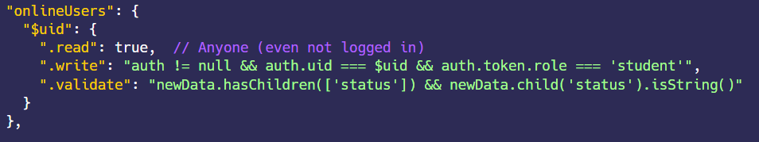
onlineUsers
This protects individual user sessions and allows access only when appropriate.
"$uid" is a wildcard → applies rules to each user's data.
.read: allows admin, viewer, or the owner of the data to read.
.write: only the student can write their own online status.
.validate: ensures only the expected field (status) is saved, and it's a string

Slide 5
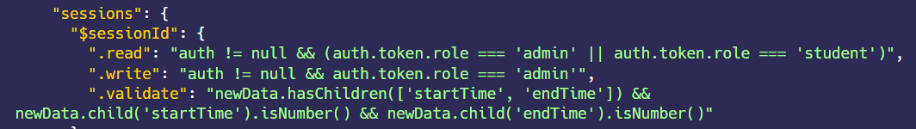
sessions
This ensures only trusted roles can manage sessions and that the data format is strict.
Admins can create/edit sessions
Viewers and admins can read sessions
Data must contain valid timestamps

Slide 6
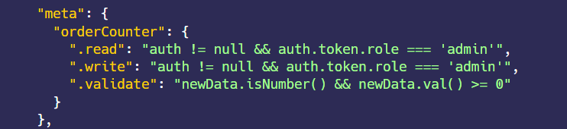
meta/orderCounter
Prevents corruption of system-critical counters.
Protects a global counter from misuse
Only admin can access or update it
Value must always be a non-negative number

Slide 7
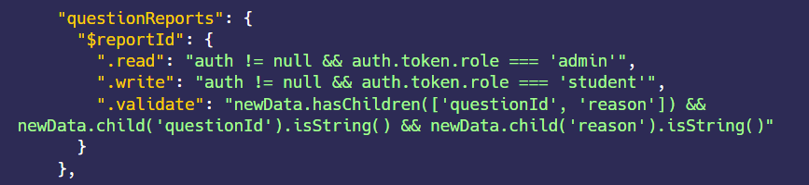
questionReports
Protects data integrity and keeps logs clean
Students report issues
Only admins can read it
Validates the format is correct.

Slide 8
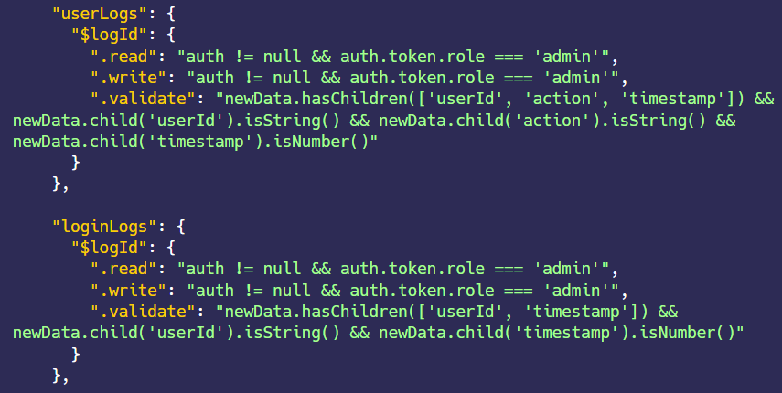
userLogs / loginLogs
These are audit logs — critical to limit access tightly.

Slide 9
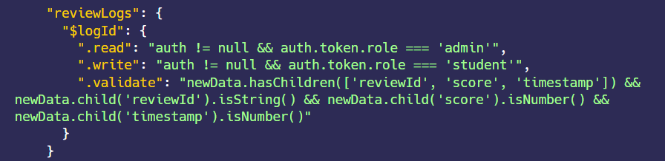
reviewLogs
Prevents fake reviews, enforces read/write separation by role
Students submit quiz reviews
Only admins can read it
Validates structure strictly.

