Slide 1


FIREBASE DATABASE SECURITY
NEXUS PROJECT

Slide 2
Overview
This document outlines the custom role-based security rules for the NEXUS iTED CCNA Practice App, using Firebase Realtime Database.
Roles:
admin: app manager with full access to all data
student: a logged-in user with full access to quizzes, reports, etc.
viewer: an unauthenticated or public visitor

Slide 3
Summary of Rule Behaviour
Path | Viewer | Student | Admin
onlineUsers | ✅ read | ✅ RW (own data) | ✅ read
reviewLogs | ❌ | ✅ write | ✅ full access
sessions | ❌ | ✅ read | ✅ full access
meta/orderCounter | ❌ | ❌ | ✅ full access
questionReports | ❌ | ✅ write | ✅ read
userLogs | ❌ | ❌ | ✅ full access
loginLogs | ❌ | ❌ | ✅ full access

Slide 4
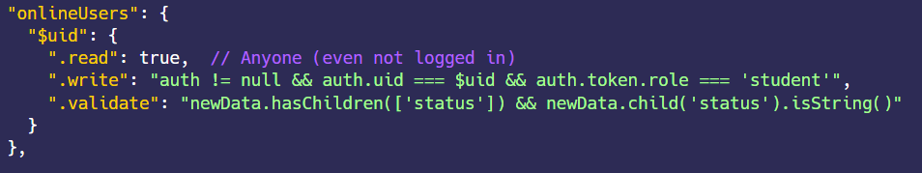
onlineUsers
This protects individual user sessions and allows access only when appropriate.
"$uid" is a wildcard → applies rules to each user's data.
.read: allows admin, viewer, or the owner of the data to read.
.write: only the student can write their own online status.
.validate: ensures only the expected field (status) is saved, and it's a string

Slide 5
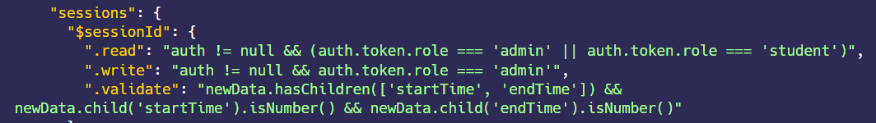
sessions
This ensures only trusted roles can manage sessions and that the data format is strict.
Admins can create/edit sessions
Students and admins can read sessions
Data must contain valid timestamps

Slide 6
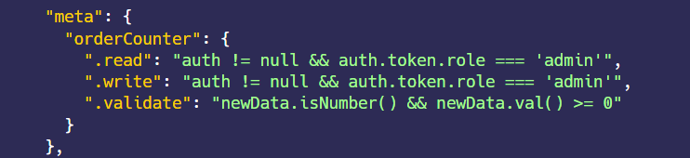
meta/orderCounter
Prevents corruption of system-critical counters.
Protects a global counter from misuse
Only admin can access or update it
Value must always be a non-negative number

Slide 7
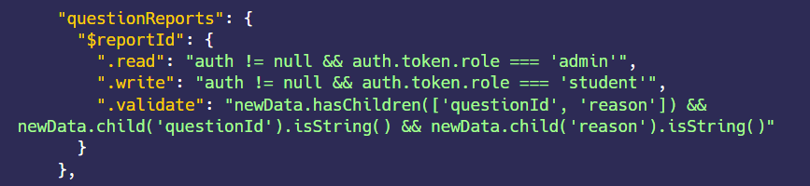
questionReports
Protects data integrity and keeps logs clean
Students report issues
Only admins can read it
Validates the format is correct.

Slide 8
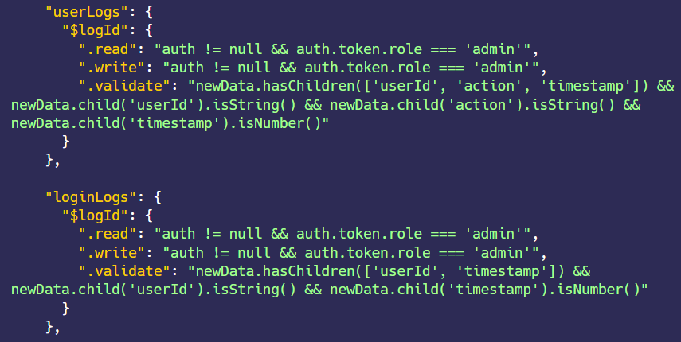
userLogs / loginLogs
These are audit logs — critical to limit access tightly.

Slide 9
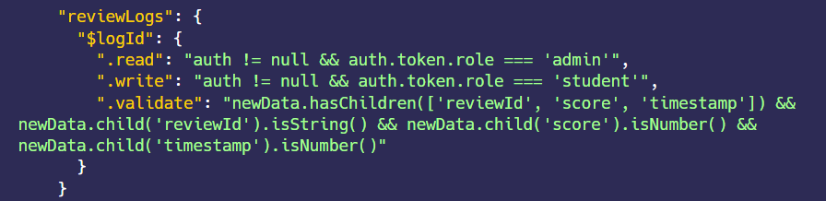
reviewLogs
Prevents fake reviews, enforces read/write separation by role
Students submit quiz reviews
Only admins can read it
Validates structure strictly.

Slide 10

TESTS

Slide 11
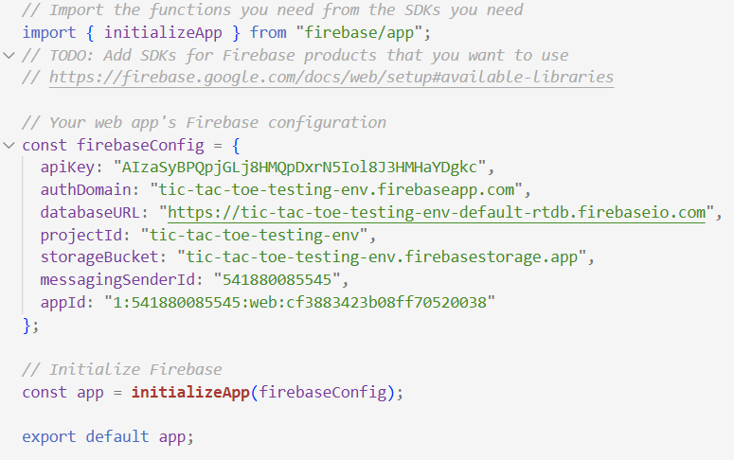
fireBaseApp.js

Slide 12
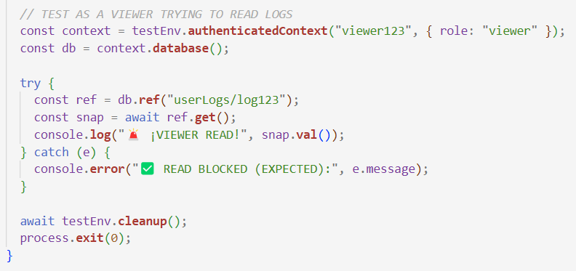
Viewer trying to read userLogs

Slide 13
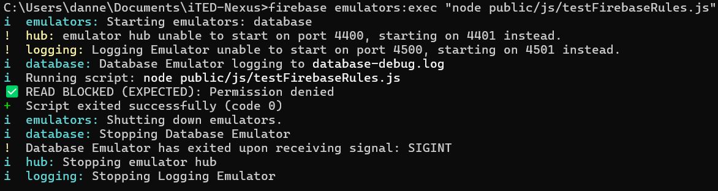
RESULT

Slide 14
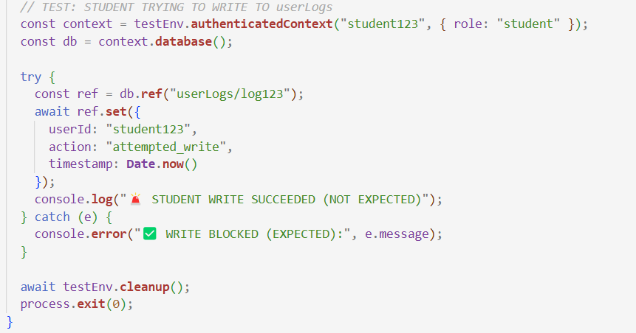
Student trying to write userLogs

Slide 15
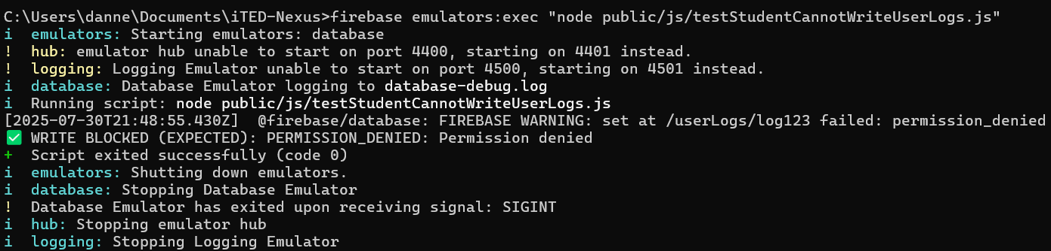
RESULT

Slide 16
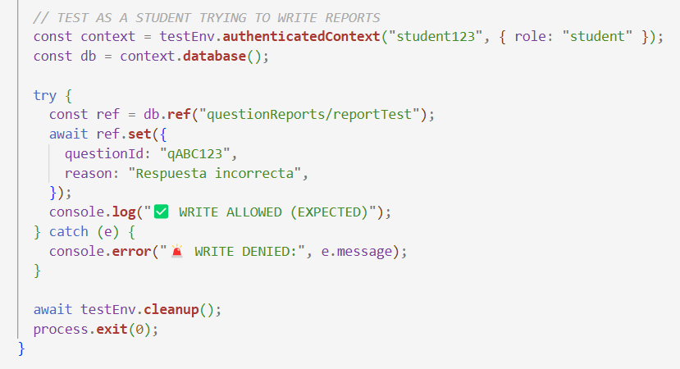
Student trying to write questionReports

Slide 17
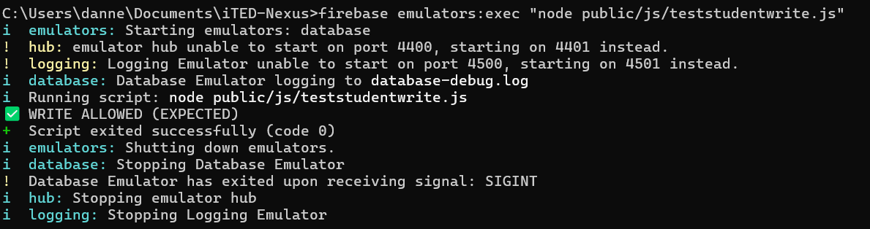
RESULT

Slide 18
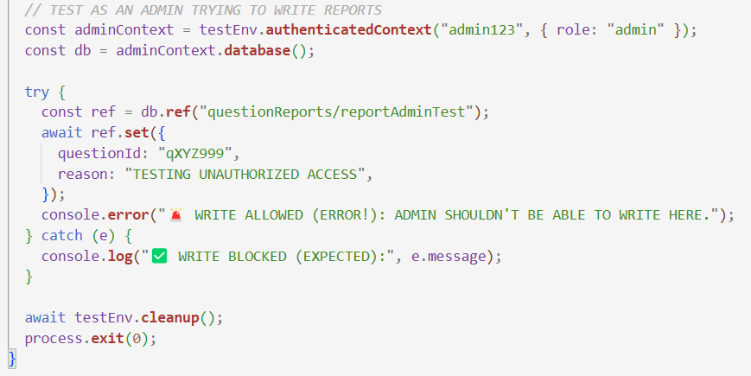
Admin trying to write questionReports

Slide 19
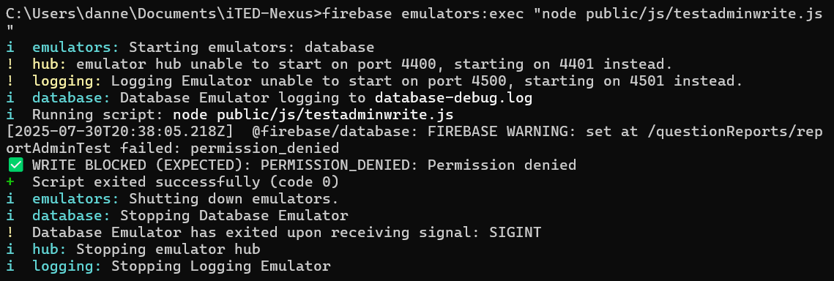
RESULT

