Slide 1

eduVPN
François Kooman
<fkooman@tuxed.net>
@fkooman
TNC18 – June 11th 2018, Trondheim

Slide 2
Outline
Screenshot Parade
Technology
Application Integration (API)
Distributed / Federated VPN
Future Developments

Slide 3
Screenshot Parade

Slide 4
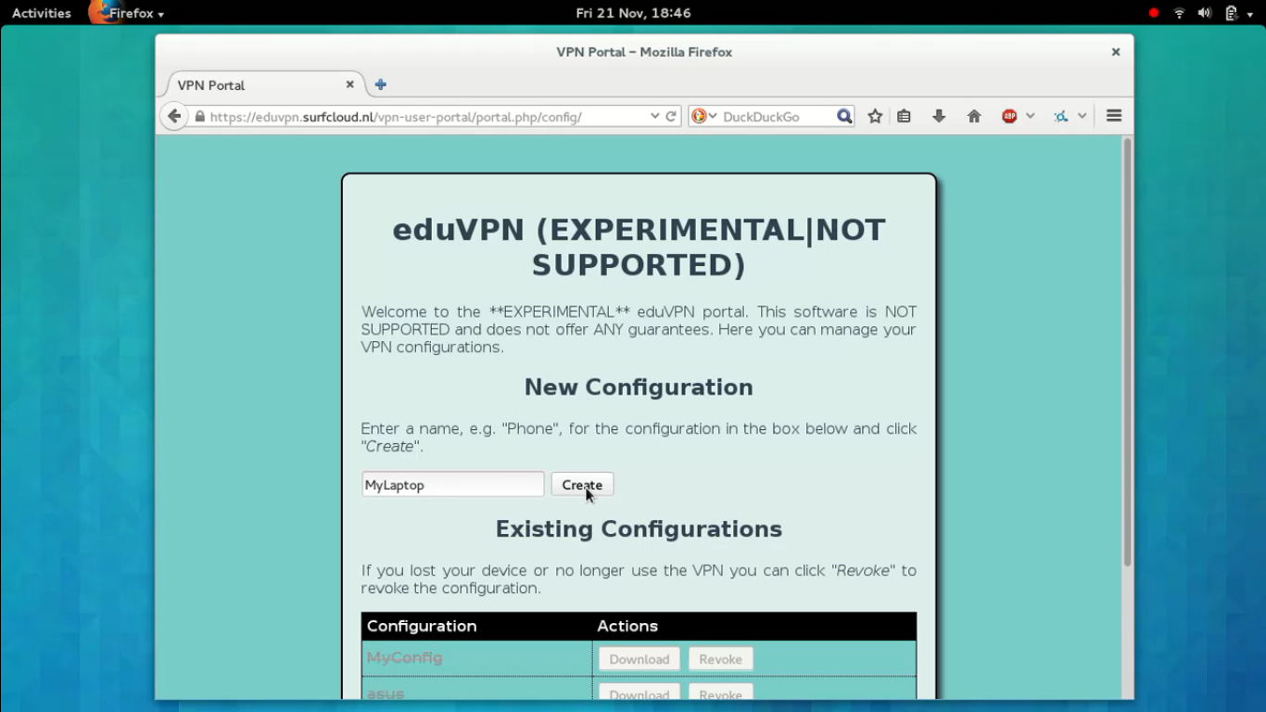
Initial Version...

Slide 5
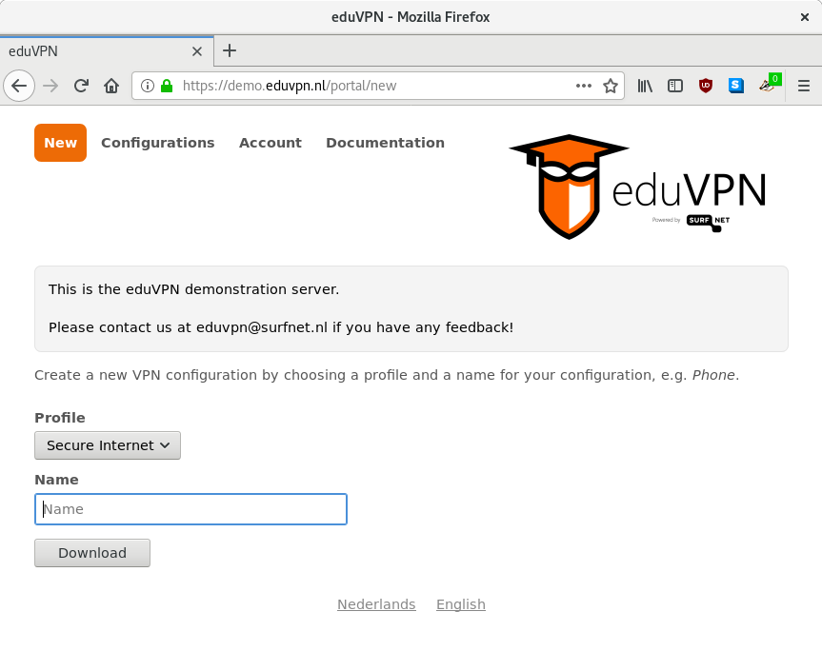
Now

Slide 6
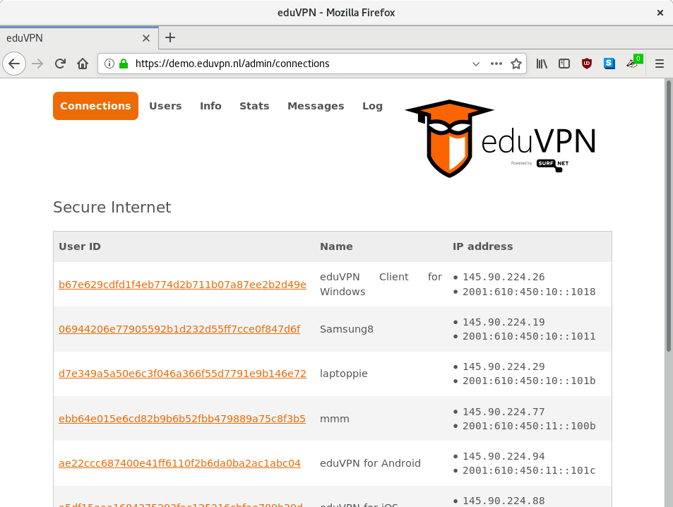

Slide 7
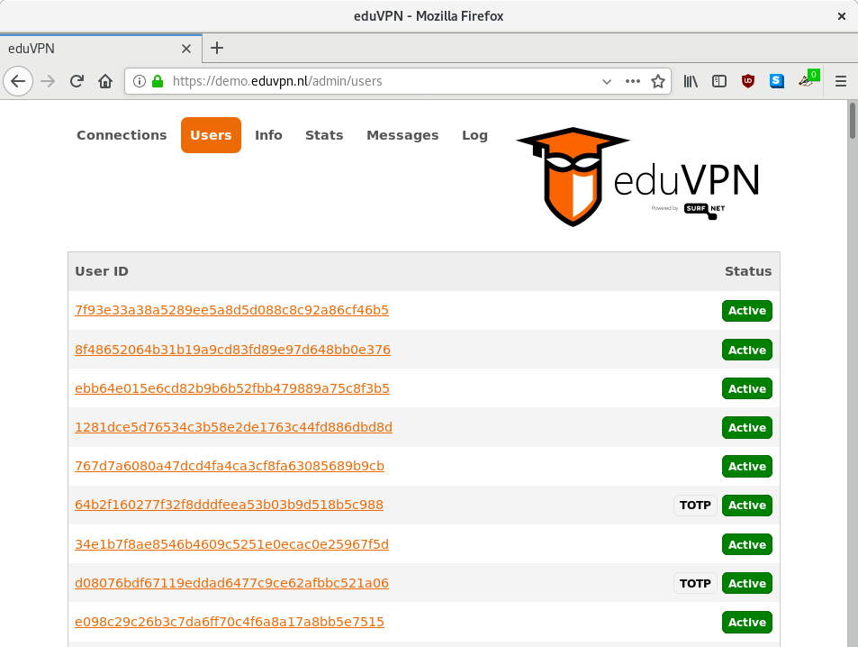

Slide 8
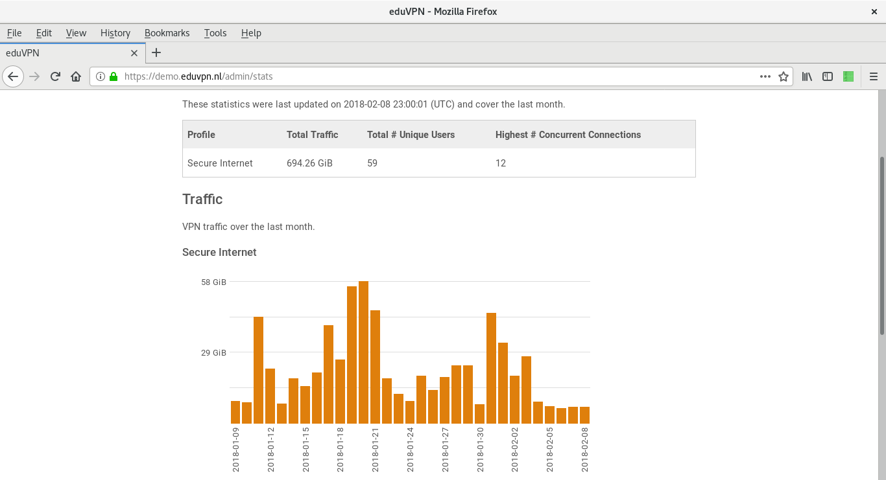

Slide 9
What
A free software, easy to use VPN service you can host yourself!

Slide 10
eduVPN vs Let’s Connect!
Project started 3.5 years ago as “eduVPN”
Initially funded by SURFnet (NL)
Now many (international) partners involved:
  GÉANT, NORDUnet, Vietsch Foundation, DeiC, AARnet, RIPE Community Fund, SIDN Fonds, NLnet, Commons Conservancy
Won ISOC “Internet Innovation Award 2018” as “Let’s Connect!”
Let’s Connect! is the software, eduVPN is the “service”

Slide 11
Use Cases
Protect against attackers on (insecure) WiFi networks
Access (private) networks at your organization or at home

Slide 12
Who is this for?
ISPs (NRENs)
Organizations with remote workers
  Universities
  Research Institutes
  Companies
Hacker spaces
Individuals
  Cheaper than buying a commercial VPN subscription!
  Easy to share with your friends!

Slide 13
Software
FLOSS (Free/Libre Open Source Software)
  AGPLv3+
Easy to install on everything from €3/month VPS, Raspberry Pi to 128 core bare metal with 10+ GBit network
Runs on Debian >= 9, Red Hat Enterprise Linux/CentOS >= 7, Fedora >= 28
Web interface for users and administrators
Native Applications (also FLOSS)
Privacy by Design & Default!
Survived two source code security audits to date

Slide 14
Development
Don’t do:
  Containers / Docker / Kubernetes
  “Cloud”
    AWS, AMP, CloudFlare, CDNs, Travis-CI, Scrutinizer
  SPA / JavaScript
  Bloated Frameworks
  Blockchain
    Never do an ICO, FFS!
  JWT/JWS

Slide 15
Audits
2017
  Radically Open Security (ROS)
    Server
2018
  Radboud University, Nijmegen, The Netherlands
    Server
  NCC Group / Fox-IT
    Windows Client

Slide 16
Privacy
Does not log originating IP address (default)
Does log VPN IP + connection time, removed after 30 days (default)
  You can find a user identifier/pseudonym with an IP address and time of incident
  Can block user without knowing the actual identity

Slide 17
Trust (I/II)
You need to trust
  Your device (laptop, smartphone)
  WiFi network / ethernet
  ISP
  The service you are using

Slide 18
Trust (II/II)
VPN helps if you don’t trust 2 and/or 3
  ISP provides insecure crappy modem
  ISP is recording metadata / monitoring everything, for fun and profit!
Sometimes you trust 2 and/or 3 more than your VPN provider!
  Too many stories of untrustworthy VPN providers...
If you don’t trust 1 and/or 4, it is game over…
  Your Android phone last received a security update in March 2015…
  Tinder doesn’t use HTTPS for showing pictures, leaks “swiping” behavior
  If Facebook or Google use you, oh well...

Slide 19
Technology

Slide 20
Technology
OpenVPN
  OpenVPN >= 2.4
  Most secure configuration possible (with OpenVPN)
OAuth 2.0 API
  Bearer tokens with Public Key Cryptography (Federation!)

Slide 21
OpenVPN
Why?
  OpenVPN 2.x audited by multiple well known parties
  Works over TCP/443 a.k.a. HTTPS port out of the box
  Easy to setup
    But… turned out not so easy to set up correctly…
  Available on many platforms/devices
  Easy integration with ACLs, 2FA, …

Slide 22
OpenVPN
Configuration “disasters”, uhhh, opportunities...
  SELinux
    (Public) cloud providers…
  Network
    Routing public IP(v6) space
  (Adaptive) Compression
  Verifying 2FA / ACL
  MTU
    Path MTU discovery… why can’t we have nice things?!
  iOS

Slide 23
OpenVPN
Reduce opportunities to shoot yourself in the foot:
  We want unmodified (official) OpenVPN clients as to work with eduVPN!
  We want unmodified OpenVPN server as packaged by your server OS to work with eduVPN!
    CentOS / RHEL / Fedora / Debian official OpenVPN >= 2.4 packages are used!

Slide 24
OpenVPN
Use packaged OpenVPN
  don’t run patched versions
Take care of generating
  Server configuration
  CA / certificates
  Packet filter / NAT rules
Let the OS take care of process management
  systemd FTW
  KISS
  This turns out to be very reliable!

Slide 25
Cryptography
AES-256-GCM
  hardware accelerated
TLS-ECDHE-RSA-WITH-AES-256-GCM-SHA384
  Mozilla TLS configuration guide
TLS >= 1.2
TLS Crypt

Slide 26
Network
Full IPv6 support
  In tunnel
  Outside tunnel
  Why do we still have to mention this in 2018? 😓
(IPv6) NAT or Public IP addresses
  NAT for IPv6 actually works really well 🕺

Slide 27
Scaling
#OpenVPN processes ~= #CPU cores
  Can quickly become very expensive…
  AES-NI helps a lot
    not for connection setup (RSA), but during active connections
Maximum 64 clients per OpenVPN process
Current biggest deployment:
  8 Profiles
  ~ 4096 IP addresses (concurrent users)
  4096 / 64 = 64 OpenVPN processes
  Start with 8 cores, can easily grow!

Slide 28
Authentication
Authentication Backend:
  SQL
    SQLite (default)
    Other SQL servers
  LDAP
  RADIUS
  SAML
Also supports 2FA (TOTP, YubiKey)
  For both “portal” access and VPN connections

Slide 29
Authorization / Group Management
“ACL” when connecting to VPN
  Only allow members of certain (LDAP, VOOT) group to access certain VPN profiles

Slide 30
Application Integration

Slide 31
OAuth
Protocol (framework) to authorize (native) applications to act on your behalf

Slide 32
OAuth
Client opens browser with URL of authorization server (AS)
AS makes sure user is authenticated, and then prompt for authorization
Browser redirects back to client
  Special URL scheme, “localhost”, claimed HTTPS URL
Client exchanges authorization code for access token
Client uses access token to talk to API

Slide 33
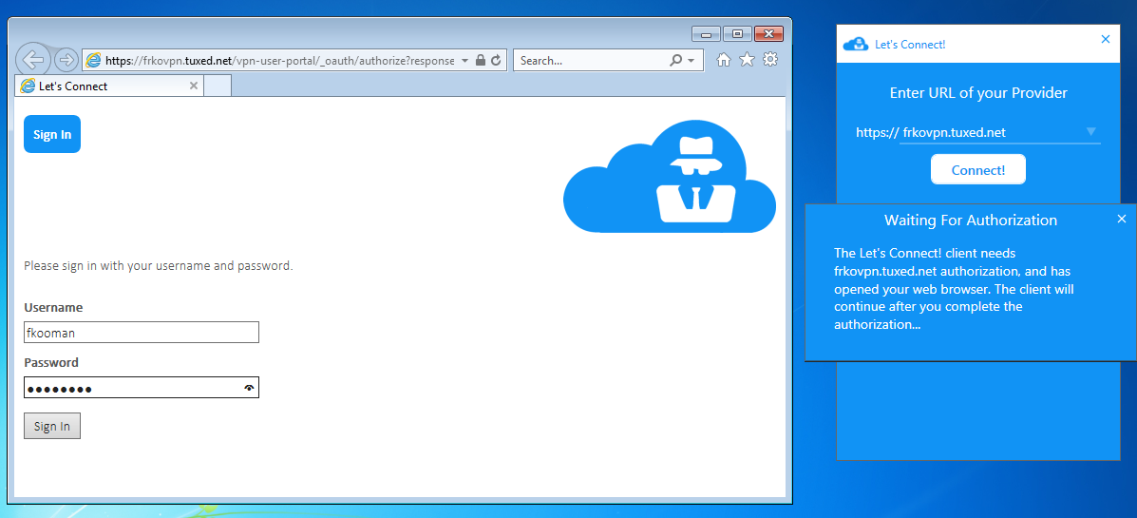

Slide 34
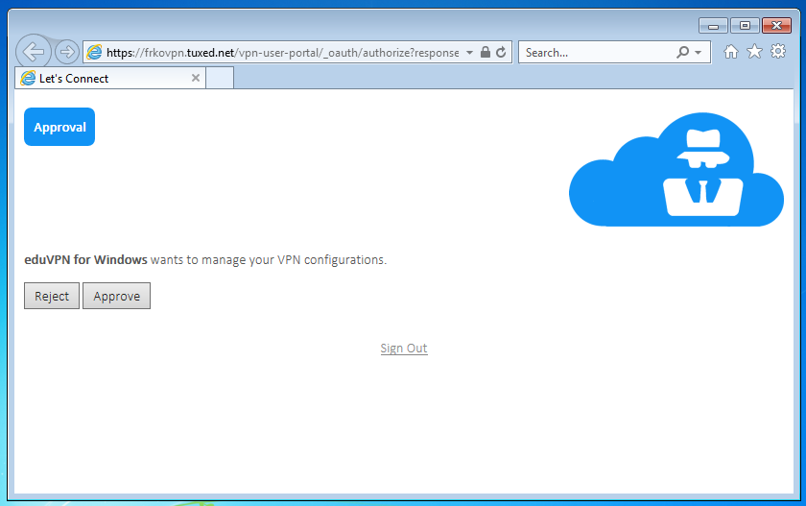

Slide 35
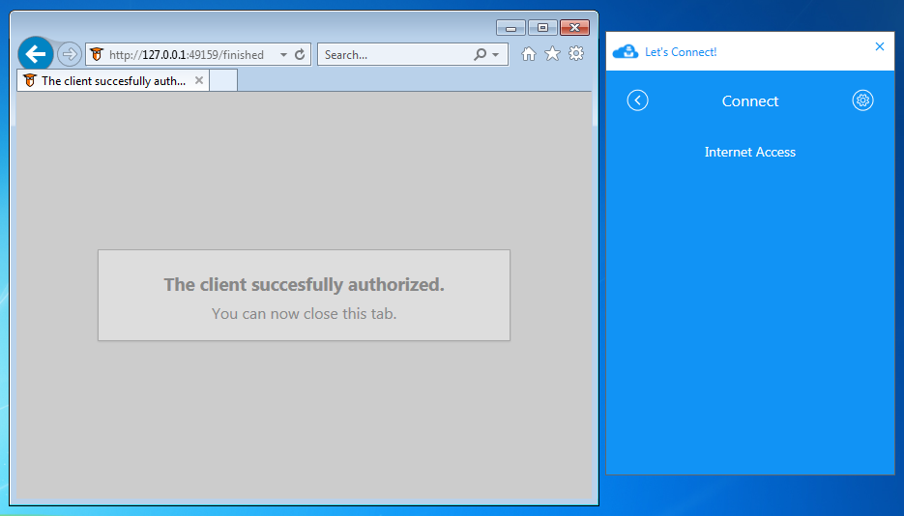

Slide 36
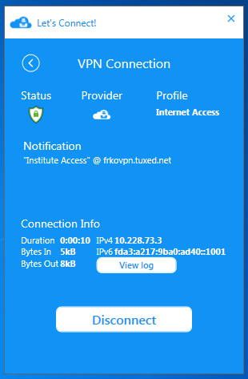

Slide 37
Distributed Operation
Allow establishing trust between multiple eduVPN deployments

Slide 38
Why?
“Load balancing”
Sharing costs for creating a distributed VPN provider network
Route around “errors” on the network when reaching certain destinations
Leveraging existing “trust” networks
Allow users choice of VPN server to use (latency, jurisdiction, ...)

Slide 39
How?
Leverage OAuth 2.0 Bearer tokens used for Native Application integration
Public Key Signatures over Bearer tokens

Slide 40
Future
Use ECC (without CA, patches for OpenVPN exist)
Look into using WireGuard as a replacement for OpenVPN (simplicity, efficiency, licensing?)
High(er) level implementation OpenVPN for all platforms (using native VPN APIs)
Get first-class Debian packages…
Move ACL/Two Factor to Authentication/Authorization phase, no longer “out of band” validation
Setup a (distributed) not for profit “friends of friends” VPN service with Let’s Connect as testing ground?

Slide 41
Questions / Discussion
https://eduvpn.org/
François Kooman
<fkooman@tuxed.net>
@fkooman

