Slide 1
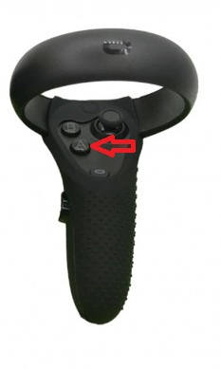
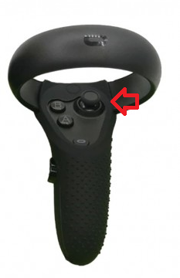
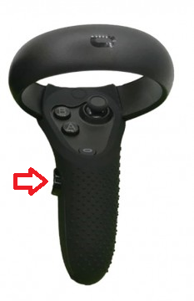
Controls
Press A to change to Flight mode and press A again to go back to Walk mode. The button is in the right controller.
While in Walk mode, use the Axis in the right controller to move forwards or backwards.
While in Flight mode, press the Grip button in the right controller to fly. The direction will be indicated by the laser coming from the right hand.

