Slide 1
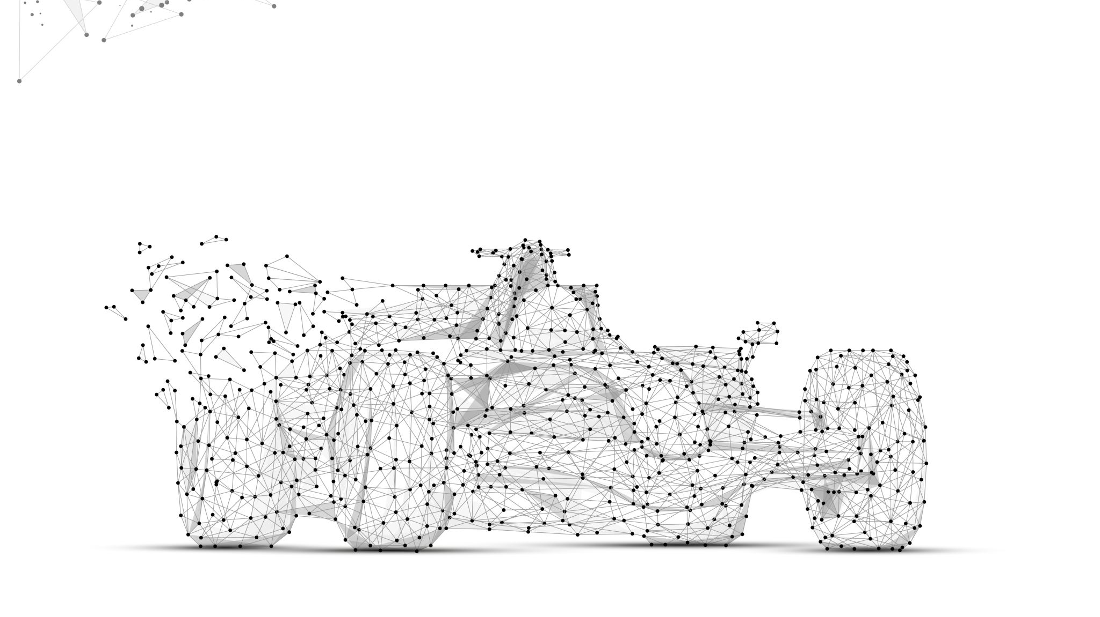
Project: Robo Car
Kevin Kovero, Mirkovszki Máté,
Nagy Edvárd, ​

Slide 2
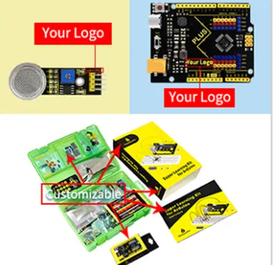
Us vs Keystudio
Features | Us | Keystudio
Ultrasonic sensor | 4 | 1
UNO R3 Clone | 1 | 1
WIFI | 1 | 0
WEB UI | 1 | 0
OLED | 1 | 0
SERVO | 0 | 1
LED | 0 | 2
RF | 0 | 1

Slide 3
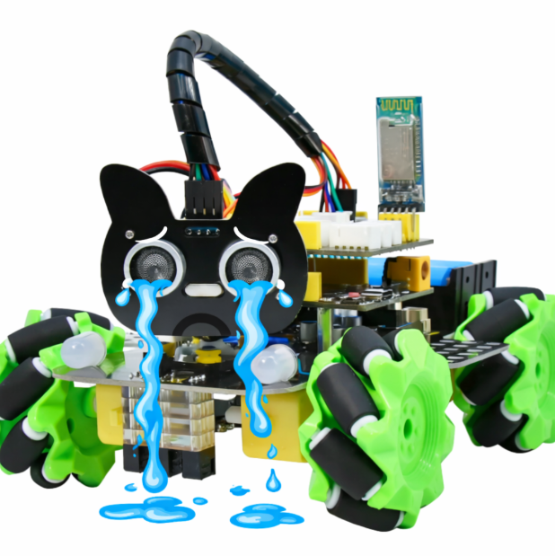
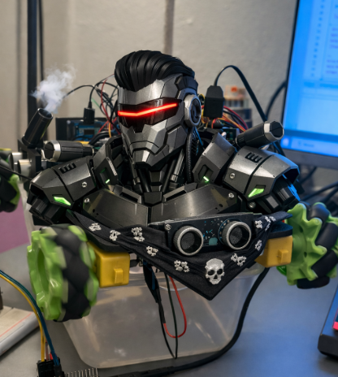
ChatGPTS respnose to the differences:

Slide 4
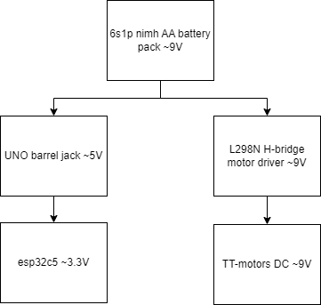
Power distribution
We used NiMH AA over 18650 for the following reasons:
Harder to catch on fire🔥
Simple charging no BMS
Can survive deep discharge
Commercial friendly more common

Slide 5
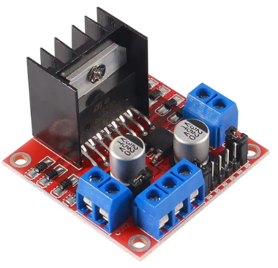
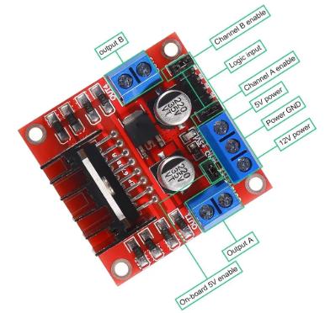
Motor driver – H bridge
L298N IC package + breakout board:
The breakout board made it easy for wirering.
The heatsink enables high power aplications.
PWM speed controll.
Decoupling capacitors to smooth out current spikes and reduce noise.

Slide 6
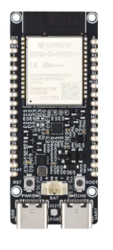
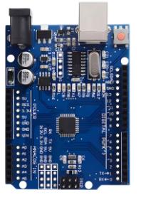
Uno and esp32
Uno-slave:
Collects data from sensors
Filters data
Sends data trough UART. (digital pins)
Esp32-master:
Receive data from uno UART. (digital pins)
OLED display car status
Sends data to cloud (hivemq mqqtt)
Hosts webUI for control

Slide 7
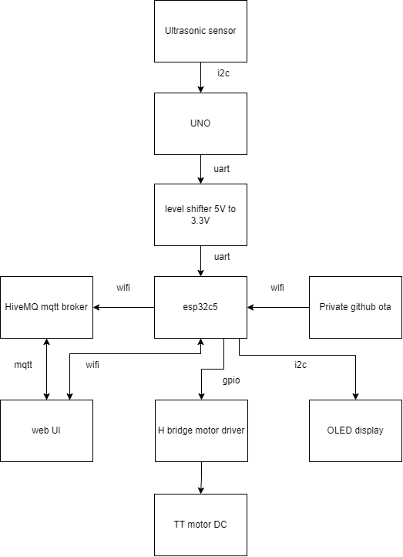
Control scheame
We used many different comunication standards inside this project
This car is TRULY an IOT device it can be controlled not just from local networks anywhere from the world using netly’s quick deploy
HiveMQ enables quick and free data cloud unlike thingspeak 15s > 10ms
Live sensor view for debugging
Wireless programing via private github OTA firmware update
Extra physical motor kill switch for safety

Slide 8

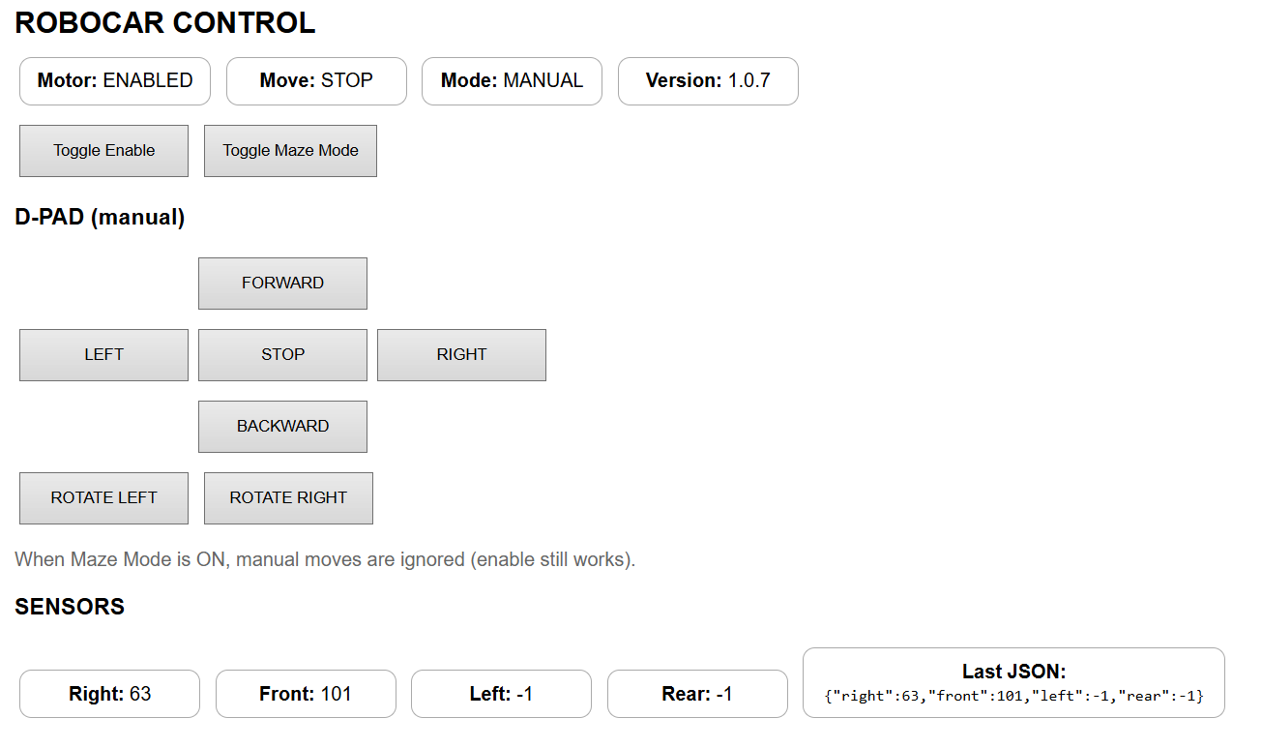
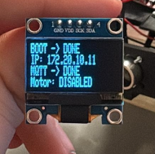

Slide 9

Cpp code:
Over 1000 lines of code!
HiveMQ hosted MQTT cloud
Private gitHUB OTA
Movement and turns as a function of time
Web ui controll not just localy via netly html
Complex maze solving obsticle avoidence algorithm

Slide 10
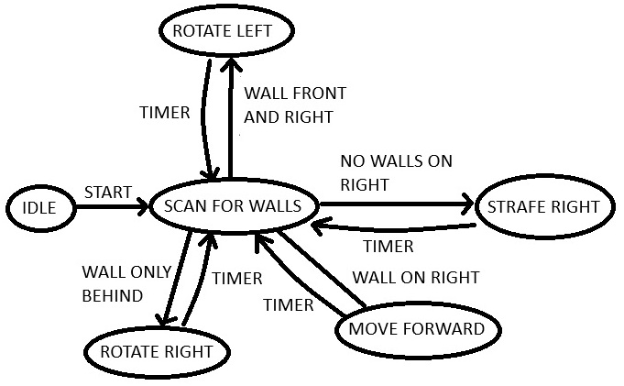
Maze solving algorithm
The robot follows the right hand wall
It keeps a safe distance and selfcorrects from the wall
If it sees the obstacle it avoids it by tuns and left or right movements
If it is in the open it will search for the nearest right side wall

Slide 11
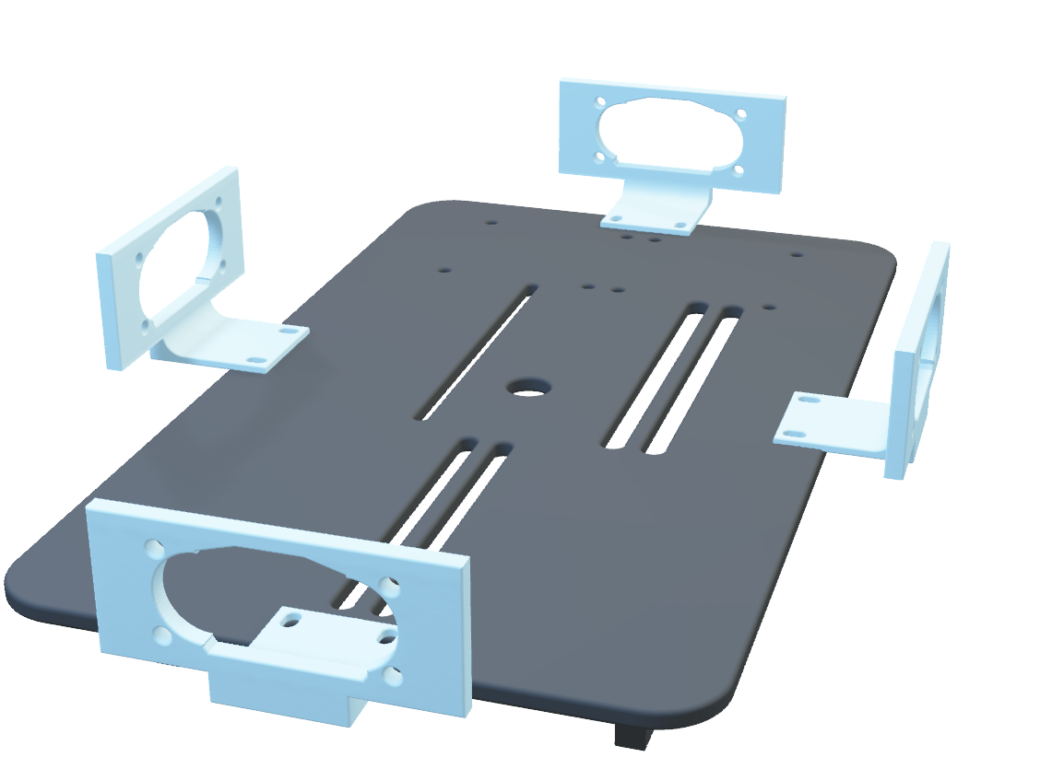
CAD-3D printing
Modular CAD design
Custom PLA body with modular slotted mounting
Custom PLA washers
M2 and M1,6 screws and nuts
Modular sensor mount with wire channels

Slide 12
Challanges and difficulties
Long compligin times IDE is slow for this size
Long download speed for OTA, esp32 small only 4mb RAM
CAD takes so mutch time to design
Clone / fake components no dimensions documantion, or just plain wrong sizes
Wirering felt like a haybale in the future deffinetly custom PCB
Microslop®️ driver support for microcontrollers is really bad
The motors and wheels have big tolarances makes precies movement near imposible

Slide 13
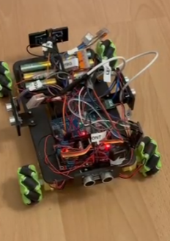
THANK YOU
Any question from the audience ?

