Slide 1
Maurya
&
Gupta
India
Ms. Susan M. Pojer
Horace Greeley HS Chappaqua, NY

Slide 2
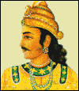
Chandragupta: 321 BCE-298 BCE
Unified northern India.
Defeated the Persian
general Seleucus.
Divided his empire into
provinces, then districts
for tax assessments and law
enforcement.
He feared assassination [like Saddam
Hussein] → food tasters, slept in different
rooms, etc.
301 BCE → gave up his throne & became
a Jain.

Slide 3
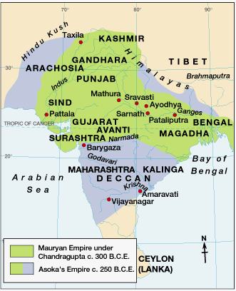
The Maurya Empire
321 BCE – 185 BCE

Slide 4
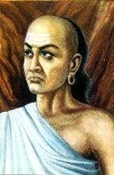
Kautilya
Chandragupta’s advisor.
Brahmin caste.
Wrote The Treatise on
Material Gain or the
Arthashastra.
A guide for the king and his ministers:
  Supports royal power.
  The great evil in society is anarchy.
  Therefore, a single authority is
  needed to employ force when
  necessary!

Slide 5
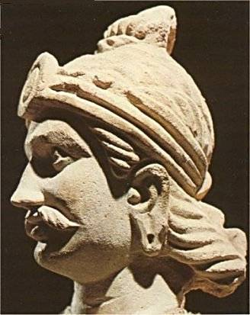
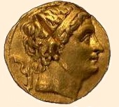
Asoka (304 – 232 BCE)
Religious conversion
after the gruesome
battle of Kalinga in
262 BCE.
Dedicated his life to
Buddhism.
Built extensive roads.
Conflict → how to balance Kautilya’s
methods of keeping power
and Buddha’s demands to
become a selfless person?

Slide 6
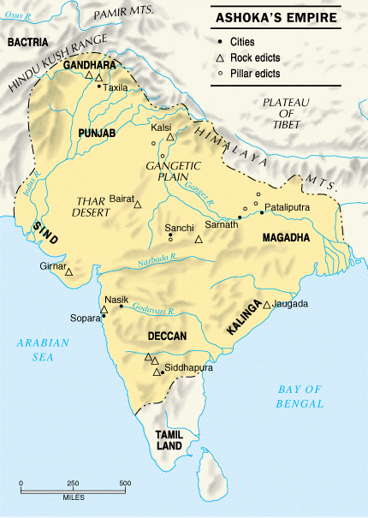
Asoka’s Empire

Slide 7
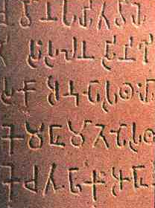
Asoka’s law code
Edicts scattered in
more than 30 places
in India, Nepal,
Pakistan, & Afghanistan.
Written mostly in
Sanskrit, but one was in
Greek and Aramaic.
10 rock edicts.
Each pillar [stupa] is 40’-50’ high.
Buddhist principles dominate his laws.

Slide 8
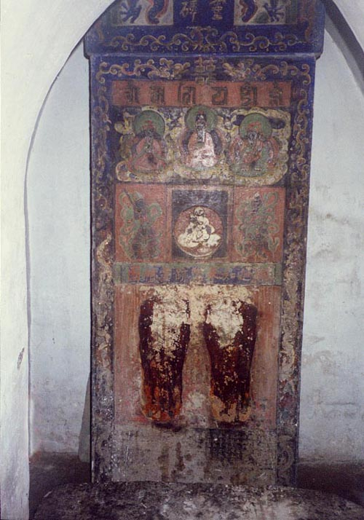
One of Asoka’sStupas

Slide 9
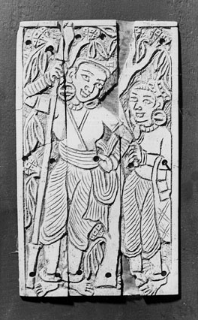
Women
Under an
Asoka
tree

Slide 10
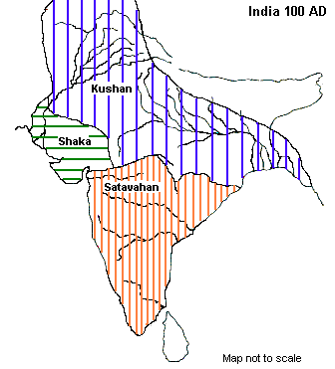
Turmoil & a power Vacuum:
220 BCE – 320 CE
Tamils
The Maurya Empire is divided into many kingdoms.

Slide 11
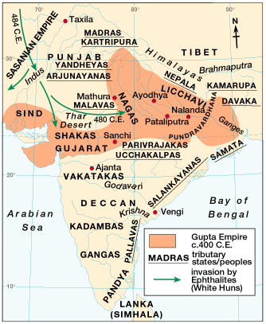
Gupta Empire: 320 CE – 647 CE

Slide 12
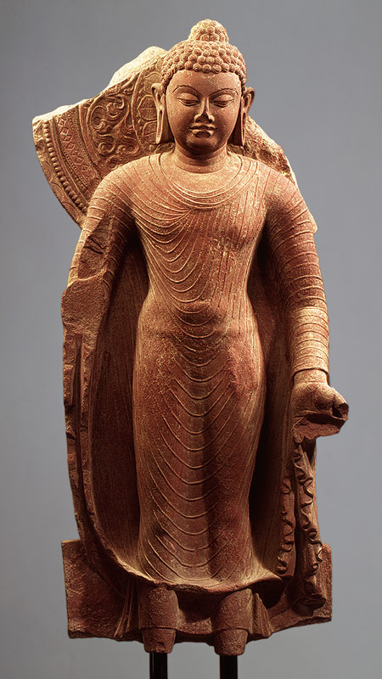
Gupta Rulers
Chandra Gupta I
  r. 320 – 335 CE
  “Great King of Kings”
Chandra Gupta II
  r. 375 - 415 CE
  Profitable trade with
  the Mediterranean
  world!
Hindu revival.
Huns invade – 450 CE

Slide 13
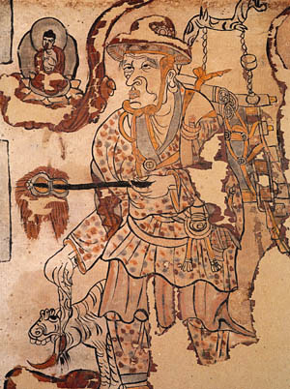
Fa-Hsien: Life in Gupta India
Chinese Buddhist monk traveled along the
Silk Road and visited India in the 5c.
He was following the path
of the Buddha.
He reported the people to
be happy, relatively free of
government oppression, and
inclined towards courtesy and
charity. Other references in
the journal, however, indicate
that the caste system was
rapidly assuming its basic features, including
"untouchability," the social isolation of a lowest
class that is doomed to menial labor.

Slide 14
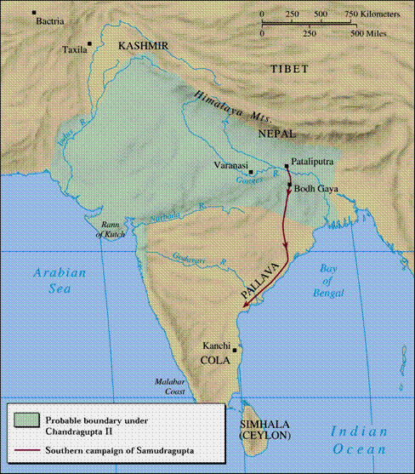
Chandra Gupta 11

Slide 15
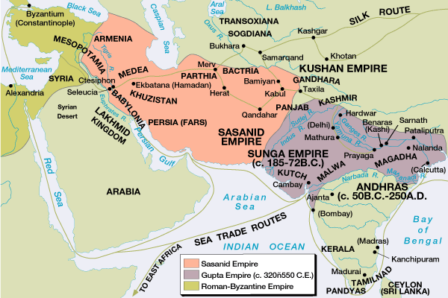
International Trade Routes during the Guptas

Slide 16
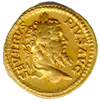
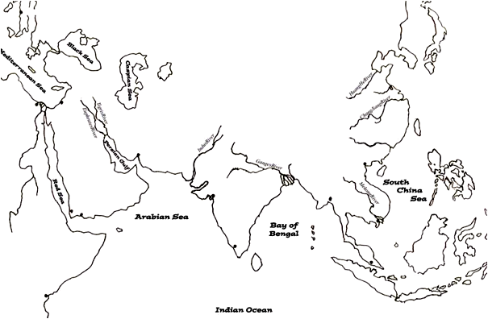
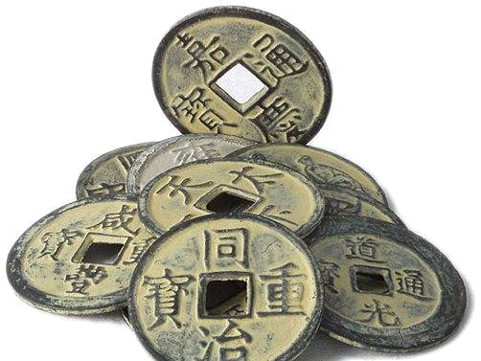
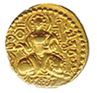
Extensive Trade:
4c
spices
silks
cotton goods
rice & wheat
spices
horses
gold & ivory
gold & ivory
cotton goods

Slide 17
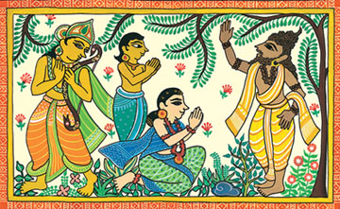
Kalidasa
The greatest of Indian poets.
His most famous play was Shakuntala.
During the reign of Chandra Gupta II.

Slide 18
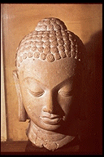
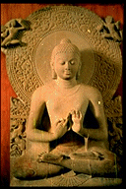
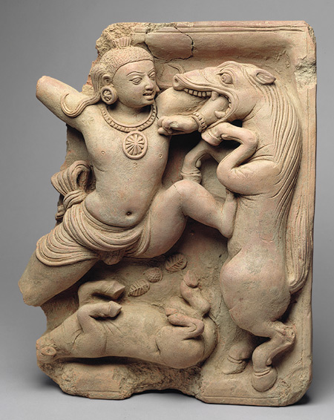
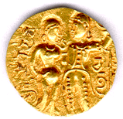
Gupta
Art
Greatly influenced
Southeast Asian art & architecture.

Slide 19
Gupta Achievements
1000 diseases
classified
500 healing
plants identified
Printed
medicinal guides
Kalidasa
Plastic
Surgery
Medicine
Literature
Inoculations
Gupta
India
C-sections
performed
Solar
Calendar
Astronomy
Mathematics
Decimal
System
The earth
is round
PI = 3.1416
Concept
of Zero

Slide 20
The Decline of the Guptas
Invasion of the White Huns in the 4c signaled
the end of the Gupta Golden Age, even though
at first, the Guptas defeated them.
After the decline of the Gupta empire, north
India broke into a number of separate Hindu
kingdoms and was not really unified again until
the coming of the Muslims in the 7c.
QUESTION:
Is the best literature and art written as
the civilization is on the rise, at its
height, or in its decline?

Slide 21
Bhartrhari
5c India court poet and philosopher.
Knowledge is man's crowning mark,
A treasure secretly buried,
The source of luxury, fame, and bliss,
A guru most venerable,
A friend on foreign journeys,
The pinnacle of divinity.
Knowledge is valued by kings
beyond wealth---
When he lacks it, a man is a brute.

