Slide 1
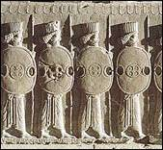
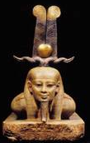
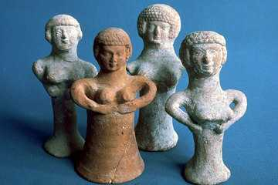

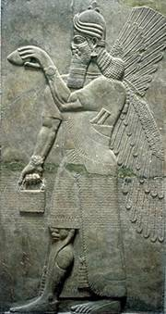
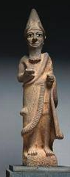
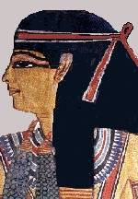
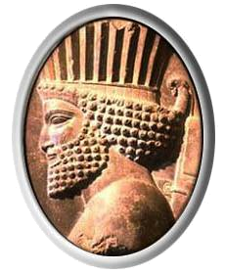
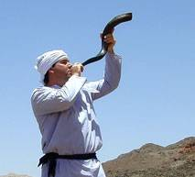
The Ancient
Middle East
Susan M. Pojer
Horace Greeley HS Chappaqua, NY

Slide 2
6. The
Persian
Empire

Slide 3
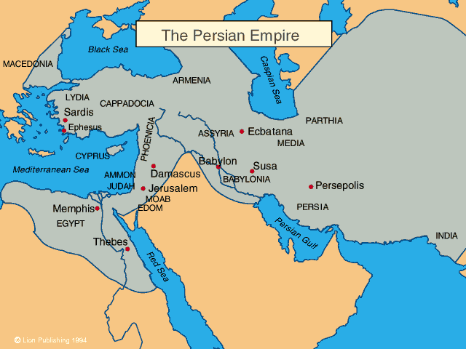
The Persian Empire

Slide 4
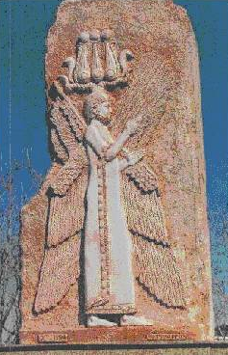
Cyrus the Great
A tolerant ruler → he allowed
different cultures within his
empire to keep their own
institutions.
The Greeks called him a
“Law-Giver.”
The Jews called him “the
anointed of the Lord.” (In 537,
he allowed over 40,000 to
return to Palestine).
580 – 529 B. C. E.

Slide 5
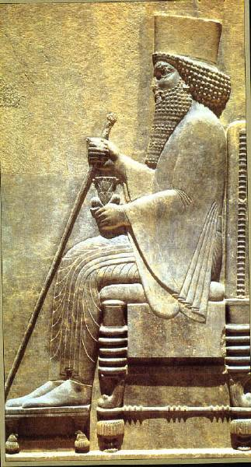
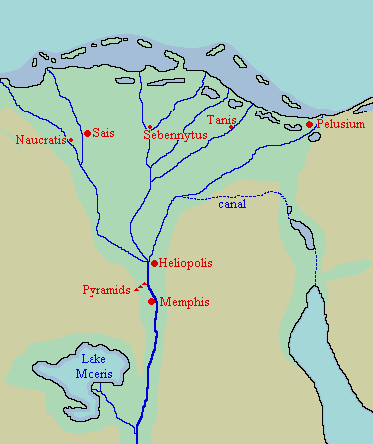
Darius the Great
(526 – 485 B. C. E.)
Built Persepolis.
He extended the
Persian Empire to the
Indus River in northern
India. (2 mil. s.q. mi.)
Built a canal in Egypt.

Slide 6
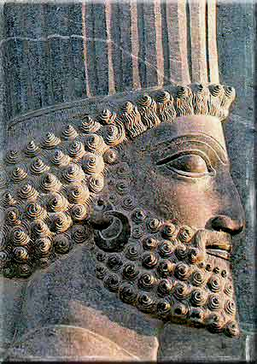
Darius the Great
(526 – 485 B. C. E.)
Established a tax-collecting system.
Divided the empire into districts
called SATRAPIES.
Built the great Royal Road system.
Established a complex postal
system.
Created a network of spies called
“the King’s eyes and ears.”

Slide 7
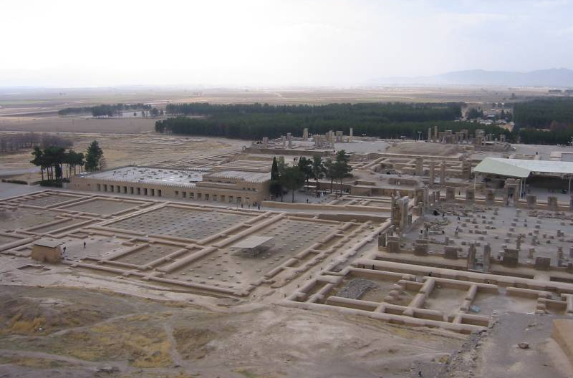
Ancient Persepolis

Slide 8
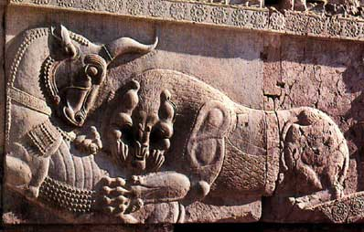
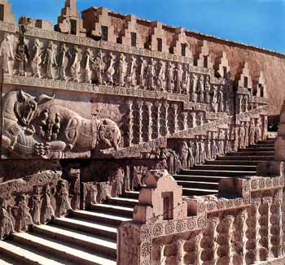
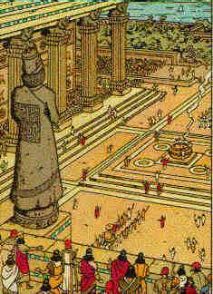
Persepolis

Slide 9
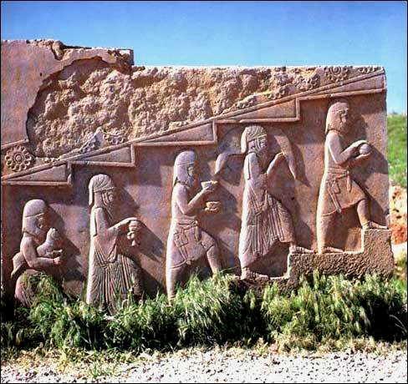
The People of Persepolis

Slide 10
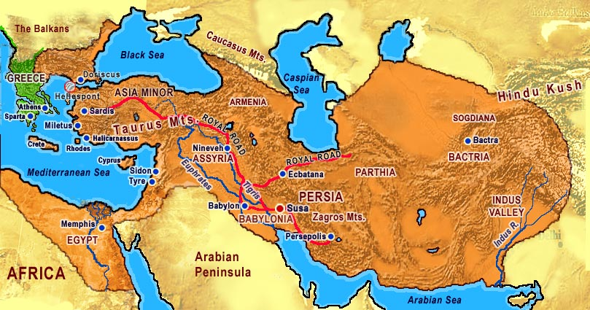
Persian “Royal Road”

Slide 11
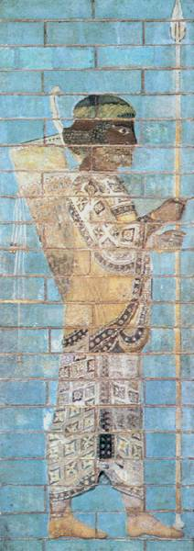
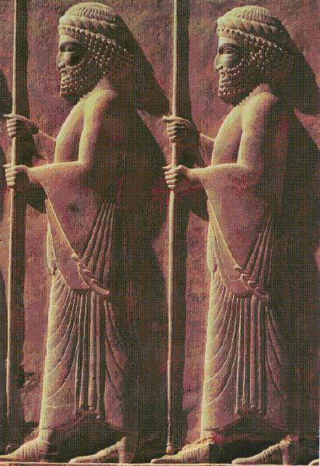
Persian Archers & Soldiers

Slide 12
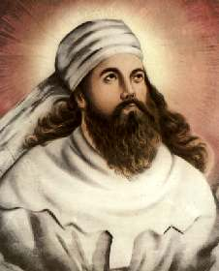
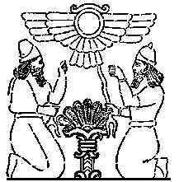
Zarathustra [Zoroaster], 6c BCE:
Good Thoughts, Good Deed, Good Words
“Tree of Life”

Slide 13
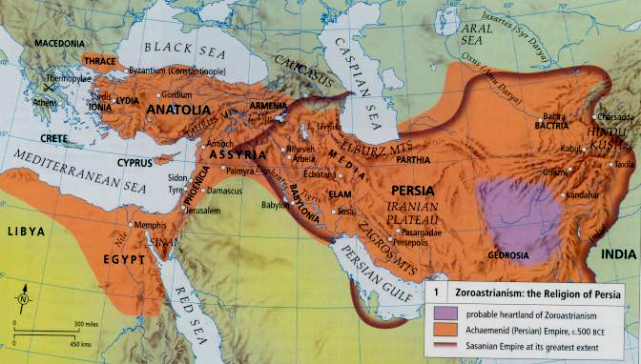
Extent of Zoroastrianism

Slide 14
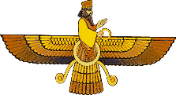
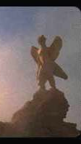
Dualistic Battle of
Good vs. Evil
Ahura Mazda
“Holy Spirit”
Ahriman
“Destructive Spirit”

Slide 15
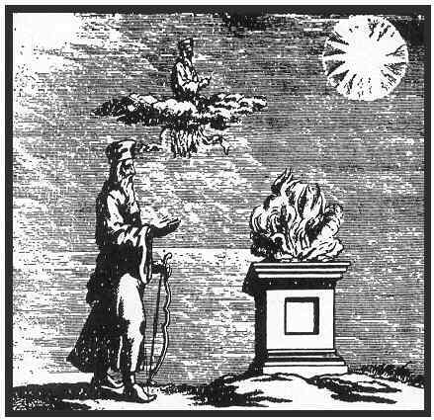
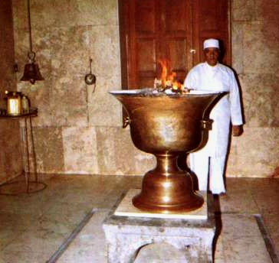
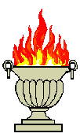
Zend-Avesta
(The “Book of Law”)
The “Sacred Fire” → the force to fight
evil.

