Slide 1
Early
Civilizations
of
Ancient India
Ms. Susan M. Pojer
Horace Greeley HS Chappaqua, NY

Slide 2
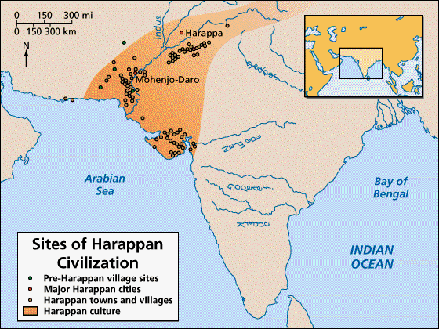
The Harappan Civilization
3300 BCE - 2400 BCE

Slide 3
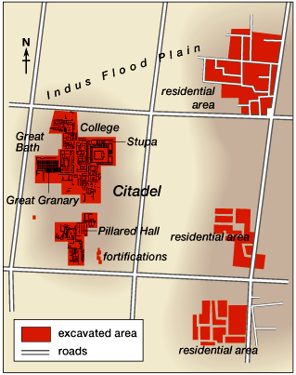
Citadel
Of
Mohenjo-Daro

Slide 4
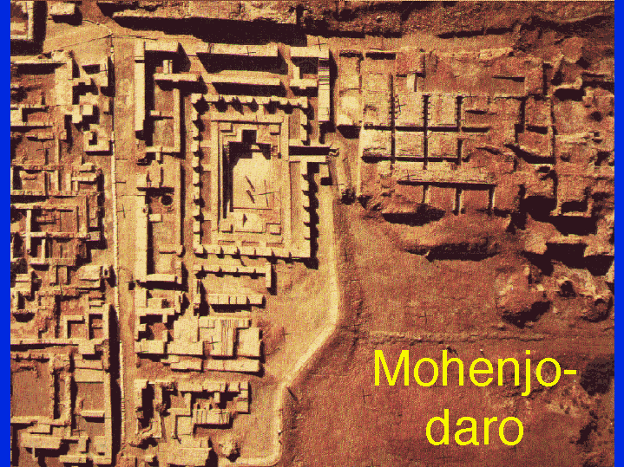
Aerial View of Mohenjo-Daro

Slide 5
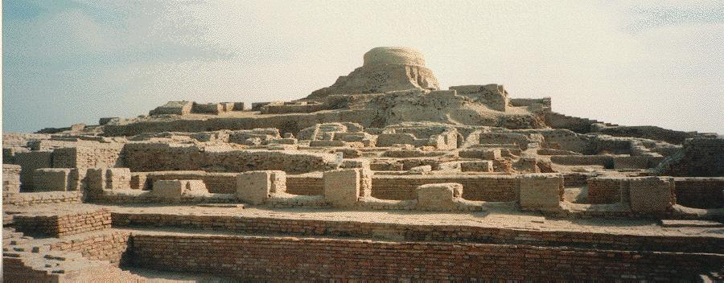
Wide View, Mohenjo-Daro

Slide 6
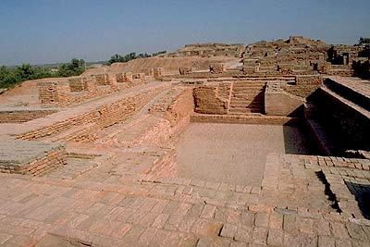
The Great Bath,
Mohenjo-Daro

Slide 7
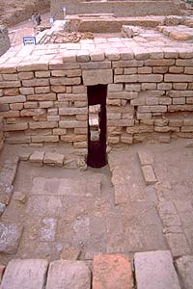
Bath Area, Mohenjo-Daro

Slide 8
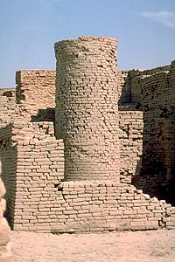
Well, Mohenjo-Daro

Slide 9
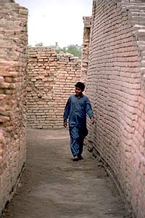
A Main Street, Mohenjo-Daro

Slide 10
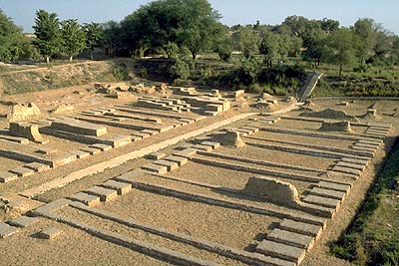
Granery, Mohenjo-Daro

Slide 11
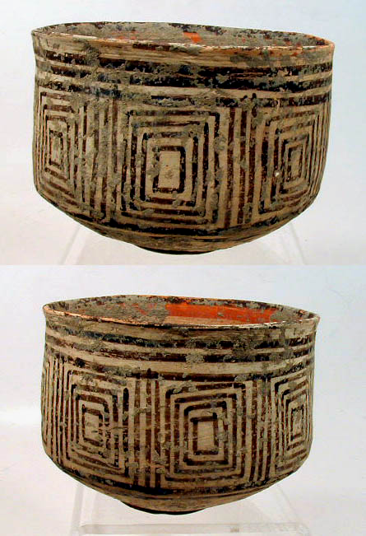
pottery, Mohenjo-Daro

Slide 12
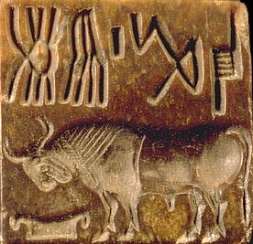
Bison Seal, Mohenjo-Daro

Slide 13
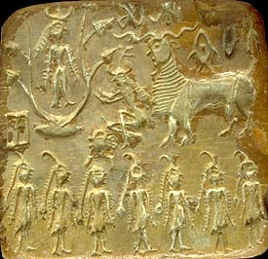
A Horned-God Seal,
Mohenjo-Daro

Slide 14
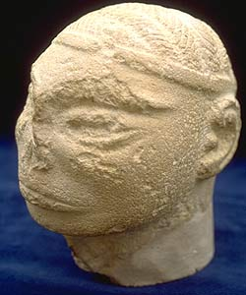
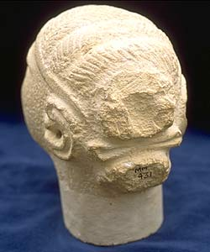
A Male Head, Mohenjo-Daro
Dravidian

Slide 15
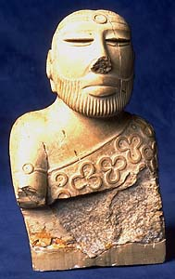
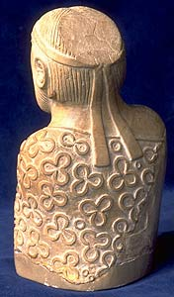
A Priest-King, Mohenjo-Daro

Slide 16
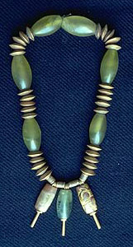
Necklace, Mohenjo-Daro

Slide 17
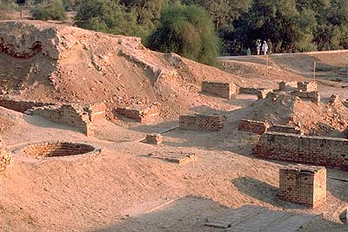
Public Well, Harappa

Slide 18
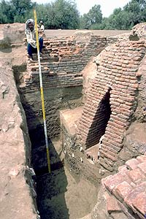
Drain, Harappa

Slide 19
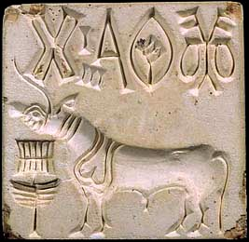
Unicorn Seal, Harappa

Slide 20
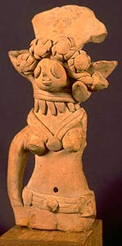
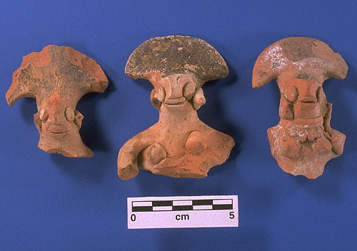
Female Figures, Harappa

Slide 21
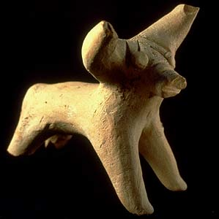
Bull Figurine, Harappa

Slide 22
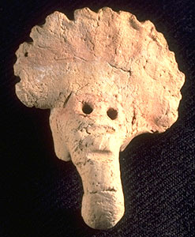
Elephant Figurine, Harappa

Slide 23
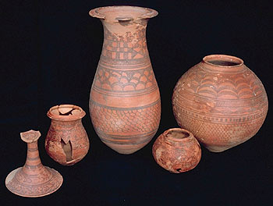
Burial Pottery, Harappa

Slide 24
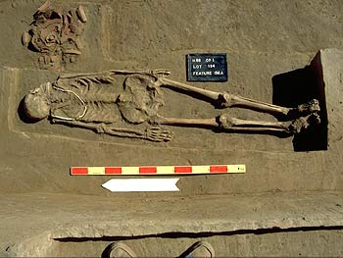
Male Skeleton, Harappa

Slide 25
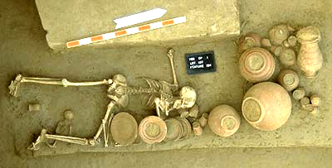
Female Skeleton with Child, Harappa

Slide 26
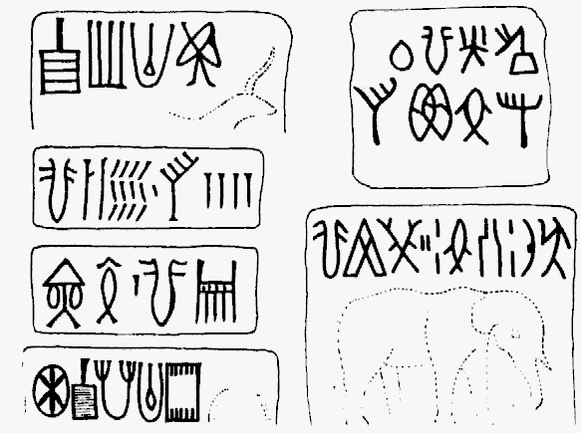
Harappan Writing
Undecipherable to date.

Slide 27
The
Vedic
Age
(1500 BCE - 500 BCE)

Slide 28
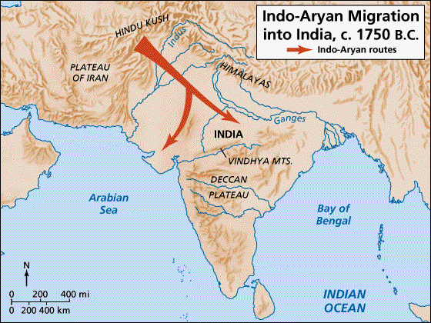
Aryan Migration
pastoral → depended on their cattle.
warriors → horse-drawn chariots.

Slide 29
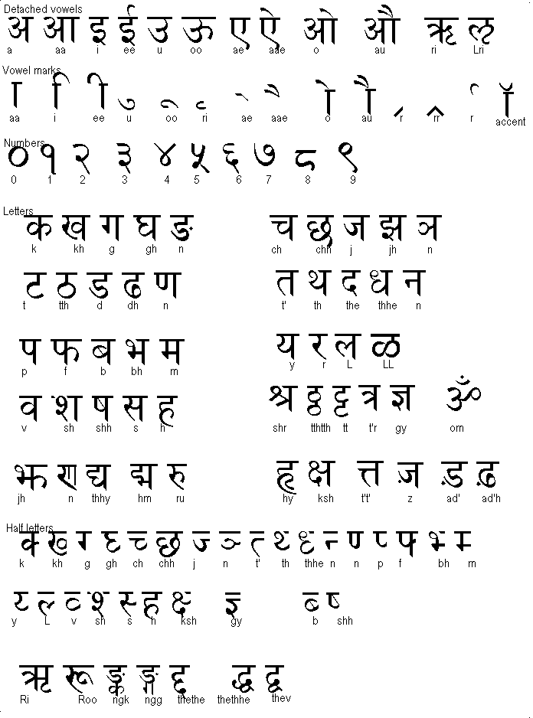
Sanskrit writing

Slide 30
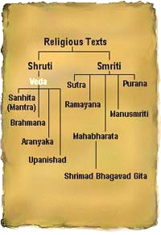
The Vedas
1200 BCE-600 BCE.
written in SANSKRIT.
Hindu core of
beliefs:
  hymns and poems.
  religious prayers.
  magical spells.
  lists of the gods
  and goddesses.
Rig Veda → oldest work.

Slide 31
Varna (Social Hierarchy)
Brahmins
Kshatriyas
Vaishyas
Shudras
Pariahs [Harijan] → Untouchables

Slide 32
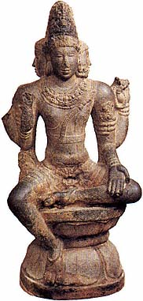
The Caste
System
Brahmins
WHO IS…
Kshatriyas
The mouth?
The arms?
The legs?
The feet?
Vaishyas
Shudras
What is a JATI?

Slide 33
The Vedic Age
The foundations for
Hinduism were established!

