Slide 1
QUANTUM NUMBERS

Slide 2
BASIC CONCEPTS OF QUANTUM MECHANICS
ELECTRONS EXIST IN AREAS OUTSIDE THE NUCLEUS. THESE AREAS ARE CALLED ENERGY LEVELS. YOU MIGHT HAVE HEARD OF THEM BEFORE AS “SHELLS”. THERE ARE NUMEROUS ENERGY LEVELS AT WHICH THE ELECTRON CAN BE FOUND, EACH AT A PROGRESSIVE HIGHER ENERGY.
THESE LEVELS ARE ASSIGNED NUMBERS 1,2,3, ETC. AS THE NUMBER INCREASES, THE ENERGY STATE OF THE ELECTRON BECOMES HIGHER.

Slide 3
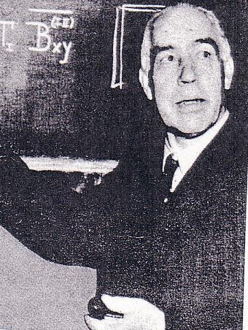
BASIC CONCEPTS OF QUANTUM MECHANICS
AN ORIGINAL ATOMIC THEORY PROPOSED BY NEILS BOHR IN THE EARLY 20TH CENTURY SUGGESTED THAT ELECTRONS CIRCLE THE NUCLEUS OF ATOMS IN ORBITS SIMILAR TO THE PATHS OF THE PLANETS AROUND THE SUN.
A MOST IMPORTANT CONCEPT OF MODERN QUANTUM THEORY IS HOWEVER, THAT ELECTRONS DO NOT MOVE IN ORBITS ABOUT THE NUCLEUS OF THE ATOM !!
THE ENERGY LEVELS OF ATOMS ARE NOT ORBITS FOR ELECTRONS. THEY ARE AREAS OF HIGH PROBABILITY OF FINDING ELECTRONS.
ELECTRON
ORBITS !!
NEILS BOHR

Slide 4
The Bohr model of the
atom is a planetary
model where the
electrons move in
distinct orbits about
the nucleus.
Each orbit represents
an energy level or
shell.
+

Slide 5
A probability
model of the
atom.
Areas of high
probability
of finding
electrons
exist but no
distinct orbits
Each major area
is defined by
n = 1, 2, 3 etc.

Slide 6
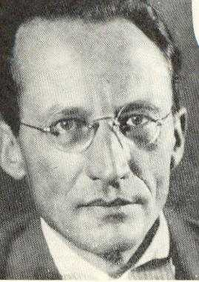
BASIC CONCEPTS OF QUANTUM MECHANICS (CONT’D)
WHEN ENERGY (HEAT, ELECTRICITY, ETC.) IS ADDED TO AN ATOM, THE ELECTRONS WITHIN THE ATOM JUMP TO HIGHER ENERGY LEVELS.
WHEN THE ELECTRONS FALL BACK TO THEIR ORIGINAL ENERGY LEVEL, THEY RELEASE THE ENERGY THAT THEY ABSORBED IN THE FORM OF LIGHT.
THEREFORE, IN ORDER TO UNDERSTAND THE ELECTRONIC STRUCTURE OF THE ATOM WE MUST FIRST UNDERSTAND THE NATURE OF LIGHT ITSELF!
WAVES &
ORBITALS
IRWIN SCHROEDINGER
QUANTUM MECHANICS GENIUS

Slide 7
USING OUR KNOWLEDGE OF LIGHT TO UNDERSTAND ELECTRONIC STRUCTURE IN ATOMS
RECALL FROM OUR PREVIOUS INFORMATION:
WHEN ATOMS ABSORB ENERGY, ELECTRONS JUMP TO HIGHER ENERGY LEVELS. WHEN THEY FALL BACK TO THEIR ORIGINAL ENERGY LEVELS, THAT ABSORBED ENERGY IS RELEASED AS LIGHT.
ANALYZING THIS EMITTED LIGHT ALLOWS US TO DISCOVER THE ELECTRONIC STRUCTURE OF THE ATOM!
BEFORE WE CAN DO THIS HOWEVER WE MUST FIRST INVESTIGATE THE SECOND NATURE OF LIGHT, THAT IS ITS PARTICLE NATURE !!

Slide 8
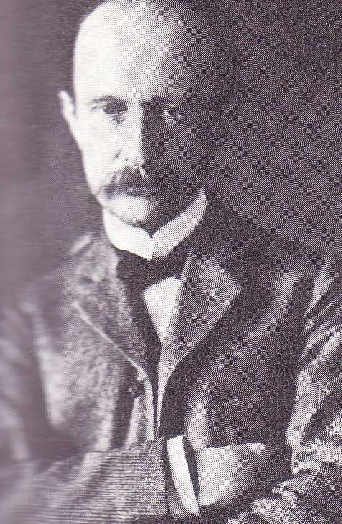
LIGHT PARTICLES, PLANCK AND PHOTONS
PARTICLES OF LIGHT ARE CALLED “PHOTONS”. THESE ARE “PACKAGES” OF LIGHT ENERGY.
MAX PLANCK WAS FIRST TO DISCOVER THE RELATIONSHIP BETWEEN THE WAVE NATURE OF LIGHT AND ITS PARTICLE NATURE.
HE FOUND THAT THE ENERGY CONTENT OF LIGHT WAS DIRECTLY RELATED TO THE FREQUENCY OF THE LIGHT WAVE.
THE EQUATION THAT MEASURES ENERGY AS A FUNCTION OF FREQUENCY IS:
ENERGY = A CONSTANT x FREQUENCY
E = h x ν
WERE h IS A CONSTANT CALLED
PLANCK’S CONSTANT (6.63 x 10⁻³⁴ JOULES SEC / PHOTON)
PHOTONS
MR. PLANCK

Slide 9
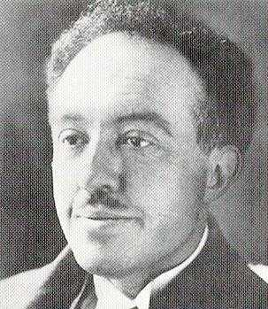
LIGHT PARTICLES, PLANCK AND PHOTONS
IN ADDITION TO LIGHT VERY HIGH VELOCITY SUBATOMIC PARTICLES (SUCH AS ELECTRONS) ALSO HAVE OBSERVEABLE WAVE PROPERTIES. THE WAVELENGTH OF THESE PARTICLE CAN BE CALCULATED USING THE DEBROGLIE EQUATION:
λ = h / m x v WHERE h = PLANCK’S CONSTANT
(6.63 x 10⁻³⁴ JOULE SEC/ PHOTON)
m = MASS IN KILOGRAMS
v = VELOCITY IN METERS / SEC
iiIF YOU’RE
MOVIN’
YOU’RE WAVEN’
De Broglie

Slide 10
LIGHT PARTICLES, PLANCK AND PHOTONS (CONT’D)
SAMPLE PROBLEM:
ALL MOVING OBJECTS HAVE WAVELENGTHS EVEN EVERYDAY OBJECTS, HOWEVER LARGE MASS PARTICLES EXHIBIT VERY SHORT WAVELENGTHS.
FOR EXAMPLE: WHAT IS THE WAVELENGTH OF A 60 Kg RUNNER WHO IS MOVING AT 10 METERS / SECOND?
λ = h / m x v, λ = (6.63 x10⁻³⁴) / (60 x 10)
λ = 1.11 x 10⁻³⁶ METERS
(A VERY, VERY SMALL WAVELENGTH)
FOR VERY SMALL MASSES (ELECTRONS)
WAVELENGTH IS SIGNIFICANTLY LARGER.

Slide 11
What are Quantum Numbers?
Quantum number are a set of four values that define the
energy state of an electron in an atom.
Quantum number values are designated as n, l, m and s
(s is often written as m_{s} )
n is called the principal quantum number and ranges
from 1, 2, 3, etc. (also refers to the energy level or shell
l represents the orbital type and depends on n. It ranges
from 0 through n – 1. It often called the azimuthal
quantum number
m depends on l. It ranges from – l thru 0 to + l. It defines
the orbital orientation in space and is call the magnetic
quantum number.
S is the spin number and is either + ½ or – ½

Slide 12
Assigning Quantum Numbers
Quantum numbers may be view as an electrons address.
Just like your address, each has its own distinct set of values.
For example in order to receive a letter, the address must contain
state and zip, city, street and name. No other person has
the exact same set of information. It is similar for electrons.
They each have their own address, n, l, m, and s.
NO TWO ELECTRON IN AN ATOM CAN HAVE THE
EXACT SAME SET OF QUANTUM NUMBERS.
QUANTUM NUMBERS ARE ASSIGNED TO EACH
EACH ELECTRON USING THE RULES PREVIOUSLY
STATED, STARTING FROM THE LOWEST VALUES.

Slide 13
Orbital types defined by the azimuthal quantum number
l = 0
s type orbital
One orientation
l = 1
p type orbital
Three orientations
l = 2
d type orbital
Five orientations
l = 3
f type orbital
Seven orientations (not shown)

Slide 14
Assigning Quantum Numbers to Atoms
atom
n l m s
H (1 e⁻)
1
0
0
-½
Lowest possible n value
Lowest possible l value (n – 1)
Lowest possible m value (-l > 0 > +l)
Lowest possible m value (- ½ or + ½ )

Slide 15
Assigning Quantum Numbers to Atoms
atom
n l m s
He (2 e⁻)
1
0
0
-½
1
0
0
+½
This time we can use the same n, l and m values as the first
electron and still get a different set of values by changing
s to = + ½
Energy level 1 is now complete. We are at the end of
period (row) 1 on the Periodic Table.

Slide 16
Assigning Quantum Numbers to Atoms
atom
n l m s
Li (3 e⁻)
1
0
0
-½
1
0
0
+½
2
0
0
-½
This time we must change n to 2 otherwise we will
duplicate the first or second set of numbers.
Following the rules we get the set shown. Notice that
when we change n we again start at the lowest possible
values for l, m and s.

Slide 17
Assigning Quantum Numbers to Atoms
atom
n l m s
Be (4 e⁻)
1
0
0
-½
1
0
0
+½
2
0
0
-½
2
0
0
+½
This time we can use the same n, l and m values as the third
electron and still get a different set of values by changing
s to = + ½

Slide 18
Assigning Quantum Numbers to Atoms
atom
n l m s
B (5 e⁻)
1
0
0
-½
1
0
0
+½
2
0
0
-½
2
0
0
+½
2
1
-1
-½
This time we must change l to 1 otherwise we will
duplicate the first or second set of numbers.
Following the rules we get the set shown. Notice that
when we change l we again start at the lowest possible
values for m and s.

Slide 19
Assigning Quantum Numbers to Atoms
atom
n l m s
C (6 e⁻)
1
0
0
-½
1
0
0
+½
2
0
0
-½
2
0
0
+½
2
1
-1
-½
2
1
0
-½
This time we can use the same n and l values as the fourth
electron and still get a different set of values by changing
m to 0

Slide 20
Assigning Quantum Numbers to Atoms
atom
n l m s
N (7 e⁻)
1
0
0
-½
1
0
0
+½
2
0
0
-½
2
0
0
+½
2
1
-1
-½
2
1
0
-½
2
1
+ 1
-½
This time we can use the same n and l values as the fourth
electron and still get a different set of values by changing
m to + 1

Slide 21
Assigning Quantum Numbers to Atoms
n l m s
atom
N (7 e⁻)
1
0
0
-½
1
0
0
+½
2
0
0
-½
2
0
0
+½
2
1
-1
-½
2
1
0
-½
2
1
+ 1
-½
2
1
- 1
+½
This time we can use the same n and l values as the fourth
electron and still get a different set of values by changing
m to – 1 and s to + ½

Slide 22
Assigning Quantum Numbers to Atoms
n l m s
atom
O (8 e⁻)
1
0
0
-½
1
0
0
+½
2
0
0
-½
2
0
0
+½
2
1
-1
-½
2
1
0
-½
2
1
+ 1
-½
2
1
- 1
+½
This time we can use the same n and l values as the fourth
electron and still get a different set of values by changing
m to – 1 and s to + ½

Slide 23
Assigning Quantum Numbers to Atoms
n l m s
atom
F (9 e⁻)
1
0
0
-½
1
0
0
+½
2
0
0
-½
2
0
0
+½
2
1
-1
-½
2
1
0
-½
2
1
+ 1
-½
2
1
- 1
+½
2
1
0
+½
This time we can use the same n and l values as the fourth
electron and still get a different set of values by changing
m to 0

Slide 24
Assigning Quantum Numbers to Atoms
n l m s
atom
Ne (10 e⁻)
1
0
0
-½
1
0
0
+½
2
0
0
-½
2
0
0
+½
2
1
-1
-½
2
1
0
-½
2
1
+ 1
-½
2
1
- 1
+½
2
1
0
+½
2
1
+ 1
+½
This time we can use the same n and l values as the fourth
electron and still get a different set of values by changing
m to + 1
Energy level 2 is now complete. We are at the end of
period (row) 2 on the Periodic Table

Slide 25
Assigning Quantum Numbers to Atoms
atom
n l m s
1
0
0
-½
Na (11 e⁻)
1
0
0
+½
2
0
0
-½
2
0
0
+½
2
1
-1
-½
2
1
0
-½
2
1
+ 1
-½
2
1
- 1
+½
2
1
0
+½
2
1
+ 1
+½
3
0
0
-½
This time we must change n to 3 otherwise we will
duplicate one of the first thru tenth set of numbers.
Following the rules we get the set shown. Notice that when we change n
we again start at the lowest possible values for l, m and s.

Slide 26
Quantum Number Summary
n =1
l = 0
m = 0
s = + ½ or – ½
n =2
l = 0
l = 1
m = - 1
m = 0
m = + 1
s = + ½ or – ½
n =3
l = 0
l = 1
l = 2
m = -2
m = - 1
m = 0
m = + 1
m = +2
s = + ½ or – ½
m = - 3
m = -2
m = - 1
m = 0
m = + 1
m = +2
m = + 3
n =4
l = 0
l = 1
l = 2
l = 3
s = + ½ or – ½

Slide 27
Translation from Spectroscopic Notation to Quantum numbers
For larger atom the assignment of quantum numbers
must continue following the rules until the number of
electrons corresponding to the particular atom is reached.
Writing quantum number for a particular electron
can be made easier by translation a spectroscopic
notation into a quantum number set.
For example a 4s² can be translated as
n = 4 , s means l = 0 and therefore m must be 0.
s can be – ½ or + ½
A 3p² can be translated as
n = 3 , p means l = 1 and therefore
m must be. -1, 0 or + 1
s can be – ½ or + ½

Slide 28
The End

