Slide 1
Intelligent Thief & Home Security System: Brahms Perspective
Eduardo Gutarra
PalashVerma

Slide 2
Overview
Introduction
Goals
Functionality
Geography
Actors
Objects
Future Work

Slide 3
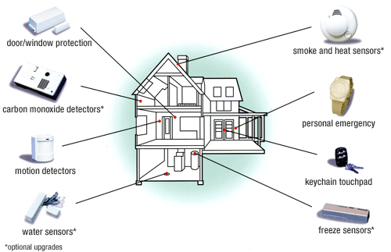
Introduction
Home Security systems come with a variety of detection systems.
Our focus for this project will be burglar (or intrusion)

Slide 4
Goals
We aim to see how effective a House Security system would be through brahms simulation
We want to create a systematic break-ins by a thief to understand the security loop-holes
We also intend to simulate a 911 emergency response centre (with limited functionality)

Slide 5
Functionality
The home owner installs a security system
The user chooses a security code and a security keyword
The House agent takes inputs from various sensors & also authenticates the house user
activation and deactivation of the security system can be done via the security keypad

Slide 6
Functionality
The motion detectors generates events and communicates with the security system
Events generated by the motion detectors raises an alarm if anything matches one of security systems rules
When an alarm is raised the house system will communicate with the security company and the house user

Slide 7
Functionality
The security company would in turn call the house user (and authenticate him by using the preselected keyword) and ask if the alarm is legitimate and if so would call 911 response system
911 response system dispatches a security team to the house based on the location and availability of teams, there can be delays

Slide 8
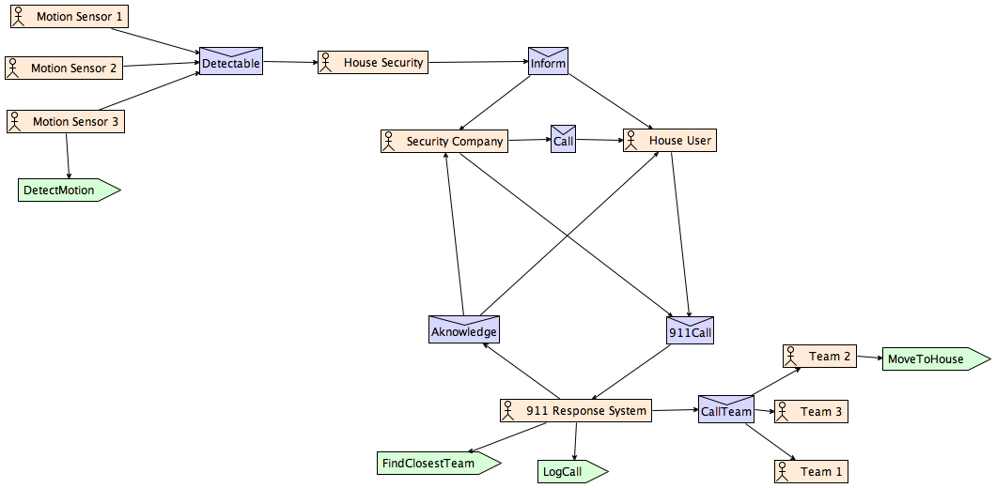

Slide 9
Functionality: Geography
House – 1: Complete House with details of rooms etc.
House 2&3
Security System’s Agent Office
911 Response Agent’s Office
911 Response Team locations

Slide 10
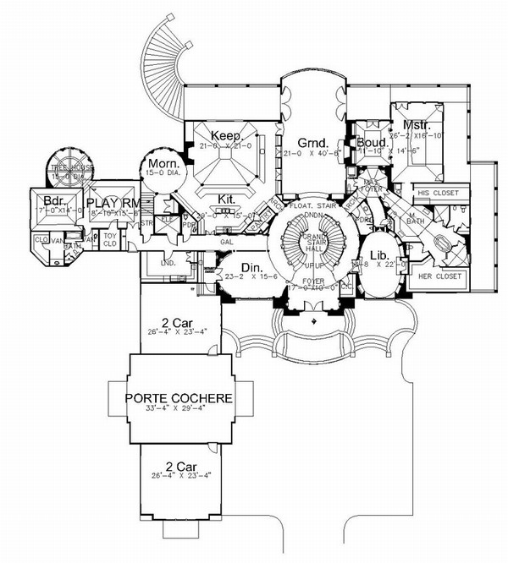
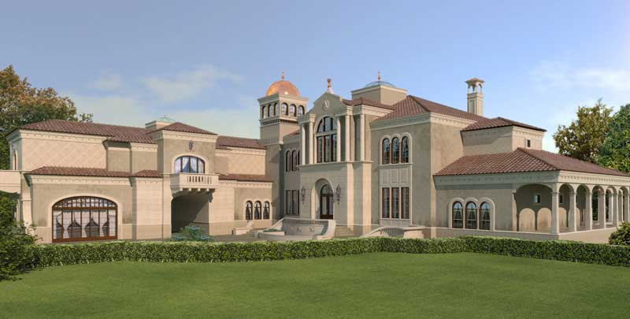


Geography

Slide 11
Functionality: Actors
Home User
Home Security Company Agent
911 Response System Agent
Response Teams
Thief

Slide 12
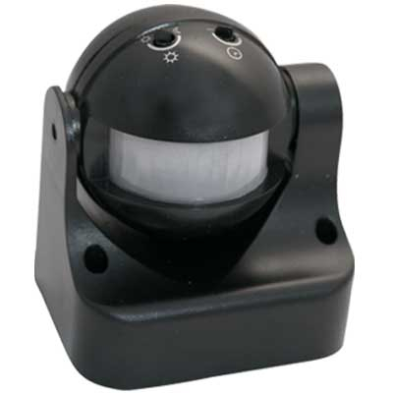
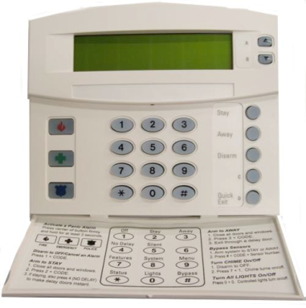
Functionality: Objects
Motion Sensors
Security Keypad

Slide 13
Future Work
Add a detailed layer to 911 Emergency response system to find the shortest distance of the house from the nearest response team base (maybe in JAVA)
Add more details to the 911 response system to make it more realistic

Slide 14
?
?
?
?
?
Questions
?
?

