Slide 1
A Data Warehouse for
Canadian Literature
Eduardo Gutarra

Slide 2
Overview
Introduction
Background
Motivation
Research Questions (Objectives)
Methodology
Schedule

Slide 3
Introduction
Data warehouses are often used as one of the principal components of Decision Support Systems.
Data warehouses can be used to perform analyses on different fields as long as there is a lot of data.
Gutenberg Canada Website provides books in Text Files and other formats, free of charge.
We want to build a Data warehouse from the books gathered from the Gutenberg Canada website and allow literary analysis.

Slide 4
Motivation
Project is inspired from the LitOLAP project
Seeks to apply Business Intelligence Techniques to the domain of text processing, to allow computer-aided literary studies.
LitOLAP allows a literary researcher answering questions such as how many commas does a given author usually have in his or her sentences?
Questions that could be important in defining style and authorship of literary works.

Slide 5
Data warehouse
A data warehouse is a database specifically used for reporting.
Populating a data warehouse (DW) involves an ETL process where the data is:
  Extracted from data sources
  Transformed to conform with other dimensions
  Loaded onto the data warehouse.
Once the DW is populated, Online Analytical Processing can be performed on it.

Slide 6
Data warehouse
Transactional
throughput is
More important
Tend to be
orders of
magnitude
larger
Sales in Store 1
OLAP
Cube
Datawarehouse
Sales in Store 2
OLAP
Cube
Query response
Time is more
important
Flat
Files
ETL Process
Summarize
The data

Slide 7
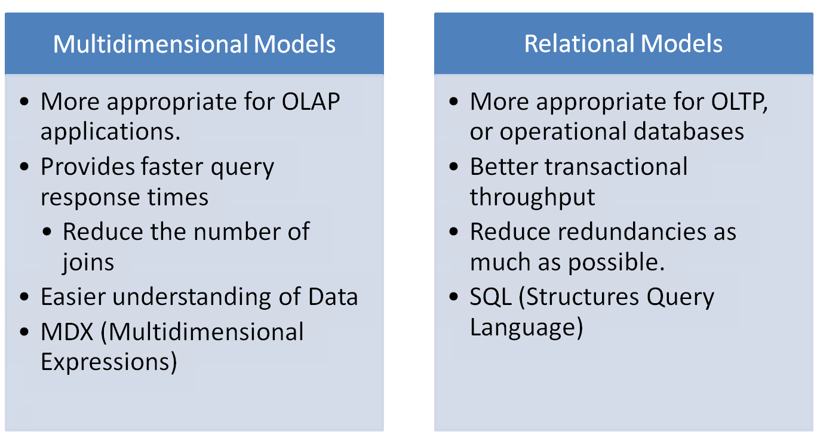
A Comparison between OLAP and OLTP

Slide 8
The Star Schema
We use the multidimensional model to design the way the data is structured
Multidimensional data model structures data in a fact table and multiple dimensions.
Facts are associated to numerical measures.
  Numerical data being tracked
  Stored in central fact table
Dimensions provide the context for the facts as attributes.
  Attributes are abstract items for convenient qualification or summarization of data.
When we store a multidimensional model in a relational database it is called a Star Schema.

Slide 9
AuthorID x SentenceID x PlaceID → Frequency
Author ID
Author Name
Occupation
DOB
DOD
Sentence ID
Book Name
Sentence #
Place ID
Place Name
Country
Continent
ID
Author ID
Sentence ID
Place ID
Frequency
ID is BigINT, so it can potentially store as many as 2^64 -1 ids

Slide 10
Example Star Schema
Geography
Time
Geography Code
Region Code
Region Mgr
City Code
City Name
Time Code
Quarter Code
Quarter Name
Week Code
Day Code
Day name
Fact Table
Sales
Geography Code
Time Code
Account Code
Dollar Amount
Units
Product
Account
Product Code
Product Name
Brand Mgr
Brand Code
Prod. Line Code
Prod. Line Name
Prod. Name
...
Account Code
Key Account Code
Account Name
Account Type
Account Market

Slide 11

Issues in our Design

Slide 12
PlaceID | City | Country | Continent
40 | Unspecified | U.S. | North America
41 | Unspecified | Unspecified | North America
42 | Unspecified | Unspecified | South America
What if the place is a country?
What if the place is a continent?

Slide 13
PlaceID | City | Country | Continent
33 | London | England | Europe
: | : | : | :
45 | London | Canada | North America
BookID | SentenceID | PlaceID | Frequency
28 | 10 | 33 | 0.8
28 | 10 | 45 | 0.2

Slide 14
SentenceID x PlaceID = Frequency
Sentence ID
Sentence #
Sentence
Book Name
Place ID
Place Name
Country
Continent
ID
Sentence ID
Place ID
Frequency
ID is BigINT, so it can potentially store as many as 2^64 -1 ids

Slide 15
The ETL Process
According to Kimball, about 70% of the effort is spent in the ETL Process
Our project has a Single Data Source

Slide 16

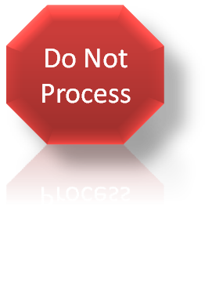

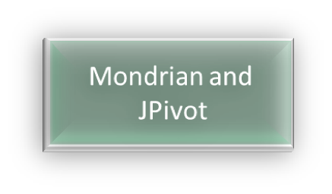



English?
No
Greatest difficulty is that
The data is not structured and
It is hard to use Pentaho’s DI for
Unstructured data
Yes
Annotated
XML File
OLAP
Schema
File
Annotated
XML File
Transform to Table
Form
MySQL
Structured
Table

Slide 17
Once the XML file is written we have a process to transform
Into a single denormalized table.
Book1.xml
21: <sentence> I have lived in <place>Saint John</place>.</sentence>
22: <sentence> This sentence has no place mentioned.</sentence>
...
Book2.xml
31: <sentence> This sentence mentions <place>Fredericton</place> and
<place> Halifax </place>.</sentence>
32: <sentence> This sentence mentions <place> Saint John </place>.</sentence>
...
Book | Place | Sentence | Frequency
Book1 | Saint John | 21 | 1
Book2 | Fredericton | 31 | 1
Book2 | Halifax | 32 | 1
Book | Place | Sentence | Frequency
Book1 | Saint John | 21 | 1
Book1 | NONE | 22 | 1
Book2 | Fredericton | 31 | 1
Book2 | Halifax | 32 | 1

Slide 18
Algorithms for reading unstructured data to relational tables.
Parse xml file and read a sentence in it.
Having the sentence, we then add the sentence to the table of sentences:
Check if we have a place in the sentence
  If there is a place, check whether it is new.
    If it is a new place, then we add an entry for it in the places table.

Slide 19
Explain how I get books from the gutenberg.ca website.

Slide 20
OLAP Schema
The OLAP Schema file defines which is the fact table and which are the dimension tables in the MySQL Schema.
Once the cube is built we also add a

Slide 21
http://msdn.microsoft.com/en-us/library/aa216779(v=sql.80).aspx

Slide 23
MDX Query Language

Slide 25
Pentaho Data Integration connects to My

Slide 27
Questions and Suggestions?

