Slide 1
A Data Warehouse for
Canadian Literature
Eduardo Gutarra

Slide 2
Overview
Introduction and Motivation
Background
The ETL Process
The multidimensional model and star schema
Issues with my star schema design
Sample MDX queries for my cube

Slide 3


Introduction
Data warehouses are often used as one of the main components of Decision Support Systems.
Data warehouses can be used to perform analyses on different fields as long as there is a lot of data.
I wanted to build a data warehouse on places mentioned in books.
Gutenberg Canada Website provides books in Text Files and other formats, free of charge.
Barcelona
Saint John
Montreal

Slide 4
Motivation
Project adds a new DW to the LitOLAP project
LitOLAP seeks to apply data warehousing techniques in the domain of literary text processing.
Allows a literary researcher answering questions over an author’s style, or particularities about book among others.
Queries include:
  Most common words
  Most common co-occurring words
  Most common word n-grams. i.e. “the red car”
  Analogies
Facilitates the analysis of literary texts to a domain expert.

Slide 5
Overview
Introduction and Motivation
Background
The ETL Process
The multidimensional model and star schema
Issues with my star schema design
Sample MDX queries for my cube

Slide 6
Data warehouse
A data warehouse is a database specifically used for reporting.
Populating a data warehouse (DW) involves an ETL process where the data is:
  Extracted from data sources
  Transformed to conform the schema of your DW.
  Loaded onto the data warehouse.
Once the DW is populated, Online Analytical Processing (OLAP) can be performed on it.

Slide 7
Data warehouse
Transactional
throughput is
More important
Tend to be
orders of
magnitude
larger
Sales in Store 1
OLAP
Cube
Data warehouse
Sales in Store 2
OLAP
Cube
Query response
Time is more
important
Flat
Files
ETL Process
Summarize
the data
Pentaho’s Data Integration Tool (Kettle)

Slide 8
Overview
Introduction and Motivation
Background
The ETL Process
The multidimensional model and star schema
Issues with my star schema design
Sample MDX queries for my cube

Slide 9
ETL Process
According to Kimball, about 70% of the effort is spent in the ETL Process
My project has a Single Data Source
Obtain the metadata, and the books
<html>
:
<body>
:
</body>
</html>
Author | Title | … | Year
Gutenberg
Canada. (index.html)

Slide 10
Gutenberg.ca
Books
Do Not Process
English?
Yes
No
WhatLanguage
GATE
Annotated
XML File
MySQL
Annotated
XML File
Transform to Table
Form
Denormalized
Table
Pentaho’s Data Integration Tool

Slide 11
Natural Language Processing
GATE -- Open-source software for text processing.
Gazetteer to determine what words or phrases are a location.
Annotates sentences and locations
Produces XML file
Book1.txt
21: I have lived in Saint John.
22: This sentece has no place mentioned.
...
Book1.xml
21: <sentence> I have lived in <place>Saint John</place>. </sentence>
22: <sentence> This sentence has no place mentioned.</sentence>
...

Slide 12
Gutenberg.ca
Books
Do Not Process
English?
Yes
No
GATE
Annotated
XML File
MySQL
Annotated
XML File
Transform to Table
Form
Denormalized
Table
Pentaho’s Data Integration Tool

Slide 13
Once the XML file is written I have a process to transform into a single denormalized table.
Book1.xml
21: <sentence> I have lived in <place>Saint John</place>.</sentence>
22: <sentence> This sentence has no place mentioned.</sentence>
...
Book2.xml
31: <sentence> This sentence mentions <place>Fredericton</place> and
<place> Halifax </place>.</sentence>
32: <sentence> This sentence mentions <place> Saint John </place>.</sentence>
...
Book | Place | Sentence | Frequency
Book1 | Saint John | 21 | 1
Book2 | Fredericton | 31 | 1
Book2 | Halifax | 32 | 1
Book | Place | Sentence | Frequency
Book1 | Saint John | 21 | 1
Book1 | NONE | 22 | 1
Book2 | Fredericton | 31 | 1
Book2 | Halifax | 32 | 1

Slide 14
Gutenberg.ca
Books
Do Not Process
English?
Yes
No
Mondrian and
JPivot
GATE
OLAP
Schema
File
Annotated
XML File
Annotated
XML File
MySQL
Transform to Table
Form
Denormalized
Table
Pentaho’s Data Integration
Tool
Populate the
Star Schema

Slide 15
Overview
Introduction and Motivation
Background
The ETL Process
The multidimensional model and star schema
Issues with my star schema design
Sample MDX queries for my cube

Slide 16
The Multidimensional Model
We use the multidimensional model to design the way the data is structured
Multidimensional model divides the data in measures and context.
Measures: Numerical data being tracked
Context: Data used for to describe the circumstances for which a given measure was obtained.

Slide 17
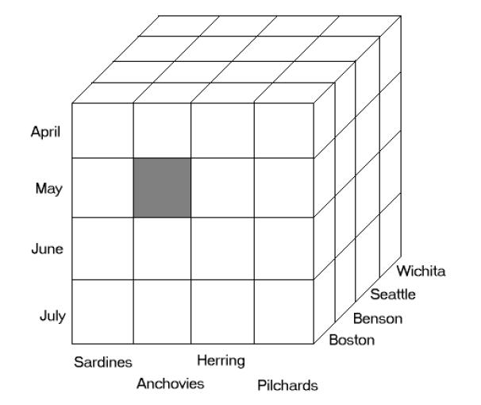
Measures
Units Sold
Profit
20
$45
Time
Location
Product
Dimensions

Slide 18
The Star Schema
When we store a multidimensional model in a relational database it is called a Star Schema.
20
$45
2NF
Dimension Table
MonthID | Month
1 | April
2 | May
3 | June
4 | July
2NF
2NF
3NF
Dimension Table
Dimension Table
Fact Table
ProductID | Product
1 | Sardines
2 | Anchovies
3 | Herring
4 | Pilchards
ProductID | LocationID | MonthID | Units Sold | Profit
2 | 1 | 2 | 20 | 45
.. | .. | .. | .. | ..
.. | .. | .. | .. | ..
LocationID | Location
1 | Boston
2 | Benson
3 | Seattle
4 | Wichita

Slide 19
Attributes
  Attributes are abstract items for convenient qualification or summarization of measurements.
  Attributes often form hierarchies.
Time
TimeID | Month | Quarter | Year
1 | January | Q1 | 2010
2 | February | Q1 | 2010
3 | March | Q1 | 2010
4 | April | Q2 | 2010
5 | May | Q2 | 2010
6 | June | Q2 | 2010
7 | July | Q3 | 2010
8 | August | Q3 | 2010
9 | September | Q3 | 2010
10 | October | Q4 | 2010
11 | November | Q4 | 2010
12 | December | Q4 | 2010
13 | January | Q1 | 2011
33
Q2
20
45
Finest
Coarsest
Q2 x Anchovies x Boston → 98

Slide 20
Overview
Introduction and Motivation
Background
The ETL Process
The multidimensional model and star schema
Issues with my star schema design
Sample MDX queries for my cube

Slide 21
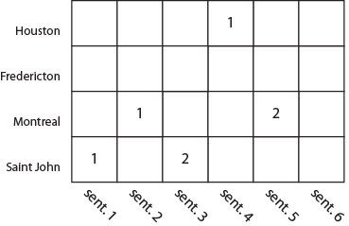
SentenceID x PlaceID →Frequency
Place
Sentence
Sentence ID
Sentence #
Text
Book
Author
Occupation
Place ID
City
Country
Continent
Sentence ID
Place ID
Frequency

Slide 22
Issues with the Design
What if the place is a country?
What if the place is a continent?
Dummy value “unspecified” can fill in the missing values
<sentence> I live in <place>Canada</place>. </sentence>
<sentence> I live in <place>North America</place>. </sentence>
PlaceID | City | Country | Continent
40 | Unspecified | Canada | North America
41 | Unspecified | Unspecified | North America
42 | Unspecified | Unspecified | South America

Slide 23
Issues with the Design
London in England, or London in Ontario?
Context required to resolve ambiguity
Allocation to partially fix the issue
<sentence> I live in <place>London</place>. </sentence>
BookID | SentenceID | PlaceID | Frequency
28 | 10 | 33 | 4/5
28 | 10 | 45 | 1/5
Fact Table
PlaceID | City | Country | Continent
33 | London | England | Europe
: | : | : | :
45 | London | Canada | North America
Dimension Table

Slide 24
Issues with the Design
Many to Many relationship between Authors and Books
Many to Many relationships are tricky.
They can lead to double-counting and other problems.
Beaumont, Francis
Author | Title | SentenceID | Frequency
? | The Knight of the Burning Pestle | 1 | 1
Fletcher, John | A Story | 2 | 1
? | A Tale of The Big Mountain | 3 | 1
Fletcher, John
Beaumont, Francis
Fletcher, John
Additional Attribute
Author_1 | Author_2 | Title | SentenceID | Frequency
Beaumont, Francis | Fletcher, John | The Knight of the Burning Pestle | 1 | 1
Fletcher, John | NULL | A Story | 2 | 1
Beaumont, Francis | Fletcher, John | A Tale of The Big Mountain | 3 | 1
Allocation
Author | Title | SentenceID | Frequency
Beaumont, Francis | The Knight of the Burning Pestle | 1 | ½
Fletcher, John | The Knight of the Burning Pestle | 2 | ½
Fletcher, John | A Story | 3 | 1
Beaumont, Francis | A Tale of The Big Mountain | 4 | ½
Fletcher, John | A Tale of The Big Mountain | 5 | ½

Slide 25
Bridge Table
Outtriger Table
Add two tables
to the Star Schema
AuthorID
AuthorName
Bridge Table
AuthorGID
AuthorID
Dimension Table
Sentence ID
Sentence #
Text
Book
AuthorGID
Occupation
Place ID
City
Country
Continent
Sentence ID
Place ID
Frequency

Slide 26
Overview
Introduction and Motivation
Background
The ETL Process
The multidimensional model and star schema
Issues with my star schema design
Sample MDX queries for my cube

Slide 27
Actual Star Schema
Sentence ID
Sentence #
Text
Book
Author
Place ID
Place Name
Sentence ID
Place ID
Frequency

Slide 28
MDX Query Language
MultiDimensional eXpressions is the query language used to navigate OLAP cubes.
Some important aspects of MDX include:
  MDX allows read-only operations. Cannot modify the data.
  ROWS and COLUMNS serve different purposes in SQL and MDX
  The SELECT and WHERE clause serve different purposes in SQL and MDX

Slide 29
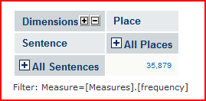
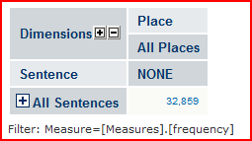
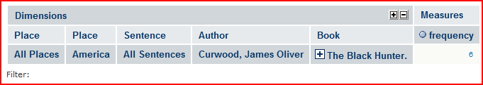
Hierarchical All Member
SELECT {[Place].[All Places]} ON COLUMNS,
{[Sentence].[All Sentences]} ON ROWS
FROM [Places]
WHERE [Measures].[frequency]
Select [Place].[NONE] ON COLUMNS,
{[Sentence].[All Sentences]} ON ROWS
from [Places]
where [Measures].[frequency]
Tuple
35,879 - 32,859 = 3020
SELECT ([Place].[America],
[Sentence].[All Sentences].[Curwood, James Oliver].[The Black Hunter.]) ON ROWS,
([Measures].[frequency]) ON COLUMNS
FROM [Places]

Slide 30
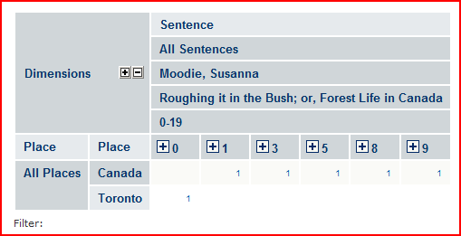
Set
SELECT NON EMPTY Hierarchize
( {
[Sentence].[Moodie, Susanna].[Roughing it in the Bush; or, Forest Life in Canada].[0-19].[0],
[Sentence].[Moodie, Susanna].[Roughing it in the Bush; or, Forest Life in Canada].[0-19].[1],
[Sentence].[Moodie, Susanna].[Roughing it in the Bush; or, Forest Life in Canada].[0-19].[2],
[Sentence].[Moodie, Susanna].[Roughing it in the Bush; or, Forest Life in Canada].[0-19].[3],
[Sentence].[Moodie, Susanna].[Roughing it in the Bush; or, Forest Life in Canada].[0-19].[4],
[Sentence].[Moodie, Susanna].[Roughing it in the Bush; or, Forest Life in Canada].[0-19].[5],
[Sentence].[Moodie, Susanna].[Roughing it in the Bush; or, Forest Life in Canada].[0-19].[6],
[Sentence].[Moodie, Susanna].[Roughing it in the Bush; or, Forest Life in Canada].[0-19].[7],
[Sentence].[Moodie, Susanna].[Roughing it in the Bush; or, Forest Life in Canada].[0-19].[8],
[Sentence].[Moodie, Susanna].[Roughing it in the Bush; or, Forest Life in Canada].[0-19].[9]
} ) ON COLUMNS,
NON EMPTY Except({[Place].[All Places].Children}, {[Place].[NONE]}) ON ROWS
from [Places]

Slide 31
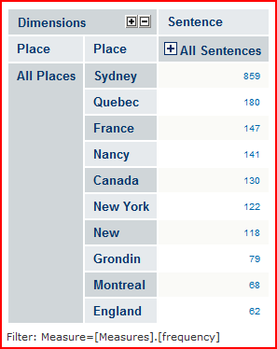
WITH SET TopPlaces AS
'TopCount( Except(
{[Place].[All Places].Children},
{[Place].[NONE]}
),
10,
[Measures].[frequency])'
SELECT NON EMPTY Hierarchize(
{[Sentence].[All Sentences]}) ON COLUMNS,
TopPlaces ON ROWS
FROM [Places]
WHERE [Measures].[frequency]

Slide 32
Thank you for attending ☺

Slide 33
OLAP Schema
The OLAP Schema file indicates where the fact table and dimension tables are in MySQL.
Mondrian creates the OLAP cube from the MySQL back-end.
JPivot provides the UI for the OLAP cube
Mondrian and
JPivot
OLAP
Schema
File
MySQL

Slide 34
References
http://blog.oaktonsoftware.com/2011/01/resolve-repeating-attributes-with.html
The LitOLAP project: Data warehousing with literature (http://academic.research.microsoft.com/Publication/4483536/the-litolap-project-data-warehousing-with-literature)
Kimball, Ralph; Joe Caserta (2008). The Data Warehouse ETL Toolkit (2nd edition). New York: Wiley. ISBN 978-0-470-14977-5.(http://www.kimballgroup.com/)
Mosha Pasumansky, Mark Whitehorn, Rob Zare: Fast Track to MDX. ISBN 1-84628-174-1
http://www.ciobriefings.com/Publications/WhitePapers/DesigningtheStarSchemaDatabase/tabid/101/Default.aspx

Slide 35
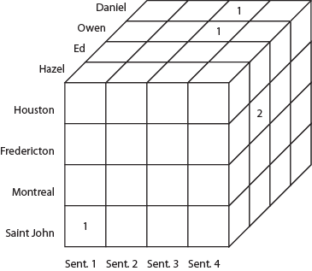
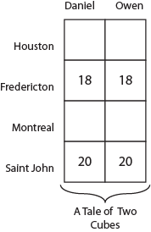
AuthorID x SentenceID x PlaceID → Frequency
Author
18 + 18 = 36
Place
20 + 20 = 40
Sentence
Author ID
Author Name
Occupation
DOB
DOD
Sentence ID
Book Name
Sentence #
Text
Place ID
City
Country
Continent
Author ID
Sentence ID
Place ID
Frequency

Slide 36
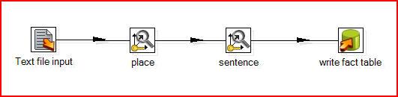
Data Integration
Pentaho’s Data Integration Tool; Kettle
Text file input is the de-normalized table.
Lookup/update steps populate dimensions.
Final step writes fact table.

Slide 37
Algorithm for turning XML to denormalized table.
Parse xml file and read a sentence in it.
Having the sentence, we then add the sentence to the table of sentences:
Check if we have a place in the sentence
  If there is a place, check whether it is new.
    If it is a new place, then we add an entry for it in the places table.

Slide 38
A Comparison
Multidimensional Models
More appropriate for OLAP applications.
Provides faster query response times
Relational Models
More appropriate for OLTP, or operational databases
Better transactional throughput
Reduce redundancies as much as possible.
Reduce the number of joins
MDX (Multidimensional Expressions)
SQL (Structured Query Language)
Easier understanding of Data

