Slide 1
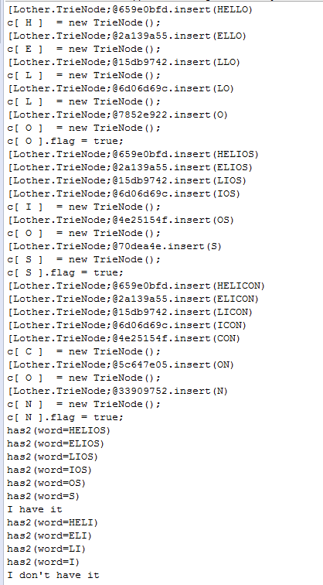
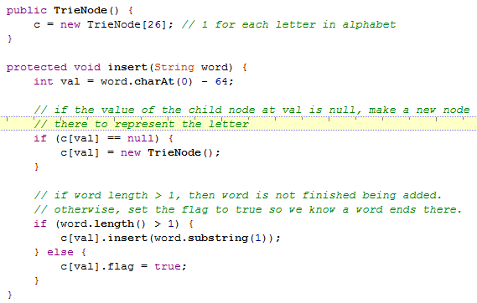
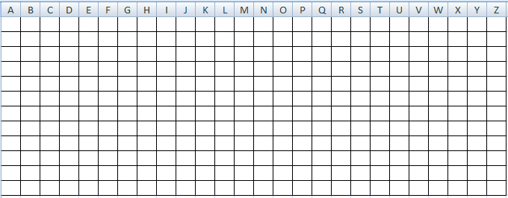

Slide 2
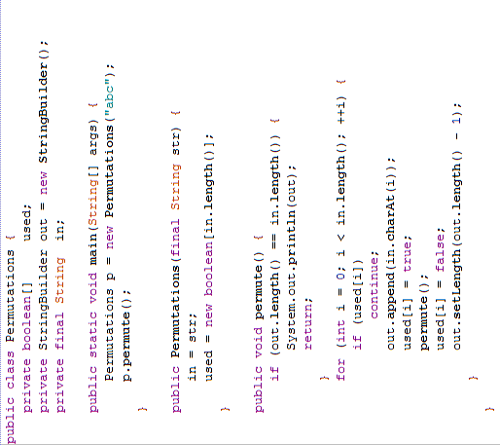
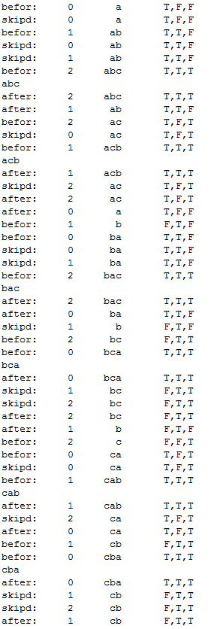


Slide 3
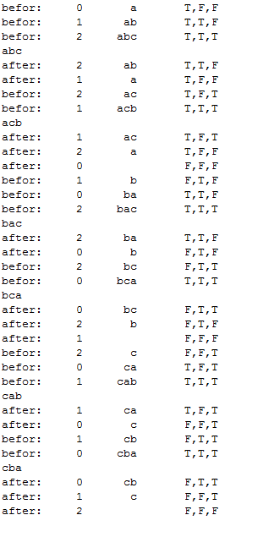
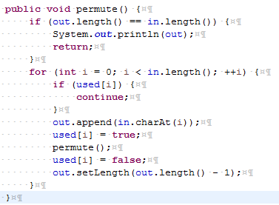

Slide 4
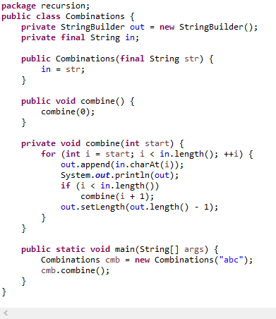
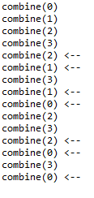

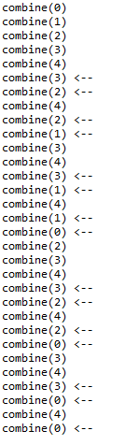


Slide 5
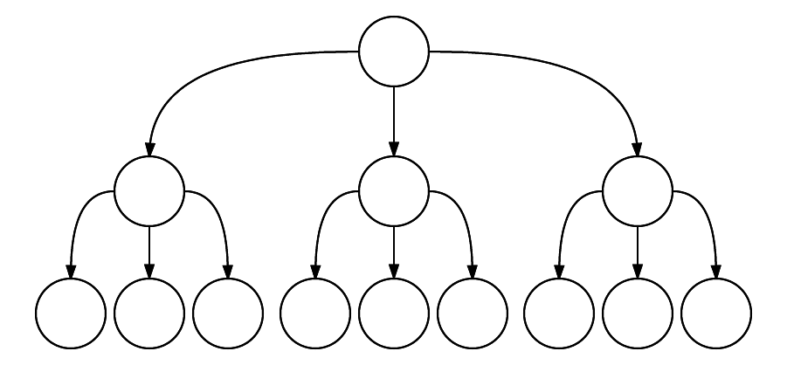
The capture all permutations algorithm works by visiting all possible combinations of 3
letters including using the same letter, but skipping those that attempt to use a
repeated letter.

Slide 6
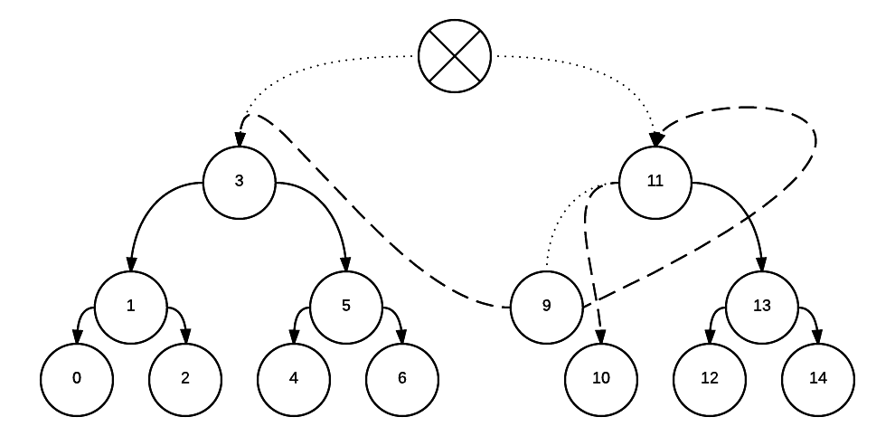
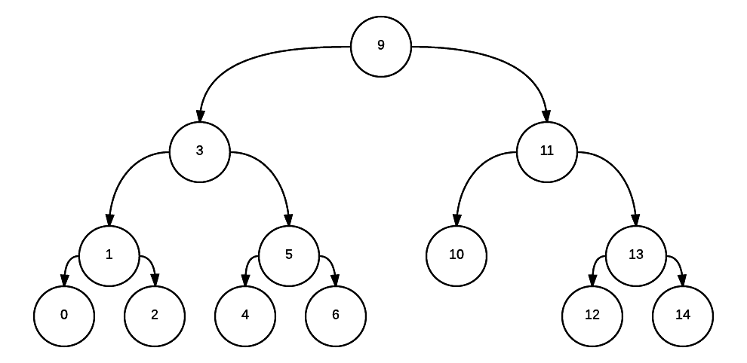

Slide 7
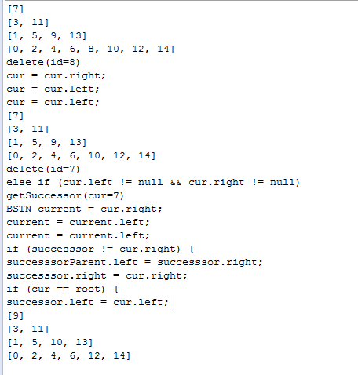
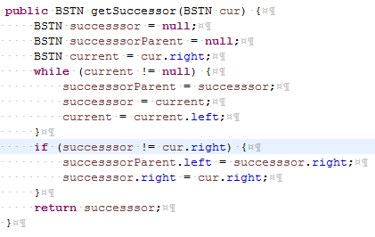
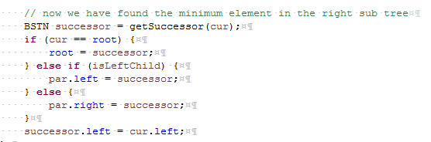

Slide 8
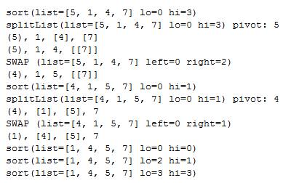
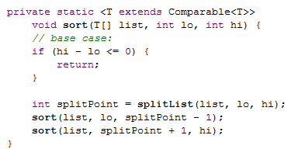
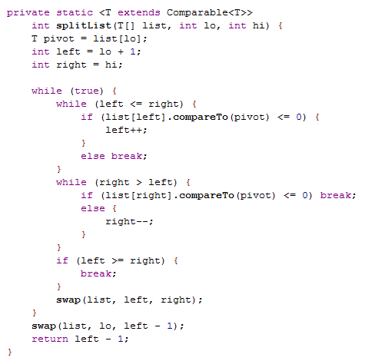
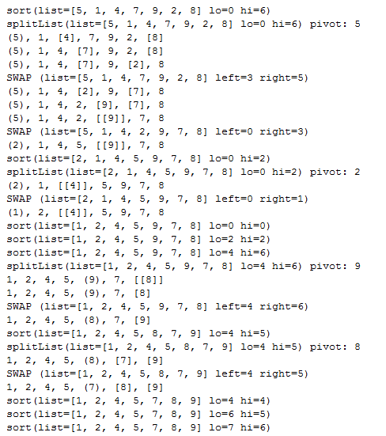
Quicksort

Slide 9
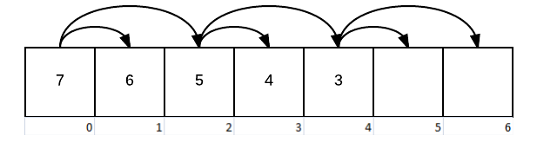
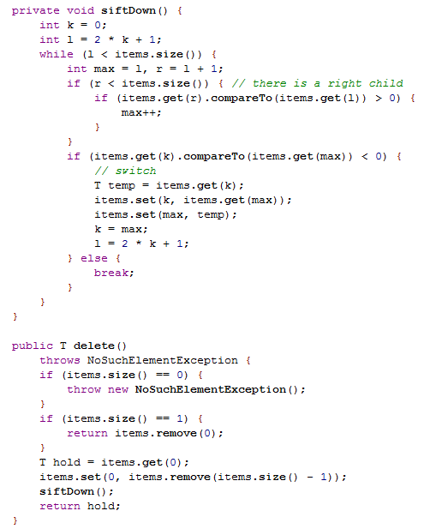
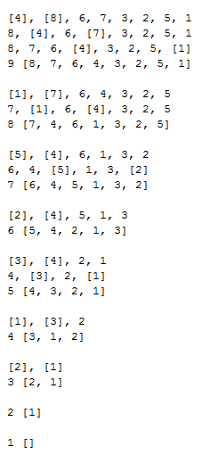
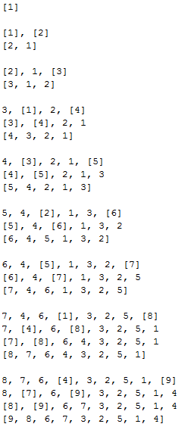

Slide 10
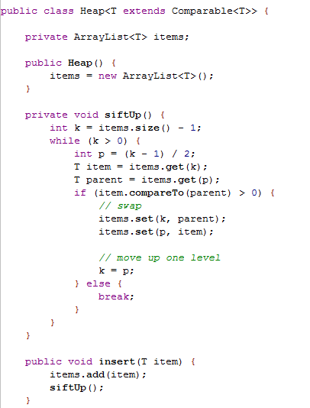

Slide 11
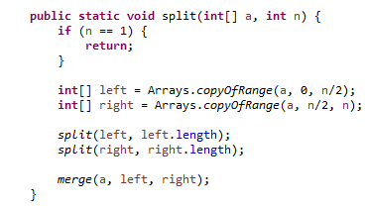
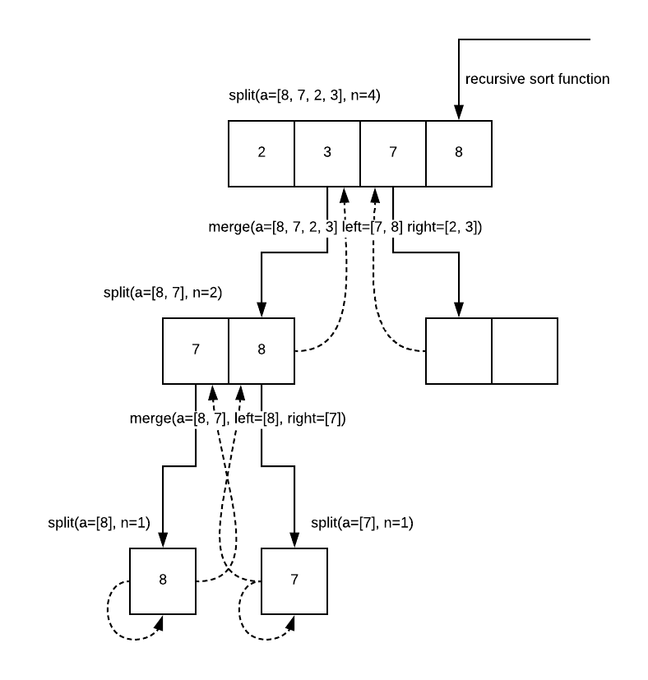
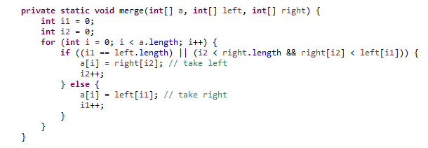
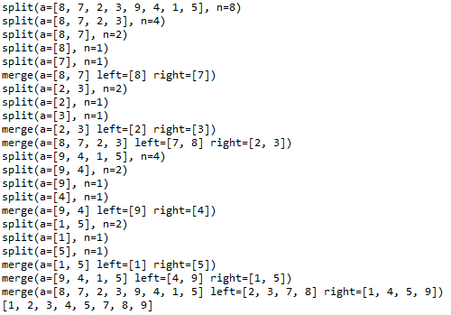

Slide 12
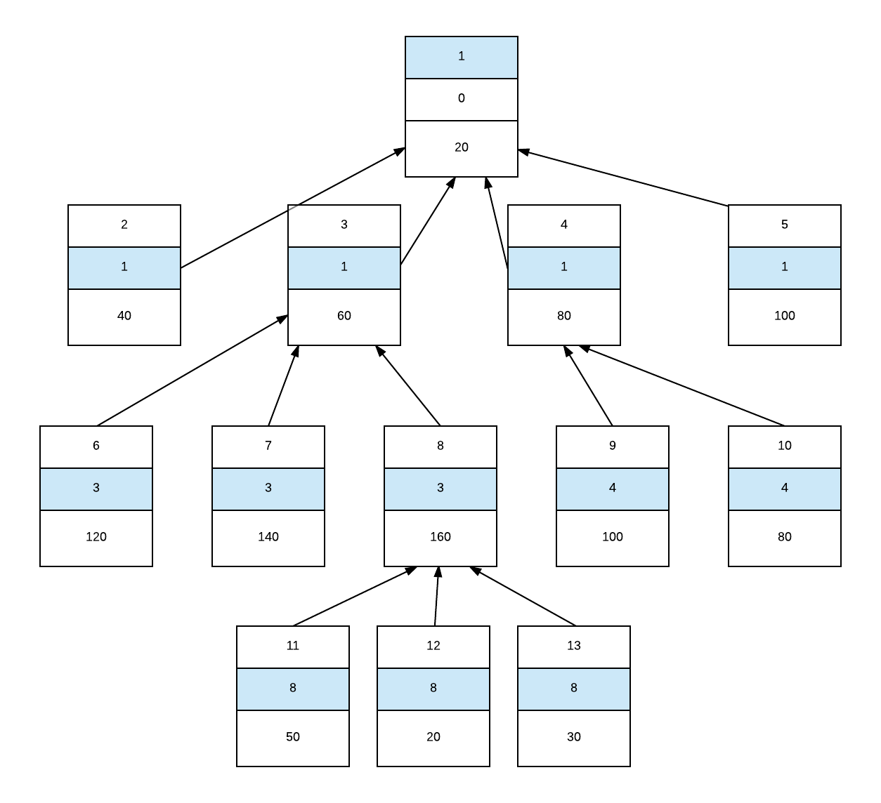

id, parent, weight
Sum: 1000
Sum: 580
Sum: 260
Sum: 260

Slide 13
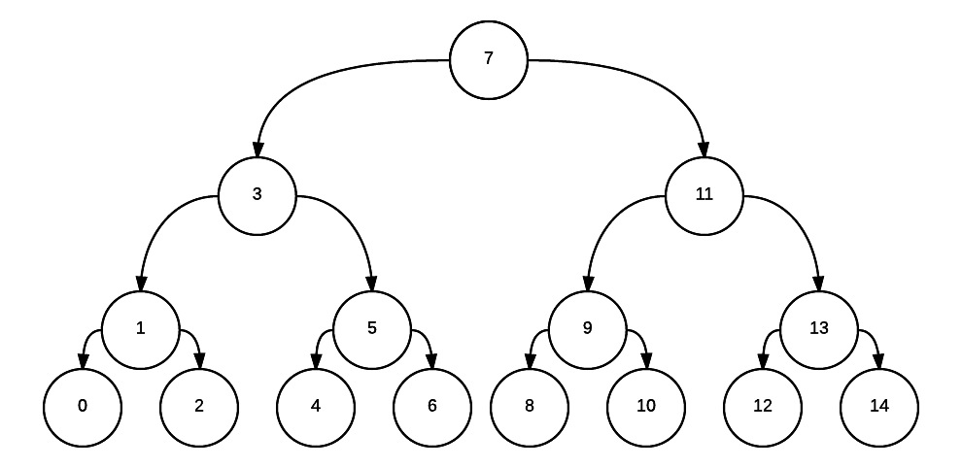
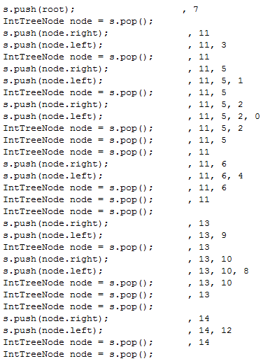
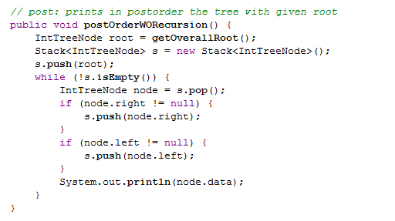

Slide 14
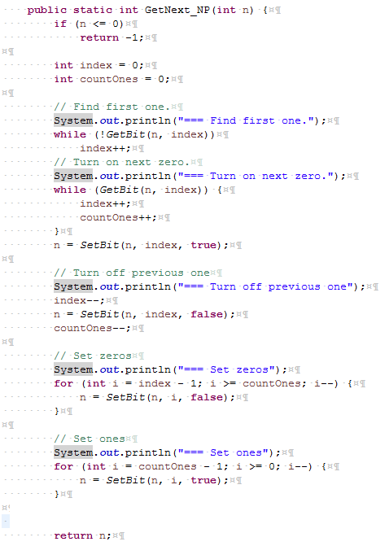
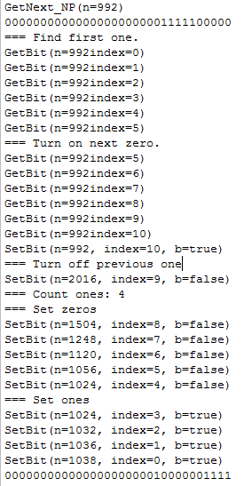
0 | 0 | 0 | 0 | 0 | 0 | 0 | 0 | 0 | 0 | 0 | 0 | 0 | 0 | 0 | 0 | 0 | 0 | 0 | 0 | 0 | 1 | 1 | 1 | 1 | 1 | 1 | 1 | 1 | 1 | 1 | 1
31 | 30 | 29 | 28 | 27 | 26 | 25 | 24 | 23 | 22 | 21 | 20 | 19 | 18 | 17 | 16 | 15 | 14 | 13 | 12 | 11 | 10 | 9 | 8 | 7 | 6 | 5 | 4 | 3 | 2 | 1 | 0
0 | 0 | 0 | 0 | 0 | 0 | 0 | 0 | 0 | 0 | 0 | 0 | 0 | 0 | 0 | 0 | 0 | 0 | 0 | 0 | 1 | 0 | 1 | 1 | 1 | 1 | 1 | 1 | 1 | 1 | 1 | 1
31 | 30 | 29 | 28 | 27 | 26 | 25 | 24 | 23 | 22 | 21 | 20 | 19 | 18 | 17 | 16 | 15 | 14 | 13 | 12 | 11 | 10 | 9 | 8 | 7 | 6 | 5 | 4 | 3 | 2 | 1 | 0

Slide 15
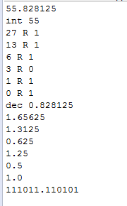
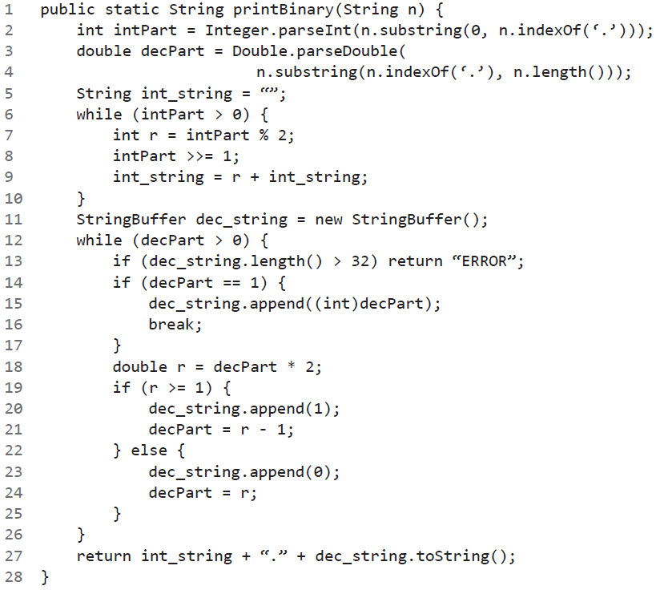

Slide 16
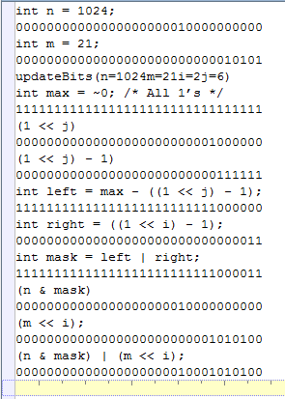
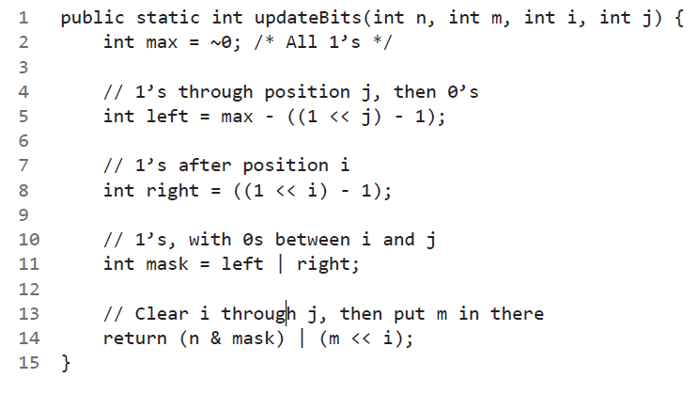

Slide 17
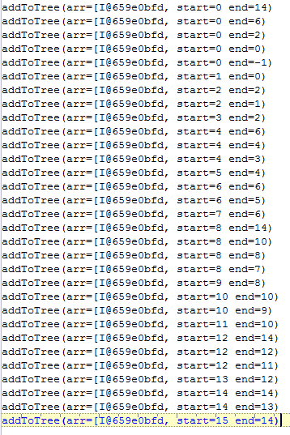
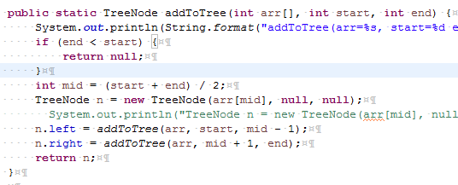

Slide 18
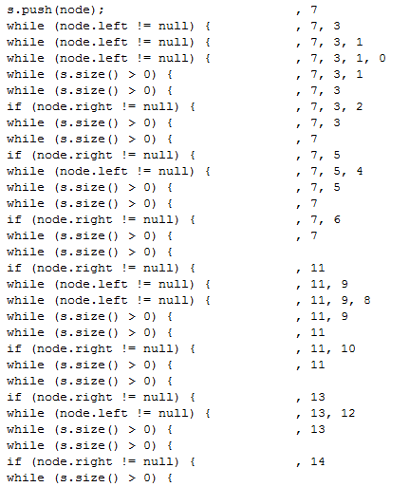
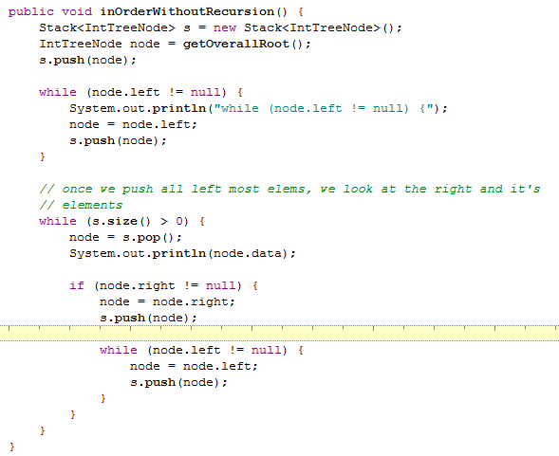

Slide 19
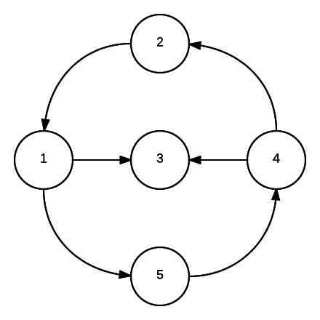
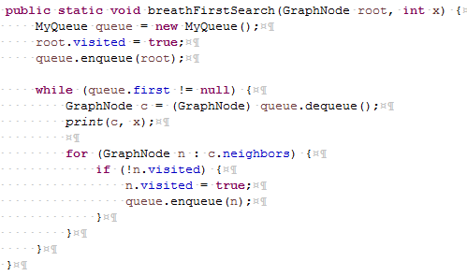
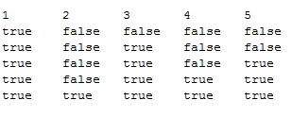
BFS
[1]
[3]
[5]<- found
[4]
[2]
1 => [[3], [5]]
2 => [[1]]
3 => []
4 => [[3], [2]]
5 => [[4]]

Slide 20
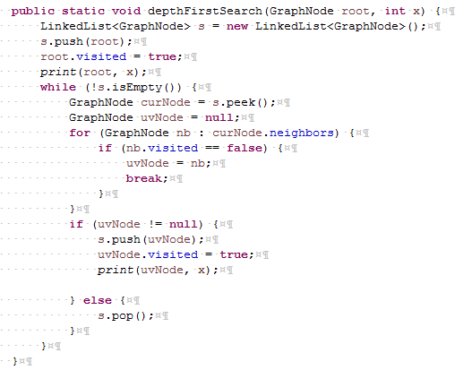
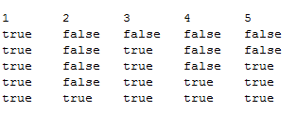
DFS
[1]
[3]
[5]
[4]
[2]<- found
1 => [[3], [5]]
2 => [[1]]
3 => []
4 => [[3], [2]]
5 => [[4]]

Slide 21
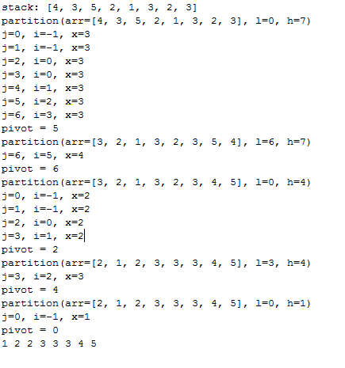
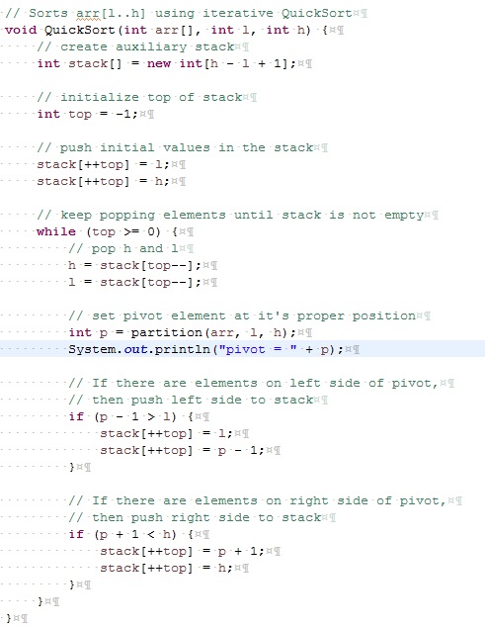


Slide 22



Slide 23


Slide 24





Slide 25



Slide 26



Slide 27


Slide 28



Dynamic Programming (DP): Edit Distance

Slide 29


Dynamic Programming (DP): Edit Distance

Slide 30





 | 0 | 1 | 2 | 3 | 4 | 5 | 6 | 7 | 8 | 9 | 10 | 11
1 | 0 | 1 | 2 | 3 | 4 | 5 | 6 | 7 | 8 | 9 | 10 | 11
5 | 0 | 1 | 2 | 3 | 4 | 1 | 2 | 3 | 4 | 5 | 2 | 3
6 | 0 | 1 | 2 | 3 | 4 | 1 | 1 | 2 | 3 | 4 | 2 | 2
8 | 0 | 1 | 2 | 3 | 4 | 1 | 1 | 2 | 1 | 2 | 2 | 2
Dynamic Programming (DP): Coin Changing Minimum

Slide 31



Dynamic Programming (DP): 0/1 Knapsack

Slide 32


Dynamic Programming (DP): Longest common sequence

Slide 33



Dynamic Programming (DP): Minimum Cost

Slide 34


Slide 35


Slide 36






Slide 37



Slide 38


Slide 39



Slide 40


